Slide 1

2019.07.12
支持任意雙線性乘積之向量神經元
Vector-neuron-based Learning with Arbitrary Bilinear Products
Speaker: | Ph.D. candidate Zhe-Cheng Fan
Adviser: | Prof. Jyh-Shing Roger Jang

Slide 2
Outline
Motivation and Goals
Previous Work
Proposed Method
Experiments
Conclusions

Slide 3
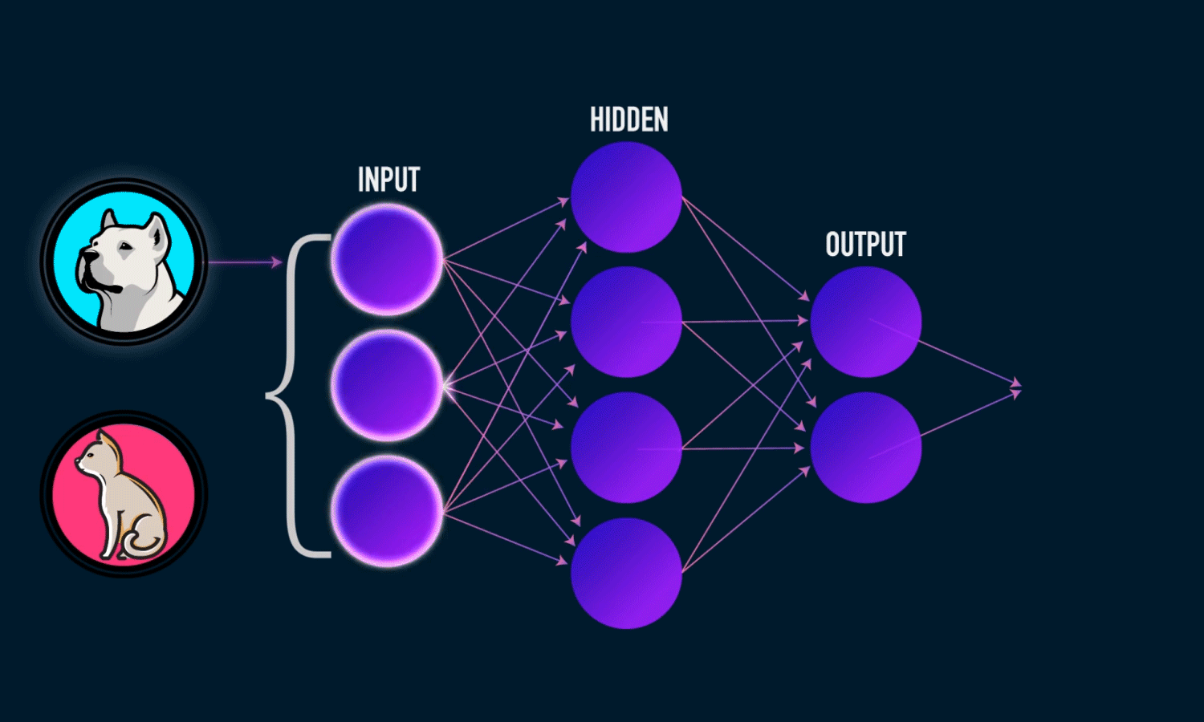
Motivation
Neural network (NN)
  Ability of learning generalization and association
  Effectiveness either nonlinear regression tasks and classifications
  Good performance obtained from learning large quantities of data

Slide 4
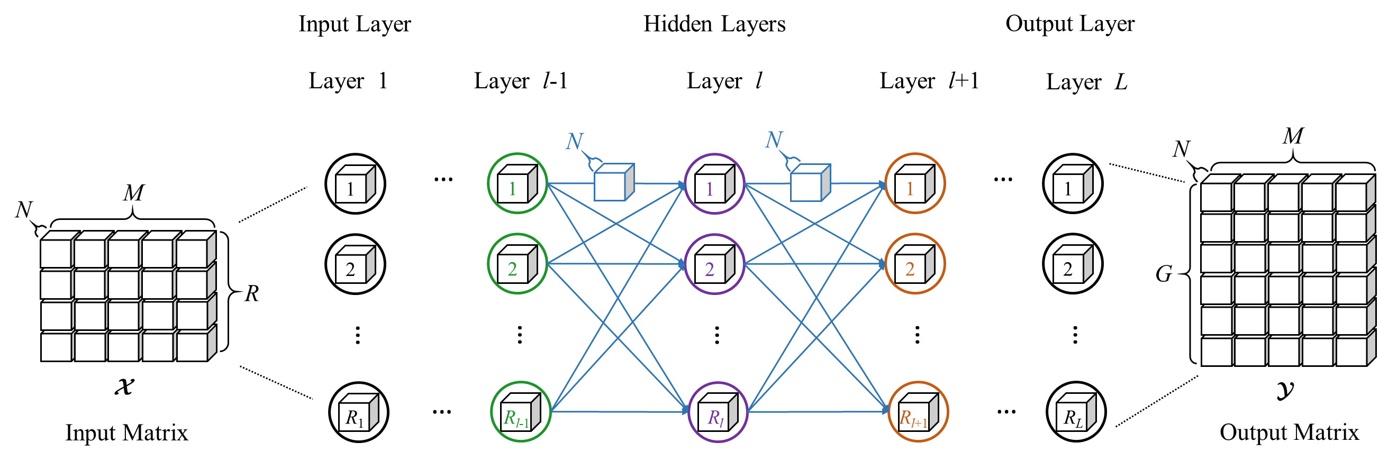
Motivation
Architecture of conventional deep neural networks
  Each neuron stands for a scalar
  : neuron : scalar
M: Num. of training samples
N: Dimension of inputs, outputs, weights,
and biases (N=1)
R: Dimension of the input layer
G: Dimension of the output layer
R₁-R_{L} : Dimension of hidden layers
Notes:
可以把 input matrix 設定在 頻譜

Slide 5
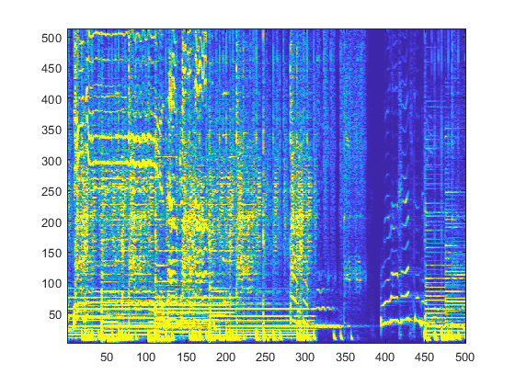
Motivation
When multidimensional data as input to NN
  Concatenated from a set of vectors
  Reformulated as a one-dimensional vector
  A network is configured to use as many neurons as the dimension of the one-dimensional vector
Example:
R
Spectrogram
M
R
R
C
C
R

Slide 6
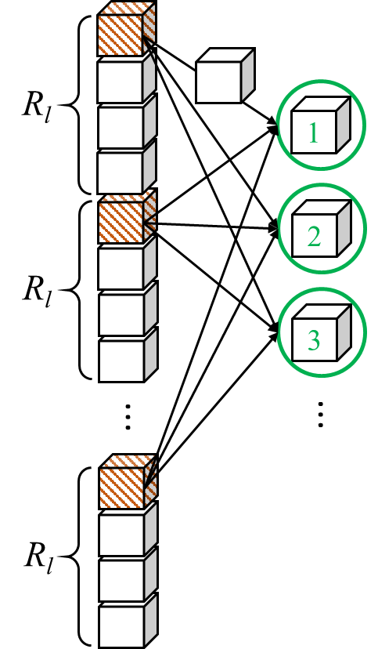
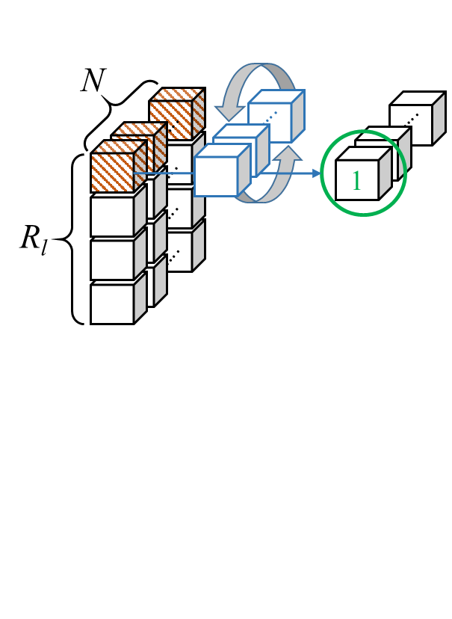
Motivation
Why using vector-valued neurons ?
  Association between each vectors in NN may not be learned
Apply bilinear products on vector-valued learning
Neural Network
Vector-valued
Neural Network
Example:
N
Spectrogram
Circular convolution
C
Notes:
左圖
傳統 Neural network 的架構
所有的向量都接在一起，變成一個很大的 feature 放進NN裡面訓練
但其實每個向量之間，相同維度的地方也許是有一些關係的 (例如咖啡色的 cube)
並沒有一組特別的 weight ，去學這樣的關係
右圖
為 vector-valued learning 的架構
所有的 Input 向量並排在一起
Weight 跟 Neuron 也是 N-dimensional 的向量
咖啡色的 cube 形成 N-dimensional 的向量
在 vector-valued NN 計算過程中，藍色的 weight-vector 可以當作一組1D的 filter 來 learn 咖啡色 cube 之間的關係
Input (咖啡色cube向量) 跟 weight 可以藉由不同的 bilinear product 學到不同的東西
所有的訓練向量疊成 R x 1 x Ｎ 維度的 tensor。咖啡色的cube 形成 N維的向量，weight 也是 N 維的向量。那我們提出 weight 和 咖啡色的 cube 可能可以藉由不同 product 運算操作學到不同的東西
(1) 較少的參數量，

Slide 7
Goals
Architecture of conventional deep neural networks
  Each neuron stands for a scalar
M: Num. of training samples
N: Dimension of inputs, outputs, weights,
and biases (N=1)
R: Dimension of the input layer
G: Dimension of the output layer
R₁-R_{L}: Dimension of hidden layers
Each neuron stands for a vector
=> Vector-valued neuron
Input, output, weights, biases are all vectors

Slide 8
Previous work
References
 | Complex value | Hyperbolic value | Hyperbolic value with Wirtinger calculus | Vector product | Orthogonal weight matrix
2 | [1-4] Nitta 1997-2004 [15] Trabelsi & Bengio 2018 | [5] Buchholz 2000 [6] Nitta 2008 | [7] Nitta 2017
3 |  |  |  | [8] Nitta 1997 [9] Tripathi 2015 | [10] Nitta 2006
4
8
N
Notes:
要說明 N 代表的意義
Ｎ：向量長度

Slide 9
Previous work
References
 | Quaternion value | Octonion value | Orthogonal weight matrix | Clifford algebra (2^{N}) | Matrix-matrix or Tensor value
2
3
4 | [11,12] Arena 1994,1998 [13] Nitta 1994
8 |  | [14] Popa 2016
N |  |  | [16,17] Nitta 2007, 2013 | [18-21] Pearson 1992-2001 | [22] Popa 2015 [23] Chien 2017
Notes:
其他的不用提，只需要題 clifford algebra 的缺點，直接跳過這一頁

Slide 10
Contribution
Vector-valued learning with arbitrary dimensionality
  N is an arbitrary positive integer
  N-dimensional vector-valued neurons
A general form of bilinear neurons
  Arbitrary bilinear products
    Seven dimensional vector product, circular conv., skew circular conv…
Apply arbitrary bilinear product on DNN and CNN
Arbitrary Bilinear Product Neural Network
=> ABIPNN
Deep Cyclic Group Network
=> DCGN
Notes:
cyclic group 是？

Slide 11
Contribution
 | Octonion value | Orthogonal weight matrix | Clifford algebra (2^{N}) | Matrix-matrix or Tensor value | Arbitrary bilinear products
2 |  |  |  |  | ABIPNN and DCGN
3
4
8 | [14] Popa 2016
N |  | [16,17] Nitta 2007, 2013 | [18-21] Pearson 1992-2001 | [22] Popa 2015 [23] Chien 2017

Slide 12
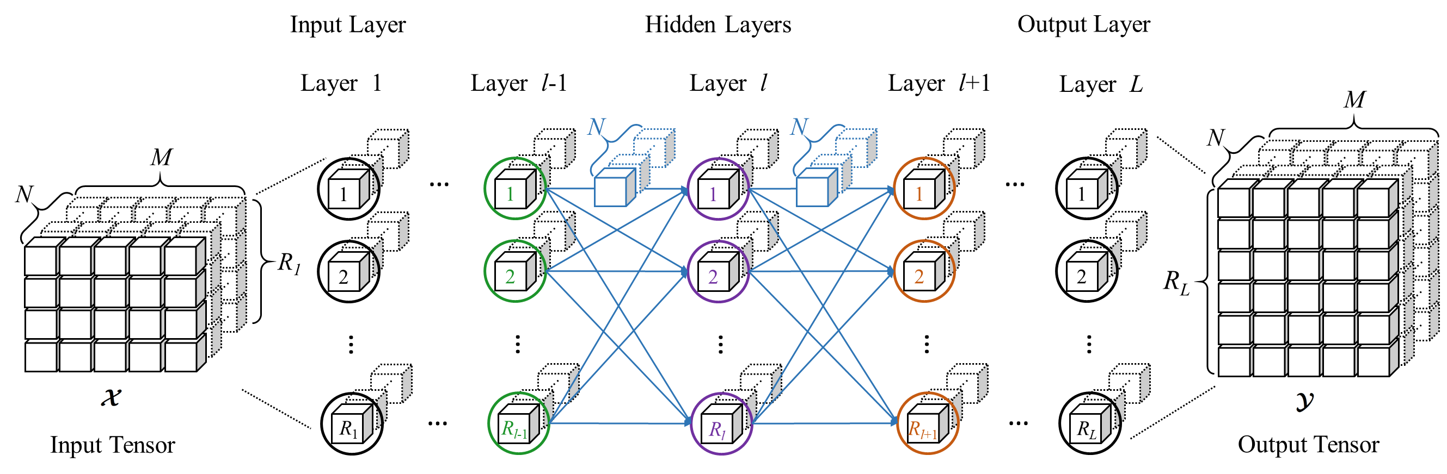
Proposed method
M: Num. of training samples
N: Dimension of inputs, outputs, weights,
and biases (N=1)
R: Dimension of the input layer
G: Dimension of the output layer
R₁-R_{L}: Dimension of hidden layers
Arch. of ABIPNN

Slide 13
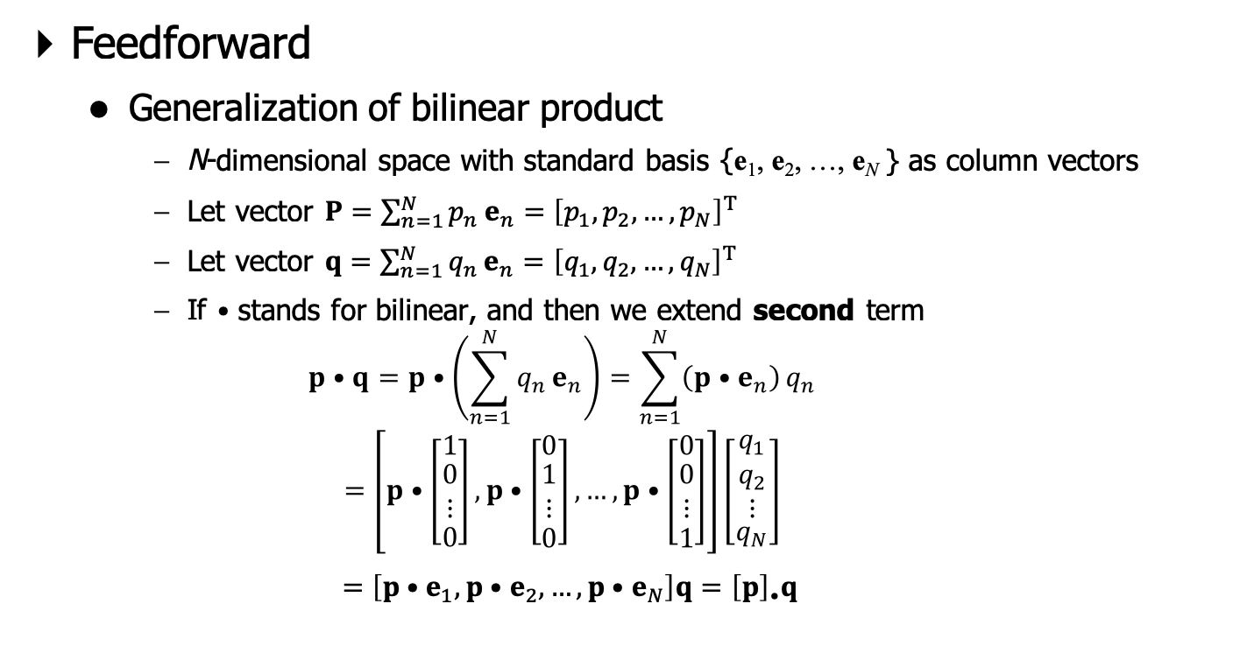
Proposed method
Feedforward
  Generalization of bilinear product
    N-dimensional space with standard basis {e₁, e₂, …, e_{N} } as column vectors
    Let vector $P=\sum_{n=1}^{N}{p_{n}}e_{n}={\left[p_{1},p_{2},…,p_{N}\right]}^{T}$
    Let vector $q=\sum_{n=1}^{N}{q_{n}}e_{n}={\left[q_{1},q_{2},…,q_{N}\right]}^{T}$
    If $•$ stands for bilinear, and then we extend second term
    $$p•q=p•\left(\sum_{n=1}^{N}{q_{n}}e_{n}\right)=\sum_{n=1}^{N}{\left(p•e_{n}\right)}q_{n}$$
    $$=\left[p•\left[\begin{matrix}1 \\ \begin{aligned}0 \\ ⋮\end{aligned} \\ 0\end{matrix}\right],p•\left[\begin{matrix}0 \\ \begin{aligned}1 \\ ⋮\end{aligned} \\ 0\end{matrix}\right],…,p•\left[\begin{matrix}0 \\ \begin{aligned}0 \\ ⋮\end{aligned} \\ 1\end{matrix}\right]\right]\left[\begin{aligned}\begin{matrix}q_{1} \\ q_{2} \\ ⋮\end{matrix} \\ q_{N}\end{aligned}\right]$$
    $=\left[p•e_{1},p•e_{2},…,p•e_{N}\right]q={\left[p\right]}_{•}q$

Slide 14
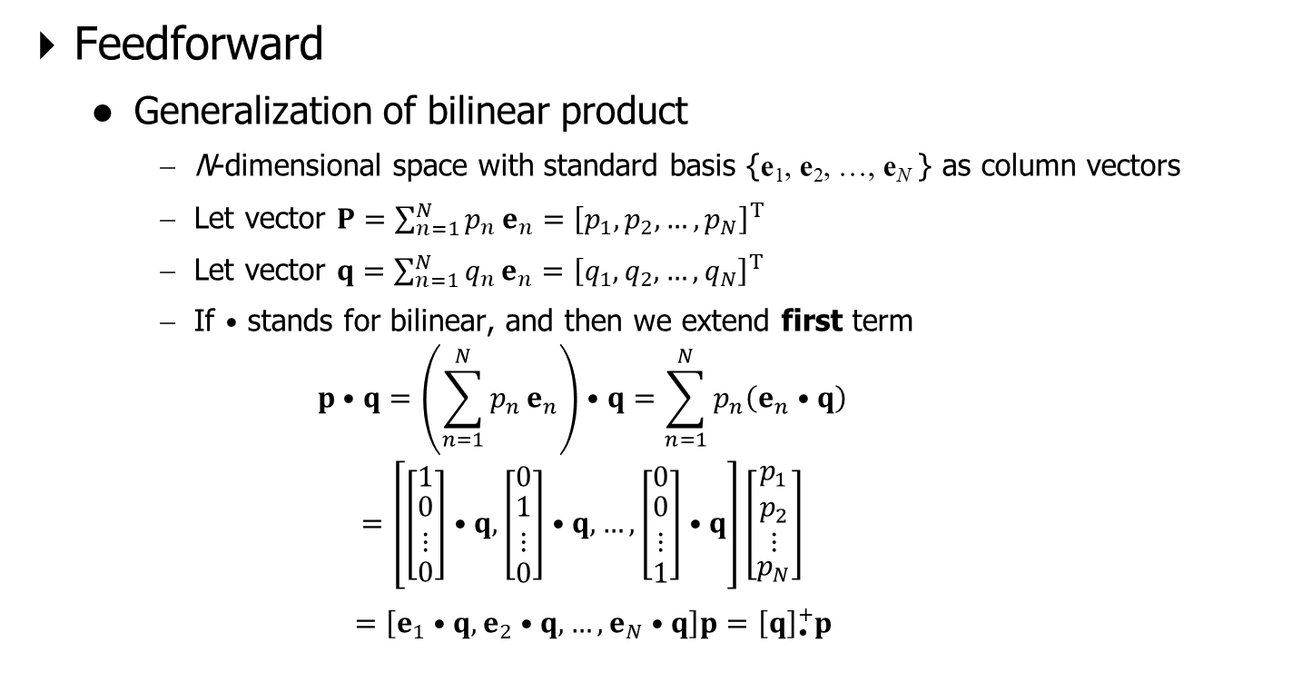
Proposed method
Feedforward
  Generalization of bilinear product
    N-dimensional space with standard basis {e₁, e₂, …, e_{N} } as column vectors
    Let vector $P=\sum_{n=1}^{N}{p_{n}}e_{n}={\left[p_{1},p_{2},…,p_{N}\right]}^{T}$
    Let vector $q=\sum_{n=1}^{N}{q_{n}}e_{n}={\left[q_{1},q_{2},…,q_{N}\right]}^{T}$
    If $•$ stands for bilinear, and then we extend first term
    $$p•q=\left(\sum_{n=1}^{N}{p_{n}}e_{n}\right)•q=\sum_{n=1}^{N}{p_{n}\left(e_{n}•q\right)}$$
    $$=\left[\left[\begin{matrix}1 \\ \begin{aligned}0 \\ ⋮\end{aligned} \\ 0\end{matrix}\right]•q, \left[\begin{matrix}0 \\ \begin{aligned}1 \\ ⋮\end{aligned} \\ 0\end{matrix}\right]•q,…,\left[\begin{matrix}0 \\ \begin{aligned}0 \\ ⋮\end{aligned} \\ 1\end{matrix}\right]•q\right]\left[\begin{aligned}\begin{matrix}p_{1} \\ p_{2} \\ ⋮\end{matrix} \\ p_{N}\end{aligned}\right]$$
    $=\left[e_{1}•q, e_{2}•q,…, e_{N}•q\right]p={\left[q\right]}_{•}^{+}p$

Slide 15
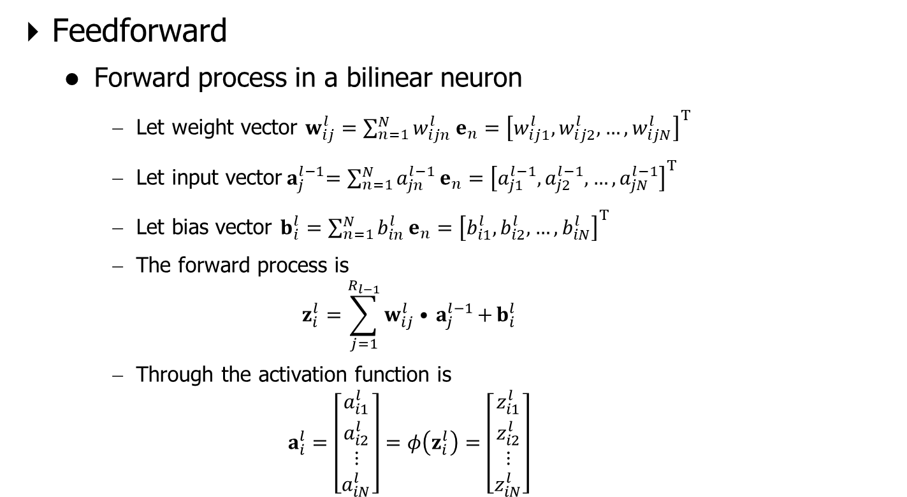
Proposed method
Feedforward
  Forward process in a bilinear neuron
    Let weight vector $w_{ij}^{l}=\sum_{n=1}^{N}{w_{ijn}^{l}}e_{n}={\left[w_{ij1}^{l},w_{ij2}^{l},…,w_{ijN}^{l}\right]}^{T}$
    Let input vector${ a}_{j}^{l−1}=\sum_{n=1}^{N}{a_{jn}^{l−1}}e_{n}={\left[a_{j1}^{l−1},a_{j2}^{l−1},…,a_{jN}^{l−1}\right]}^{T}$
    Let bias vector $b_{i}^{l}=\sum_{n=1}^{N}{b_{in}^{l}}e_{n}={\left[b_{i1}^{l},b_{i2}^{l},…,b_{iN}^{l}\right]}^{T}$
    The forward process is
    $$z_{i}^{l}=\sum_{j=1}^{R_{l−1}}{w_{ij}^{l}•{ a}_{j}^{l−1}+}b_{i}^{l}$$
    Through the activation function is
    $$a_{i}^{l}=\left[\begin{aligned}\begin{matrix}a_{i1}^{l} \\ a_{i2}^{l} \\ ⋮\end{matrix} \\ a_{iN}^{l}\end{aligned}\right]=φ\left(z_{i}^{l}\right)=\left[\begin{aligned}\begin{matrix}z_{i1}^{l} \\ z_{i2}^{l} \\ ⋮\end{matrix} \\ z_{iN}^{l}\end{aligned}\right]$$

Slide 16

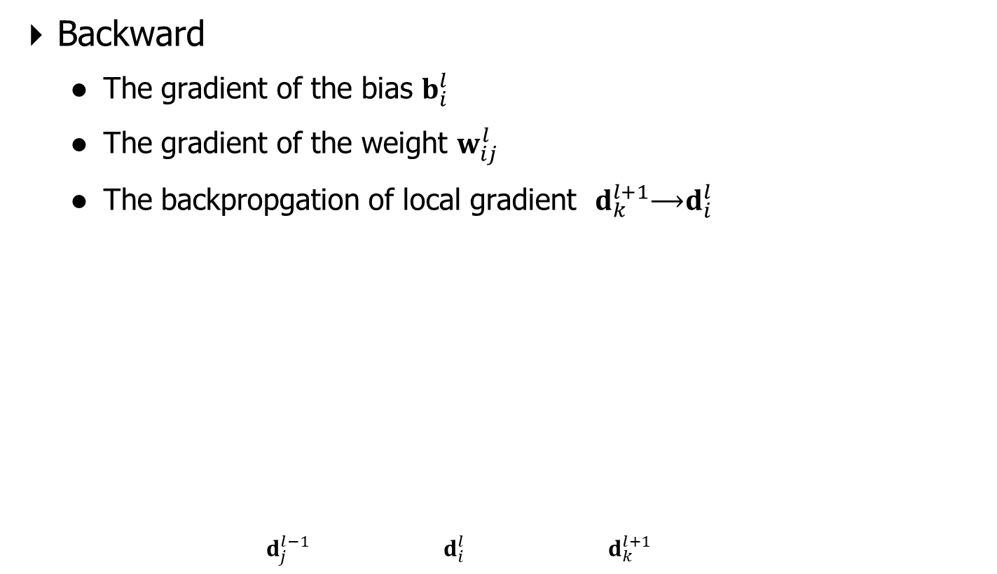
Proposed method
Backward
  The gradient of the bias $b_{i}^{l}$
  The gradient of the weight $w_{ij}^{l}$
  The backpropgation of local gradient $d_{k}^{l+1}$⟶$d_{i}^{l}$
    $${ d}_{j}^{l−1} { d}_{i}^{l}{ d}_{k}^{l+1}$$
Backpropagation
Backpropagation

Slide 17
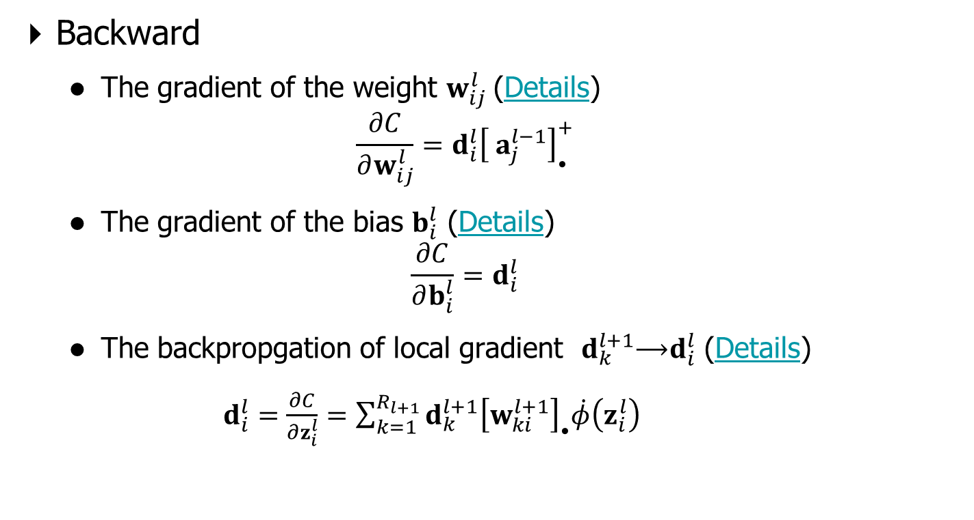
Proposed method
Backward
  The gradient of the weight $w_{ij}^{l}$ (Details)
  $$\frac{∂C}{∂w_{ij}^{l}}={d_{i}^{l}\left[{ a}_{j}^{l−1}\right]}_{•}^{+}$$
  The gradient of the bias $b_{i}^{l}$ (Details)
  $$\frac{∂C}{∂b_{i}^{l}}=d_{i}^{l}$$
  The backpropgation of local gradient $d_{k}^{l+1}$⟶$d_{i}^{l}$ (Details)
  $d_{i}^{l}=\frac{∂C}{∂z_{i}^{l}}=\sum_{k=1}^{R_{l+1}}{d_{k}^{l+1}{\left[w_{ki}^{l+1}\right]}_{•}\dot{φ}\left(z_{i}^{l}\right)}$

Slide 18
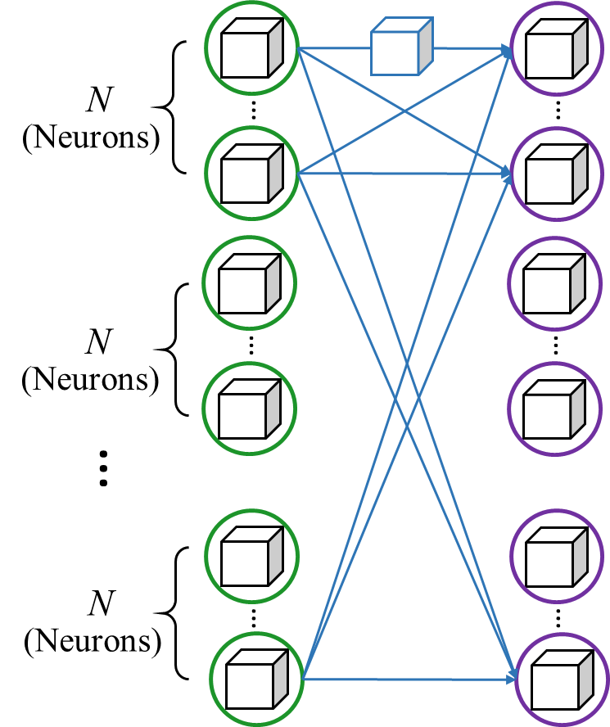
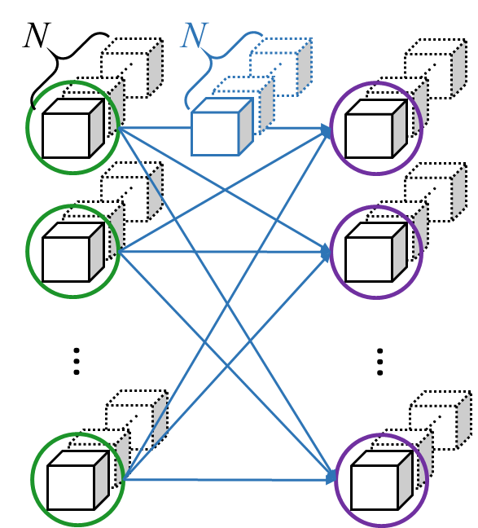
Proposed method
Computational cost of DNN and ABIPNN
  Under the same internal dimensionality
    The number of parameters
    The number of multiplication operations
ABIPNN
DNN
Notes:
加圖 解釋 under the same internal dimensionality

Slide 19
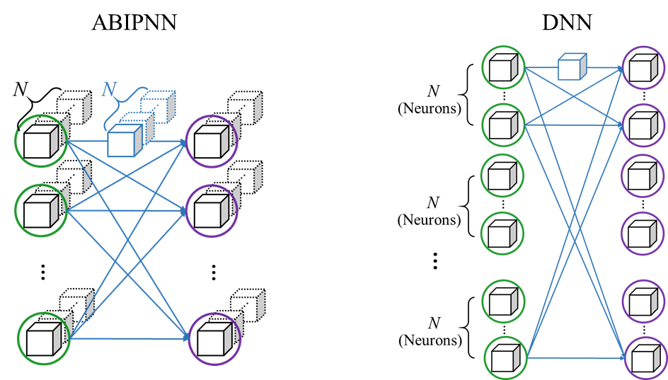
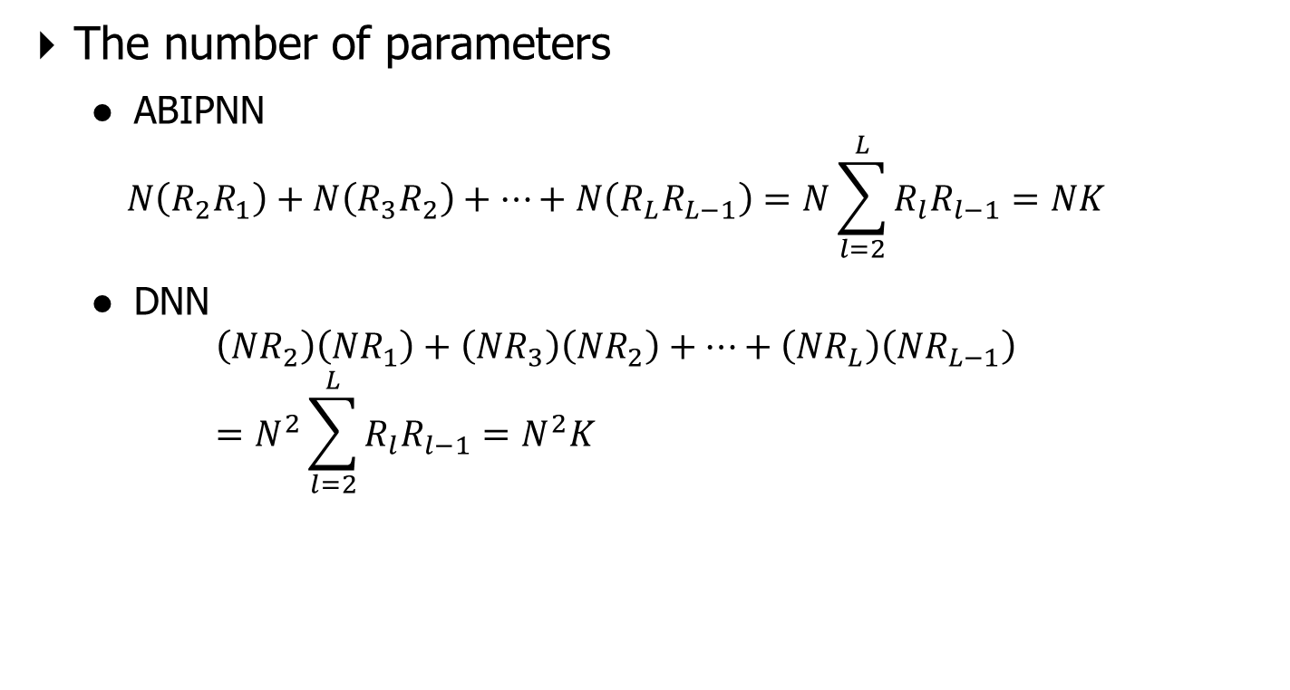
Proposed method
The number of parameters
  ABIPNN
  $$N\left(R_{2}R_{1}\right)+N\left(R_{3}R_{2}\right)+…+N\left(R_{L}R_{L−1}\right)=N\sum_{l=2}^{L}{R_{l}R_{l−1}=NK}$$
  DNN
  $$\left({NR}_{2}\right)\left({NR}_{1}\right)+\left({NR}_{3}\right)\left({NR}_{2}\right)+…+\left({NR}_{L}\right)\left({NR}_{L−1}\right)=N^{2}\sum_{l=2}^{L}{R_{l}R_{l−1}=N^{2}K}$$

Slide 20
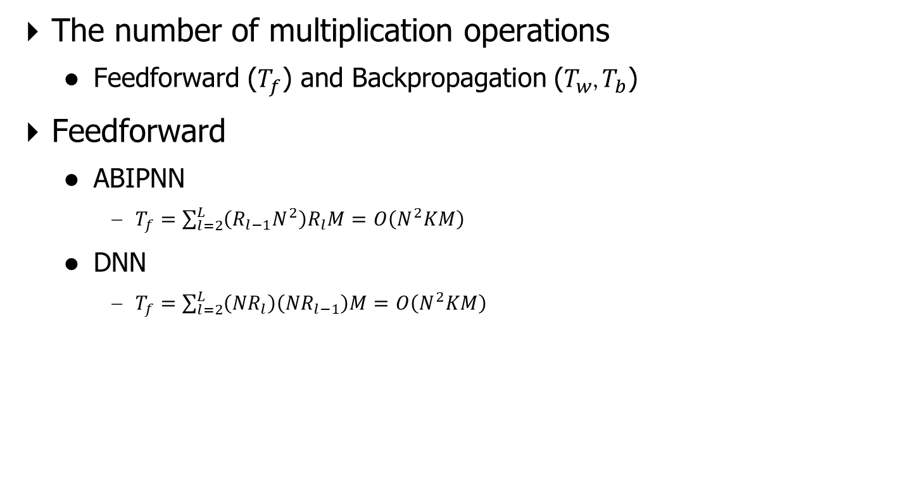
Proposed method
The number of multiplication operations
  Feedforward ($T_{f}$) and Backpropagation ($T_{w}$, $T_{b}$)
Feedforward
  ABIPNN
    $T_{f}=\sum_{l=2}^{L}{\left(R_{l−1}N^{2}\right)R_{l}M=O\left(N^{2}KM\right)}$
  DNN
    $T_{f}=\sum_{l=2}^{L}{\left({NR}_{l}\right)\left({NR}_{l−1}\right)M=O\left(N^{2}KM\right)}$

Slide 21

Proposed method
Backpropagation (Details)
  ABIPNN
    $$T_{b}=\sum_{l=2}^{L}{R_{l+1}\left(N^{2}+N^{2}\right)R_{l}M=O\left(N^{2}KM\right)}$$
    $$T_{w}=\sum_{l=2}^{L}{\left(N^{2}\right)R_{l}R_{l−1}M=O\left(N^{2}KM\right)}$$
  DNN
    $$T_{b}=\sum_{l=2}^{L}{\left({NR}_{l}\right)\left({NR}_{l−1}\right)M=O\left(N^{2}KM\right)}$$
    $$T_{w}=\sum_{l=2}^{L}{\left({NR}_{l}\right)M\left({NR}_{l−1}\right)=O\left(N^{2}KM\right)}$$

Slide 22
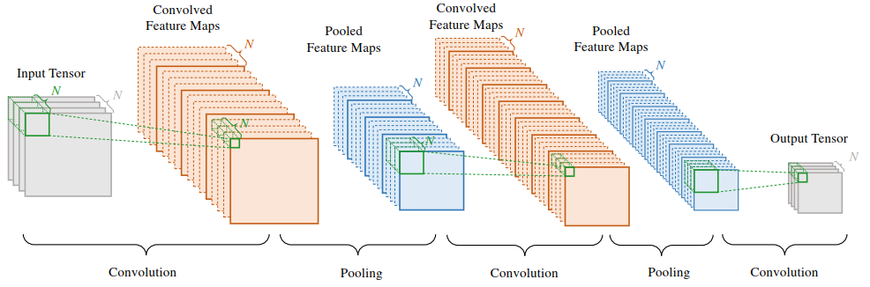
Proposed method
Arch. of DCGN
  Inputs, outputs, kernel maps and feature maps are three-way tensors
  When N is 1, the arch. Reduces to conventional CNN

Slide 23
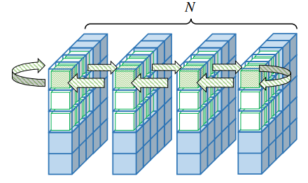
Proposed method
Apply vector-valued on CNN => DCGN
  Green cubes: Scalars compose of kernel maps
  Blue cubes: Scalars compose of feature maps

Slide 24
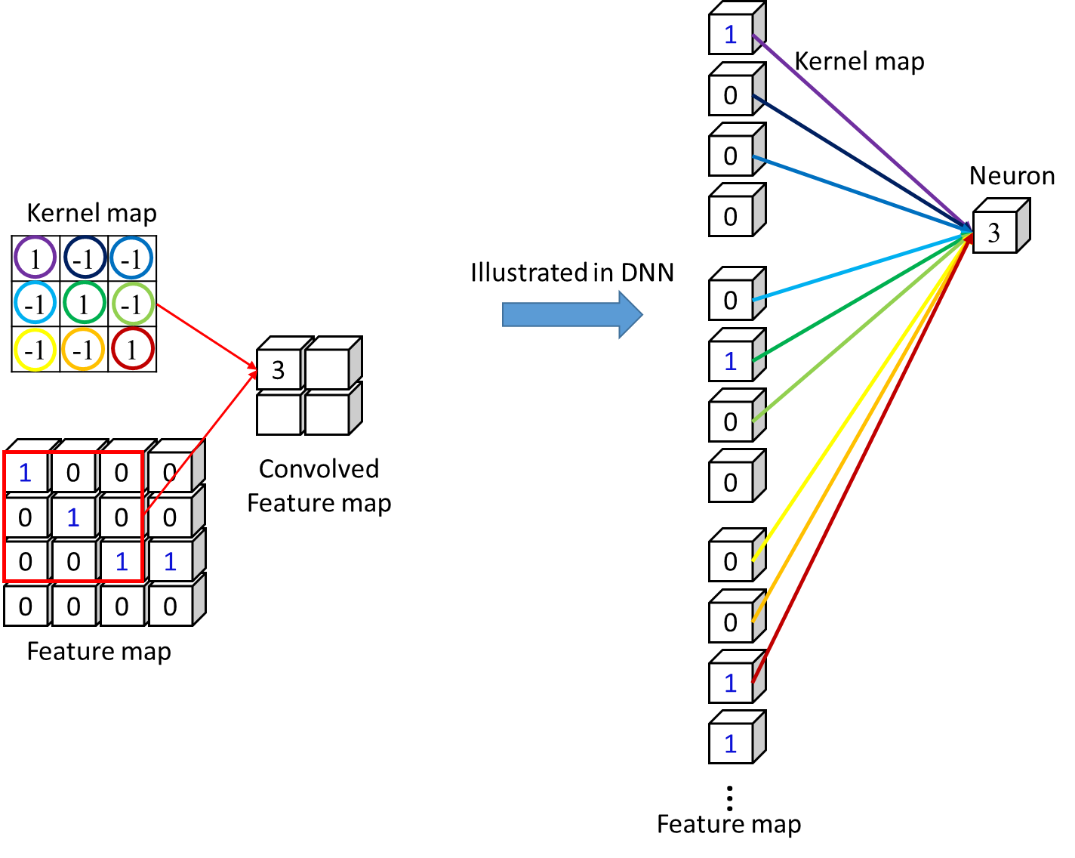
Proposed method
CNN convolution (1)

Slide 25
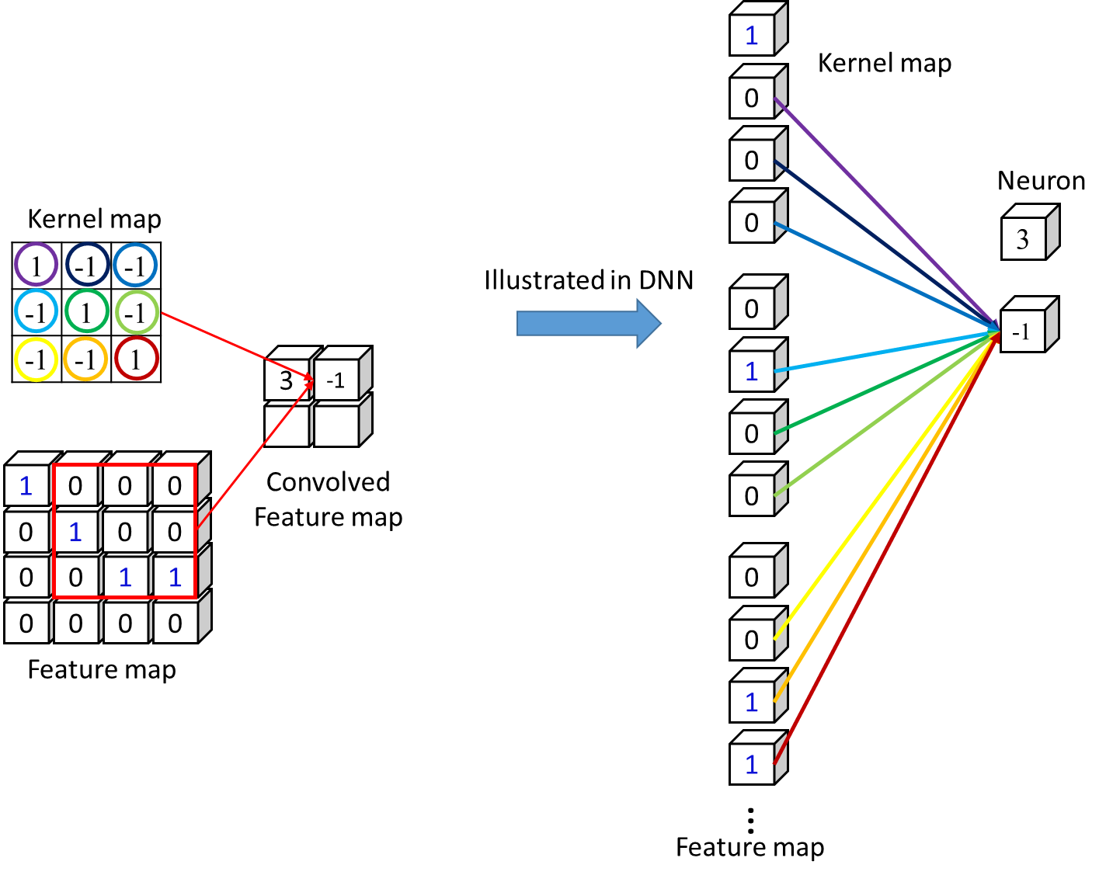
Proposed method
CNN convolution (2)

Slide 26
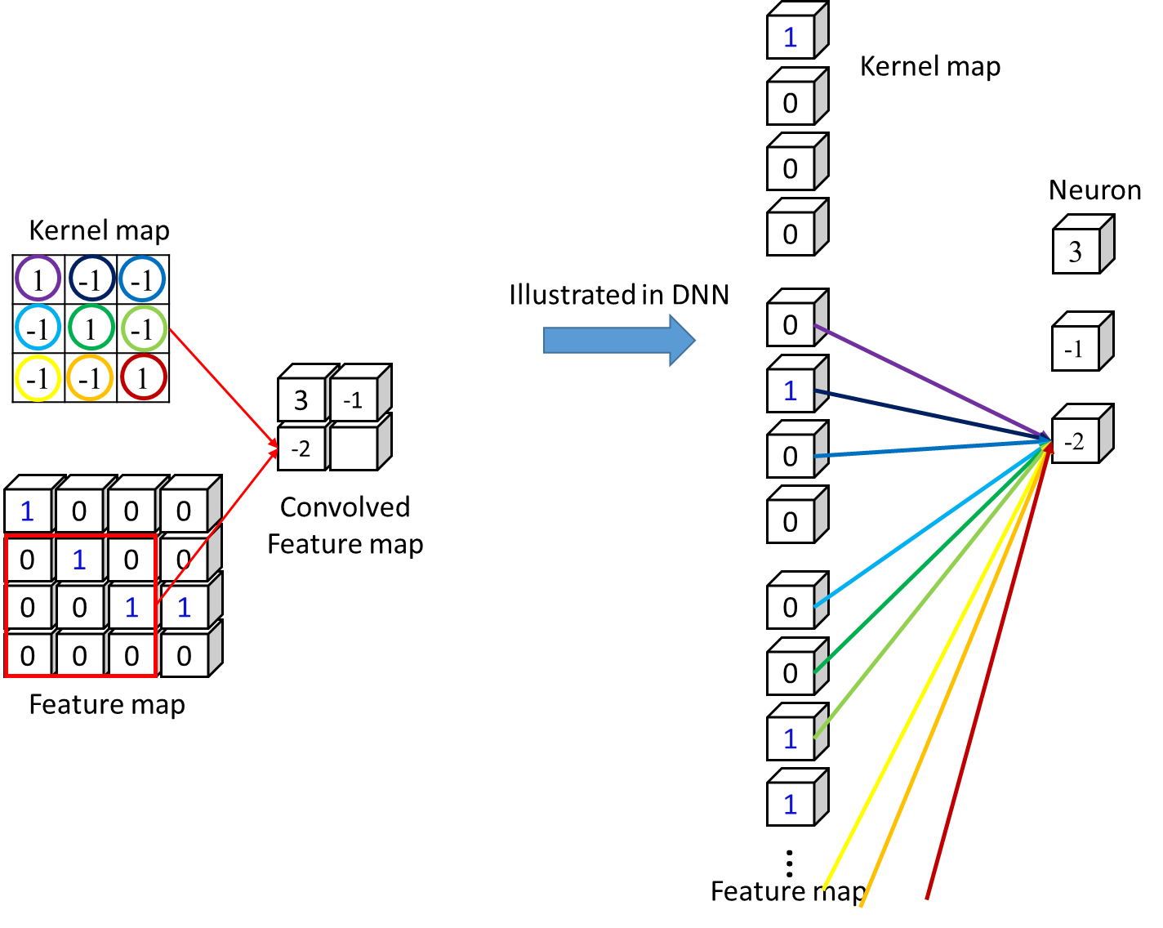
Proposed method
CNN convolution (3)

Slide 27
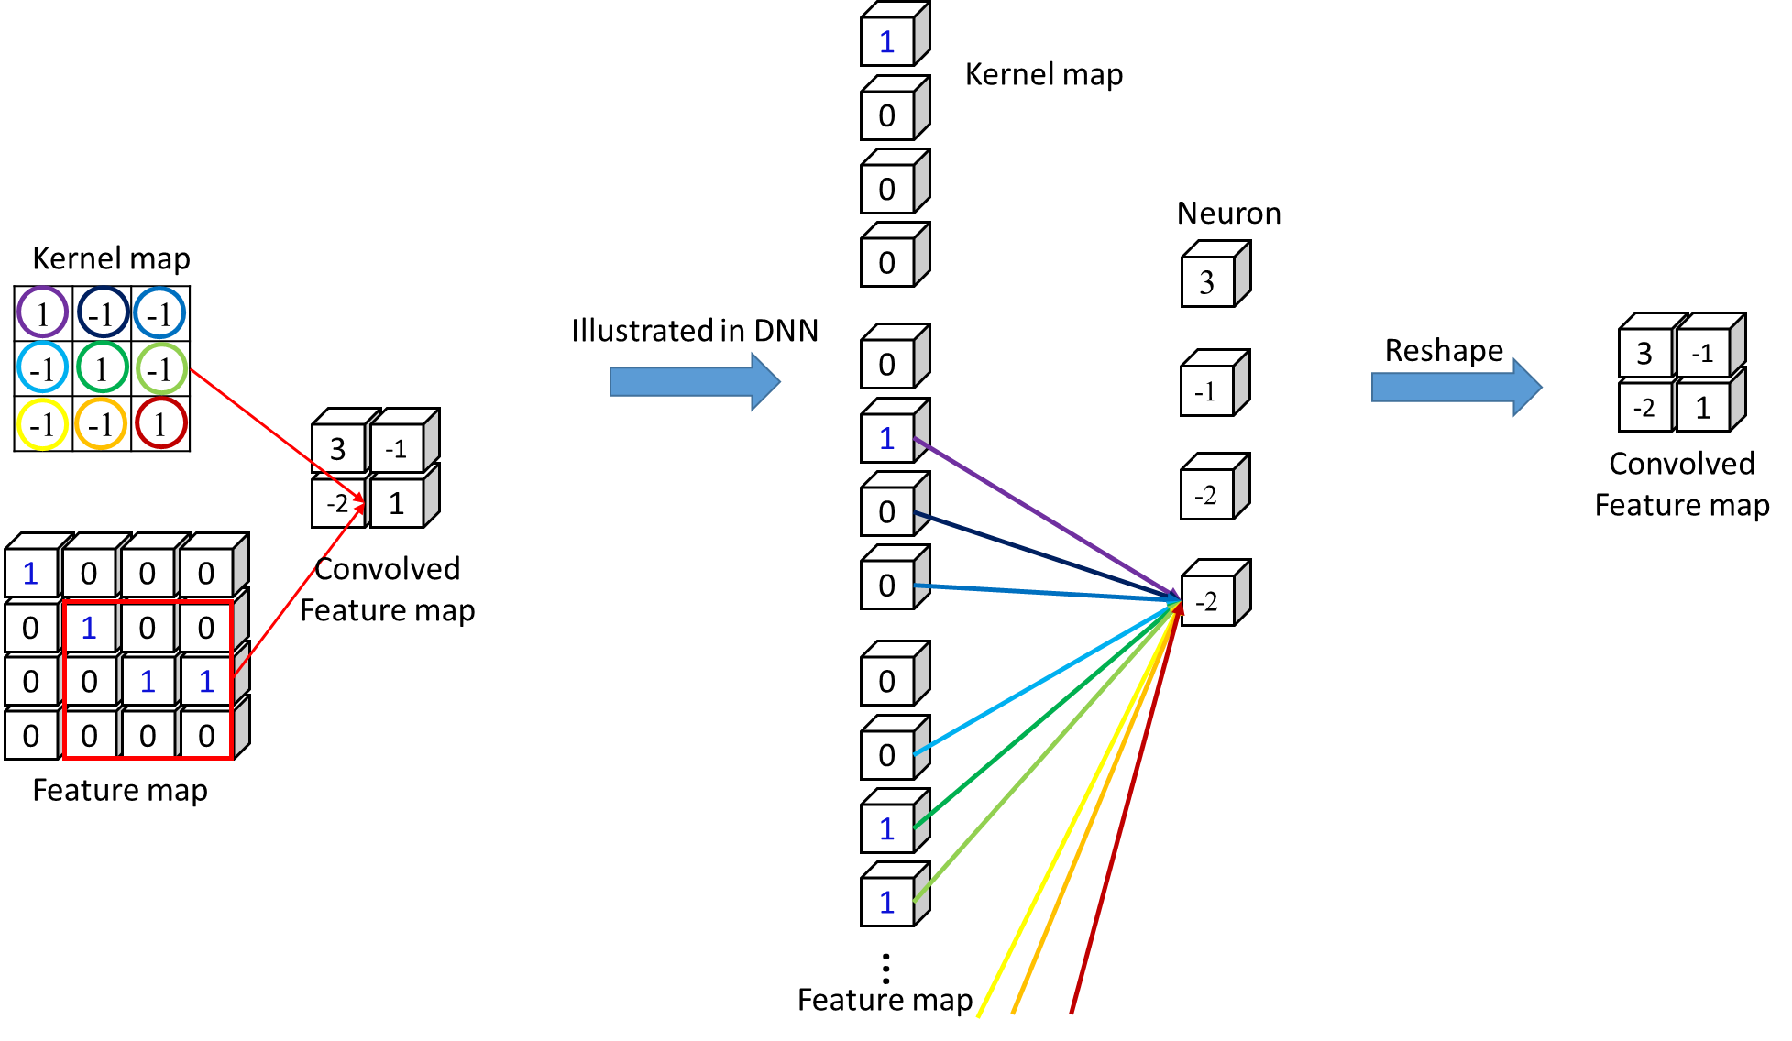
Proposed method
CNN convolution (4)

Slide 28
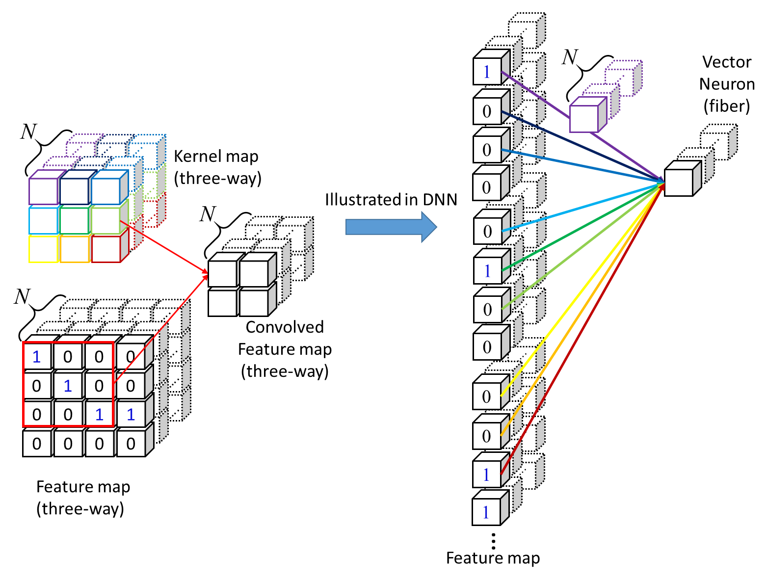
Proposed method
DCGN convolution (1)
Notes:
比較 DCGN 跟 3D convolution 差別

Slide 29
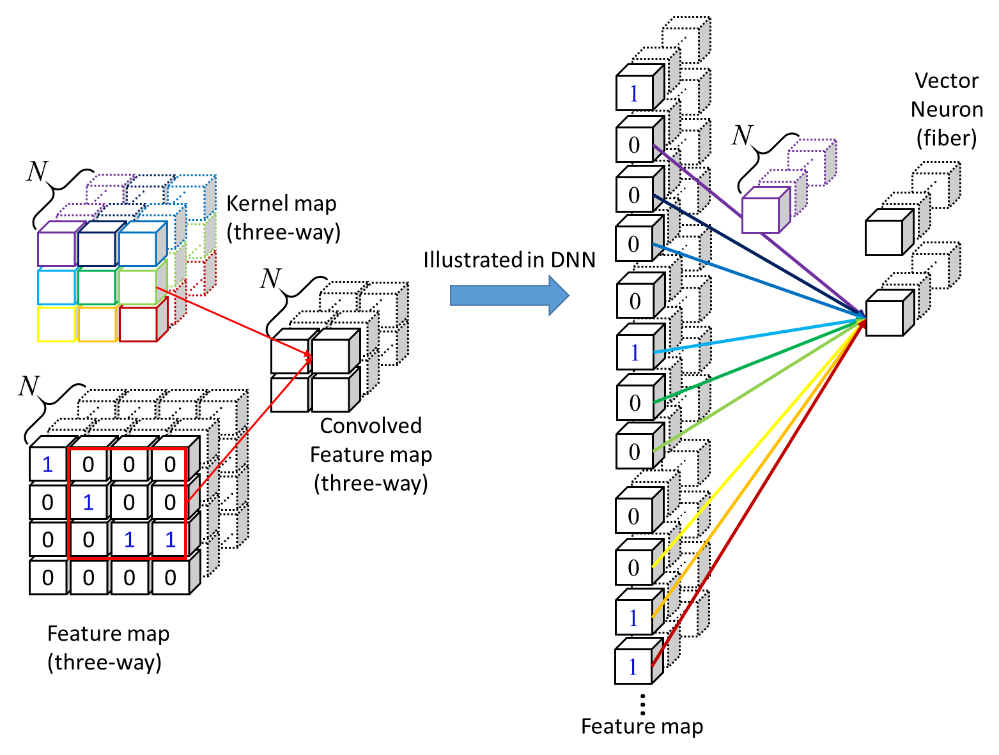
Proposed method
DCGN convolution (2)

Slide 30
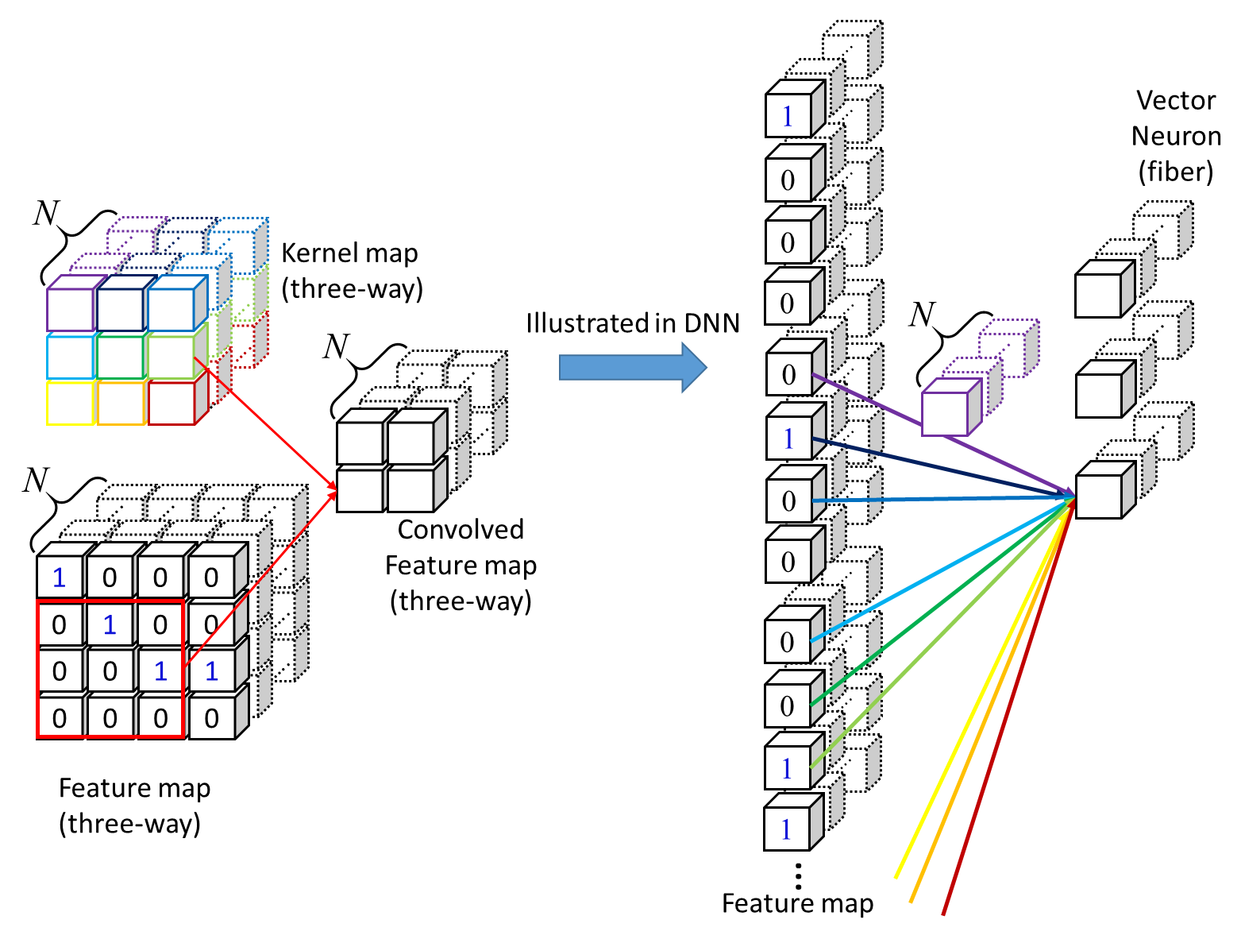
Proposed method
DCGN convolution (3)

Slide 31
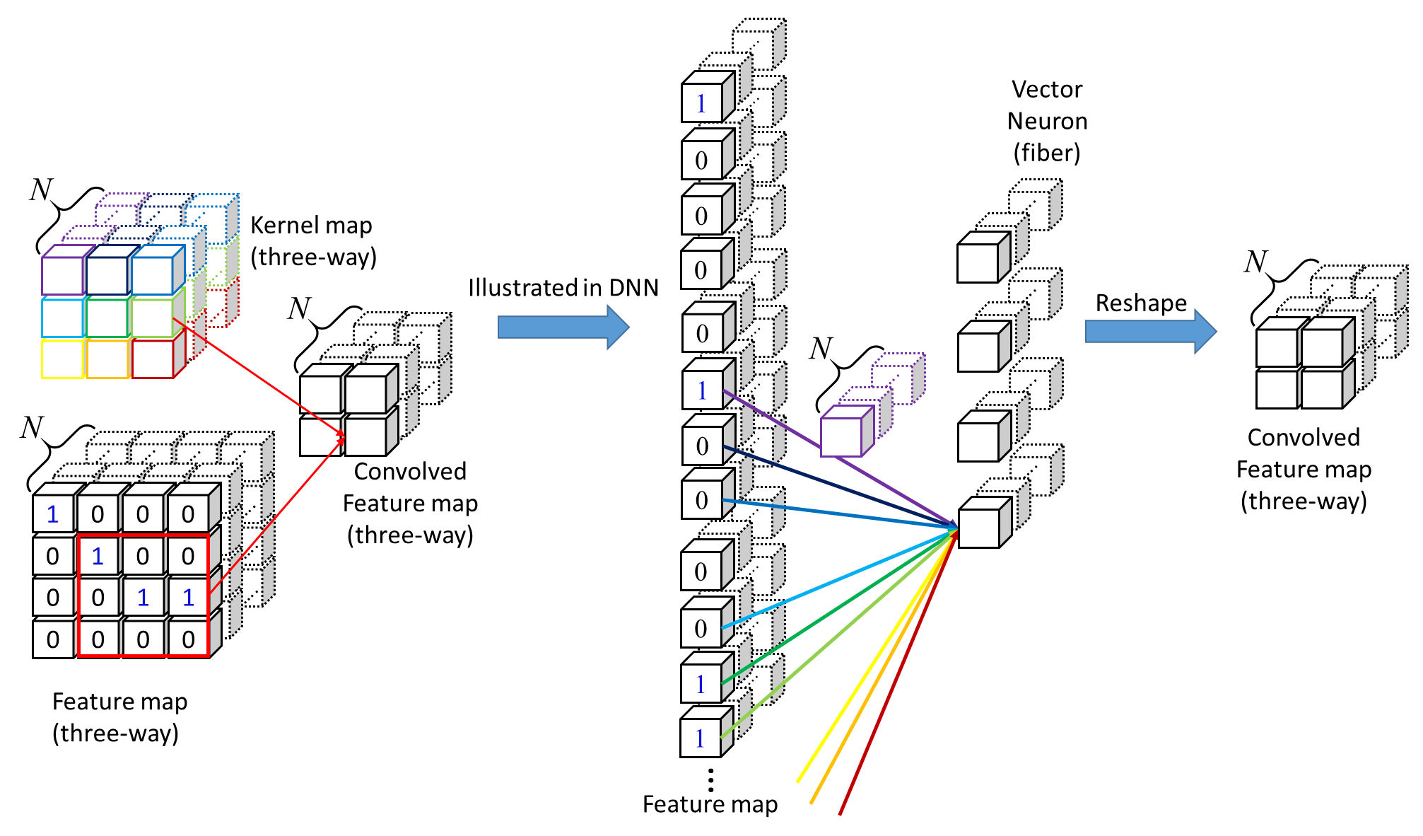
Proposed method
DCGN convolution (4)

Slide 32
Experiments
Application on regression problems
  Color image inpainting
    Set N = 3 for DCGN
    Remove texts consisting of variant fonts
  Singing voice separation
    Set N = 1, 3, 5, 7 for ABIPNN
    Separate singing voice from accompaniment
  Multispectral (hyperspectral) image denoising
    Set N = 3-6 for DCGN, N = 10 for ABIPNN
    Remove Gaussian noise

Slide 33
Experiments
General settings
  Bilinear product: Circular convolution
  Activation function:
    ABIPNN: Sigmoid
    DCGN: ReLU
  Number of hidden layers: 3
  Objective function: Mean square error
  Gradient Optimization: Adam

Slide 34
Experiments
Color image inpainting - DCGN
  LabelMe dataset
    MIT Computer Science and Artificial Intelligence Laboratory (CSAIL)
    Training set: 2,920 images
    Test set: 1,133 images
    Resolution: 2,952 x 1,944
  Dataset settings
    Resize images to 512 x 512
    Randomly select 150 images from the training set for validation
    Contaminate all the images by the same text with variant fonts

Slide 35
Experiments
Color image inpainting - DCGN
  Experimental settings
    The size of kernel maps: 3x3
    Number of epochs: 100
    Convolutional hidden layers => without any pooling layers
  Comparison of architectures
    DCGN: Has 24 kernel maps
    CNN₁ : Has the same number of kernels per layer as DCGN
    CNN₂ : More kernels but the total number of parameters similar to DCGN
    CNN₃ : More kernels and three times the total number of parameters as DCGN

Slide 36
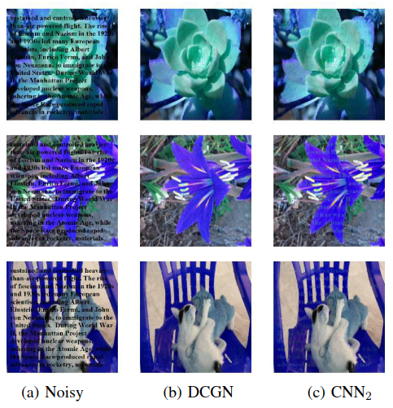
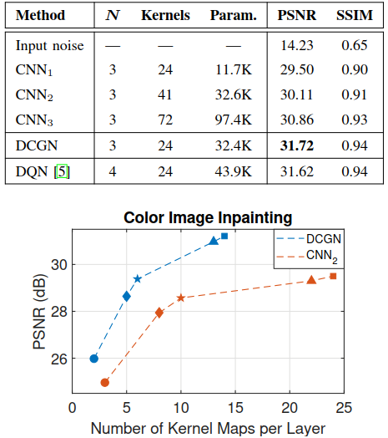
Experiments
Color image inpainting - DCGN
  Paired t-test : p-value < 0.01

Slide 37
Experiments
Singing voice separation - ABIPNN
  Demixing Secret Database 100 (DSD100)
    Signal Separation Evaluation Campaign (SiSEC), 2016
    100 different songs
      50 for development and 50 for test
    Durations
      Range : From 2 min and 22 s to 7 min and 20 s
      Average : 4 min and 10 s
    Sample rate: 44,100 Hz
  Dataset settings
    Downsampling: 8,000 Hz
    STFT: 1024-point
    Hop size: 256-point

Slide 38
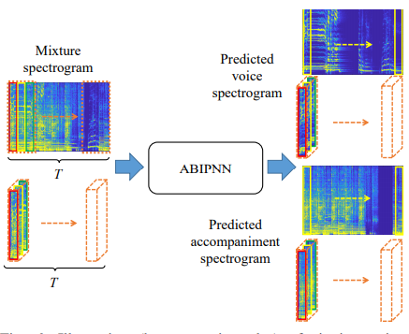
Experiments
Singing voice separation - ABIPNN
  Illustration (best seen in color) of singing voice separation
    Extract the second dimension for ideal ratio mask (IRM)

Slide 39
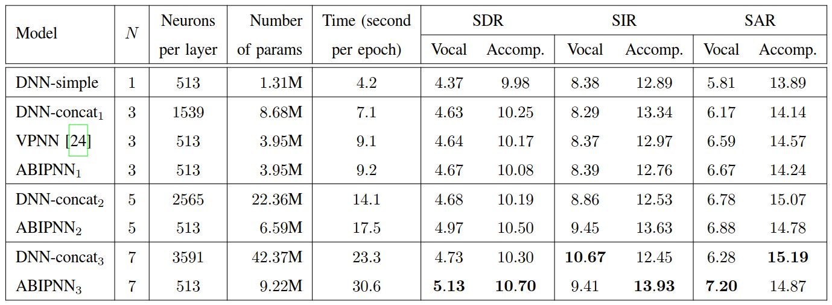
Experiments
Singing voice separation - ABIPNN
  Blind Source Separation (BSS) Eval Toolbox v3.0
    Source to distortion ratio (SDR), Source to interferences ratio (SIR), Source to artifact ratio (SAR)
    Number of epochs: 1,000

Slide 40
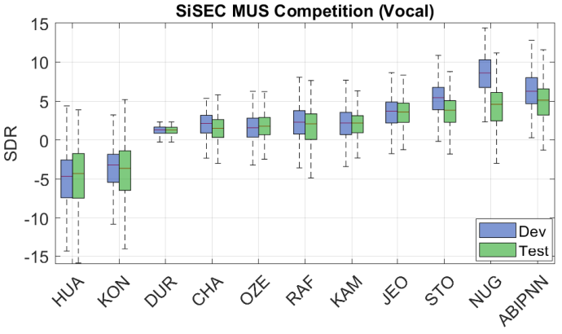
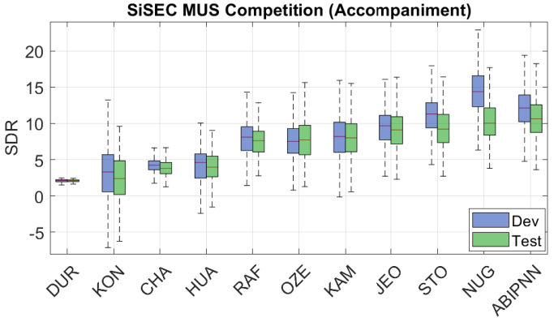
Experiments
Singing voice separation - ABIPNN
  N is set to 7
  Comparison of other’s architecture without augmentation data

Slide 41
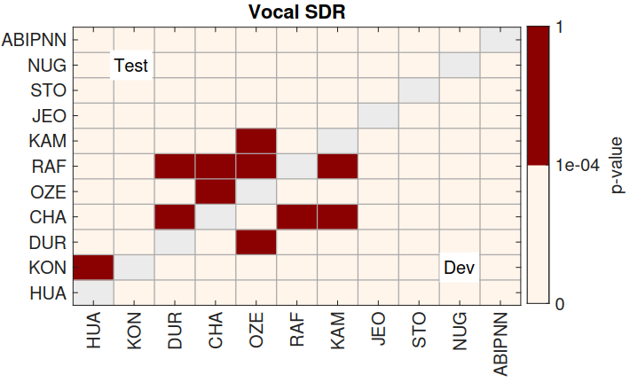
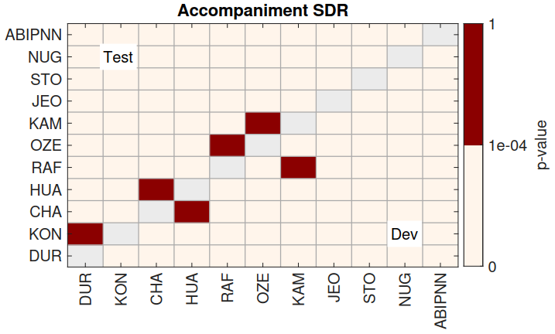
Experiments
Singing voice separation - ABIPNN
  N is set to 7
  Wilcoxon signed-rank test results for SDR vocals
  p-value > 1e-04 indicates no significance difference

Slide 42
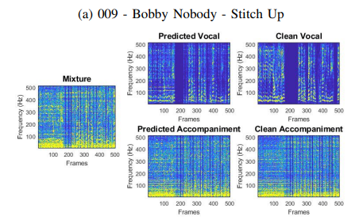
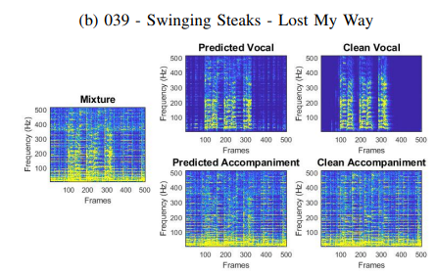
Experiments
Singing voice separation - ABIPNN
  Separated results by using ABIPNN

Slide 43
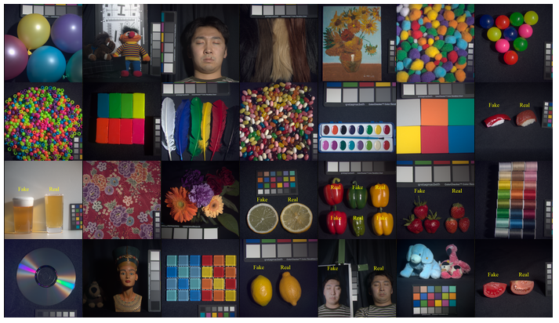
Experiments
Multispectral (hyperspectral) image denoising
  Multispectral Image Database
    32 real-world scenes
    Each scene contains 31 monochrome images with size : 512 x 512
    Captured from wavelength 400 nm to 700 nm with a step size of 10 nm
  Dataset settings
    Train “Chart and Stuffed Toy” scene
    Take last 10 bands
    Resize each image into 205 x 205
    Divide each image into 8 × 8 × 10
    overlapping tensor patches
    Select 10,000 patches randomly
    for training, rest for test

Slide 44
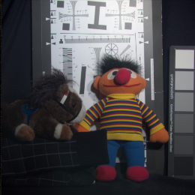
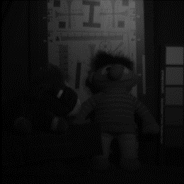
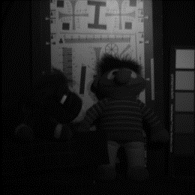
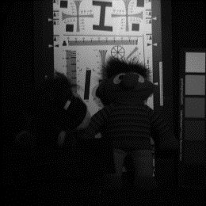
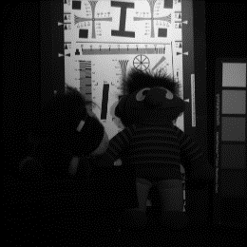

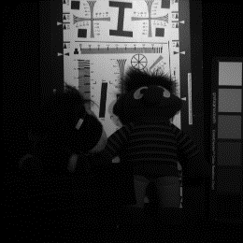
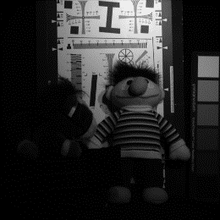
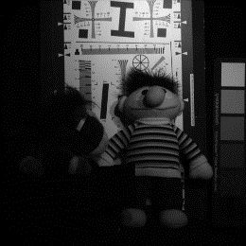

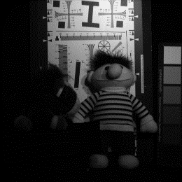



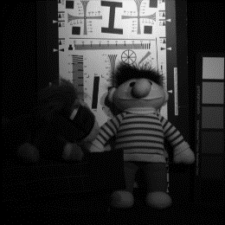
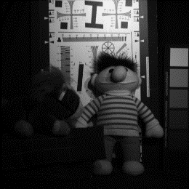
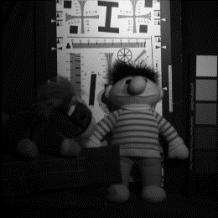
Experiments
Multispectral image denoising - ABIPNN
RGB Image
400 nm
410 nm
420 nm
430 nm
440 nm
…
450 nm
Last 10 bands
610 nm
620 nm
630 nm
640 nm
650 nm
660 nm
670 nm
680 nm
690 nm
700 nm

Slide 45

Experiments
Multispectral image denoising - ABIPNN
  Evaluation index: PSNR
  Number of training epochs: 3,000
  Illustration of multispectral image denoising using ABIPNN

Slide 46

Experiments
Multispectral image denoising - ABIPNN
  Experimental settings
    DNN-parallel
      Each channel is trained by a NN
      Arch.: 64-512-512-512-64
    DNN-concat
      10 channels are concatenated.
      Arch.: 640-1450-1450-1450-640
    ABIPNN
      The dimensionality of inputs, outputs,
      weights and bias is 10
      Arch.: 64-512-512-512-64

Slide 47

Experiments
Multispectral image denoising - ABIPNN
  Recovered examples
    Denoised images at the 700 nm
    Sparsity: 10%
    Sigma: 200

Slide 48
Experiments
Multispectral image denoising - DCGN
  Experimental settings
    The size of kernel maps: 3x3
    Number of epochs: 30
    Three convolutional layers => without any pooling layers
  Architectures
    DCGN: Has 24 kernel maps
    CNN₁ : Has the same number of kernels per layer as DCGN
    CNN₂ : More kernels but the total number of parameters similar to DCGN
    CNN₃ : More kernels and three times the total number of parameters as DCGN

Slide 49

Experiments
Multispectral image denoising - DCGN
  Experimental results
    N = 3-6 (bands)

Slide 50

Experiments
Multispectral image denoising - DCGN
  Recovered examples
    Denoised images at the 700 nm
    Sparsity: 10%
    Sigma: 200

Slide 51
Conclusions
Vector-valued neural network
  N-dimensional vector-valued neurons
  N is an arbitrary positive integer
  Perform vector-valued learning on CNN (DCGN)
A general form of bilinear neurons
  Arbitrary bilinear products
Experiments on color image inpainting, mutispectral image denoising and singing voice separation
Next steps
  Test the proposed method on classification problems
  Test on the dataset with even larger dimensions

Slide 52

Notes:
conclusion : 加上此架構可以延伸 graph neural network
singing voice separation 加上 CNN DCGN 3D-CNN
Multi-spectral image 跟 ABIPNN 比 Ｎ＝6的情況

Slide 53

Bilinear products
Suppose there are three vectors $X=\left[x_{1},x_{2},…,x_{N}\right]$, $Y=\left[y_{1},y_{2},…,y_{N}\right]$ and $Z=\left[z_{1},z_{2},…,z_{N}\right]$. The bilinear operation B have following formal definition
  $\text{B}\text{(}\text{X}\text{+}\text{Y}\text{, }\text{Z}\text{) = }\text{B}\text{(}\text{X}\text{, }\text{Z}\text{) + }\text{B}\text{(}\text{Y}\text{, }\text{Z}\text{)}$
  $B\left(a∗X, Z\right)=a∗B\left(X, Z\right)$
  $B\left(X, Y+Z\right)=B\left(X, Y\right)+B\left(X, Z\right)$
  $B\left(X, a∗Z\right)=a∗B\left(X, Z\right)$
  (Back)
Notes:
分開律

Slide 54

Circular Convolution
0
Counterclockwise
rotation
3
Fixed
5
4
1
2
0
0
0
3
4
5
5
4
3
5
4
3
1
2
1
2
1
2

Slide 55
References
Reference
    [1] T. Nitta, “An extension of the back-propagation algorithm to complex numbers,” Neural Netw., vol. 10, no. 8, pp. 1391–1415, 1997.
    [2] T.Nitta, “An analysis of the fundamental structure of complex-valued neurons,” Neural Process. Lett., vol. 12, no. 3, pp. 239–246, 2000.
    [3] T.Nitta, “Orthogonality of decision boundaries in complex-valued neural networks,” Neural Comput., vol. 16, no. 1, pp. 73–97, Jan. 2004.
    [4] T.Nitta, “Solving the XOR problem and the detection of symmetry using a single complex-valued neuron,” Neural Netw., vol. 16, no. 8, pp. 1101– 1105, 2003.
    [5] S. Buchholz and G. Sommer, “A hyperbolic multilayer perceptron,” in Proc. Int. Joint Conf. Neural Netw. (IJCNN), 2000, pp. 129–133.
    [6] T. Nitta and S. Buchholz, “On the decision boundaries of hyperbolic neurons,” in Proc. Int. Joint Conf. Neural Netw. (IJCNN), 2008, pp. 2974–2980.

Slide 56
References
Reference
    [7] T. Nitta and Y. Kuroe, “Hyperbolic gradient operator and hyperbolic back-propagation learning algorithms,” IEEE Trans. Neural Netw. Learn. Syst., no. 99, pp. 1–14, Mar. 2017.
    [8] T. Nitta, “A backpropagation algorithm for neural networks based an 3D vector product,” in Proc. Int. Joint Conf. Neural Netw. (IJCNN), 1993, pp. 589–592.
    [9] B. K. Tripathi, High Dimensional Neurocomputing. India: Springer, New Delhi, 2015.
    [10] T. Nitta, “Three-dimensional vector valued neural network and its generalization ability,” in Neural Information Processing–Letters and Reviews, 2006, pp. 237–242.
    [11] P. Arena, L. Fortuna, L. Occhipinti, and M. Xibilia, “Neural networks for quaternion-valued function approximation,” in Proc. IEEE Int. Symp. Circuits and Syst., 1994, pp. 307–310.

Slide 57
References
Reference
    [12] P. Arena, L. Fortuna, G. Muscato, and M. Xibilia, “MLP in quaternion algebra,” in Neural Networks in Multidimensional Domains. London: Springer-Verlag London, 1998, vol. 234, pp. 49–75.
    [13] T. Nitta, “A quaternary version of the back-propagation algorithm,” in Proc. IEEE Int. Conf. Neural Netw., 1995, pp. 2753–2756.
    [14] C.-A. Popa, “Octonion-valued neural networks,” in Proc. Int. Conf. Artificial Neural Netw., 2016, pp. 435–443.
    [15] C. Trabelsi, O. Bilaniuk, Y. Zhang, D. Serdyuk, S. Subramanian, J.-F. Santos, S. Mehri, N. Rostamzadeh, Y. Bengio, and C. J. Pal, “Deep complex networks,” in Proc. Int. Conf. Learn. Representations (ICLR), 2018.
    [16] T. Nitta, “N-dimensional vector neuron,” in Proc. Int. Joint Conf. Artificial Intelligence (IJCAI), 2007, pp. 2–7.

Slide 58
References
Reference
    [17] T.Nitta, “N-dimensional vector neuron and its application to the N-bit parity problem,” in Complex-valued neural networks: Advances and applications. New York: John Wiley and Sons, 2013, pp. 59–74.
    [18] J. K. Pearson and D. L. Bisset, “Back propagation in a Clifford algebra.” in Proc. IEEE Int. Conf. Neural Netw., vol. 2, 1992, pp. 413–416.
    [19] J. K. Pearson and D. L. Bisset, “Neural networks in the Clifford domain,” in Proc. IEEE Int. Conf. Neural Netw., vol. 3, 1994, pp. 1465–1469.
    [20] E. J. Bayro-Corrochano, “Geometric neural computing,” IEEE Trans. Neural Netw., vol. 12, no. 5, pp. 968–986, 2001.
    [21] S. Buchholz and G. Sommer, “Clifford algebra multilayer perceptrons,” in Geometric Computing with Clifford Algebras: Theoretical Foundations and Applications in Computer Vision and Robotics. Berlin, Heidelberg: Springer Berlin Heidelberg, 2001, pp. 315–334.

Slide 59
References
Reference
    [22] C.-A. Popa, “Matrix-valued neural networks,” in Mendel 2015. Cham: Springer International Publishing, 2015, pp. 245–255.
    [23] J.-T. Chien and Y.-T. Bao, “Tensor-factorized neural networks,” IEEE Trans. Neural Netw. Learn. Syst., no. 99, pp. 1–14, Apr. 2017.

Slide 60

Proposed method
Backward
  The gradient of the weight $w_{ij}^{l}$
    According Jacobian matrix, the partial derivative of C with respect to $w_{ij}^{l}$ is
    $$\frac{∂C}{∂w_{i}^{l}}=\left[\begin{matrix}\frac{∂C}{∂w_{ij1}^{l}}, & \frac{∂C}{∂w_{ij2}^{l}}, & …, \end{matrix}\frac{∂C}{∂w_{ijN}^{l}}\right]={\left[\begin{matrix}\frac{∂C}{∂z_{i1}^{l}}\frac{∂z_{i1}^{l}}{∂w_{ij1}^{l}}+ & \frac{∂C}{∂z_{i2}^{l}}\frac{∂z_{i2}^{l}}{∂w_{ij1}^{l}}+… & +\frac{∂C}{∂z_{iN}^{l}}\frac{∂z_{iN}^{l}}{∂w_{ij1}^{l}} \\ \begin{aligned}\frac{∂C}{∂z_{i1}^{l}}\frac{∂z_{i1}^{l}}{∂w_{ij2}^{l}}+ \\ \end{aligned} & \begin{aligned}\frac{∂C}{∂z_{i2}^{l}}\frac{∂z_{i2}^{l}}{∂w_{ij2}^{l}}+… \\ ⋮\end{aligned} & \begin{aligned}+\frac{∂C}{∂z_{iN}^{l}}\frac{∂z_{iN}^{l}}{∂w_{ij2}^{l}} \\ \end{aligned} \\ \frac{∂C}{∂z_{i1}^{l}}\frac{∂z_{i1}^{l}}{∂w_{ijN}^{l}}+ & \frac{∂C}{∂z_{i2}^{l}}\frac{∂z_{i2}^{l}}{∂w_{ijN}^{l}}+… & +\frac{∂C}{∂z_{i1}^{l}}\frac{∂z_{i2}^{l}}{∂w_{ijN}^{l}}\end{matrix}\right]}^{T}$$

Slide 61




Proposed method
Backward
  The gradient of the weight $w_{ij}^{l}$
    According Jacobian matrix, the partial derivative of C with respect to $w_{ij}^{l}$ is
    $$\frac{∂C}{∂w_{i}^{l}}=\left[\begin{matrix}\frac{∂C}{∂w_{ij1}^{l}}, & \frac{∂C}{∂w_{ij2}^{l}}, & …, \end{matrix}\frac{∂C}{∂w_{ijN}^{l}}\right]={\left[\begin{matrix}\frac{∂C}{∂z_{i1}^{l}}\frac{∂z_{i1}^{l}}{∂w_{ij1}^{l}}+ & \frac{∂C}{∂z_{i2}^{l}}\frac{∂z_{i2}^{l}}{∂w_{ij1}^{l}}+… & +\frac{∂C}{∂z_{iN}^{l}}\frac{∂z_{iN}^{l}}{∂w_{ij1}^{l}} \\ \begin{aligned}\frac{∂C}{∂z_{i1}^{l}}\frac{∂z_{i1}^{l}}{∂w_{ij2}^{l}}+ \\ \end{aligned} & \begin{aligned}\frac{∂C}{∂z_{i2}^{l}}\frac{∂z_{i2}^{l}}{∂w_{ij2}^{l}}+… \\ ⋮\end{aligned} & \begin{aligned}+\frac{∂C}{∂z_{iN}^{l}}\frac{∂z_{iN}^{l}}{∂w_{ij2}^{l}} \\ \end{aligned} \\ \frac{∂C}{∂z_{i1}^{l}}\frac{∂z_{i1}^{l}}{∂w_{ijN}^{l}}+ & \frac{∂C}{∂z_{i2}^{l}}\frac{∂z_{i2}^{l}}{∂w_{ijN}^{l}}+… & +\frac{∂C}{∂z_{i1}^{l}}\frac{∂z_{i2}^{l}}{∂w_{ijN}^{l}}\end{matrix}\right]}^{T}$$
$$d_{i2}^{l}$$
$$d_{iN}^{l}$$
Start from the first entry
$$d_{i1}^{l}$$
$$d_{i}^{l}≜\left[d_{i1}^{l}\begin{matrix}, & d_{i2}^{l}, & …, \end{matrix}d_{iN}^{l}\right]$$

Slide 62


Proposed method
Backward
  The gradient of the weight $w_{ij}^{l}$
    According Jacobian matrix, the partial derivative of C with respect to $w_{ij}^{l}$ is
    $$\frac{∂C}{∂w_{i}^{l}}=\left[\begin{matrix}\frac{∂C}{∂w_{ij1}^{l}}, & \frac{∂C}{∂w_{ij2}^{l}}, & …, \end{matrix}\frac{∂C}{∂w_{ijN}^{l}}\right]={\left[\begin{matrix}\frac{∂C}{∂z_{i1}^{l}}\frac{∂z_{i1}^{l}}{∂w_{ij1}^{l}}+ & \frac{∂C}{∂z_{i2}^{l}}\frac{∂z_{i2}^{l}}{∂w_{ij1}^{l}}+… & +\frac{∂C}{∂z_{iN}^{l}}\frac{∂z_{iN}^{l}}{∂w_{ij1}^{l}} \\ \begin{aligned}\frac{∂C}{∂z_{i1}^{l}}\frac{∂z_{i1}^{l}}{∂w_{ij2}^{l}}+ \\ \end{aligned} & \begin{aligned}\frac{∂C}{∂z_{i2}^{l}}\frac{∂z_{i2}^{l}}{∂w_{ij2}^{l}}+… \\ ⋮\end{aligned} & \begin{aligned}+\frac{∂C}{∂z_{iN}^{l}}\frac{∂z_{iN}^{l}}{∂w_{ij2}^{l}} \\ \end{aligned} \\ \frac{∂C}{∂z_{i1}^{l}}\frac{∂z_{i1}^{l}}{∂w_{ijN}^{l}}+ & \frac{∂C}{∂z_{i2}^{l}}\frac{∂z_{i2}^{l}}{∂w_{ijN}^{l}}+… & +\frac{∂C}{∂z_{i1}^{l}}\frac{∂z_{i2}^{l}}{∂w_{ijN}^{l}}\end{matrix}\right]}^{T}$$
$$d_{i2}^{l}$$
$$d_{iN}^{l}$$
Start from the first entry
$$d_{i1}^{l}$$
$$\frac{∂z_{i}^{l}}{∂w_{ij1}^{l}}$$
$$d_{i}^{l}=\left[d_{i1}^{l}\begin{matrix}, & d_{i2}^{l}, & …, \end{matrix}d_{iN}^{l}\right]$$

Slide 63

Proposed method
Backward
  The gradient of the weight $w_{ij}^{l}$
    Recall that
    $$z_{i}^{l}=\sum_{j=1}^{R_{l−1}}{\left(\begin{aligned}a_{j1}^{l−1}\left(w_{ij1}^{l}e_{1}+…+w_{ijN}^{l}e_{N}\right)e_{1} \\ +a_{j2}^{l−1}\left(w_{ij1}^{l}e_{1}+…+w_{ijN}^{l}e_{N}\right)e_{2} \\ ⋮ \\ {+a}_{jN}^{l−1}\left(w_{ij1}^{l}e_{1}+…+w_{ijN}^{l}e_{N}\right)e_{N}\end{aligned}\right)+b_{i}^{l}}$$
    And we can write
    $$\frac{∂z_{i}^{l}}{∂w_{ij1}^{l}}={\left[\begin{matrix}\frac{∂z_{i1}^{l}}{∂w_{ij1}^{l}}, & \frac{∂z_{i2}^{l}}{∂w_{ij1}^{l}}, & …, \end{matrix}\frac{∂z_{iN}^{l}}{∂w_{ij1}^{l}}\right]}^{T}=\left[\begin{matrix}e_{1}•e_{1}, & e_{1}•e_{2}, & …,e_{1}•e_{N}\end{matrix}\right]{ a}_{j}^{l−1}$$
    Then we can get
    $$\frac{∂C}{∂w_{ij1}^{l}}=d_{i}^{l}\left[\sum_{n=1}^{N}{{a_{jn}^{l−1}e}_{1}•e_{n}}\right]$$

Slide 64

Proposed method
Backward (Back)
  The gradient of the weight $w_{ij}^{l}$
    After each entry are calculated
    $$\frac{∂C}{∂w_{ij}^{l}}=\left[\begin{matrix}\frac{∂C}{∂w_{ij1}^{l}}, & \frac{∂C}{∂w_{ij2}^{l}}, & …, \end{matrix}\frac{∂C}{∂w_{ijN}^{l}}\right]\text{=}d_{i}^{l}\left[e_{1}•\left[\sum_{n=1}^{N}{a_{jn}^{l−1}e_{n}}\right], …,e_{N}•\left[\sum_{n=1}^{N}{a_{jn}^{l−1}e_{n}}\right]\right]$$
    Recall that ${\left[q\right]}_{•}^{+}=\left[e_{1}•q, e_{2}•q,…, e_{N}•q\right]$ and ${ a}_{j}^{l−1}=\sum_{n=1}^{N}{a_{jn}^{l−1}}e_{n}$
    Then we can get
    $$\frac{∂C}{∂w_{ij}^{l}}={d_{i}^{l}\left[{ a}_{j}^{l−1}\right]}_{•}^{+}$$

Slide 65

Proposed method
Backward
  The gradient of the bias $b_{i}^{l}$
    From the forward process, we know
      $$z_{i}^{l}=\sum_{j=1}^{R_{l−1}}{w_{ij}^{l}•{ a}_{j}^{l−1}+}b_{i}^{l}$$
    The equation could be rewritten as
    $$z_{i}^{l}=\sum_{j=1}^{R_{l−1}}{\left[w_{ij}^{l}•e_{1},w_{ij}^{l}•e_{2},…,w_{ij}^{l}•e_{N}\right]{ a}_{j}^{l−1}+}b_{i}^{l}$$
    =$\sum_{j=1}^{R_{l−1}}{\left[{a_{j1}^{l−1}w}_{ij}^{l}•e_{1},{a_{j1}^{l−1}w}_{ij}^{l}•e_{2},…,{a_{j1}^{l−1}w}_{ij}^{l}•e_{N}\right]+}b_{i}^{l}$
    $=\sum_{j=1}^{R_{l−1}}{\left(\begin{aligned}a_{j1}^{l−1}\left(w_{ij1}^{l}e_{1}+…+w_{ijN}^{l}e_{N}\right)e_{1} \\ +a_{j2}^{l−1}\left(w_{ij1}^{l}e_{1}+…+w_{ijN}^{l}e_{N}\right)e_{2} \\ ⋮ \\ {+a}_{jN}^{l−1}\left(w_{ij1}^{l}e_{1}+…+w_{ijN}^{l}e_{N}\right)e_{N}\end{aligned}\right)+b_{i}^{l}}$

Slide 66

Proposed method
Backward
  The gradient of the bias $b_{i}^{l}$
    According Jacobian matrix, the partial derivative of C with respect to $b_{i}^{l}$ is
    $$\frac{∂C}{∂b_{i}^{l}}=\left[\begin{matrix}\frac{∂C}{∂b_{i1}^{l}}, & \frac{∂C}{∂b_{i2}^{l}}, & …, \end{matrix}\frac{∂C}{∂b_{iN}^{l}}\right]={\left[\begin{matrix}\frac{∂C}{∂z_{i1}^{l}}\frac{∂z_{i1}^{l}}{∂b_{i1}^{l}}+ & \frac{∂C}{∂z_{i2}^{l}}\frac{∂z_{i2}^{l}}{∂b_{i1}^{l}}+… & +\frac{∂C}{∂z_{iN}^{l}}\frac{∂z_{iN}^{l}}{∂b_{i1}^{l}} \\ \begin{aligned}\frac{∂C}{∂z_{i1}^{l}}\frac{∂z_{i1}^{l}}{∂b_{i2}^{l}}+ \\ \end{aligned} & \begin{aligned}\frac{∂C}{∂z_{i2}^{l}}\frac{∂z_{i2}^{l}}{∂b_{i2}^{l}}+… \\ ⋮\end{aligned} & \begin{aligned}+\frac{∂C}{∂z_{iN}^{l}}\frac{∂z_{iN}^{l}}{∂b_{i2}^{l}} \\ \end{aligned} \\ \frac{∂C}{∂z_{i1}^{l}}\frac{∂z_{i1}^{l}}{∂b_{iN}^{l}}+ & \frac{∂C}{∂z_{i2}^{l}}\frac{∂z_{i2}^{l}}{∂b_{iN}^{l}}+… & +\frac{∂C}{∂z_{i1}^{l}}\frac{∂z_{i2}^{l}}{∂b_{iN}^{l}}\end{matrix}\right]}^{T}$$

Slide 67




Proposed method
Backward
  The gradient of the bias $b_{i}^{l}$
    According Jacobian matrix, the partial derivative of C with respect to $b_{i}^{l}$ is
    $$\frac{∂C}{∂b_{i}^{l}}=\left[\begin{matrix}\frac{∂C}{∂b_{i1}^{l}}, & \frac{∂C}{∂b_{i2}^{l}}, & …, \end{matrix}\frac{∂C}{∂b_{iN}^{l}}\right]={\left[\begin{matrix}\frac{∂C}{∂z_{i1}^{l}}\frac{∂z_{i1}^{l}}{∂b_{i1}^{l}}+ & \frac{∂C}{∂z_{i2}^{l}}\frac{∂z_{i2}^{l}}{∂b_{i1}^{l}}+… & +\frac{∂C}{∂z_{iN}^{l}}\frac{∂z_{iN}^{l}}{∂b_{i1}^{l}} \\ \begin{aligned}\frac{∂C}{∂z_{i1}^{l}}\frac{∂z_{i1}^{l}}{∂b_{i2}^{l}}+ \\ \end{aligned} & \begin{aligned}\frac{∂C}{∂z_{i2}^{l}}\frac{∂z_{i2}^{l}}{∂b_{i2}^{l}}+… \\ ⋮\end{aligned} & \begin{aligned}+\frac{∂C}{∂z_{iN}^{l}}\frac{∂z_{iN}^{l}}{∂b_{i2}^{l}} \\ \end{aligned} \\ \frac{∂C}{∂z_{i1}^{l}}\frac{∂z_{i1}^{l}}{∂b_{iN}^{l}}+ & \frac{∂C}{∂z_{i2}^{l}}\frac{∂z_{i2}^{l}}{∂b_{iN}^{l}}+… & +\frac{∂C}{∂z_{i1}^{l}}\frac{∂z_{i2}^{l}}{∂b_{iN}^{l}}\end{matrix}\right]}^{T}$$
Start from the first entry
$$d_{i1}^{l}$$
$$d_{i2}^{l}$$
$$d_{iN}^{l}$$
$$\frac{∂C}{∂z_{i}^{l}}=\left[\frac{∂C}{∂z_{i1}^{l}}\begin{matrix}, & \frac{∂C}{∂z_{i1}^{l}}, & …, \end{matrix}\frac{∂C}{∂z_{i1}^{l}}\right]≜\left[d_{i1}^{l}\begin{matrix}, & d_{i2}^{l}, & …, \end{matrix}d_{iN}^{l}\right]=d_{i}^{l}$$

Slide 68


Proposed method
Backward (Back)
  The gradient of the bias $b_{i}^{l}$
    According Jacobian matrix, the partial derivative of C with respect to $b_{i}^{l}$ is
    $$\frac{∂C}{∂b_{i}^{l}}=\left[\begin{matrix}\frac{∂C}{∂b_{i1}^{l}}, & \frac{∂C}{∂b_{i2}^{l}}, & …, \end{matrix}\frac{∂C}{∂b_{iN}^{l}}\right]={\left[\begin{matrix}\frac{∂C}{∂z_{i1}^{l}}\frac{∂z_{i1}^{l}}{∂b_{i1}^{l}}+ & \frac{∂C}{∂z_{i2}^{l}}\frac{∂z_{i2}^{l}}{∂b_{i1}^{l}}+… & +\frac{∂C}{∂z_{iN}^{l}}\frac{∂z_{iN}^{l}}{∂b_{i1}^{l}} \\ \begin{aligned}\frac{∂C}{∂z_{i1}^{l}}\frac{∂z_{i1}^{l}}{∂b_{i2}^{l}}+ \\ \end{aligned} & \begin{aligned}\frac{∂C}{∂z_{i2}^{l}}\frac{∂z_{i2}^{l}}{∂b_{i2}^{l}}+… \\ ⋮\end{aligned} & \begin{aligned}+\frac{∂C}{∂z_{iN}^{l}}\frac{∂z_{iN}^{l}}{∂b_{i2}^{l}} \\ \end{aligned} \\ \frac{∂C}{∂z_{i1}^{l}}\frac{∂z_{i1}^{l}}{∂b_{iN}^{l}}+ & \frac{∂C}{∂z_{i2}^{l}}\frac{∂z_{i2}^{l}}{∂b_{iN}^{l}}+… & +\frac{∂C}{∂z_{i1}^{l}}\frac{∂z_{i2}^{l}}{∂b_{iN}^{l}}\end{matrix}\right]}^{T}$$
    $$\frac{∂C}{∂b_{i}^{l}}=\left[\begin{matrix}\frac{∂C}{∂b_{i1}^{l}}, & \frac{∂C}{∂b_{i2}^{l}}, & …, \end{matrix}\frac{∂C}{∂b_{iN}^{l}}\right]=\left[d_{i1}^{l}\begin{matrix}, & d_{i2}^{l}, & …, \end{matrix}d_{iN}^{l}\right]=d_{i}^{l}$$
Start from the first entry
$$d_{i1}^{l}$$
$$d_{i2}^{l}$$
$$d_{iN}^{l}$$
$$\frac{∂C}{∂z_{i}^{l}}=\left[\frac{∂C}{∂z_{i1}^{l}}\begin{matrix}, & \frac{∂C}{∂z_{i2}^{l}}, & …, \end{matrix}\frac{∂C}{∂z_{iN}^{l}}\right]≜\left[d_{i1}^{l}\begin{matrix}, & d_{i2}^{l}, & …, \end{matrix}d_{iN}^{l}\right]=d_{i}^{l}$$
After each entry is calculated

Slide 69

Proposed method
Backward
  The backpropgation of local gradient $d_{k}^{l+1}$⟶$d_{i}^{l}$
    From the chain rule, we can get
    $$d_{i}^{l}=\frac{∂C}{∂z_{i}^{l}}=\sum_{k=1}^{R_{l+1}}{\frac{∂C}{∂z_{k}^{l+1}}\frac{∂z_{k}^{l+1}}{∂a_{i}^{l}}\frac{∂a_{i}^{l}}{∂z_{i}^{l}}}$$

Slide 70



Proposed method
Backward
  The backpropgation of local gradient $d_{k}^{l+1}$⟶$d_{i}^{l}$
    From the chain rule, we can get
    $$d_{i}^{l}=\frac{∂C}{∂z_{i}^{l}}=\sum_{k=1}^{R_{l+1}}{\frac{∂C}{∂z_{k}^{l+1}}\frac{∂z_{k}^{l+1}}{∂a_{i}^{l}}\frac{∂a_{i}^{l}}{∂z_{i}^{l}}}$$
    From the Jacobian, we can derive $\frac{∂z_{k}^{l+1}}{∂a_{i}^{l}}$
    $$\frac{∂z_{k}^{l+1}}{∂a_{i}^{l}}=\left[\begin{matrix}\frac{∂z_{k1}^{l+1}}{∂a_{i1}^{l}} & … & \frac{∂z_{k1}^{l+1}}{∂a_{iN}^{l}} \\ ⋮ & ⋱ & ⋮ \\ \frac{∂z_{kN}^{l+1}}{∂a_{i1}^{l}} & … & \frac{∂z_{kN}^{l+1}}{∂a_{iN}^{l}}\end{matrix}\right]$$
$$d_{k}^{l+1}$$
$$\dot{φ}\left(z_{i}^{l}\right)$$

Slide 71




Proposed method
Backward (Back)
  The backpropgation of local gradient $d_{k}^{l+1}$⟶$d_{i}^{l}$
    From the chain rule, we can get
    $$d_{i}^{l}=\frac{∂C}{∂z_{i}^{l}}=\sum_{k=1}^{R_{l+1}}{\frac{∂C}{∂z_{k}^{l+1}}\frac{∂z_{k}^{l+1}}{∂a_{i}^{l}}\frac{∂a_{i}^{l}}{∂z_{i}^{l}}=\sum_{k=1}^{R_{l+1}}{d_{k}^{l+1}{\left[w_{ki}^{l+1}\right]}_{•}\dot{φ}\left(z_{i}^{l}\right)}}$$
    From the Jacobian, we can derive $\frac{∂z_{k}^{l+1}}{∂a_{i}^{l}}$
    $$\frac{∂z_{k}^{l+1}}{∂a_{i}^{l}}=\left[\begin{matrix}\frac{∂z_{k1}^{l+1}}{∂a_{i1}^{l}} & … & \frac{∂z_{k1}^{l+1}}{∂a_{iN}^{l}} \\ ⋮ & ⋱ & ⋮ \\ \frac{∂z_{kN}^{l+1}}{∂a_{i1}^{l}} & … & \frac{∂z_{kN}^{l+1}}{∂a_{iN}^{l}}\end{matrix}\right]=\left[\begin{matrix}w_{ki}^{l+1}•e_{1}, & w_{ki}^{l+1}•e_{2}, & …,w_{ki}^{l+1}•e_{N}\end{matrix}\right]={\left[w_{ki}^{l+1}\right]}_{•}$$
$$d_{k}^{l+1}$$
$$\dot{φ}\left(z_{i}^{l}\right)$$
Start from the first column
Recall that ${\left[p\right]}_{•}=\left[p•e_{1},p•e_{2},…,p•e_{N}\right]$

Slide 72





Proposed method
Backpropagation
  ABIPNN
    $$T_{b}=\sum_{l=2}^{L}{R_{l+1}\left(N^{2}+N^{2}\right)R_{l}M=O\left(N^{2}KM\right)}$$
    $$T_{w}=\sum_{l=2}^{L}{\left(N^{2}\right)R_{l}R_{l−1}M=O\left(N^{2}KM\right)}$$
  DNN
    $$T_{b}=\sum_{l=2}^{L}{\left({NR}_{l}\right)\left({NR}_{l−1}\right)M=O\left(N^{2}KM\right)}$$
    $$T_{w}=\sum_{l=2}^{L}{\left({NR}_{l}\right)\left({NR}_{l−1}\right)M=O\left(N^{2}KM\right)}$$
    (Back)

