Slide 1
麵包影像辨識 Bread Image Recognition
J.-S. Roger Jang (張智星)
MIR Lab, CSIE Dept.
National Taiwan University
jang@mirlab.org, http://mirlab.org/jang

Slide 2
Outline
Image dataset
Specs for training & test
Hardware specs
Specs for training
Specs for evaluation
Experimental results
To-do list

Slide 3
Image Dataset
麵包拍攝方法
每個麵包拍攝一次，每次取得60張。（其他細節？）
原始解析度？
如何標示標準答案？
Training set：單一麵包
13種麵包，每一種麵包有60張，總共有780張
每一種麵包：90% for training, 10% for validation
Test set：多個麵包
總共有90張，有兩至四種麵包組合
？張麵包不相鄰，另有？張麵包相鄰

Slide 4
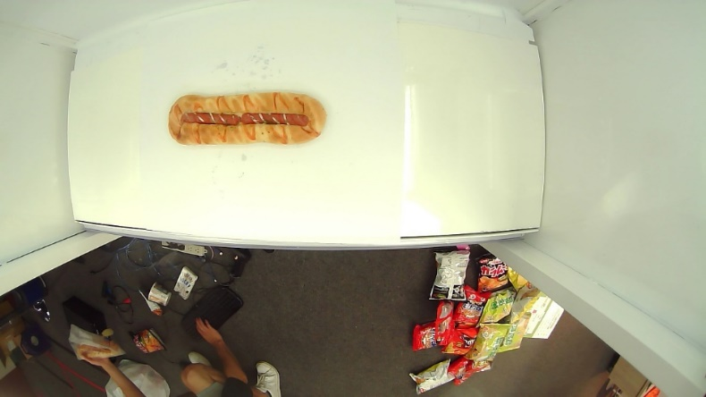
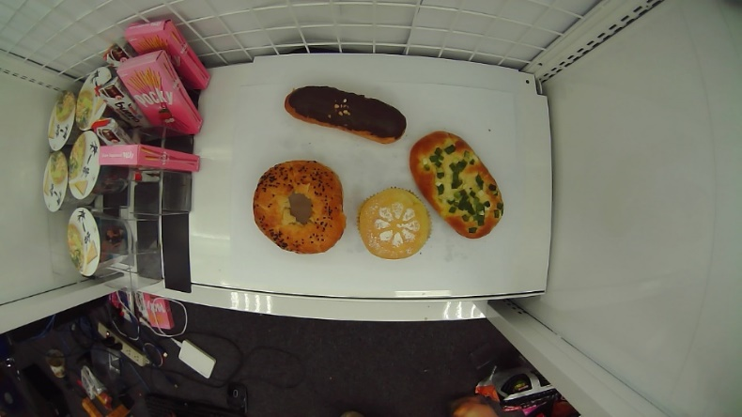
麵包影像範例
訓練資料
熱狗麵包
波羅麵包
測試資料
麵包不相鄰
麵包相鄰

Slide 5
Hardware Specs
Hardware specs for our training machine
OS: Ubuntu
CPU: ？核、編號？
GPU: 1080Ti、？張
RAM: 11GB
HD: ?TB

Slide 6
Specs for Training
Model architecture
Yolo v3
Data preprocessing
Image resized to ?x? for training
Data augmentation?
同時進行recognition與detection
Other parameters
Training method: ??
?

Slide 7
Specs for Evaluation
Output processing
Remove duplicate bounding boxes?
Data augmentation?
Performance indices
Detection rate?
Accuracy?

Slide 8
Results of Modeling Training
Plot of training and validation （請畫圖）
Loss and accuracy
Best loss/accuracy
Training loss: 5.5631
Validation loss: 5.3172
Test results?
Elapsed time
Training & validation: 6 hours
Test: ?? hours

Slide 9
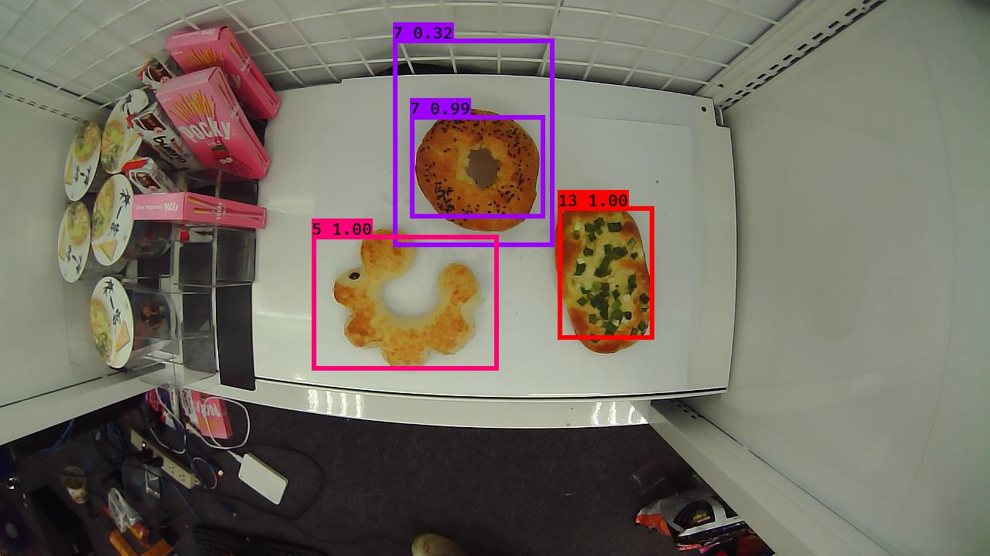
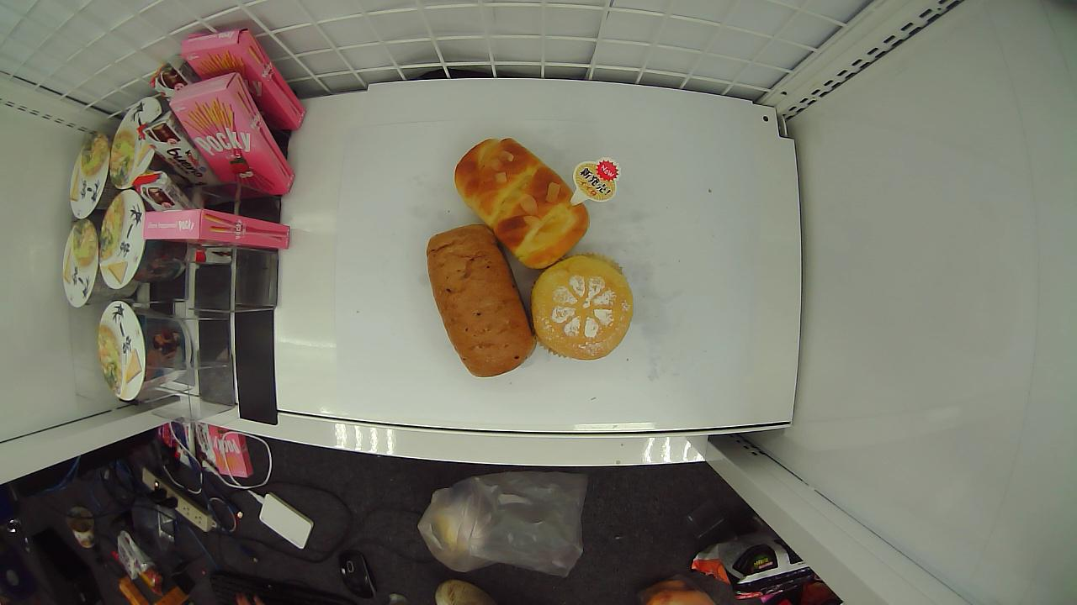
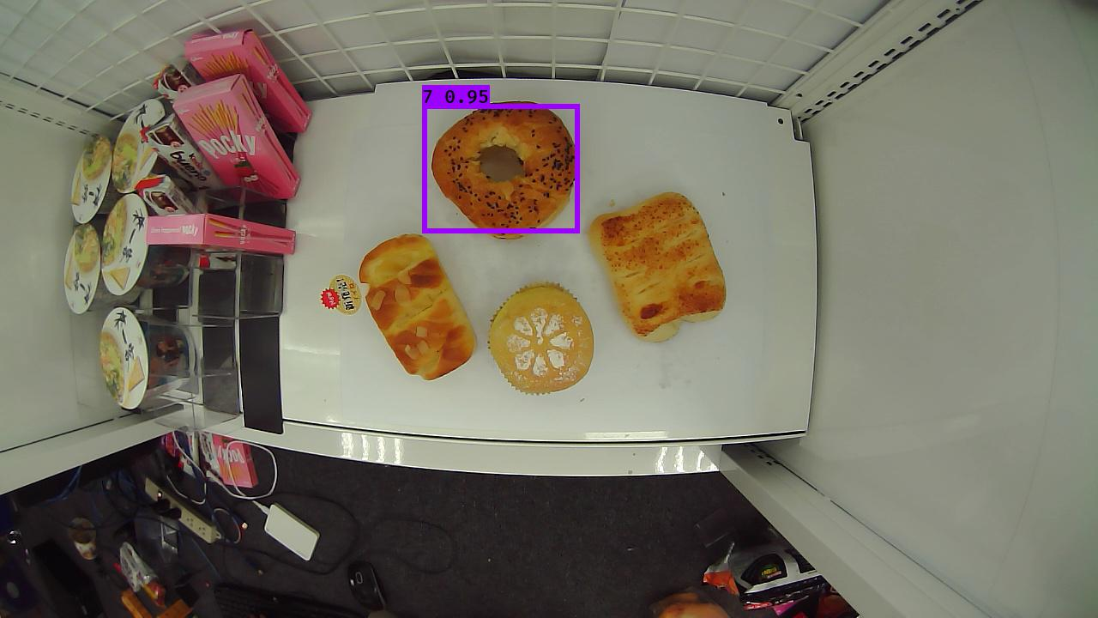
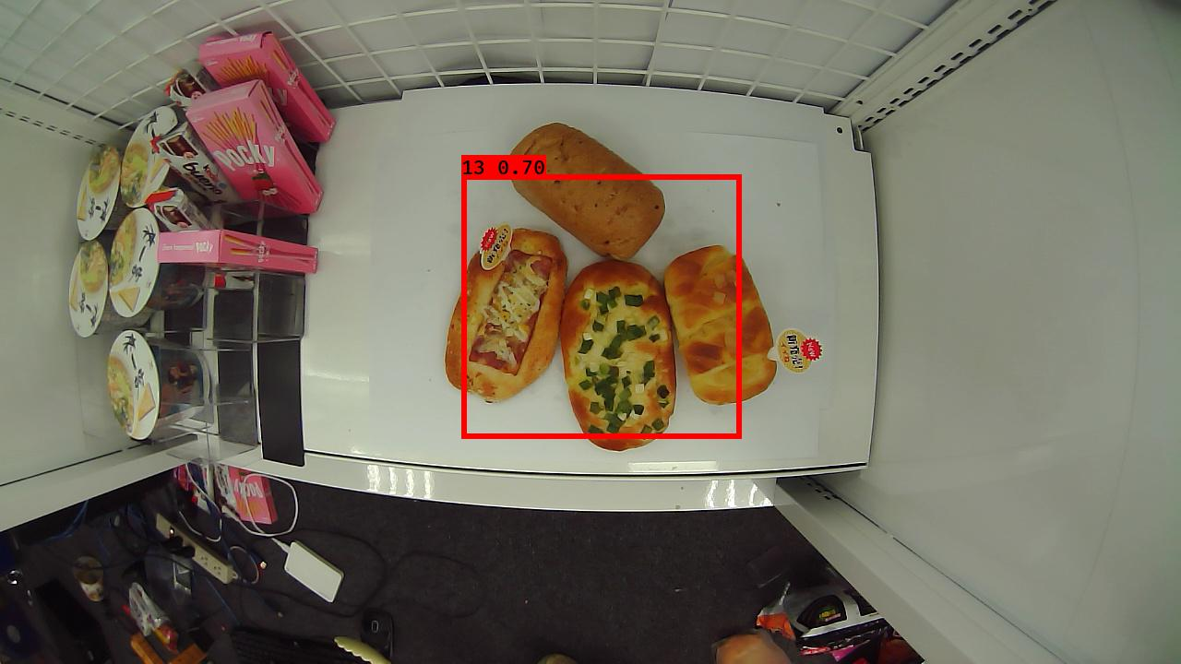
Typical Test Cases
麵包不相鄰
麵包相鄰
辨識正確！

Slide 10
錯誤分析
錯誤分析
？
？
改進方向
？
？

Slide 11
Conclusions and Future Work
Conclusions
…
…
…
Future work
…
…

