Slide 1
Root-finding Algorithms 求根演算法
Roger Jang (張智星)
CSIE Dept, National Taiwan University
2020/3/10

Slide 2
Root-finding Algorithms
Goal: Find x such that f(x)=0.
f(x) is continuous with single input.
f(x) = 0 is hard to solve directly.
Types
Closed methods
Enclose the root in an interval ➔ Reduce the length of the interval iteratively
Example: Bisection
Open methods
Approximate the function with a model ➔ Find the new model (and new zero) iteratively
Example: Newton’s method, fixed point iteration

Slide 3
Comparison
Closed methods
Robust
Error can be bounded
Always converges
Not efficient
Open methods
Not as robust
Error cannot be bounded
Not always converges
More efficient
Bisection
Newton’s method

Slide 4
Bisection: Algorithm
Concept
Perform binary search in an interval
Steps in bisection
Find an interval [a, b] such that f(a)f(b)<0.
Set c=(a+b)/2
New interval = [c, b] if f(c)f(b)<0, else new interval = [a, c]
Go back to step 2 until the length of interval is small.

Slide 5
Bisection: Error Bound
Observation: The error is reduced by a half at each iteration.
Example
Iteration 1 ➔ Determine c₁ to have error=(b-a)/2
Iteration 2 ➔ Determine c₂ to have error=(b-a)/2²
…
Iteration n ➔ Determine c_{n} to have error=(b-a)/2^{n}
➔ Find the minimum n to achieve an error bound θ:
$$\frac{b−a}{2^{n}}≤θ⇒ n≥\log_{2}\left(\frac{b−a}{θ}\right)$$
Quiz!

Slide 6
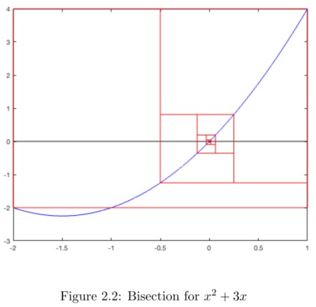
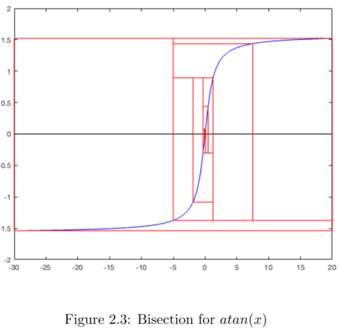
Bisection: Examples

Slide 7
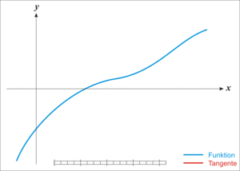
Newton’s Method: Algorithm
AKA Newton-Raphson method
Concept: Approximate the root by a tangent line iteratively

Slide 8
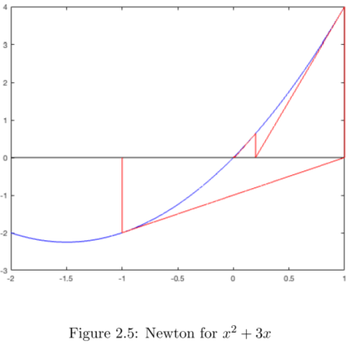
Newton’s Method: Example

Slide 9
Fixed-point Iteration: Algorithm
If x_{n+1}=g(x_{n}) converges to x when n is large, then x is a fixed-point of x_{n+1}=g(x_{n}).
Algorithm
Convert f(x)=0 to x=g(x).
Iterate x_{n+1}=g(x_{n}) until it converges to a fixed point, which is the root of f(x). Stop the algorithm.
If the previous step does not converge, go back to step 1 to find a new g(x).
Problem
How to convert f(x)=0 to x=g(x)?
How to make sure the iteration converges?

Slide 10
Fixed-point Iteration: Conversion of f(x)=0
How to convert f(x)=0 to x=g(x)?
Examples
More examples

Slide 11
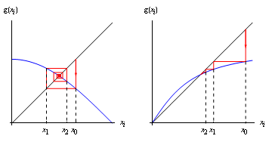
Fixed-point Iteration: Convergence
x_{n+1}=g(x_{n}) converges with any given $x_{0}∈\left[a, b\right]$ when |g’(x)|<1 for all $x∈\left[a, b\right].$
Spiral plots of convergence
Is this sufficient or necessary
for convergence?

Slide 12
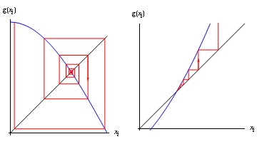
Fixed-point Iteration: Divergence
Spiral plots of divergence

Slide 13
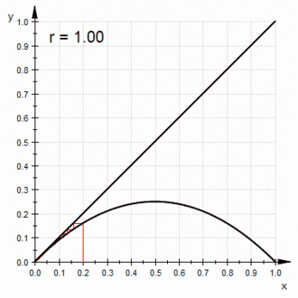
Fixed-point Iteration: From Convergence to Divergence
Example: From Convergence to Divergence

Slide 14
Reference
References
Lecture Notes CME108: Introduction to Scientific Computing, Stanford University (pdf file)
Wikipedia: Root-finding algorithm
3.1 Unit Project: Function Iteration and Chaos

