Slide 1
Shallow Copy
Jyh-Shing Roger Jang (張智星)
CSIE Dept, National Taiwan University

Slide 2
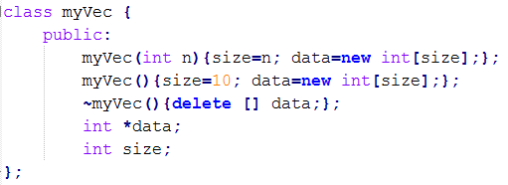
Memory Allocation in Classes
Common programming errors when using “new” and “delete” for memory management in C++ classes
Default copy constructor and assignment operator are based on “shallow copy”, which leads to errors easily.
We need to design our own constructor/operator.
Function overloading!
Double deletion!
Default copy constructor invoked
➔ Shared memory & double deletion!
Default assignment operator invoked
➔ Share memory, memory leak, and double deletion!

Slide 3
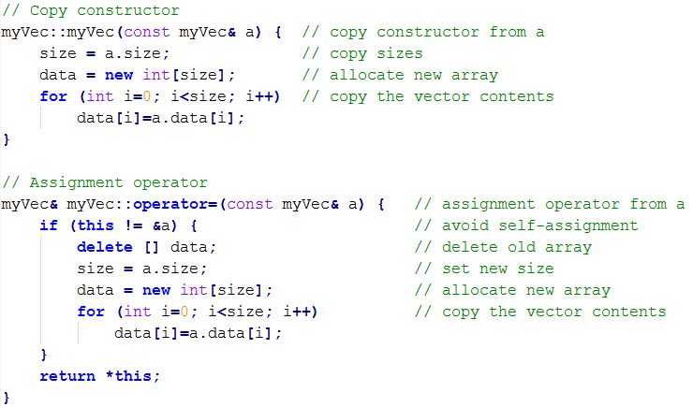
How to Fix “Shallow Copy”?
To fix the problem of “shallow copy”
Define our own copy constructor
Define our own assignment operator
Avoid memory leak

Slide 4
Examples Which Fix “Shallow Copy”
Examples
shallowCopy00.cpp: Demo of shallow copy
deepCopy00.cpp: Use new copy constructor only
deepCopy01.cpp: Use new assignment operator only
deepCopy02.cpp: Use both
Lesson learned
If a class allocates memory via “new” (or the likes, such as “malloc” or “calloc”), we should provide a new copy constructor and a new assignment operator to allocate new memory for the created copy.

Slide 5
Q & A
Questions
How to avoid the error message (due to double deletion) in shallowCopy00.cpp?
If we use STL vectors, do we still the problem of “shallow copy”? ➔ Please give examples and post to FB.
Further studies
How to check memory leak?
Tools: Purify (Windows), Valgrind (Unix/Linux), Dr. Memory (both)
Please post on FB if you know other good tools to identify memory leak.
How to avoid memory leak?
Use STL (standard template library)

Slide 6
Quiz
A program is used to record each student’s quiz scores
Class definition:
Main program:
Quiz:
What are the contents of a and b?
What are the two potential problems of this program?
Shared memory & double deletion

