Slide 1
ML-based Side-Channel Attack for POI Selection in Thermal Emission
J.-S. Roger Jang (張智星)
MIR Lab, CSIE Dept.
National Taiwan University
jang@mirlab.org, http://mirlab.org/jang

Slide 2
Side-Channel Attack
Goal
  Obtain secret information from a chip, such as discovering the key of AES-128 during encryption
Characteristics
  Non-invasive attacks by monitoring physical measurements
  Measurements: Power consumption, electromagnetic field, thermal emission, etc.
Basic idea
  Different operations cause changes in measurements

Slide 3
Side-Channel Attack
Our goals
  Decrypt AES-128 using thermal map
  Locate leakage tiles on a chip
Assumptions
  Plaintext (input) and encrypted text (output) are known.
  Reverse engineering to find the key of AES-128
Methods
  AES-128 encrypts within a 4x4 matrix
  Build 16 models, each with 256 classes
    Input: thermal map
    Output: value of a byte, 0~255
Byte 0 | Byte 4 | Byte 8 | Byte 12
Byte 1 | Byte 5 | Byte 9 | Byte 13
Byte 2 | Byte 6 | Byte 10 | Byte 14
Byte 3 | Byte 7 | Byte 11 | Byte 15

Slide 4
Dataset
Full-chip thermal images
  Average temperature during an encryption process using a given plaintext (based on Ansys’ simulation tool)
  Size: 201 x 201 pixels, 1 pixel= 10 μm x 10 μm
  Amount: 20,000 images, 17,000/3,000 for training/test
Plaintext and key
  20,000 different plaintext, such as
    [64, 4E ,7F ,36, C3, D6, 6B, 78, 88, C6, 93, 87, F4, 33, A4, 0E]
  A single key
    [00, 11, 22, 33, 44, 55, 66, 77, 88, 99, AA, BB, CC, DD, EE, FF]
Tile: each pixel
Trace: each image

Slide 5
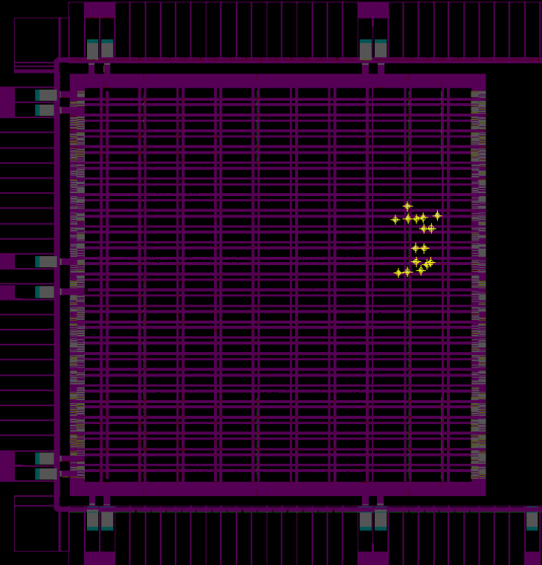
Operating POI in a Thermal Map
Byte 0 | Byte 4 | Byte 8 | Byte 12
Byte 1 | Byte 5 | Byte 9 | Byte 13
Byte 2 | Byte 6 | Byte 10 | Byte 14
Byte 3 | Byte 7 | Byte 11 | Byte 15
Operating POI (points of interest)
  16 tiles where AES encryption is processed
  Most leakage tiles for each byte
    To be identified by machine learning
Detailed locations of
16 operating POI
AES-128 SoC design[1],
with 16 operating POI
Thermal map
Byte
11
Byte
6
Byte
7
Byte
13
Byte
12
Byte
1
201pixels
Byte
8
Byte
2
Byte
10
Byte
5
Byte
14
Byte
15
Byte
0
Byte
3
Byte
4

Slide 6
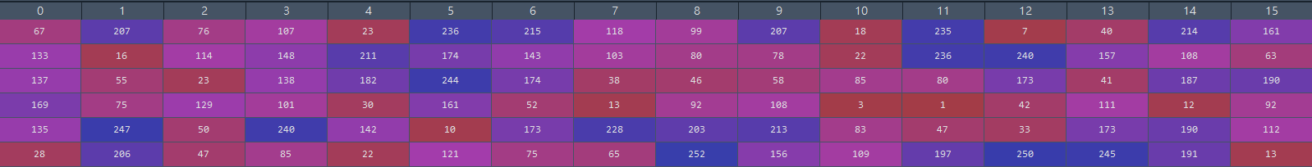
Labels for Classification
Class labels
  Encryption results from 1st round SubByte stage
    Sbox[plaintext ⊕ key]
  16 labels corresponds to Byte0 – Byte15 for all images
Reverse engineering
  Since we know the encryption process and plaintext, we can reverse engineer and find the key
A snapshot of 16 labels for the first 6 images in dataset
Image1 labels
…
Image 6 labels

Slide 7
Label Distribution
Class labels (0-FF)
Number of images
Number of images

Slide 8
Our Approach
Our approach
  Preprocess
    Sharpening filtering to match power map
    Tile pre-selection based on temperature variance
  Machine learning for classification
  Feature selection for better performance

Slide 9
Flowchart of Proposed Approaches
Preprocessing
Standard deviation
POI selection
Check invalid inputs
Sharpen images
Attack model training
Calculate standard deviation for each pixel
Lineup model
Image heatmap model
Best POI number model
Side-channel attack
Evaluation metrics
Rank
Require traces to disclose (RTD)
Top-5 accuracy
Leakage tiles identification
Monitor the changes of loss response curve
Loss
Sequential forward selection

Slide 10
Flowchart of Proposed Approaches
Preprocessing
Check invalid images
Sharpen images

Slide 11
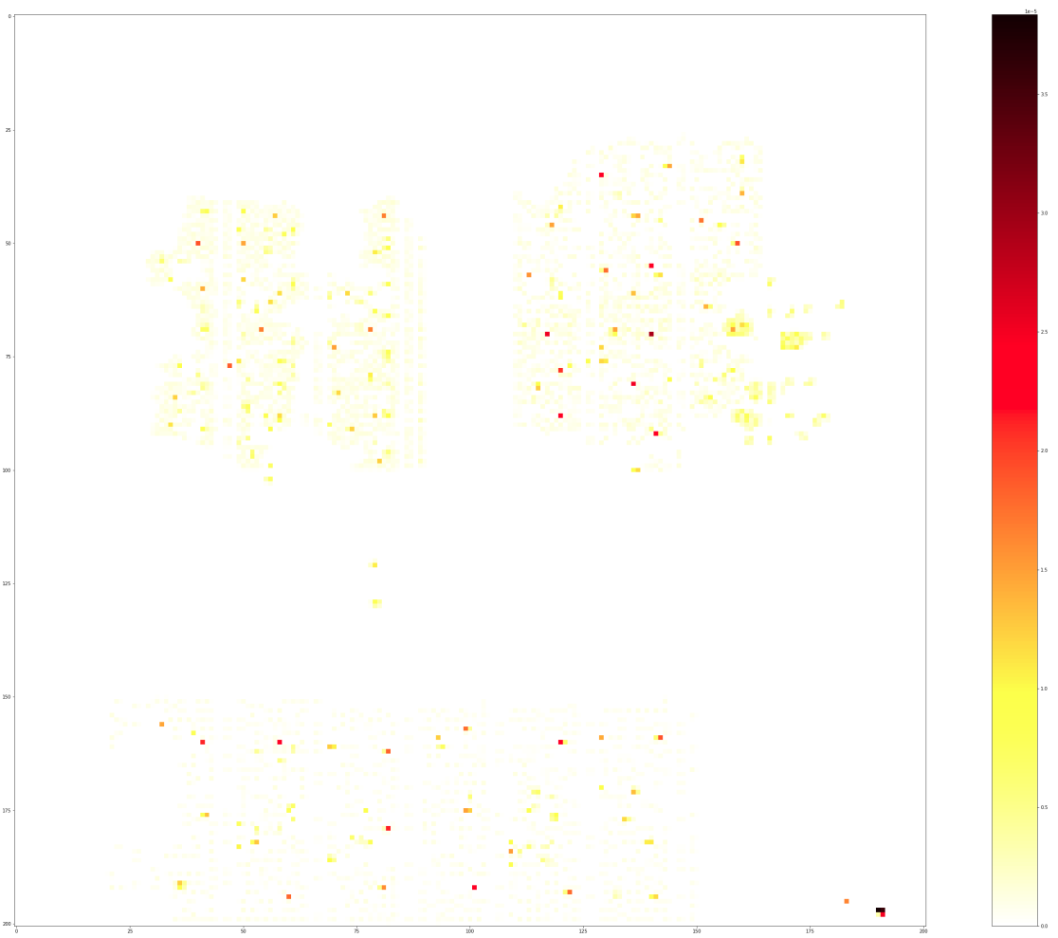
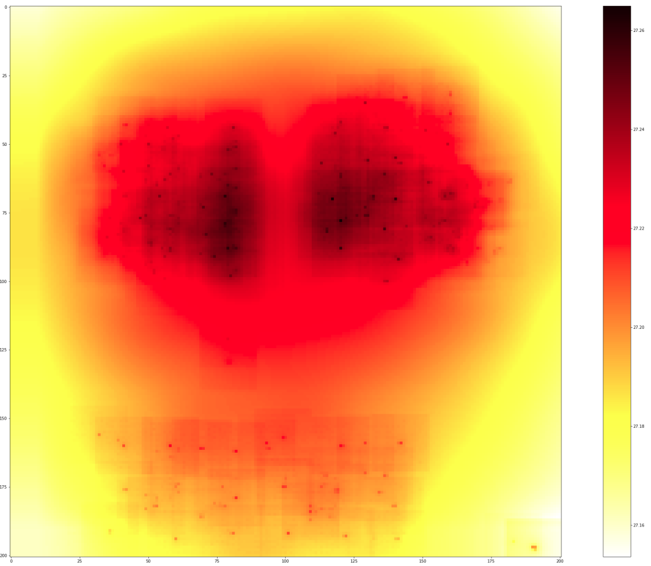
Preprocessing - Observation
Observation
  Heat conducts between wires and layers due to thermal junction coupling effect ➔ Thermal map is a blur version of power map ➔ To recover power map from thermal map via a sharpening filter
Power map (0 ~ 0.0000402 w)
Thermal map (27.1538 ~ 27.2650 °C)

Slide 12
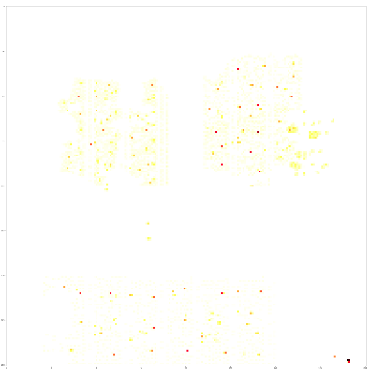
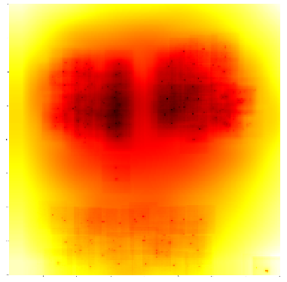
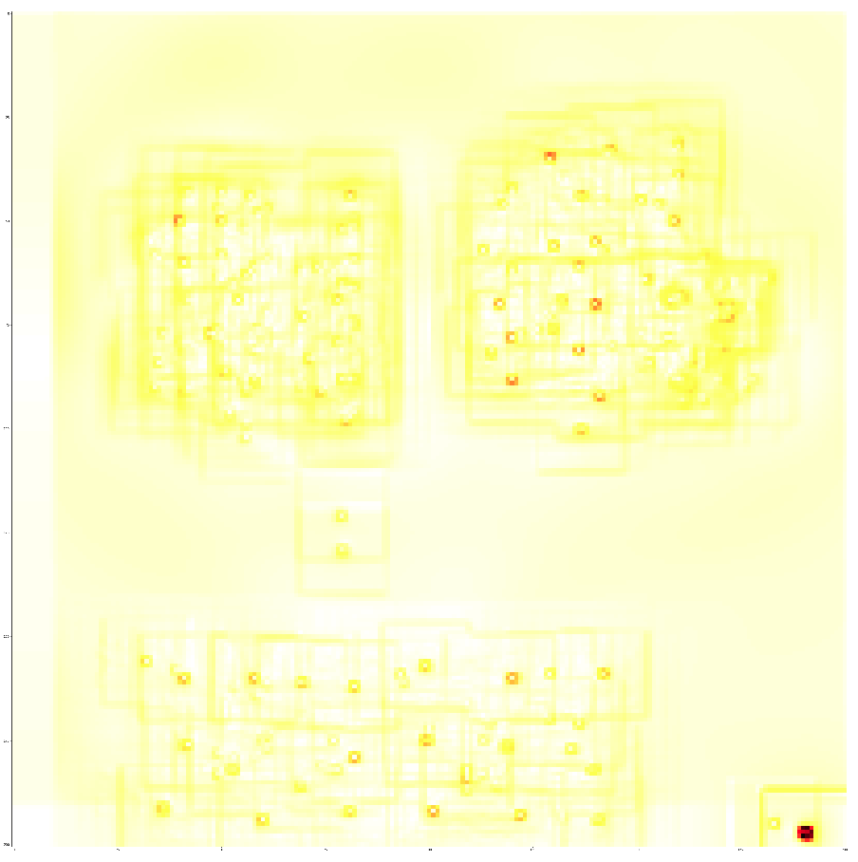
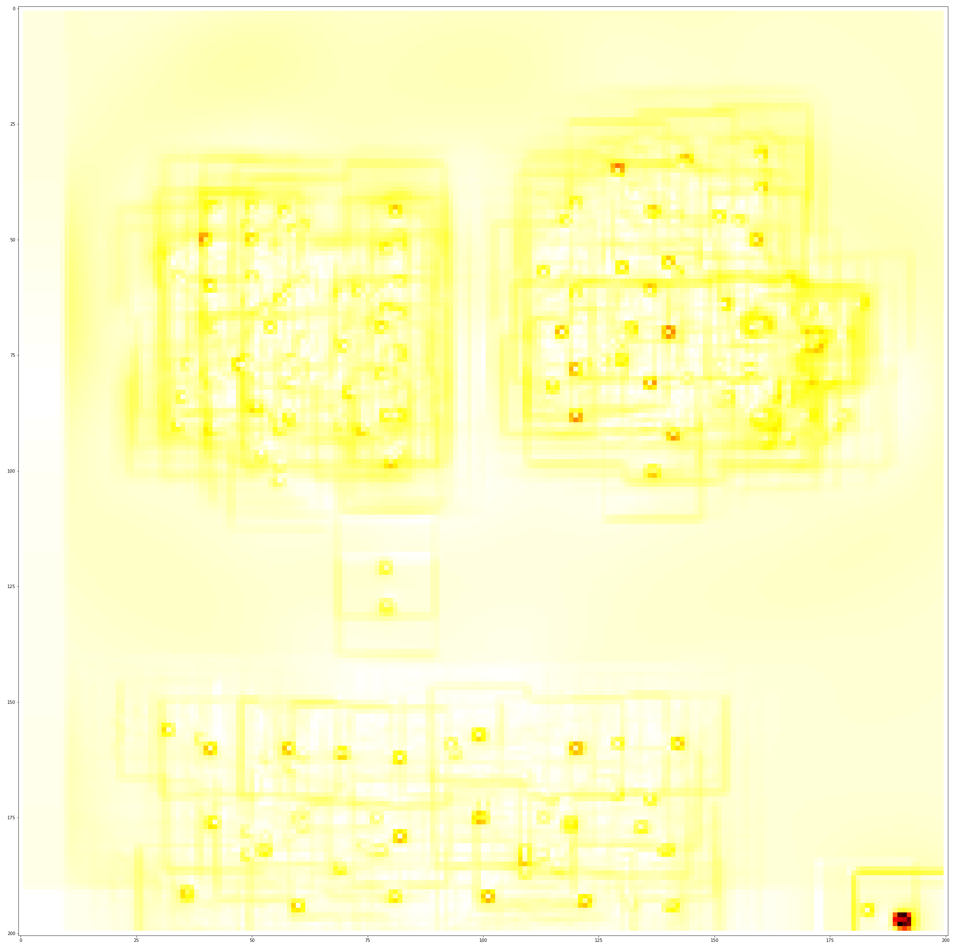
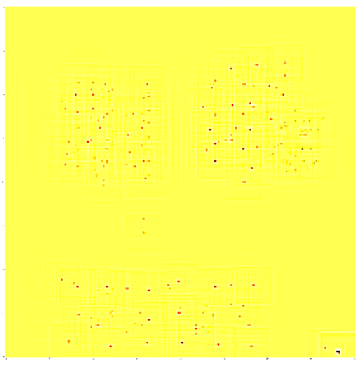
Preprocessing – Sharpening Filters
Power
 | Average Pearson correlation value
Power vs No filter | 0.2068
Power vs Sobel | 0.1931
Power vs Prewitt | 0.1931
Power vs Laplacian | 0.6529
Sharpening filters
  First order derivative kernel
    Sobel, Prewitt
  Second order derivative kernel
    Laplacian
Comparison
  Average Pearson correlation value for all training data
    Power vs (No filter, Sobel, Prewitt and Laplacian)
No filter (original)
Sobel
Prewitt
Laplacian

Slide 13
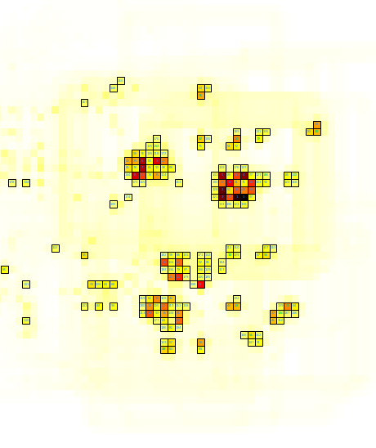
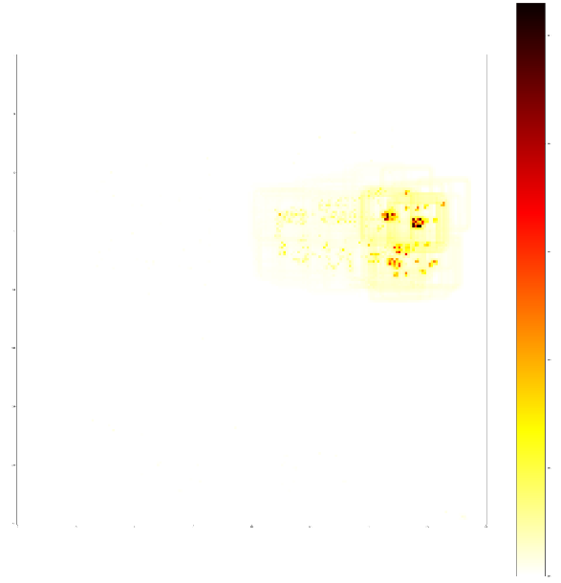
Tile Selection based on Standard Deviation
Select N tiles based on their standard deviation (within 17,000 images)
All 16 operating-POIs are selected when N=200.
11
7
6
1
Standard deviation map
12
8
13
2
10
5
9
14
15
0
3
4

Slide 14
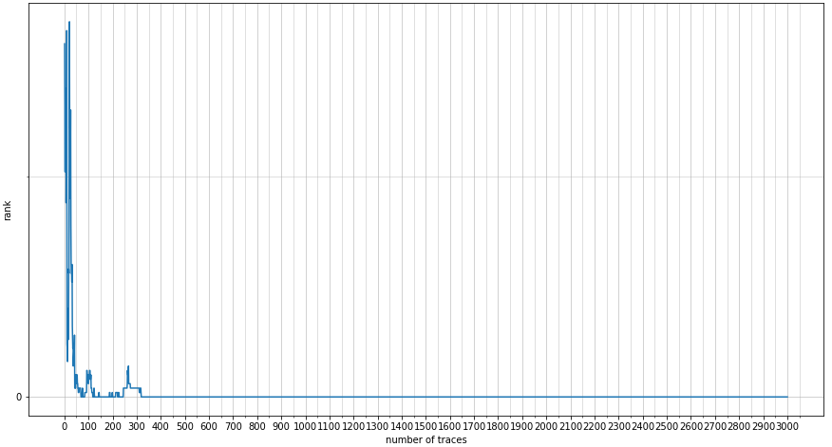
Evaluation Metrics
Cross entropy loss
  Use validation loss to choose the best number of POI
Ranking
  Compute all labels’ log probabilities for each of 3,000 traces
  Transform from label to key and obtain key’s log probability
  Sort correct key’s rank among all candidates while accumulating the log probability from trace 1 to 3,000.
RTD (required traces to disclose)
  Min no. of traces required for a correct key to stay at rank 0 in a stable state ➔ The less, the easier to crack a byte.
Correct key’s rank
Key rank stays 0 from 318 to 3000

Slide 15
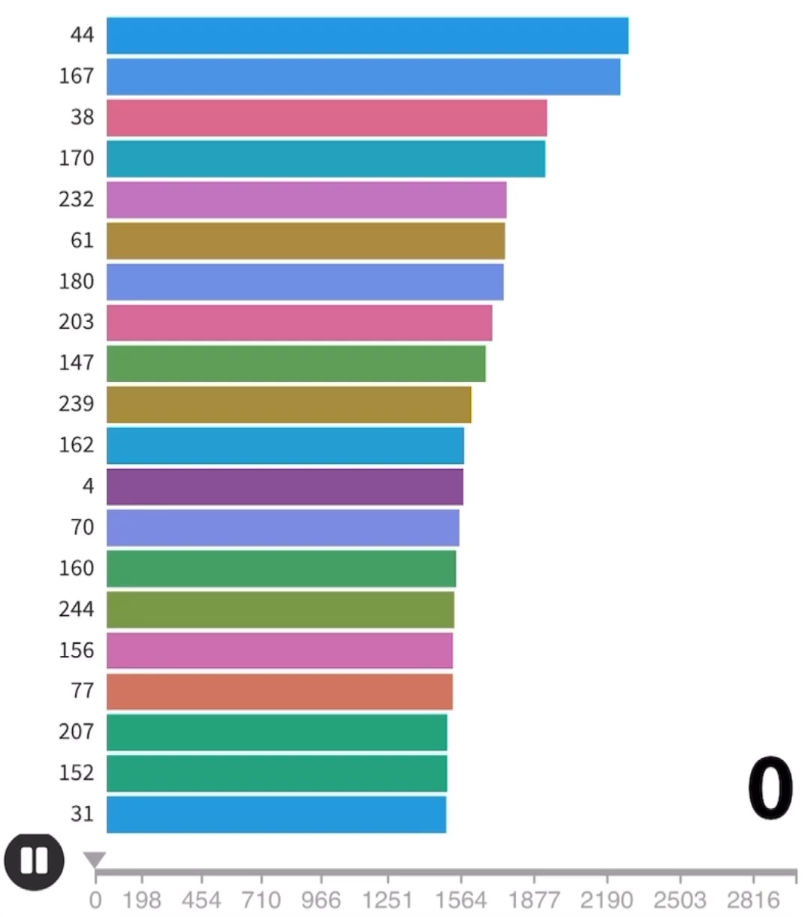
Rank & RTD
A racing bar chart to simulated the accumulation of keys’ log probabilities and their ranking
  Correct key is 221 (0xDD)
  221 stays at rank 0 from 26 to 3,000 ➔ RTD = 25

Slide 16
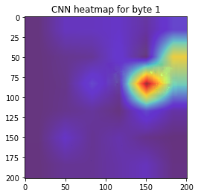
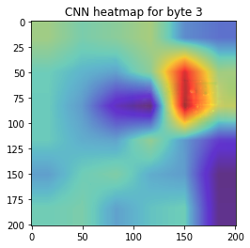
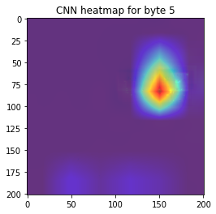
Image Heatmap via CNN
Objective
  Acquire the heatmap of an chip using CNN for classification
Steps
  Train model with full size chip thermal images
  Use backpropagation to get the heatmap of an image
Result

Slide 17
POI Search: Lineup Selection
Objective
  POI search by lineup selection via MLP
Result
  200 ➔ 137 POI for byte 0
Remark: For trials that can not find the key within 3,000 traces
(ex: before 49 POI), its RTD is recorded as 3,000 + correct key rank
Not able to crack within 3000 traces
Best point where the loss is the lowest

Slide 18
POI Search: Sequential Forward Selection
Objective
  POI search by sequential forward selection via MLP
Result
  137 ➔ 8 POI for byte 0
Operating POI for byte0 is No. 49
with coordinate (94, 161)
POI59
(94, 162)
POI123
(93, 161)
POI55
(93, 162)
POI140
(88, 150)
POI118
(81, 114)
POI186
(91, 163)
POI87
(94, 166)
POI49
(94, 161)

Slide 19
Summary
Conclusions
  Location depended side-channel attack
    Decrypted AES-128 using full-chip temperature image and selected POI
  Leakage points detection
    Best POI number search gives precise leakage tiles’ location
Future work
  Other efficient classifiers
  From heuristics to exhaustive search of POI
    200 ➔ 137➔ 8 ➔ ???
  Test attacking performance with other filters
  Test with different types of emission

