Slide 1
ML-based Side-Channel Attack for POI Selection in Thermal Emission
J.-S. Roger Jang (張智星)
MIR Lab, CSIE Dept.
National Taiwan University
jang@mirlab.org, http://mirlab.org/jang

Slide 2
Project Summary
Our goals
Decrypt AES-128 using thermal map (non-invasive)
Locate leakage tiles on a chip
Assumptions
Plaintext (input) and encrypted text (output) are known.
Large amount of I/O data are available.
Methods
AES-128 encrypts within a 4x4 matrix
Build 16 ML models, each with 256 classes
Input: thermal map
Output: value of a byte, 0~255
Byte 0 | Byte 4 | Byte 8 | Byte 12
Byte 1 | Byte 5 | Byte 9 | Byte 13
Byte 2 | Byte 6 | Byte 10 | Byte 14
Byte 3 | Byte 7 | Byte 11 | Byte 15

Slide 3
Flowchart of Proposed Approaches
Preprocessing
Standard deviation
POI selection
Check invalid inputs
Sharpen images
Attack model training
Calculate standard deviation for each pixel
Lineup model
Image heatmap model
Best POI number model
Side-channel attack
Evaluation metrics
Rank
Require traces to disclose (RTD)
Top-5 accuracy
Leakage tiles identification
Monitor the changes of loss response curve
Loss
Sequential forward selection

Slide 4
Dataset
Full-chip thermal images
Average temperature during an encryption process using a given plaintext (based on Ansys’ simulation tool)
Size: 201 x 201 pixels, 1 pixel= 10 μm x 10 μm
Amount: 20,000 images, 17,000/3,000 for training/test
Plaintext and key
20,000 different plaintext, such as
[64, 4E ,7F ,36, C3, D6, 6B, 78, 88, C6, 93, 87, F4, 33, A4, 0E]
A single key
[00, 11, 22, 33, 44, 55, 66, 77, 88, 99, AA, BB, CC, DD, EE, FF]
Tile: each pixel
Trace: each image

Slide 5
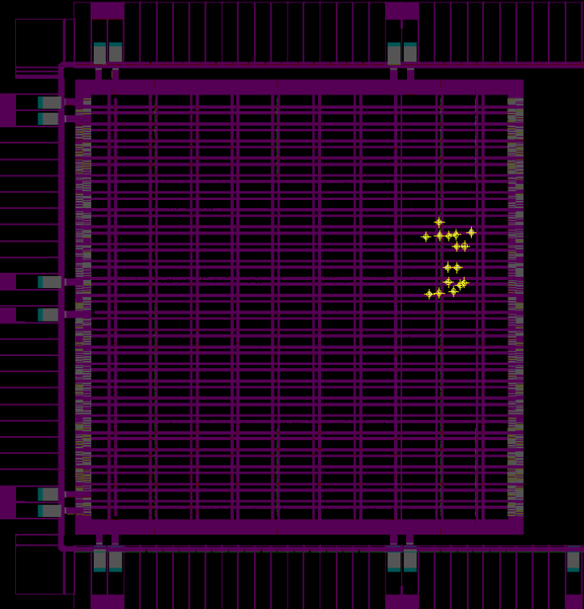
Operating POI in a Thermal Map
Byte 0 | Byte 4 | Byte 8 | Byte 12
Byte 1 | Byte 5 | Byte 9 | Byte 13
Byte 2 | Byte 6 | Byte 10 | Byte 14
Byte 3 | Byte 7 | Byte 11 | Byte 15
Operating POI (points of interest)
16 tiles where AES encryption is processed
Most leakage tiles for each byte
To be identified by machine learning
Detailed locations of
16 operating POI
AES-128 SoC design[1],
with 16 operating POI
Thermal map
Byte
11
Byte
6
Byte
7
Byte
13
Byte
12
Byte
1
201pixels
Byte
8
Byte
2
Byte
10
Byte
5
Byte
14
Byte
15
Byte
0
Byte
3
Byte
4

Slide 6
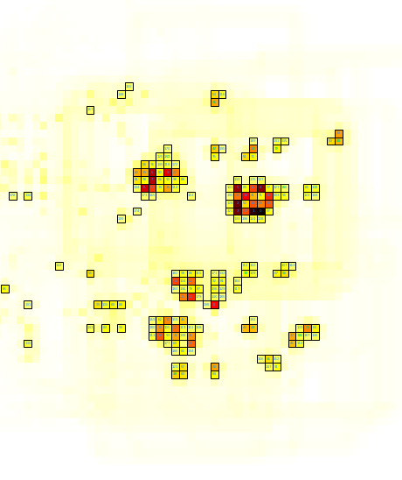
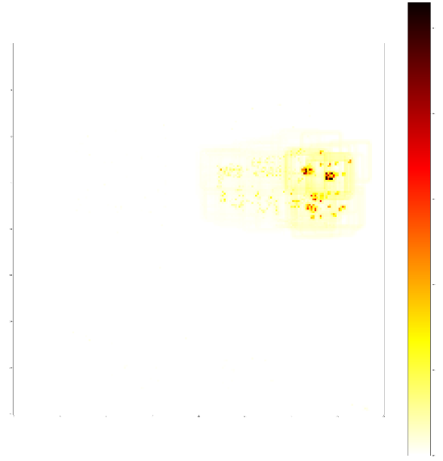
Tile Selection based on Standard Deviation
Select N tiles based on their standard deviation (within 17,000 images)
All 16 operating-POIs are selected when N=200.
11
7
6
1
Standard deviation map
12
8
13
2
10
5
9
14
15
0
3
4

Slide 7
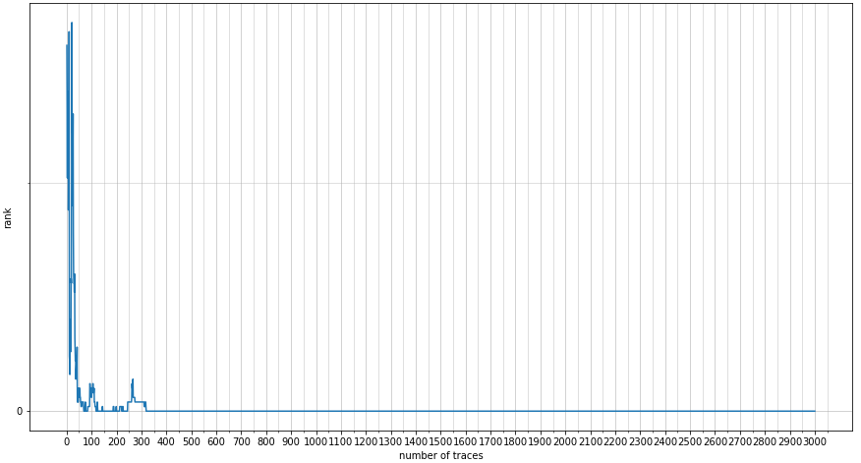
Evaluation Metrics
Cross entropy loss
Use validation loss to choose the best number of POI
Ranking
Compute all labels’ log probabilities for each of 3,000 traces
Transform from label to key and obtain key’s log probability
Sort correct key’s rank among all candidates while accumulating the log probability from trace 1 to 3,000.
RTD (required traces to disclose)
Min no. of traces required for a correct key to stay at rank 0 in a stable state ➔ The less, the easier to crack a byte.
Correct key’s rank
Key rank stays 0 from 318 to 3000

Slide 8
POI Search: Lineup Selection
Objective
POI search by lineup selection via MLP
Result
200 ➔ 137 POI for byte 0
Remark: For trials that can not find the key within 3,000 traces
(ex: before 49 POI), its RTD is recorded as 3,000 + correct key rank
Not able to crack within 3000 traces
Best point where the loss is the lowest

Slide 9
POI Search: Sequential Forward Selection
Objective
POI search by sequential forward selection via MLP
Result
137 ➔ 8 POI for byte 0
Operating POI for byte0 is No. 49
with coordinate (94, 161)
POI59
(94, 162)
POI123
(93, 161)
POI55
(93, 162)
POI140
(88, 150)
POI118
(81, 114)
POI186
(91, 163)
POI87
(94, 166)
POI49
(94, 161)

Slide 10
Summary
Conclusions
Location depended side-channel attack
Decrypted AES-128 using full-chip temperature image and selected POI
Leakage points detection
Best POI number search gives precise leakage tiles’ location
Future work
Other efficient classifiers
From heuristics to exhaustive search of POI
200 ➔ 137➔ 8 ➔ ???
Test attacking performance with other filters
Test with different types of emission

