Slide 1
Performance Indices for Binary Classification
張智星 (Roger Jang)
jang@mirlab.org
http://mirlab.org/jang
多媒體資訊檢索實驗室
台灣大學 資訊工程系

Slide 2
Confusion Matrix for Binary Classification
Terminologies used in a confusion matrix
Commonly used formulas
Predicted
0: negative
1: positive
TN (true negative)
Correct rejection
00
FP (false positive)
False alarm
Type-1 error
01
N=
TN+FP
0: negative
Target
FN (false negative)
Miss
Type-2 error
10
TP (true positive)
Hit
11
1: positive
P=
FN+TP

Slide 3
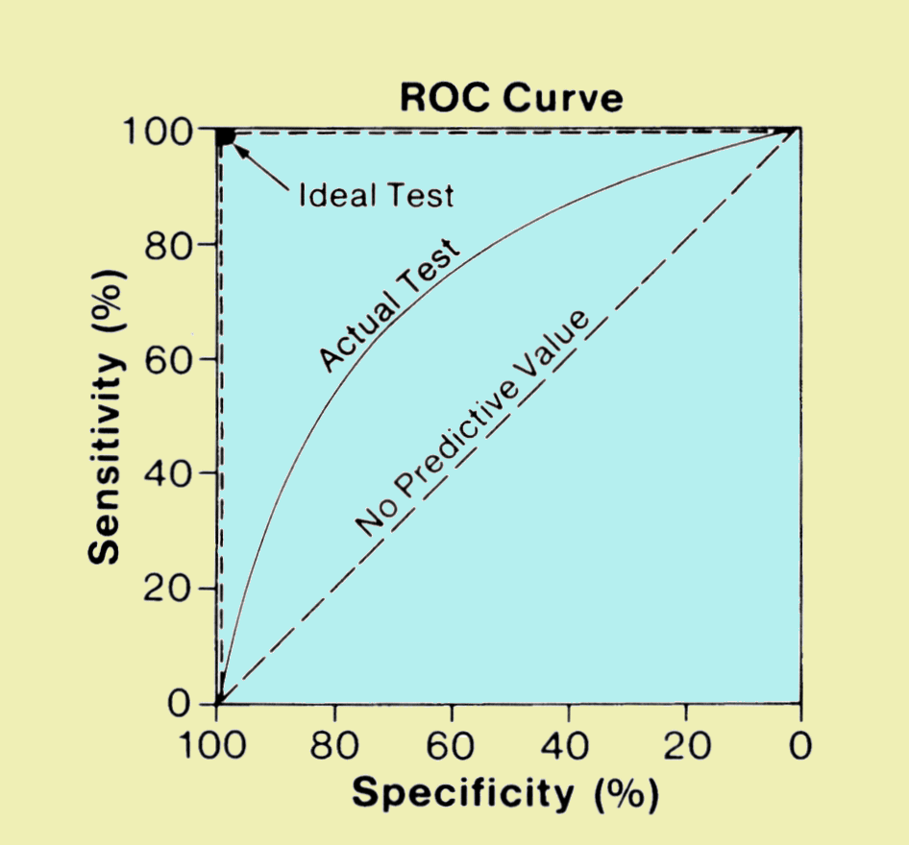
ROC Curve and AUC
ROC: receiver operating characteristic
Plot of TPR vs FPR, parameterized by a threshold for the predicted class in [0, 1]
AUC: area under the curve
AUC for ROC is a commonly used performance index for binary classification
AUC=1 ➔ perfect
AUC=0.5 ➔ bad
AUC is defined clearly is the predicted class is continuous within [0, 1].
Source:
http://www.sprawls.org/ppmi2/IMGCHAR

Slide 4
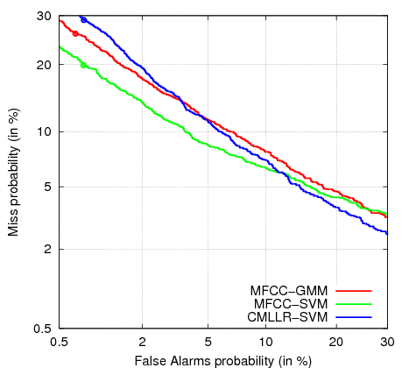
DET Curve
DET: Detection error tradeoff
Plot of FNR (miss) vs FPR (false alarm)
Up-side-down view of ROC
Preserve the same info as ROC
Easier to interpret
Source:
http://rs2007.limsi.fr/index.php/Constrained_MLLR_for_Speaker_Recognition

Slide 5
Example of DET Curve
detGet.m (in MLT)

Slide 6
Example of DET Curve (2)
detPlot.m (in MLT)

Slide 7

Class Probability
How to create class probability?
$prob=\frac{1}{1+e^{−a({ll}_{1}−{ll}_{0})}}$

