Slide 1
Representative Vector in a Set
J.-S. Roger Jang (張智星)
MIR Lab, CSIE Dept.
National Taiwan University
jang@mirlab.org, http://mirlab.org/jang

Slide 2
Outline
Problem definition
Basic definition
Distance functions
Representative element in a set of
Numbers
Vectors
Same dim.
Different dim.
Objects

Slide 3
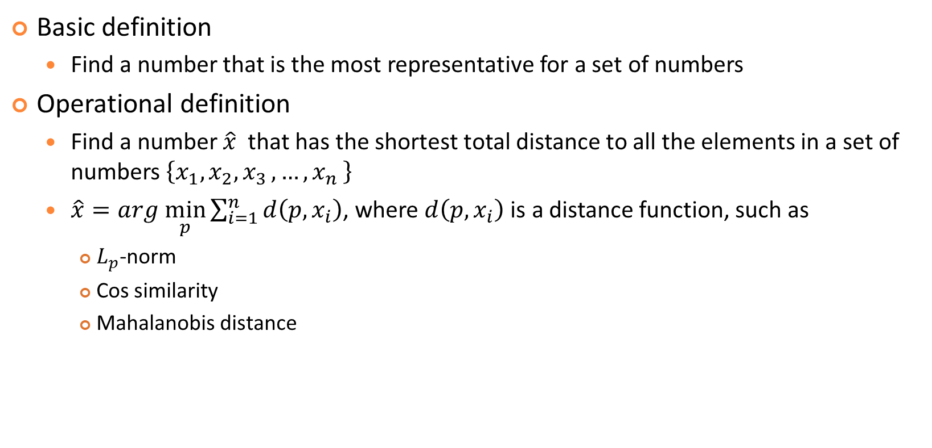
Representative Number: Definition
Basic definition
Find a number that is the most representative for a set of numbers
Operational definition
Find a number $\hat{x}$ that has the shortest total distance to all the elements in a set of numbers $\left\{x_{1},x_{2}{,x}_{3}, …{,x}_{n}\right\}$
$\hat{x}=arg \min_{p}{\sum_{i=1}^{n}{d\left(p, x_{i}\right)}}$, where $d\left(p, x_{i}\right)$ is a distance function, such as
$L_{p}$-norm
Cos similarity
Mahalanobis distance

Slide 4

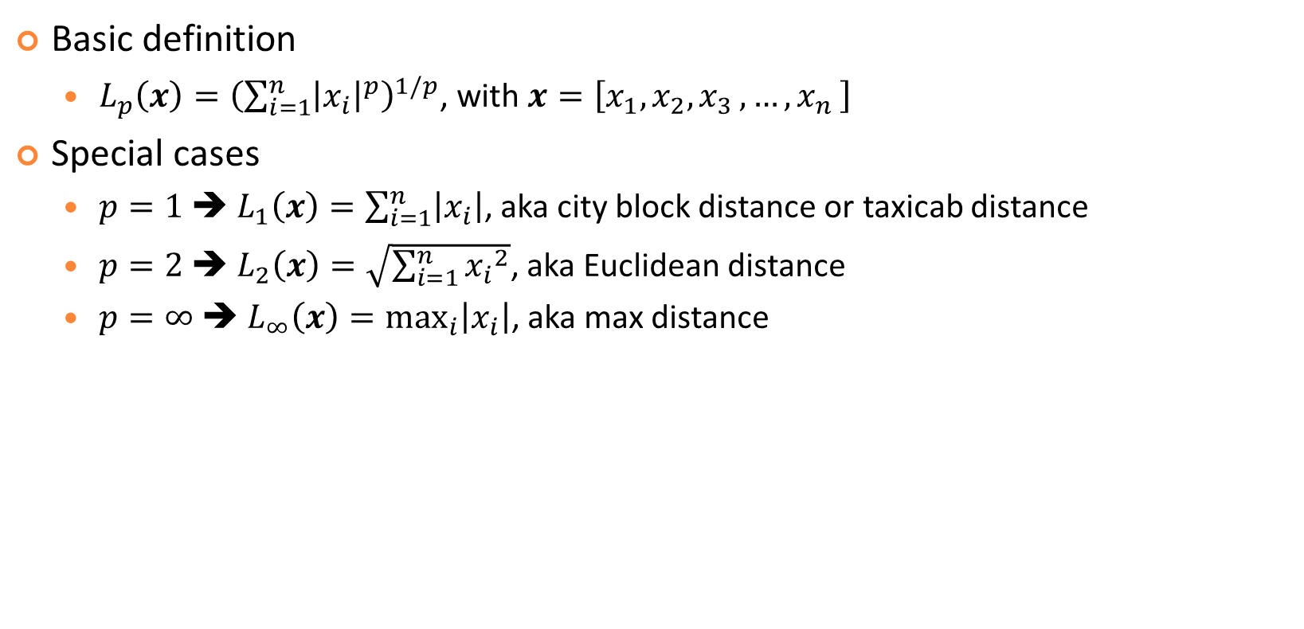
Distance Function: $L_{p}$-norm
Basic definition
$L_{p}\left(x\right)={\left(\sum_{i=1}^{n}{{\left|x_{i}\right|}^{p}}\right)}^{1/p}$, with $x=\left[x_{1},x_{2}{,x}_{3}, …{,x}_{n}\right]$
Special cases
$p=1$➔ $L_{1}\left(x\right)=\sum_{i=1}^{n}{\left|x_{i}\right|}$, aka city block distance or taxicab distance
$p=2$➔ $L_{2}\left(x\right)=\sqrt{\sum_{i=1}^{n}{{x_{i}}^{2}}}$, aka Euclidean distance
$p=∞$➔ $L_{∞}\left(x\right)=\max_{i}\left|x_{i}\right|$, aka max distance

Slide 5
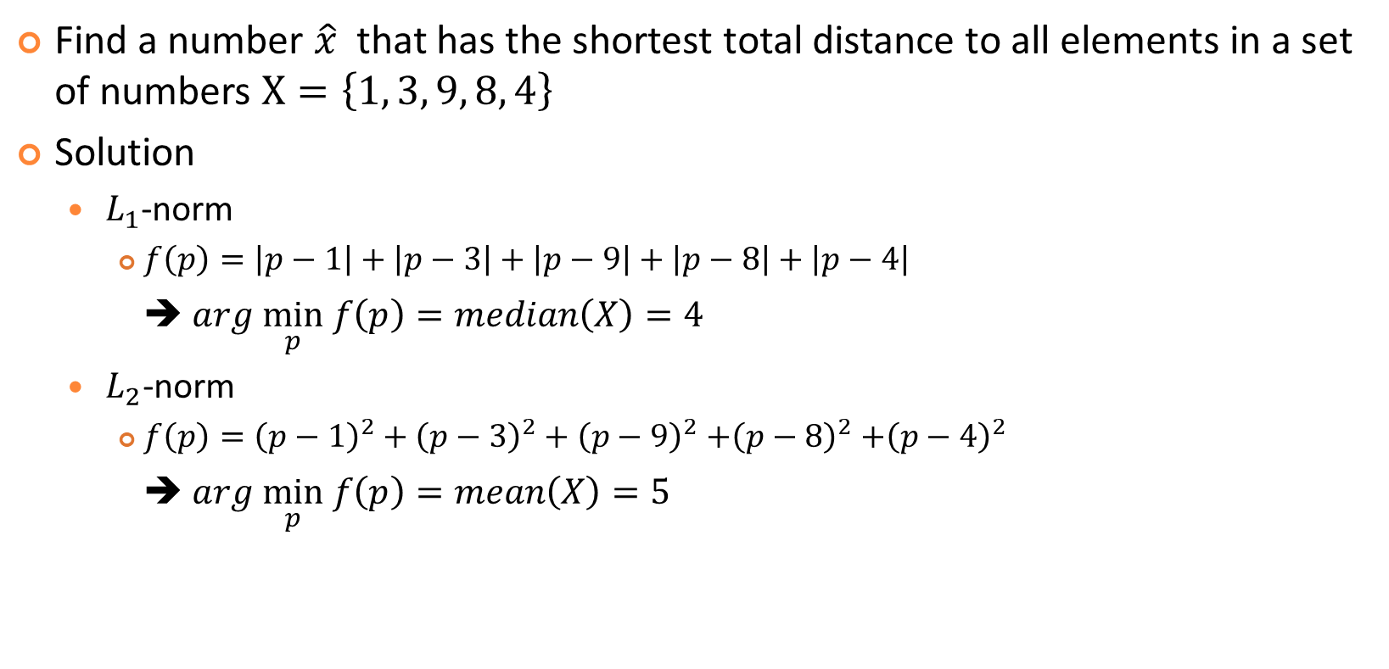
Representative Number: Examples
Find a number $\hat{x}$ that has the shortest total distance to all elements in a set of numbers $X=\left\{1, 3, 9, 8, 4\right\}$
Solution
$L_{1}$-norm
$f\left(p\right)=\left|p−1\right|+\left|p−3\right|+\left|p−9\right|+\left|p−8\right|+\left|p−4\right|$
➔ $arg \min_{p} f\left(p\right)=median\left(X\right)=4$
$L_{2}\text{−}\text{norm}$
$f\left(p\right)={\left(p−1\right)}^{2}+{\left(p−3\right)}^{2}+{\left(p−9\right)}^{2}$ $+{\left(p−8\right)}^{2}$ $+{\left(p−4\right)}^{2}$
➔ $arg \min_{p} f\left(p\right)=mean\left(X\right)=5$

Slide 6
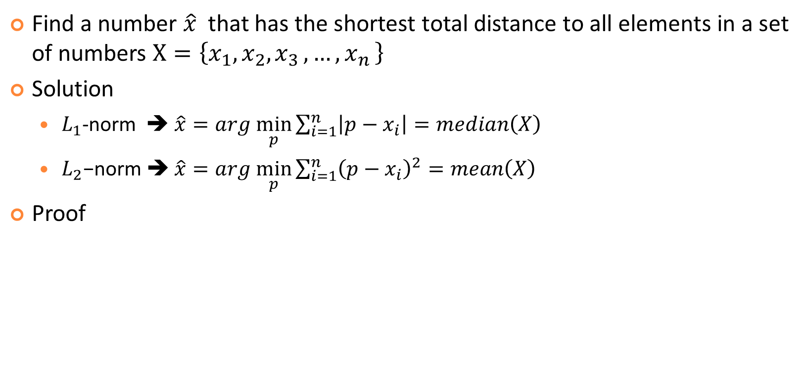
Representative Number: General Cases
Find a number $\hat{x}$ that has the shortest total distance to all elements in a set of numbers $X=\left\{x_{1},x_{2}{,x}_{3}, …{,x}_{n}\right\}$
Solution
$L_{1}$-norm ➔ $\hat{x}=arg \min_{p}\sum_{i=1}^{n}{\left|p−x_{i}\right|}=median\left(X\right)$
$L_{2}\text{−}\text{norm}$ ➔ $\hat{x}=arg \min_{p}\sum_{i=1}^{n}{{\left(p−x_{i}\right)}^{2}}=mean\left(X\right)$
Proof
Both with complexity O(n)
More robust to outliers
More efficient in computing

Slide 7

Representative Vector of Same Dim.
Find a vector $\hat{x}$ that has the shortest total distance to all vectors of the same dim. in a set $X=\left\{x_{1},x_{2}, x_{3}, …,x_{n}\right\}$
Solution
$L_{1}$-norm ➔ $\hat{x}=arg \min_{p}\sum_{i=1}^{n}{L_{1}\left(p−x_{i}\right)}=median\left(X\right)$
$L_{2}\text{−}\text{norm}$ ➔ $\hat{x}=arg \min_{p}\sum_{i=1}^{n}{{\left\|p−x_{i}\right\|}^{2}}=mean\left(X\right)$

Slide 8
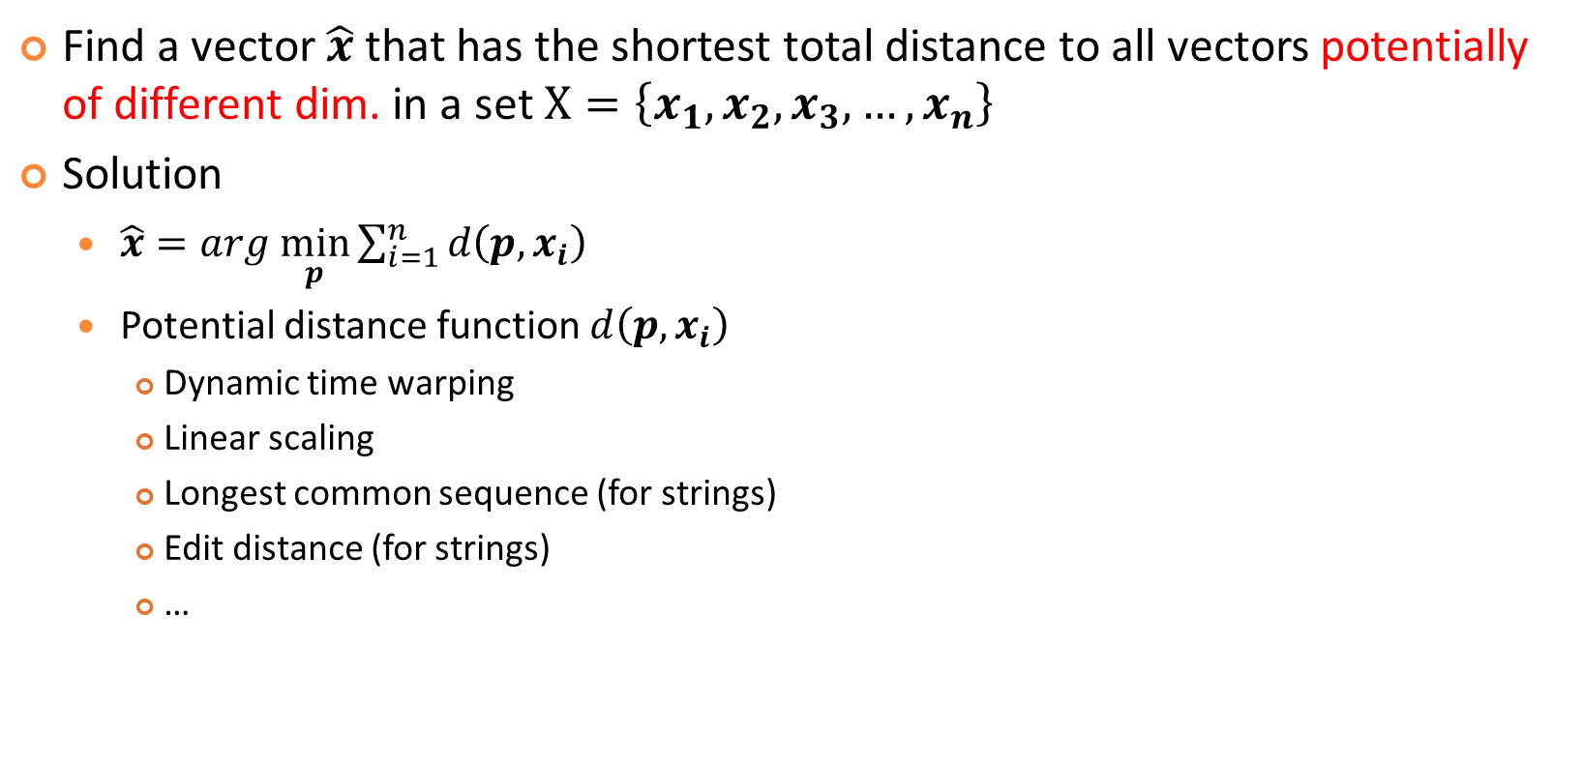
Representative Vector of Different Dim.
Find a vector $\hat{x}$ that has the shortest total distance to all vectors potentially of different dim. in a set $X=\left\{x_{1},x_{2}, x_{3}, …,x_{n}\right\}$
Solution
$\hat{x}=arg \min_{p}\sum_{i=1}^{n}{d\left(p, x_{i}\right)}$
Potential distance function $d\left(p, x_{i}\right)$
Dynamic time warping
Linear scaling
Longest common sequence (for strings)
Edit distance (for strings)
…

Slide 9

Representative Object
Find an object $\hat{x}$ that has the shortest total distance to all the objects in a set of objects $X=\left\{x_{1},x_{2}, x_{3}, …,x_{n}\right\}$
Solution
$\hat{x}=arg \min_{p}\sum_{i=1}^{n}{d\left(p, x_{i}\right)}$, where $d\left(p, x_{i}\right)$ is a distance function

