Slide 1
Introduction to
Recurrent Neural Networks (RNN)
J.-S. Roger Jang (張智星)
jang@mirlab.org
http://mirlab.org/jang
MIR Lab, CSIE Dept.
National Taiwan University

Slide 2
NN vs. RNN
Two types of tasks in machine learning
  Tasks of fixed-dimension input
    MNIST database (28x28 inputs), Iris dataset (4 inputs), …
  Tasks of variable-dimension input
    Text, speech, singing…
So we have two types of classifiers
  Static classifiers with fixed-dimension input
    KNNC, QC, NBC, SVM, NN, random forest, …
  Sequence classifiers for variable-dimension input
    HMM, RNN, CRF…

Slide 3
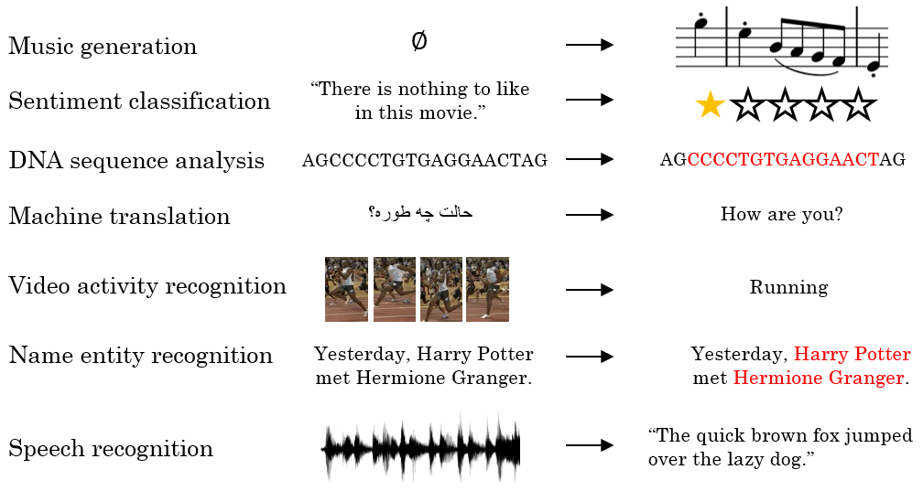
Examples of Sequence Data

Slide 4
Recurrent Neural Networks (RNN)
RNN
  NN that uses values from the previous step
  Or equivalently, NN that has memory
Advantage of RNN
  Good for sequence input
Example
  Compute the cumulated sum of a sequence
    Input=[1 2 3], output=6
    Input=[1 3 4 5 2 4 3], output=22
  Output 1 if the number of 1s is odd
    Input= 100011, output=1
    Input=1000010101, output=0

Slide 5
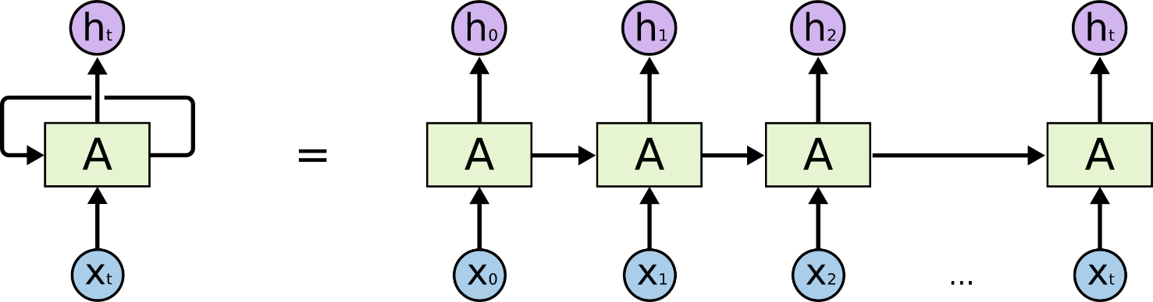
Unfold in Time for RNN
RNNs can be transformed into a feedforward static mapping via unfold in time
Training is based on BPTT (back propagation through time) over the unfolded network
Unfolded network!

Slide 6
Vanilla RNN Cell and Its Unfolded Network
The vanilla RNN cell
Unfolded network
  Feedforward, ready for BP (backpropagation)
x_{t}
h_{t-1}
W
y₁
y₂
y₃
h_{t}
x₁ h₀
x₂ h₁
h₁
x₃ h₂
h₂
h₃
Weights are shared
over time!

Slide 7
BP for Unfolded Network
Unfolded network ➔ Feedforward ➔ BP as usual!
Gradient vanishing problem ➔ Especially severe in RNN
h₀
x₁
h₁
x₂
h₂
x₃
h₃
y₁
y₂
y₃
y

Slide 8
Input-Output Scenarios
Single - Single
Feed-forward Network
Single - Multiple
Image Captioning
Multiple - Single
Sentiment Classification
Multiple - Multiple
Translation
Image Captioning

Slide 9
Long Short-Term Memory (LSTM)
Add a memory cell that is not subject to matrix multiplication or squishing, thereby avoiding gradient vanishing
x_{t}
h_{t-1}
h_{t}
c_{t-1}
c_{t}
S. Hochreiter and J. Schmidhuber, Long short-term memory, Neural Computation 9 (8), pp. 1735–1780, 1997

Slide 10



The LSTM Cell
x_{t}
h_{t-1}
W_{g}
Cell
c_{t}
h_{t} $=tanh⁡c_{t}$
$$g_{t}=tanh⁡W_{g}\left(\begin{matrix}x_{t} \\ h_{t−1}\end{matrix}\right)$$
$$c_{t}=c_{t−1}+g_{t}$$
* Dashed line indicates time-lag

Slide 11
The LSTM Cell
x_{t}
h_{t-1}
W_{g}
Cell
c_{t}
h_{t}
$$g_{t}=tanh⁡W_{g}\left(\begin{matrix}x_{t} \\ h_{t−1}\end{matrix}\right)$$

Slide 12


The LSTM Cell
x_{t} h_{t-1}
i_{t}
W_{i}
Input Gate
$$i_{t}=σ\left(W_{i}\left(\begin{matrix}x_{t} \\ h_{t−1}\end{matrix}\right)+b_{i}\right)$$
x_{t}
h_{t-1}
W_{g}
Cell
.
c_{t}
h_{t}
$$g_{t}=tanh⁡W_{g}\left(\begin{matrix}x_{t} \\ h_{t−1}\end{matrix}\right)$$
$$c_{t}=c_{t−1}+i_{t}⨀ g_{t}$$

Slide 13


The LSTM Cell
x_{t} h_{t-1}
x_{t} h_{t-1}
i_{t}
W_{i}
W_{o}
Input Gate
Output Gate
o_{t}
$$i_{t}=σ\left(W_{i}\left(\begin{matrix}x_{t} \\ h_{t−1}\end{matrix}\right)+b_{i}\right)$$
$$o_{t}=σ\left(W_{o}\left(\begin{matrix}x_{t} \\ h_{t−1}\end{matrix}\right)+b_{o}\right)$$
x_{t}
h_{t-1}
W_{g}
Cell
.
.
c_{t}
h_{t}
$$h_{t}=o_{t}⨀ tanh⁡c_{t}$$
$$g_{t}=tanh⁡W_{g}\left(\begin{matrix}x_{t} \\ h_{t−1}\end{matrix}\right)$$
$$c_{t}=c_{t−1}+i_{t}⨀{ g}_{t}$$

Slide 14


The LSTM Cell
x_{t} h_{t-1}
x_{t} h_{t-1}
i_{t}
W_{i}
W_{o}
Input Gate
Output Gate
o_{t}
$$i_{t}=σ\left(W_{i}\left(\begin{matrix}x_{t} \\ h_{t−1}\end{matrix}\right)+b_{i}\right)$$
$$o_{t}=σ\left(W_{o}\left(\begin{matrix}x_{t} \\ h_{t−1}\end{matrix}\right)+b_{o}\right)$$
x_{t}
h_{t-1}
W_{g}
Cell
.
.
c_{t}
h_{t}
$$h_{t}=o_{t}⨀ tanh⁡c_{t}$$
$$g_{t}=tanh⁡W_{g}\left(\begin{matrix}x_{t} \\ h_{t−1}\end{matrix}\right)$$
$$c_{t}={f_{t}⨀c}_{t−1}+i_{t}⨀ g_{t}$$
Forget Gate
f_{t}
$$f_{t}=σ\left(W_{f}\left(\begin{matrix}x_{t} \\ h_{t−1}\end{matrix}\right)+b_{f}\right)$$
W_{f}
x_{t} h_{t-1}

Slide 15
Deep RNN
RNN with multiple hidden layers
y₁
y₂
y₃
y₄
y₅
y₆
x₁
x₂
x₃
x₄
x₅
x₆

Slide 16
Bidirectional RNNs
RNNs can process the input sequence in forward and in the reverse direction
y₁
y₂
y₃
y₄
y₅
y₆
x₁
x₂
x₃
x₄
x₅
x₆

Slide 17
RNN for Singing Transcription
Basic idea
  x_{i} ➔ Feature vector of frame i
  o_{i} ➔ Output vector of frame i = [onset prob, offset prob]
Questions
  How to reinforce the correct order of onset/offset?
  How to determine the note pitch (pitch between onset and offset)?
…

Slide 18
References
Some course material taken from the following slides
  http://slazebni.cs.illinois.edu/spring17/lec02_rnn.pptx by Arun Mallya
  http://fall97.class.vision/slides/5.pptx
  https://cs.uwaterloo.ca/~mli/Deep-Learning-2017-Lecture6RNN.ppt
Videos
  https://www.youtube.com/watch?v=xCGidAeyS4M by李宏毅
  https://www.youtube.com/watch?v=rTqmWlnwz_0 by李宏毅
  https://www.youtube.com/watch?v=lycKqccytfU

