Slide 1
Quadratic Classifiers (QC)
J.-S. Roger Jang (張智星)
jang@mirlab.org
http://mirlab.org/jang
MIR Lab, CSIE Dept.
National Taiwan University

Slide 2
Review: PDF Modeling
Goal:
Find a PDF (probability density function) that can best describe a given dataset
Steps:
Select a class of parameterized PDF
Identify the parameters via MLE (maximum likelihood estimate) based on a given set of sample data
Commonly used PDFs:
Multi-dimensional Gaussian PDF
Gaussian mixture models (GMM)

Slide 3
PDF Modeling for Classification
Procedure for classification based on PDF
Training stage: PDF modeling of each class based on the training dataset
Test stage: For each entry in the test dataset, pick the class with the max. PDF
Commonly used classifiers:
Quadratic classifiers, with n-dim. Gaussian PDF
Gaussian-mixture-model classifier, with GMM PDF

Slide 4
1D Gaussian PDF Modeling
1D Gaussian PDF:
MLE of μ (mean) and σ² (variance)
Quiz!
Quiz!
Sometimes n-1 is used
instead of n!

Slide 5
D-dim. Gaussian PDF Modeling
D-dim Gaussian PDF:
MLE of μ (mean) and Σ (covariance matrix)
Sometimes n-1 is used
instead of n!

Slide 6
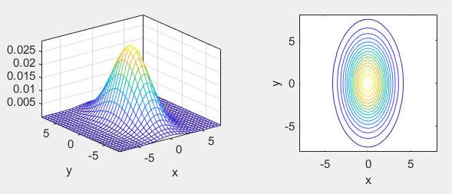
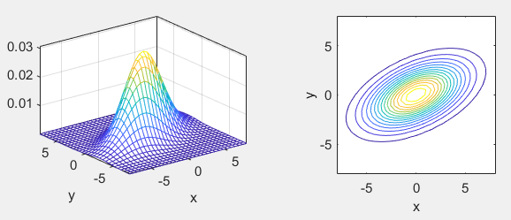

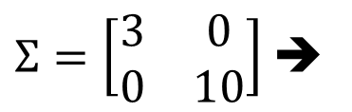
2D Gaussian PDF
Bivariate normal distribution:
PDF
Contours
$Σ=\left[\begin{matrix}3 & 0 \\ 0 & 10\end{matrix}\right]$ ➔
$Σ=\left[\begin{matrix}9 & 3 \\ 3 & 4\end{matrix}\right]$ ➔

Slide 7
Training and Test Stages of QC
Quiz!
Training stage
Identify the Gaussian PDF of each class via MLE
Test stage
Assign a sample point to the class C by taking class prior into consideration:
Prior!

Slide 8
Characteristics of QC
If each class is modeled by a Gaussian PDF, the decision boundary between any two classes is a quadratic curve.
That is why it is called quadratic classifier.
How to prove it?
Some examples?
Quiz!

Slide 9
QC on Gender Dataset (1/2)
Scatter plot of Gender dataset
ds=prData('gender');
figure; dsScatterPlot(ds);
Notes:
ds=prData('gender');
figure; dsScatterPlot(ds);

Slide 10
QC on Gender Dataset (2/2)
PDF for each class
Decision boundary
ds=prData('gender');
[qcPrm, logLike, recogRate, hitIndex]=qcTrain(ds);
figure; qcPlot(ds, qcPrm, '2dPdf');
figure; qcPlot(ds, qcPrm, 'decBoundary');
Notes:
ds=prData('gender');
[qcPrm, logLike, recogRate, hitIndex]=qcTrain(ds);
figure; qcPlot(ds, qcPrm, '2dPdf');
figure; qcPlot(ds, qcPrm, 'decBoundary');

Slide 11
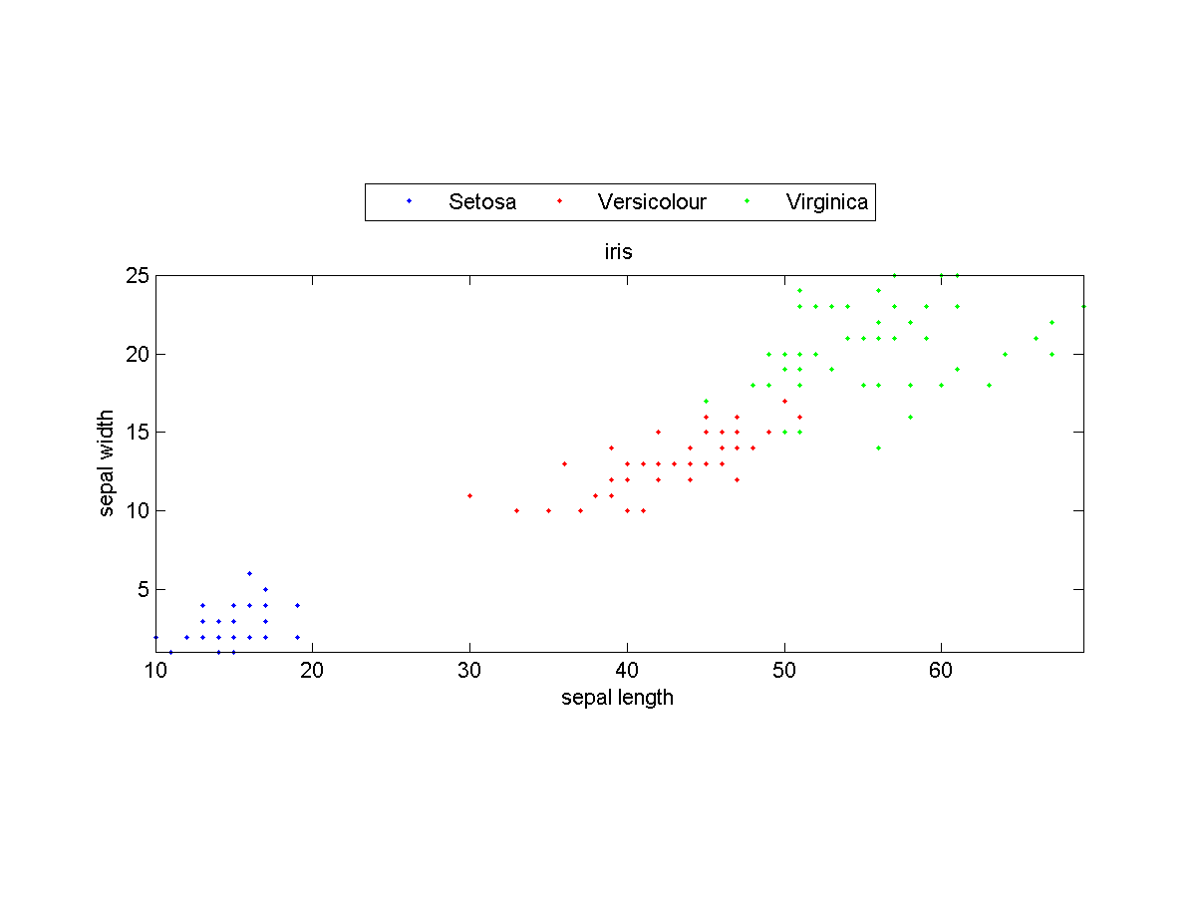
QC on Iris Dataset (1/2)
Scatter plot of Iris dataset (with only the last two dim.)
ds=prData('iris');
ds.input=ds.input(3:4, :);
figure; dsScatterPlot(ds);
Notes:
ds=prData('iris');
ds.input=ds.input(3:4, :);
figure; dsScatterPlot(ds);

Slide 12
QC on Iris Dataset (2/2)
PDF for each class
Dec. boundaries
ds=prData('iris');
ds.input=ds.input(3:4, :);
[qcPrm, logLike, recogRate, hitIndex]=qcTrain(ds);
figure; qcPlot(ds, qcPrm, '2dPdf');
ds.hitIndex=hitIndex; % For plotting
figure; qcPlot(ds, qcPrm, 'decBoundary');
Notes:
ds=prData('iris');
ds.input=ds.input(3:4, :);
[qcPrm, logLike, recogRate, hitIndex]=qcTrain(ds);
figure; qcPlot(ds, qcPrm, '2dPdf');
ds.hitIndex=hitIndex; % Attach hitIndex to DS for plotting
figure; qcPlot(ds, qcPrm, 'decBoundary');

Slide 13
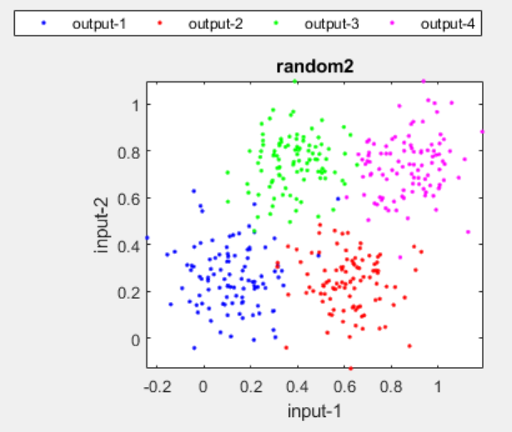
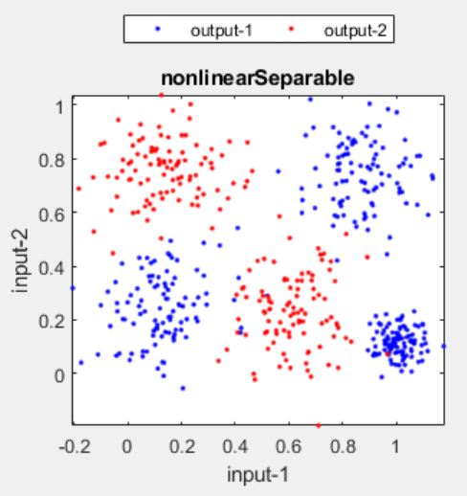
Strength and Weakness of QC
Quiz!
Strength
Easy computation when the dimension d is small
Fast method for computing leave-one-out cross validation
Weakness
QC cannot handle bi-modal data
The covariance matrix (d by d) is big when the dimension d is median large
The inverse of the covariance matrix may not exist
Uni-modal!
Multi-modal!

Slide 14
Fix: Simplified Versions of QC
Quiz!
How to simplified QC
Make the covariance matrix diagonal ➔ Equivalent to naïve Bayes classifiers (proof?)
Make the covariance matrix a constant times an identity matrix
gaussianMle;
This is necessary when Σ of
full covariance is not invertible.

Slide 15
Exercise: Infeasible Datasets for QC
What types of datasets will make QC not usable? Can you give some examples in 2D and 3D? And how to fix it?

