Slide 1
Naïve Bayes Classifiers (NBC)
J.-S. Roger Jang (張智星)
jang@mirlab.org
http://mirlab.org/jang
MIR Lab, CSIE Dept.
National Taiwan University

Slide 2
Assumptions & Characteristics
Assumptions:
Statistical independency between features
Statistical independency between samples
Each feature governed by a feature-wise parameterized PDF (usually a 1D Gaussian)
Characteristics
Simple and easy (That’s why it’s named “naïve ”.)
Highly successful in real-world applications regardless of the strong assumptions

Slide 3
Training and Test Stages of NBC
Quiz!
Training stage
Identify class PDF, as follows.
Identify feature PDF by MLE for 1D Gaussians
Class PDF is the product of all the corresponding feature PDFs
Test stage
Assign a sample to the class by taking class prior into consideration:
In practice, we take log and sum…

Slide 4
NBC for Gender Dataset (1/2)
Scatter plot of Gender dataset
PDF on each features and each class
ds=prData('gender');
figure; dsScatterPlot(ds);
[nbcPrm, logLike, recogRate, hitIndex]=nbcTrain(ds);
figure; nbcPlot(ds, nbcPrm, '1dPdf');
Notes:
ds=prData('gender');
figure; dsScatterPlot(ds);
[nbcPrm, logLike, recogRate, hitIndex]=nbcTrain(ds);
figure; nbcPlot(ds, nbcPrm, '1dPdf');

Slide 5
NBC for Gender Dataset (2/2)
PDF for each class
Decision boundary
Quadratic
decision
boundary
ds=prData('gender');
[nbcPrm, logLike, recogRate, hitIndex]=nbcTrain(ds);
figure; nbcPlot(ds, nbcPrm, '2dPdf');
figure; nbcPlot(ds, nbcPrm, 'decBoundary');
Notes:
ds=prData('gender');
[nbcPrm, logLike, recogRate, hitIndex]=nbcTrain(ds);
figure; nbcPlot(ds, nbcPrm, '2dPdf');
figure; nbcPlot(ds, nbcPrm, 'decBoundary');

Slide 6
NBC for Iris Dataset (1/2)
Scatter plot of Iris dataset (with only the last two dim.)
PDF on each features and each class
ds=prData('iris');
ds.input=ds.input(3:4, :);
figure; dsScatterPlot(ds);
[nbcPrm, logLike, recogRate, hitIndex]=nbcTrain(ds);
figure; nbcPlot(ds, nbcPrm, '1dPdf');
Notes:
ds=prData('iris');
ds.input=ds.input(3:4, :);
figure; dsScatterPlot(ds);
[nbcPrm, logLike, recogRate, hitIndex]=nbcTrain(ds);
figure; nbcPlot(ds, nbcPrm, '1dPdf');

Slide 7
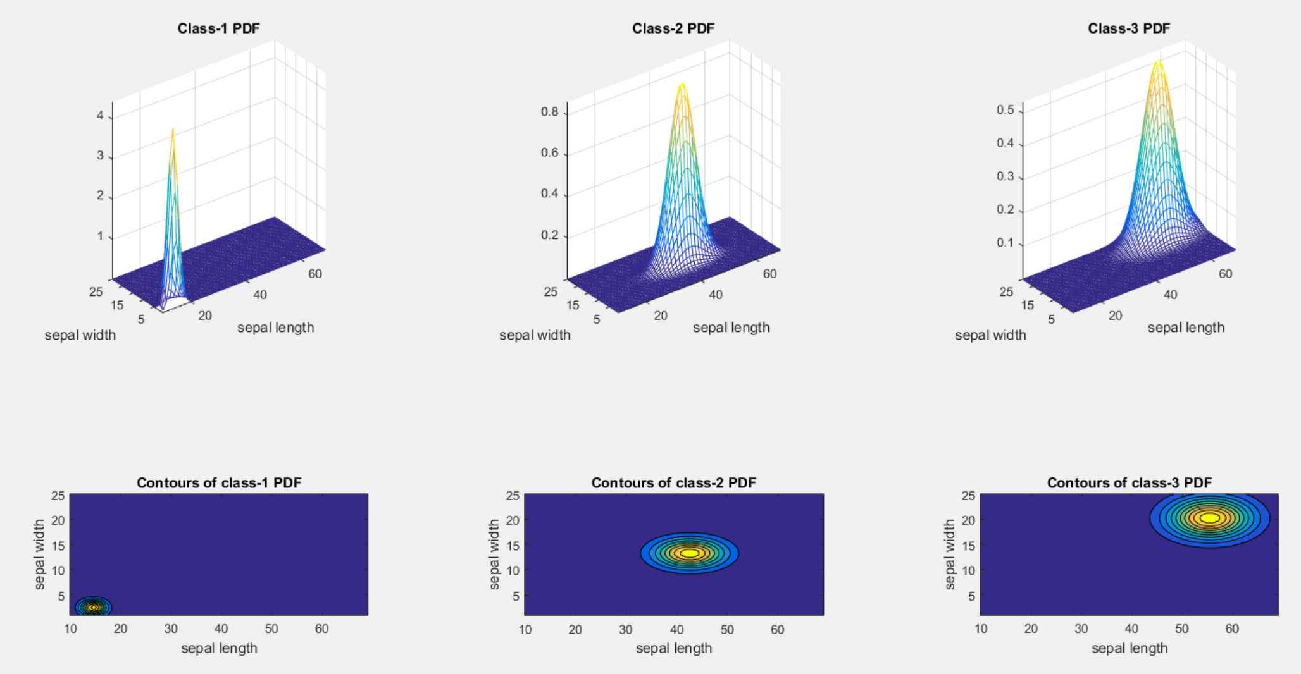
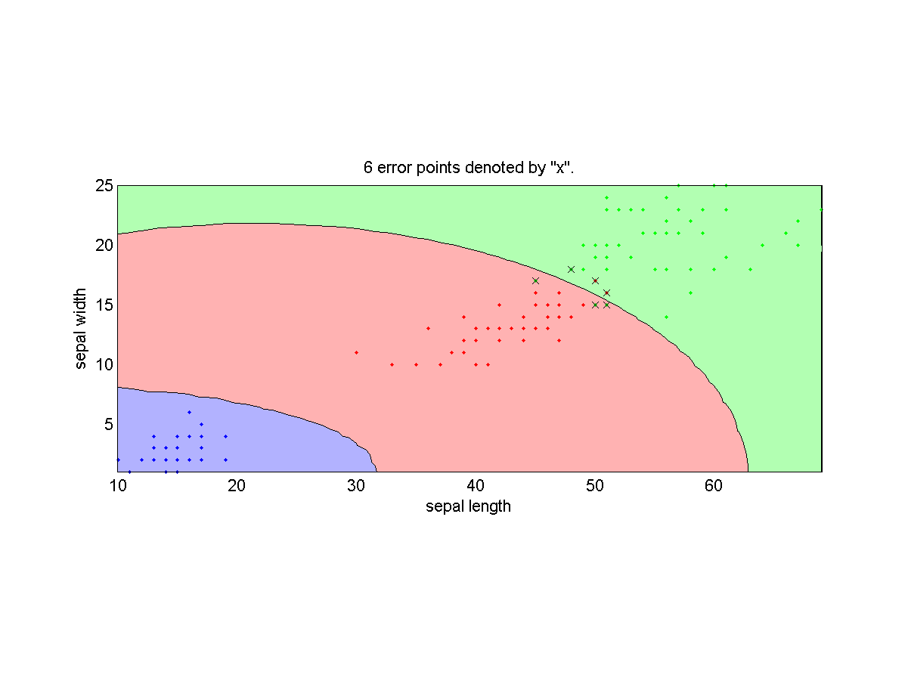
NBC for Iris Dataset (2/2)
PDF for each class
Dec. boundaries
Quadratic
decision
boundary
ds=prData('iris');
ds.input=ds.input(3:4, :);
[nbcPrm, logLike, recogRate, hitIndex]=nbcTrain(ds);
figure; nbcPlot(ds, nbcPrm, '2dPdf');
ds.hitIndex=hitIndex; % For plotting
figure; nbcPlot(ds, nbcPrm, 'decBoundary');
Notes:
ds=prData('iris');
ds.input=ds.input(3:4, :);
[nbcPrm, logLike, recogRate, hitIndex]=nbcTrain(ds);
figure; nbcPlot(ds, nbcPrm, '2dPdf');

Slide 8
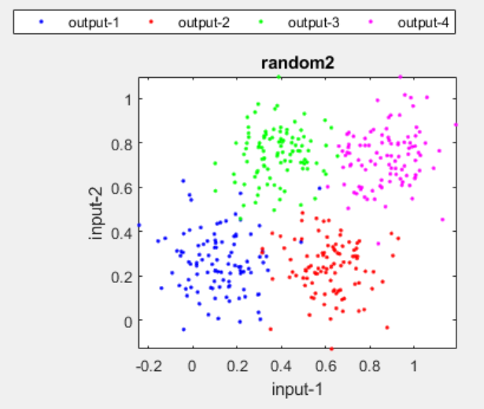
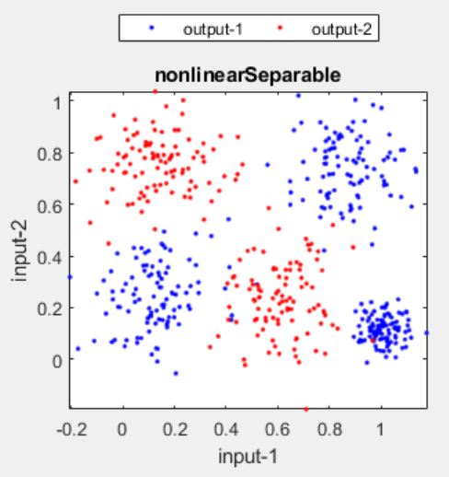
Strength and Weakness of NBC
Quiz!
Strength
Efficient in training and test
Weakness
Not able to deal with bi-modal data
Uni-modal!
Multi-modal!

Slide 9
NBC vs. QC
Quiz!
NBC is a simplified special case of QC (quadratic classifier).
NBC’s decision boundary is quadratic. (Why?)
Same as QC, but simpler (How?)
There exists fast methods for computing leave-one-out cross validation for NBC and QC.
NBC
QC

Slide 10
Exercise: Infeasible Datasets for NBC
What kinds of datasets will make NBC not usable?

Slide 11
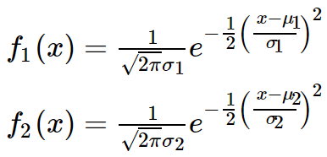
Exercise: Decision Boundary of Single-input NBC
The PDFs of two-class single-input NBC can be described by the following two equations. What is the reasonable decision boundary?

Slide 12
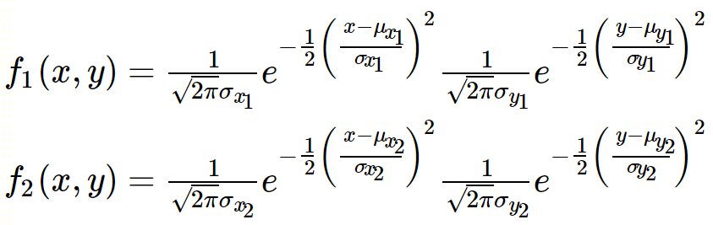
Exercise: Decision Boundary of Two-input NBC
Two PDFs of the two-input NBC

Slide 13
Exercise: Complexity of LOOCV for NBC
We can use an fast method to compute LOOCV. What is the complexity of LOOCV using the original NBC and the fast method?

