Slide 1
Backpropagation (BP)
J.-S. Roger Jang (張智星)
jang@mirlab.org
http://mirlab.org/jang
MIR Lab, CSIE Dept.
National Taiwan University

Slide 2
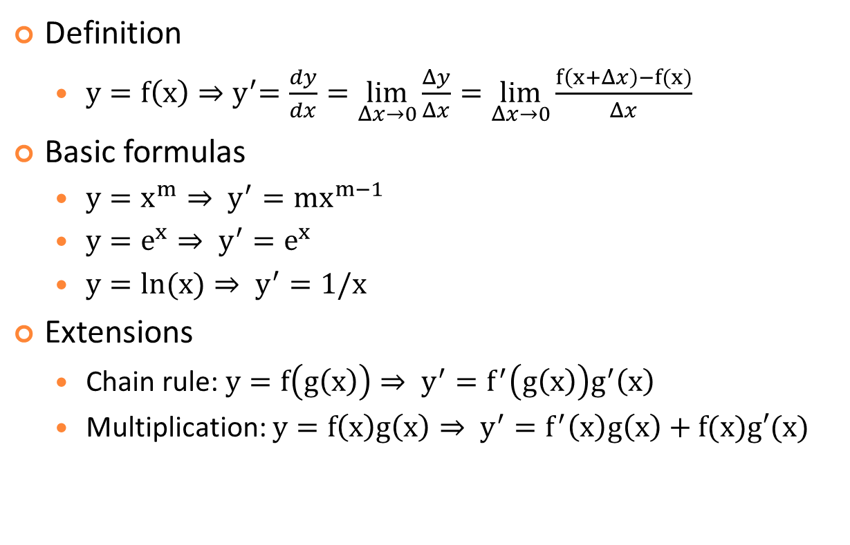
Basics in Differentiation
Definition
$y=f\left(x\right){⇒y}^{′}=\frac{dy}{dx}=\lim_{Δx→0}{\frac{Δy}{Δx}}=\lim_{Δx→0}{\frac{f\left(x+Δx\right)−f(x)}{Δx}}$
Basic formulas
$y=x^{m}⇒ y^{′}=mx^{m−1}$
$y=e^{x}⇒ y^{′}=e^{x}$
$y=ln(x)⇒ y^{′}=1/x$
Extensions
Chain rule: $y=f\left(g\left(x\right)\right)⇒ y^{′}=f^{′}\left(g\left(x\right)\right)g^{′}\left(x\right)$
Multiplication: $y=f\left(x\right)g\left(x\right)⇒ y^{′}=f^{′}\left(x\right)g\left(x\right)+f(x)g′(x)$

Slide 3

Adaptive Networks
About adaptive networks
A feedforward network where each node can have any function.
MLP is only a special case
x
1
u
$$\left\{\begin{aligned}\text{Node}\text{ 1: }u=x+e^{αy} \\ \text{Node}\text{ 2: }v=\ln\left(βx+y\right) \\ \text{Node}\text{ 3: }o=\left(u^{2}+v^{3}\right)/γ\end{aligned}\right. \\ \text{Network} \text{input}\text{:} x,y \\ \text{Network} \text{output}\text{:} o \\ \text{Network} \text{parameters}\text{:} α,β,γ \\ \text{Overall} \text{function}\text{:}\underset{output}{\underbrace{o}}=f(\underset{inputs}{\underbrace{x,y}};\underset{parameters}{\underbrace{α,β,γ}})$$
α
3
o
v
y
2
γ
β

Slide 4
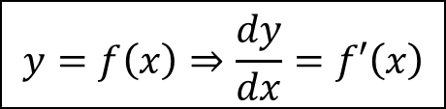
Simple Derivatives
Review of derivatives
Network representation
$$y=f\left(x\right)⇒\frac{dy}{dx}=f′\left(x\right)$$
f(.)
x
y

Slide 5
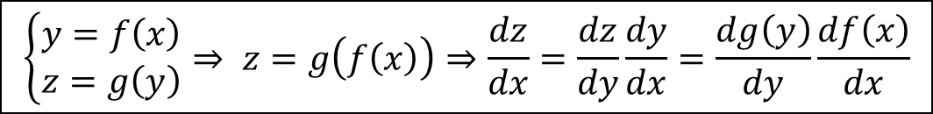
Chain Rule for One-input Composite Functions
Chain rule for one-input composite functions:
Network representation
$$\left\{\begin{matrix}y=f\left(x\right) \\ z=g\left(y\right)\end{matrix}⇒\right. z=g\left(f\left(x\right)\right)⇒\frac{dz}{dx}=\frac{dz}{dy}\frac{dy}{dx}=\frac{dg\left(y\right)}{dy}\frac{df\left(x\right)}{dx}$$
f(.)
y
g(.)
x
z

Slide 6
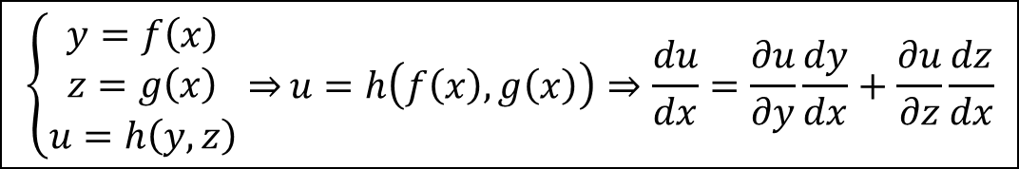
Chain Rule for Two-input Composite Functions
Chain rule for two-input composite functions:
Network representation
$$\left\{\begin{matrix}y=f\left(x\right) \\ z=g\left(x\right) \\ u=h\left(y,z\right)\end{matrix}⇒\right.u=h\left(f\left(x\right),g\left(x\right)\right)⇒\frac{du}{dx}=\frac{∂u}{∂y}\frac{dy}{dx}+\frac{∂u}{∂z}\frac{dz}{dx}$$
f(.)
y
h(. , .)
x
u
g(.)
z

Slide 7
Backpropagation in Adaptive Networks
Backpropagation (BP)
A systematic way to compute gradient from output toward input in an adaptive network.
Reinvented in 1986 for MLP.
AKA ordered derivatives.
A way to compute gradient, not gradient descent itself.

Slide 8
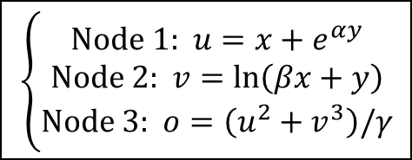
BP in Two-layer Adaptive Networks
x
1
u
α
3
o
v
y
2
γ
β
$$\left\{\begin{aligned}\text{Node}\text{ 1: }u=x+e^{αy} \\ \text{Node}\text{ 2: }v=\ln\left(βx+y\right) \\ \text{Node}\text{ 3: }o=\left(u^{2}+v^{3}\right)/γ\end{aligned}\right.$$

Slide 9
BP in Three-layer Adaptive Networks
p
x
1
3
u
α
γ
o
5
v
y
2
q
4
β

Slide 10

BP from Next Layer to Current Layer
General formula for backpropagation, assuming
“o” is the network’s final output
“α” is a parameter in node 1
Backpropagation!
α
y₁
$$\left\{\begin{matrix} \\ \begin{aligned}\frac{∂o}{∂x}=\frac{∂o}{∂y_{1}}\frac{∂y_{1}}{∂x}+\frac{∂o}{∂y_{2}}\frac{∂y_{2}}{∂x}+\frac{∂o}{∂y_{3}}\frac{∂y_{3}}{∂x} \\ \frac{∂o}{∂α}=\frac{∂o}{∂x}\frac{∂x}{∂α}\end{aligned}\end{matrix}\right. \\ \frac{∂o}{∂x}:{Derivative in current layer}$$
$\frac{∂o}{∂y_{1}}, \frac{∂o}{∂y_{2}}, \frac{∂o}{∂y_{3}}: D$erivative in next layer
x
1
4
y₂
2
5
y₃
3
6

Slide 11
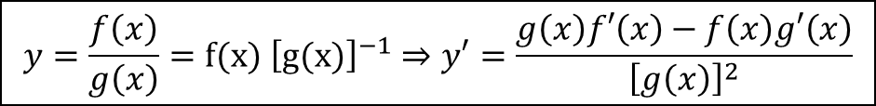
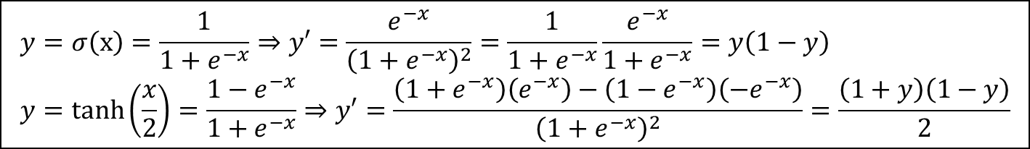
Chain Rule in Activation Functions
Derivatives of activation functions
Formula
Quiz!
$$y=σ\left(x\right)=\frac{1}{1+e^{−x}}⇒y′=\frac{e^{−x}}{{\left(1+e^{−x}\right)}^{2}}=\frac{1}{1+e^{−x}}\frac{e^{−x}}{1+e^{−x}}=y\left(1−y\right) \\ y=\tanh\left(\frac{x}{2}\right)=\frac{1−e^{−x}}{1+e^{−x}}⇒y′=\frac{\left(1+e^{−x}\right)\left(e^{−x}\right)−\left(1−e^{−x}\right)\left(−e^{−x}\right)}{{\left(1+e^{−x}\right)}^{2}}=\frac{\left(1+y\right)\left(1−y\right)}{2}$$
$$y=\frac{f\left(x\right)}{g\left(x\right)}=f(x) {\left[g(x)\right]}^{−1}⇒y′=\frac{g\left(x\right)f′\left(x\right)−f\left(x\right)g′\left(x\right)}{{\left[g\left(x\right)\right]}^{2}}$$

Slide 12
BP in Two-layer MLP
x₁
1
y₁
1
o
y₂
x₂
2

Slide 13
BP in Three-layer MLP
x₁
y₁
1
1
z₁
x₂
1
o
2
y₂
2
z₂
x₃
3
y₃

Slide 14
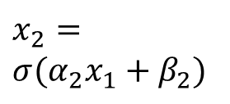
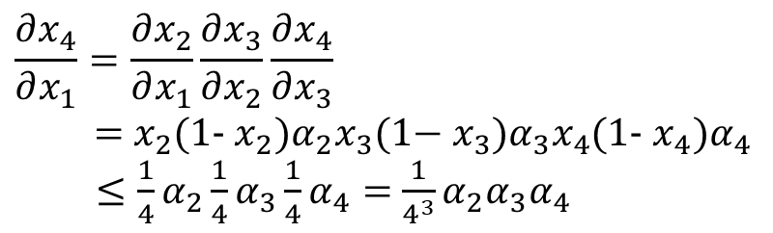
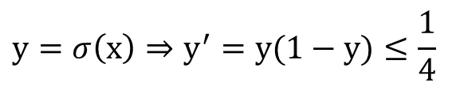
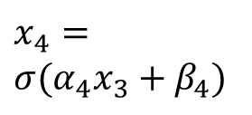
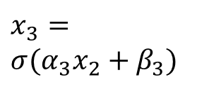
Gradient Vanishing in DNN
Gradient vanishing due to cascaded sigmoidal functions
Solutions
Different learning rates for different layers
Skip connections
x₁
x₄
$$x_{2}=$$
$$σ(α_{2}x_{1}+β_{2})$$
$$x_{3}=$$
$$σ(α_{3}x_{2}+β_{3})$$
$$x_{4}=$$
$$σ(α_{4}x_{3}+β_{4})$$
$$y=σ\left(x\right)⇒y^{′}=y(1−y)≤\frac{1}{4}$$
$$\frac{∂x_{4}}{∂x_{1}}=\frac{∂x_{2}}{∂x_{1}}\frac{∂x_{3}}{∂x_{2}}\frac{∂x_{4}}{∂x_{3}}$$
= $x_{2}$(1- $x_{2})α_{2}x_{3}\text{(1−} x_{3})α_{3}x_{4}$(1- $x_{4})α_{4}$
$≤\frac{1}{4}α_{2}\frac{1}{4}α_{3}\frac{1}{4}α_{4}=$ $\frac{1}{4^{3}}α_{2}α_{3}α_{4}$

Slide 15
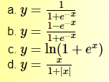
Exercises
Express the derivative y’ in terms of y:
Derive the derivative of tanh(x/2) in terms of sigmoid(x)
Express tanh(x/2) in terms of sigmoid(x).
Given y=sigmoid(x) and y’=y(1-y), find the derivative of tanh(x/2).

