Slide 1
MLP and DNN
J.-S. Roger Jang (張智星)
jang@mirlab.org
http://mirlab.org/jang
MIR Lab, CSIE Dept.
National Taiwan University

Slide 2
Concept of Modeling
Modeling
Given desired i/o pairs (training set) of the form (x₁, ..., x_{n}; y), construct a model to match the i/o pairs
Two steps in modeling
Structure identification: input selection, model complexity
Example: Order determination in polynomial fitting
Parameter identification: optimal parameters
Example: Coefficient determination in polynomial fitting
x₁
Unknown target system
y
. . .
x_{n}
Model
y*

Slide 3
Neural Networks (NN)
Supervised Learning
Multilayer perceptrons (MLP)
Deep neural networks (DNN)
Convolutional neural networks (CNN)
Radial basis function networks
Modular neural networks
Learning vector quantization (LVQ)
Unsupervised Learning
Competitive learning networks
Kohonen self-organizing networks
ART (adaptive resonant theory)
Others
Hopfield networks
NN
Static
MLP
CNN
DNN_{a}
DNN_{b}
Sequence
RNN
LSTM

Slide 4
Single-layer Perceptrons
Proposed by Widrow & Hoff in 1960
AKA ADALINE (Adaptive Linear Neuron)
x1
w0
w1
y
w2
female
x2
x2 (voice freq.)
male
Quiz!
x1 (hair length)
perceptronDemo.m

Slide 5
Multilayer Perceptrons (MLPs)
Extension of SLP to MLP to have complex decision boundaries
How to train MLPs?
Use sigmoid function to replace signum function
Use gradient descent for updating parameters
x1
y1
x2
y2

Slide 6
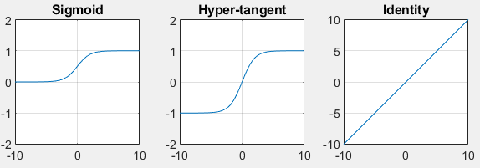
Continuous Activation Functions
In order to use gradient descent, we need to replace the signum function by its continuous versions
y = 1/(1+exp(-x))
y = tanh(x/2)
y = x

Slide 7
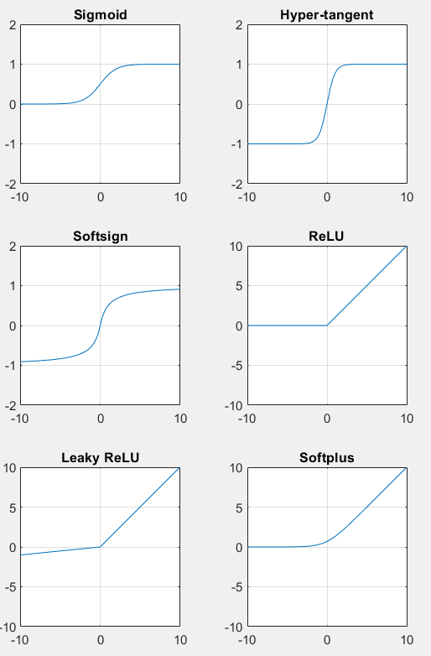
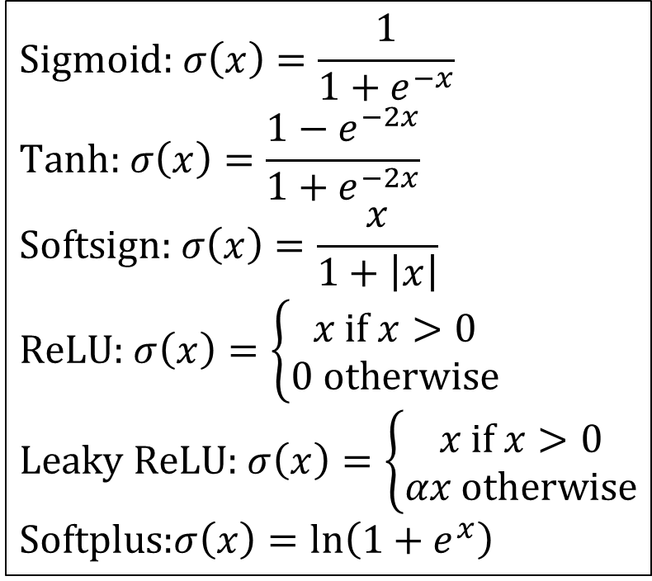
More Activation Functions
$$Sigmoid\text{:} σ\left(x\right)=\frac{1}{1+e^{−x}} \\ \text{Tanh}\text{:} σ\left(x\right)=\frac{1−e^{−2x}}{1+e^{−2x}} \\ \text{Softsign}\text{:} σ\left(x\right)=\frac{x}{1+\left|x\right|} \\ \text{ReLU}\text{:} σ\left(x\right)=\left\{\begin{aligned}x \text{if} x>0 \\ 0 \text{otherwise}\end{aligned}\right. \\ \text{Leaky} \text{ReLU}\text{:} σ\left(x\right)=\left\{\begin{aligned}x \text{if} x>0 \\ αx \text{otherwise}\end{aligned}\right. \\ \text{Softplus}\text{:}σ\left(x\right)=\ln\left(1+e^{x}\right)$$

Slide 8
Classical MLPs
Typical 2-layer MLPs:
Learning rules
Derivative-based
Gradient descent
Conjugate gradient method
…
Derivative-free
Genetic algorithms
Simulated annealing
…
x1
y1
x2
y2

Slide 9
MLP Examples
XOR problem
Training data
Network Arch.
x1 x2 y
0 0 0
0 1 1
1 0 1
1 1 0
x1
y
x2
x2
x1
y
x2
x1

Slide 10
MLP Decision Boundaries
Single-layer: Half planes
Exclusive-OR
problem
Intertwined
regions
Most general
regions
A
B
A
B
B
A

Slide 11
MLP Decision Boundaries
Two-layer: Convex decision boundaries
Exclusive-OR
problem
Intertwined
regions
Most general
regions
A
B
A
B
B
A

Slide 12
MLP Decision Boundaries
Three-layer: Arbitrary decision boundaries
Exclusive-OR
problem
Intertwined
regions
Most general
regions
A
B
A
B
B
A
Universal approximator: MLP with 3 layers can approximate any given functions!

Slide 13
Summary: MLP Decision Boundaries
Quiz!
XOR
Intertwined
General
1-layer: Half planes
A
B
A
B
B
A
2-layer: Convex
A
B
A
B
B
A
3-layer: Arbitrary
A
B
A
B
B
A

Slide 14
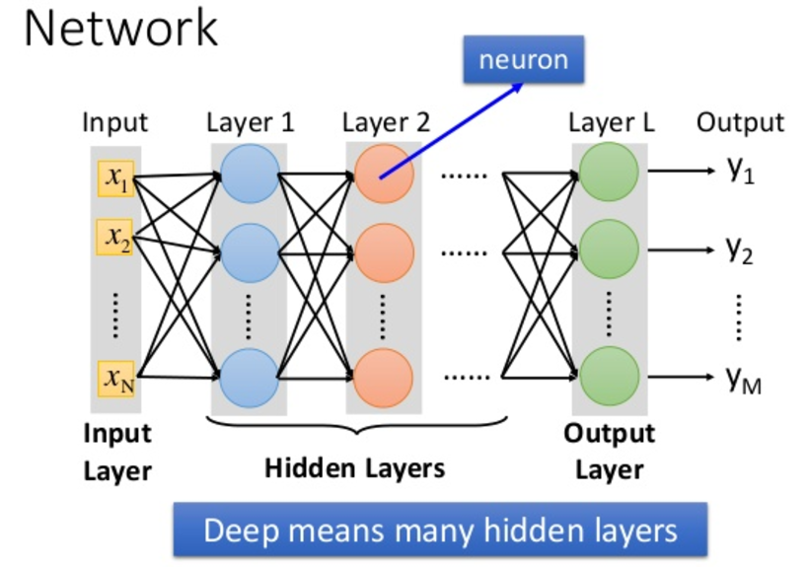
Deep Neural Networks (DNN) ➔ MLP with Many Layers!

Slide 15
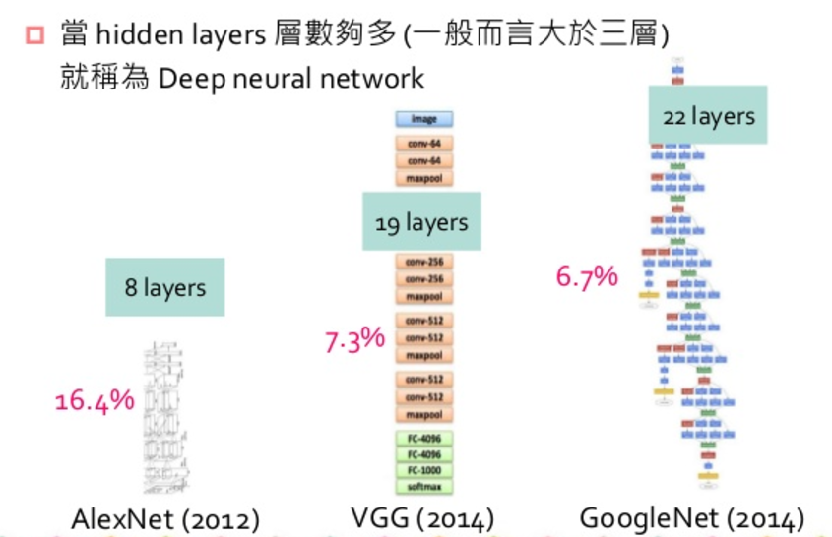
Convolutional NN (CNN): Another Type of DNN
CNNs are commonly used for image classification.

Slide 16
Training an MLP
Methods for training MLP
Gradient descent
Gauss-Newton method
Levenberg-Marquart method
Backpropagation: A systematic way to compute gradients, starting from the NN’s output

Slide 17
Backpropagation
Backpropagation (BP)
A systematic way to compute gradient from output toward input in an adaptive network.
Reinvented in 1986 for MLP.
AKA ordered derivatives.
A way to compute gradient, not gradient descent itself.
For backpropagation, please refer to another video shown in Youtube description.

Slide 18
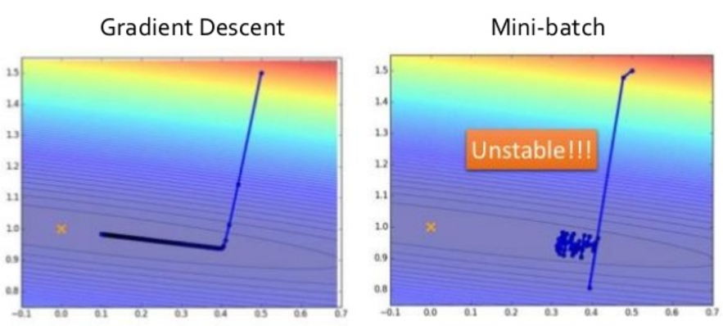
Use of Mini-batch in Gradient Descent
Goal: To speed up the training with large dataset
Approach: Update by mini-batch instead of epoch
If dataset size is 1000
Batch size = 10 ➔ 100 updates in an epoch ➔ mini batch
Batch size = 100 ➔ 10 updates in an epoch ➔ mini batch
Batch size=1000 ➔ 1 update in an epoch ➔ full batch
A process of going
through all data
Update by epoch
Update by mini-batch
Slower
update!
Faster
update!

Slide 19
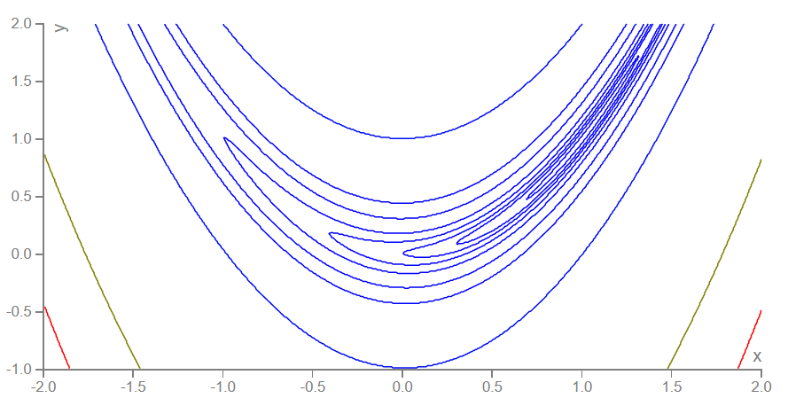
Use of Momentum Term in Gradient Descent
Purpose of using momentum term
Avoid oscillations in gradient descent (banana function!)
Escape from local minima (???)
Formula
Original:
With momentum term:
Contours of banana function
Momentum
term

Slide 20
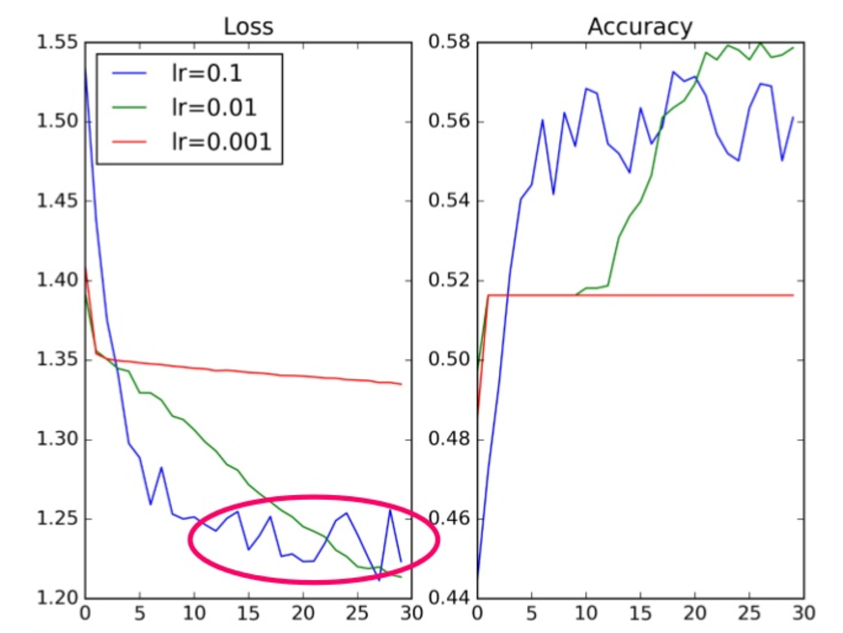
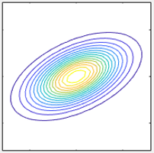
Learning Rate Scheduling
Learning rate scheduling

Slide 21
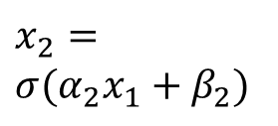
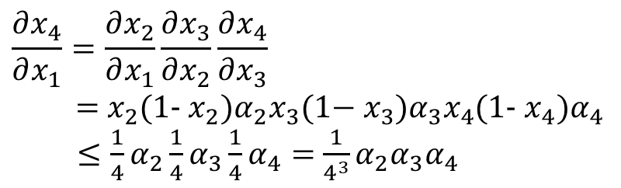
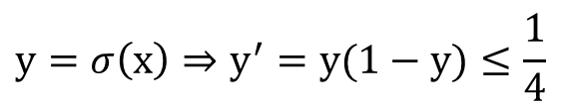
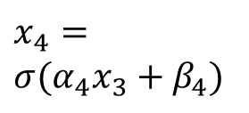
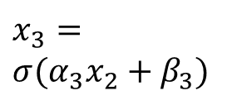
Gradient Vanishing in DNN
Gradient vanishing due to cascaded sigmoidal functions
Solutions
Different learning rates for different layers
Skip connections
x₁
x₄
$$x_{2}=$$
$$σ(α_{2}x_{1}+β_{2})$$
$$x_{3}=$$
$$σ(α_{3}x_{2}+β_{3})$$
$$x_{4}=$$
$$σ(α_{4}x_{3}+β_{4})$$
$$y=σ\left(x\right)⇒y^{′}=y(1−y)≤\frac{1}{4}$$
$$\frac{∂x_{4}}{∂x_{1}}=\frac{∂x_{2}}{∂x_{1}}\frac{∂x_{3}}{∂x_{2}}\frac{∂x_{4}}{∂x_{3}}$$
= $x_{2}$(1- $x_{2})α_{2}x_{3}\text{(1−} x_{3})α_{3}x_{4}$(1- $x_{4})α_{4}$
$≤\frac{1}{4}α_{2}\frac{1}{4}α_{3}\frac{1}{4}α_{4}=$ $\frac{1}{4^{3}}α_{2}α_{3}α_{4}$

Slide 22
Optimizer in Keras
Choices of optimization methods in Keras
SGD: Stochastic gradient descent
Adagrad: Adaptive learning rate
RMSprop: Similar to Adagrad
Adam: Similar to RMSprop + momentum
Nadam: Adam + Nesterov momentum

Slide 23
Exercise 1
Handcraft sets of weights for the following two networks to solve the XOR problem:
XOR training data
Network Arch.
x y z
0 0 0
0 1 1
1 0 1
1 1 0
x
1.
z
y
y
x
2.
z
y
x

Slide 24
Solution 1 to Network 1
y
y
y
(0, 1)
(1, 1)
(0, 1)
(1, 1)
(0, 1)
(1, 1)
=
∩
x
x
x
(0, 0)
(1, 0)
L₁
(0, 0)
(1, 0)
L₁
(0, 0)
(1, 0)
L₂
L₂
_{x} | _{y} | _{z} | L₁ | L₂ | L₃
0 | 0 | 0 | 1 | 0 | 0
0 | 1 | 1 | 1 | 1 | 1
1 | 0 | 1 | 1 | 1 | 1
1 | 1 | 0 | 0 | 1 | 0
L₂
L₁
L₃
x
L₃
➔
➔
z
y
L₁
L₂

Slide 25
Solution 2 to Network 1
y
y
y
(0, 1)
(1, 1)
(0, 1)
(1, 1)
(0, 1)
(1, 1)
=
∩
x
x
L₂
x
(0, 0)
(1, 0)
(0, 0)
(1, 0)
(0, 0)
(1, 0)
L₁
L₂
_{x} | _{y} | _{z} | L₁ | L₂ | L₃
0 | 0 | 0 | 0 | 0 | 0
0 | 1 | 1 | 0 | 1 | 1
1 | 0 | 1 | 1 | 0 | 1
1 | 1 | 0 | 0 | 0 | 0
L₁
L₃
x
L₃
➔
➔
z
y
L₁
L₂

Slide 26
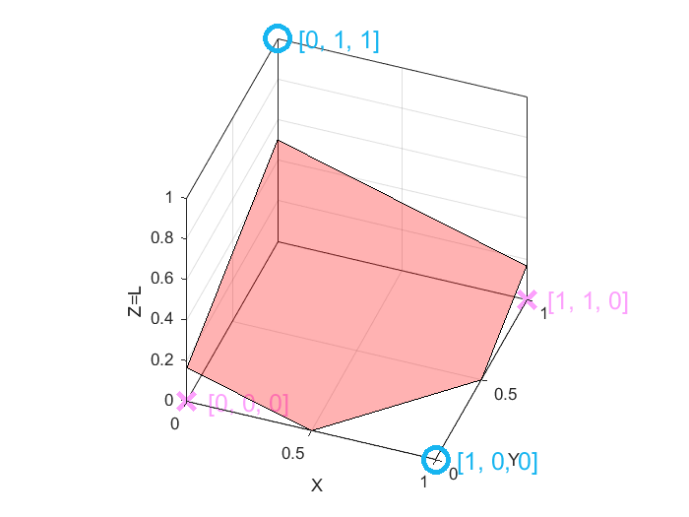
Solution to Network 2
y
y
L
(0, 1)
(1, 1)
(0, 1)
(1, 1)
P
=
➔
x
x
(0, 0)
(1, 0)
(0, 0)
(1, 0)
_{x} | _{y} | _{z} | L | P
0 | 0 | 0 | 0 | 0
0 | 1 | 1 | 1 | 1
1 | 0 | 1 | 0 | 1
1 | 1 | 0 | 0 | 0
L
x
P
➔
z
y

Slide 27
Exercise 2
What is the minimum no. of nodes of an MLP (with possible skip connections) that can achieve the following decision boundary?

Slide 28

Exercise 3
In the example of gender classification…
What is the learning rule of a “second-order” perceptron in the gender classification example?
What types of decision boundaries are possible?
$$f\left(x;{w}\right)=\operatorname{sgn}\left(w_{0}+w_{1}x_{1}+w_{2}x_{2}+w_{3}x_{1}^{2}+w_{4}x_{2}^{2}+w_{5}x_{1}x_{2}\right) \\ =\left\{\begin{matrix}1 \text{if} \text{female} \\ −1 \text{if} \text{male}\end{matrix}\right. \\ \left\{\begin{matrix}Δw_{0}=η\left(y−f\left(x;{w}\right)\right) \\ Δw_{1}=ηx_{1}\left(y−f\left(x;{w}\right)\right) \\ \begin{aligned}Δw_{2}=ηx_{2}\left(y−f\left(x;{w}\right)\right) \\ Δw_{3}=η\left(y−f\left(x;{w}\right)\right) \\ Δw_{4}=η\left(y−f\left(x;{w}\right)\right) \\ Δw_{5}=ηx_{1}x_{2}\left(y−f\left(x;{w}\right)\right)\end{aligned}\end{matrix}\right.$$

Slide 29
Exercise 4
If the activation function used in your DNN is a hyper-tangent function, do you still have the “gradient vanishing” problem?

