Slide 1
Taiwanese Plant Image Recognition
Jyh-Shing Roger Jang
Dept. of CSIE, National Taiwan University, Taiwan

Slide 2
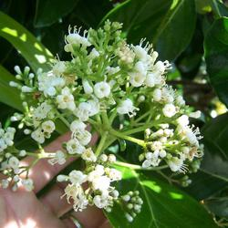
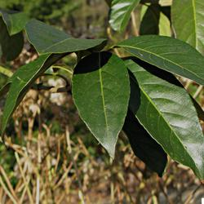
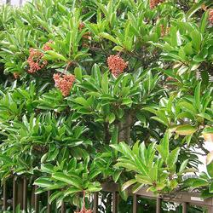
ITRI Plant Image Dataset
ITRI Dataset of Taiwanese plant image
  ITRI dataset
    Image size: 250X250, RGB
    Image count: about 200k images
    No of classes: about 2.4k
  ITRI-500 dataset
    Top-500 largest classes
    Image count: 107,841 (Training: 97,054, Test: 10,787)
    Biggest class: 405 images, smallest class: 142 images
Images in the same category

Slide 3
Key Methods
Convolution neural network
  Currently most popular and effective algorithm to classify images.
  Computing power boosted owing to GPU acceleration, which makes complex network possible to train and use.
Transfer learning
  Fine-tune the well-trained model to fit another dataset.
  Time-saving for “teaching” the network.
Data augmentation
  Rotating, zooming and flipping the training images to learn more proper features.

Slide 4
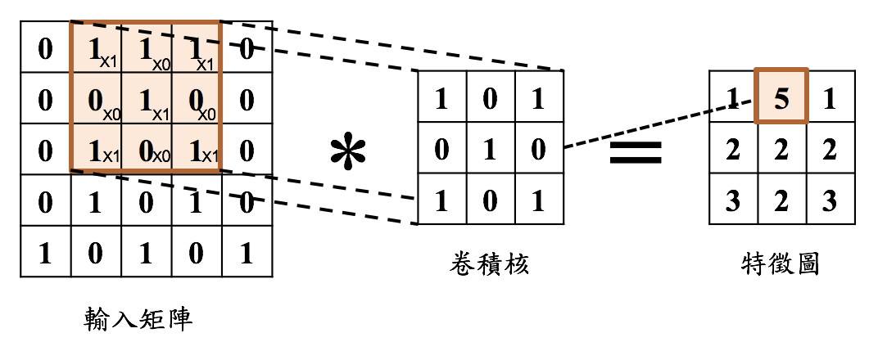
Convolution Neural Network
Convolution layer
Pooling layer
Feature maps
Image
Feature maps
Fully-connected layer
Output

Slide 5
Transfer Learning
Train on large dataset
Train on relatively smaller dataset
Model A
Give weights
Model B
Knowledge of classify various object
Target results

Slide 6
System Flowchart
CNN model training
Training data
Image preprocessing
Data augmentation
Test data
Image preprocessing
Plant classification
CNN model
Result

Slide 7
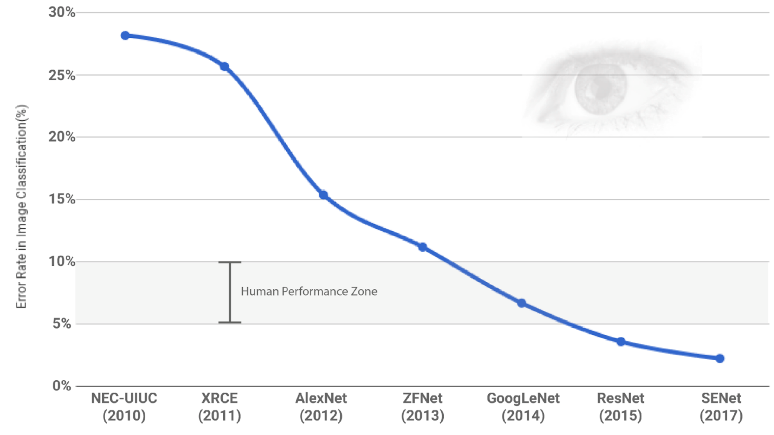
Model Candidates (1/2)
Potential models for transfer learning
  Inception V3
    Top 1 accuracy on Imagenet 2012 : 78.8%
    Highly improved compare to the first inception net version.
  InceptionRes V2
    Top 1 accuracy on Imagenet 2012 : 80.4%
    Combine the ResNet concept with inception net.
  Xception
    Top 1 accuracy on Imagenet 2012 : 79.0%
    Extreme version of inception net, separate all the channel and spatial feature learning.

Slide 8
Model Candidates (2/2)
Google’s models for transfer learning
  Inception V3
    Top-1 accuracy on Imagenet 2012: 78.8%
    Highly improved compare to the first inception net version.
  InceptionRes V2
    Top-1 accuracy on Imagenet 2012: 80.4%
    Combine the ResNet concept with inception net.
  Xception
    Top-1 accuracy on Imagenet 2012: 79.0%
    Extreme version of inception net, separate all the channel and spatial feature learning.

Slide 9
Experimental Settings (1/2)
Image processing
  Resize: resolution [250, 250] to [227, 227]
  Pixel value: 0~255 to 0.0~1.0
Data augmentation
  Rotation degree range = -20 ~ +20
  Zooming range = 10%
  Horizontal flip = True
Transfer Learning (CNN models)
  Xception, Inception V3, Inception Res
    Weight = ‘imagenet’
    Learning rate = 0.045
    Momentum = 0.9
    Decay = 1e-6

Slide 10
Experimental Settings (2/2)
Activation function
  Softmax (on output layer)
Loss function
  Cross entropy
Optimization
  Stochastic gradient descent (SGD)
Environment
  OS: Ubuntu 16.04
  CPU: Intel Xeon CPU E5-2630 v4
  GPU: Nvidia GeForce GTX 1080 Ti
  Memory: 128GB
  Programming language: Python 3.6.3 & TensorFlow 1.3.0

Slide 11
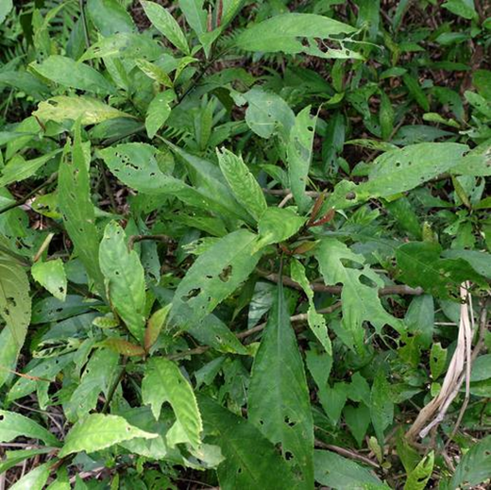
Data augmentation
Multi-scale training
Random
crop
Input
image
Input image
224*224
Original image
250*250
Different image sizes
S = {224, 320, 410, 500}

Slide 12

Data augmentation
Random crop
Original image
Cropped images

Slide 13
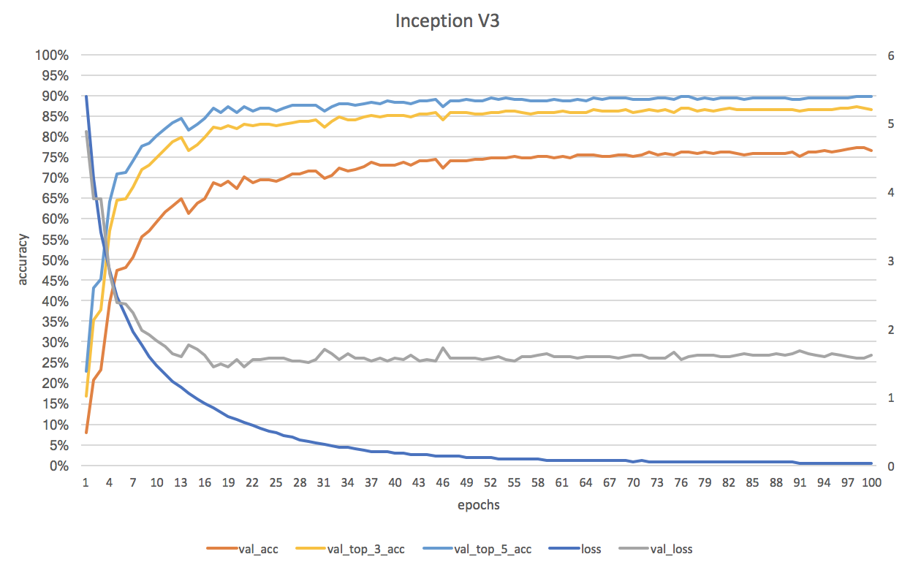
Model Candidates Experimental Results (1/3)
89.77%
87.07%
77.15%
Class : 500
Epoch : 100
Time : 36 hours

Slide 14
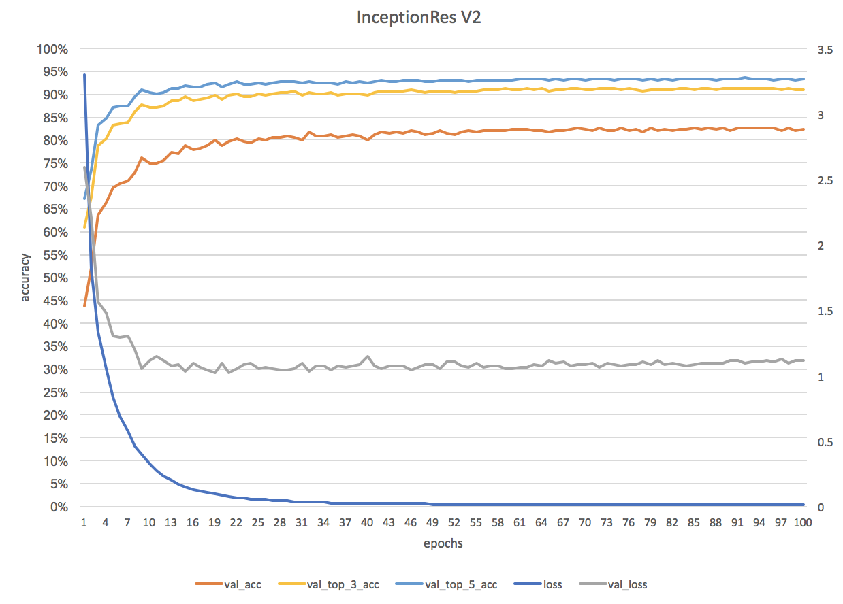
Model Candidates Experimental Results (2/3)
93.33%
91.11%
82.59%
Class : 500
Epoch : 100
Time : 36 hours

Slide 15
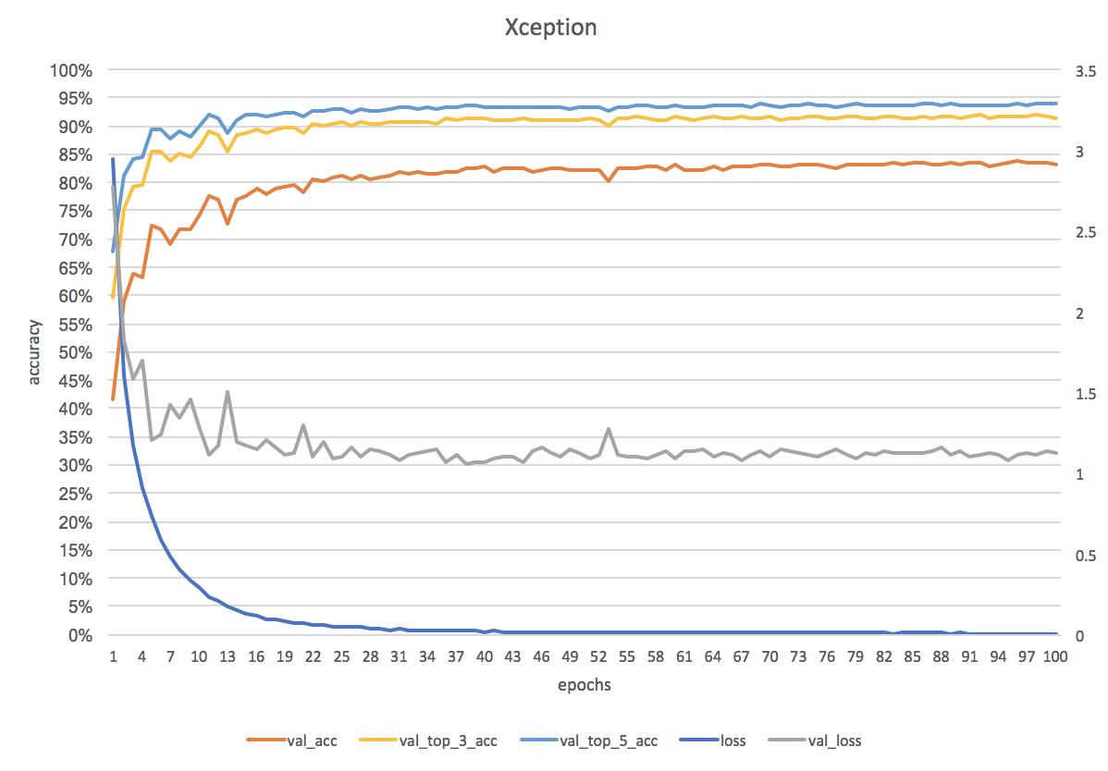
Model Candidates Experimental Results (3/3)
93.77%
91.67%
83.60%
Class : 500
Epoch : 100
Time : 36 hours

Slide 16
Model Candidates Conclusions
ITRI-500 dataset
 | Top1 acc | Top3 acc | Top5 acc
InceptionV3 | 77.15% | 87.07% | 89.77%
InceptionResV2 | 82.59% | 91.11% | 93.33%
Xception | 83.60% | 91.67% | 93.77%

Slide 17
Experimental Results
Accuracy of each class

Slide 18
Error Analysis
Feature extraction
Euclidean distance
  Use Euclidean distance of two extracted image features to find the most similar image.
Convolution layer
Pooling layer
Feature maps
Image
Feature maps
Fully-connected layer
Output
Extract layer output as feature

Slide 19
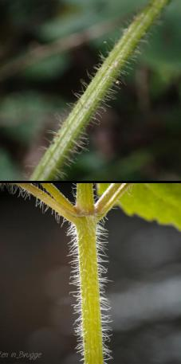
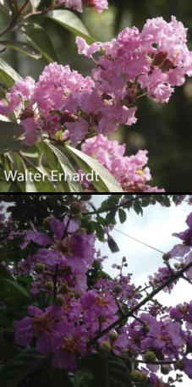
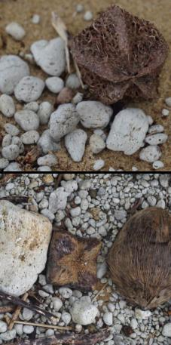
Error Analysis - Similar
Miss predicted
images
Most similar
images in
predicted class

Slide 20
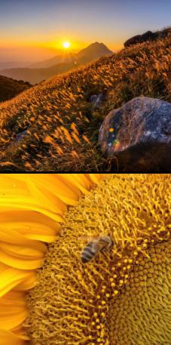
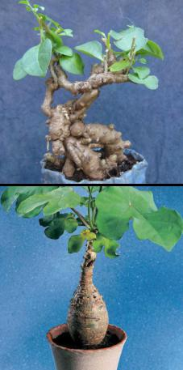
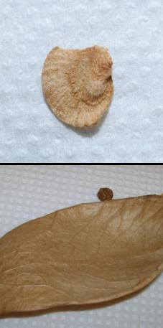
Error Analysis - Not Similar
Miss predicted
images
Most similar
images in
predicted class

Slide 21
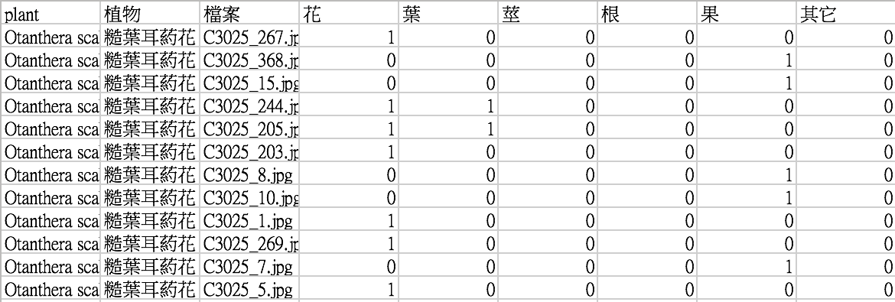
Improvement 1: Organ based model (1/2)
Organ based model
Organ number distribution

Slide 22

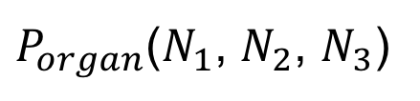
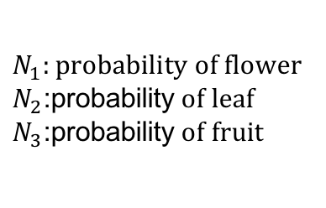



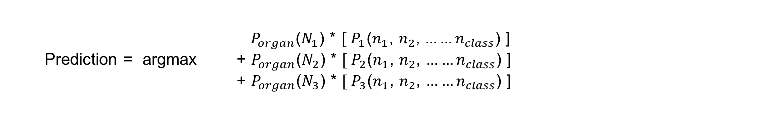
Improvement 1: Organ based model (2/2)
Organ based Model
Training
data
$P_{organ}$($N_{1}$, $N_{2}$, $N_{3}$)
Organ classifier
$N_{1}:probability of flower$
$N_{2}$:probability$of leaf$
$N_{3}$:probability$of fruit$
Flower model
$P_{flower}$($n_{1}$, $n_{2}$, $……n_{class}$)
Training
data
Transfer Xception
Leaf model
$P_{leaf}$($n_{1}$, $n_{2}$, $……n_{class}$)
Fruit model
$P_{fruit}$($n_{1}$, $n_{2}$, $……n_{class}$)
$P_{m}$($n_{s}$): probability of each class in m model
  $P_{organ}$($N_{1}$) * $[ P_{1}$($n_{1}$, $n_{2}$, $……n_{class}$) ]
  Prediction = argmax + $P_{organ}$($N_{2}$) * $[ P_{2}$($n_{1}$, $n_{2}$, $……n_{class}$) ]
  + $P_{organ}$($N_{3}$) * ${[ P}_{3}$($n_{1}$, $n_{2}$, $……n_{class}$) ]

Slide 23
Improvement 2: Reclassification
Image reclassification if confidence is low
  How to define confidence?
  How to perform reclassification based on segmented image?
  How to segment images for reclassification?
    K-means clustering
  How to fill the background of segmented images?
    Use mean color from other segmented images
  How to select segmented images for reclassification?
    Another classifier based on region properties, colors, etc.

Slide 24
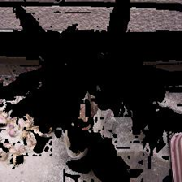
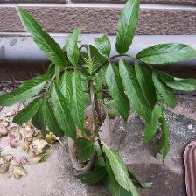
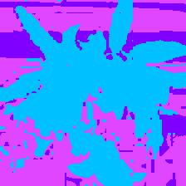
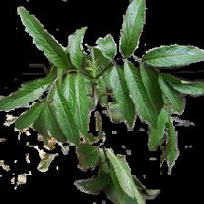
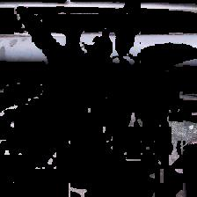
Image Post-processing
Image segmentation with k-means clustering
  On plant images

Slide 25
Image Post-processing
Select the best image for re-classification
CNN model
Plant classification

Slide 26
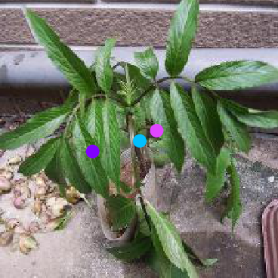
Image Post-processing
Select the best image for re-classification
  Select the segmented image whose centroid is closest to the center of original image
  Other features for better selection: colors, shapes, region properties, etc.

Slide 27
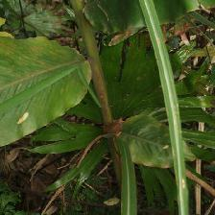

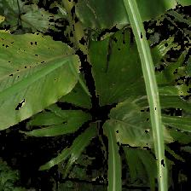
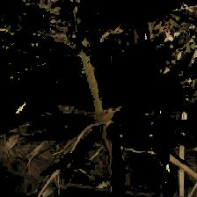
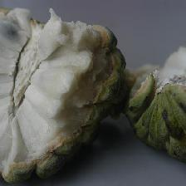
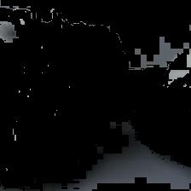
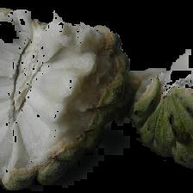
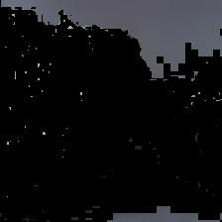
Experimental Results
Re-classification after image post-processing
  Correct prediction cases
Original image
Segmented images

Slide 28
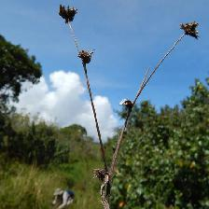
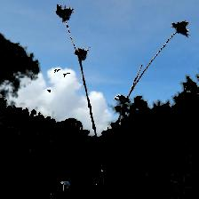
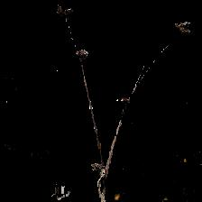
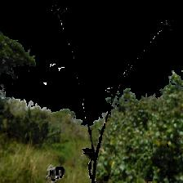
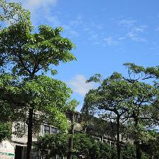
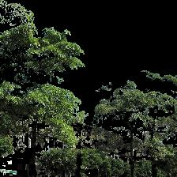
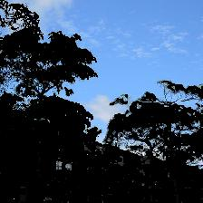
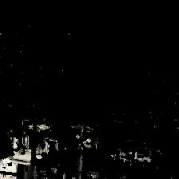
Experimental Results
Re-classification after image post-processing
  Wrong prediction cases
Original image
Segmented images

Slide 29
Thank you for your attention

