Slide 1
Performance Indices for Sequence Decoding
J.-S. Roger Jang (張智星)
MIR Lab, CSIE Dept.
National Taiwan University
jang@mirlab.org, http://mirlab.org/jang

Slide 2
Examples of Sequence Decoding
Automatic Speech Recognition (ASR)
Audio event detection
Decoding of Morse code
…

Slide 3
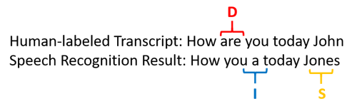


Accuracy of Sequence Decoding in ASR
Accuracy of ASR for English
WER: word error rate
Example:
Facts
Accuracy could be negative! ➔ Counter intuitive!
Use edit distance (based on DP) to find D, I, and S. ➔ Computation intensive!
Edit distance is symmetric ➔ ed(x, y) = ed(y, x).
$$WER=\frac{D+I+S}{N}⇒Accuracy=1−WER$$
Length of groundtruth
$$WER=\frac{1+1+1}{5}=60\%⇒Accuracy=40\%$$

Slide 4
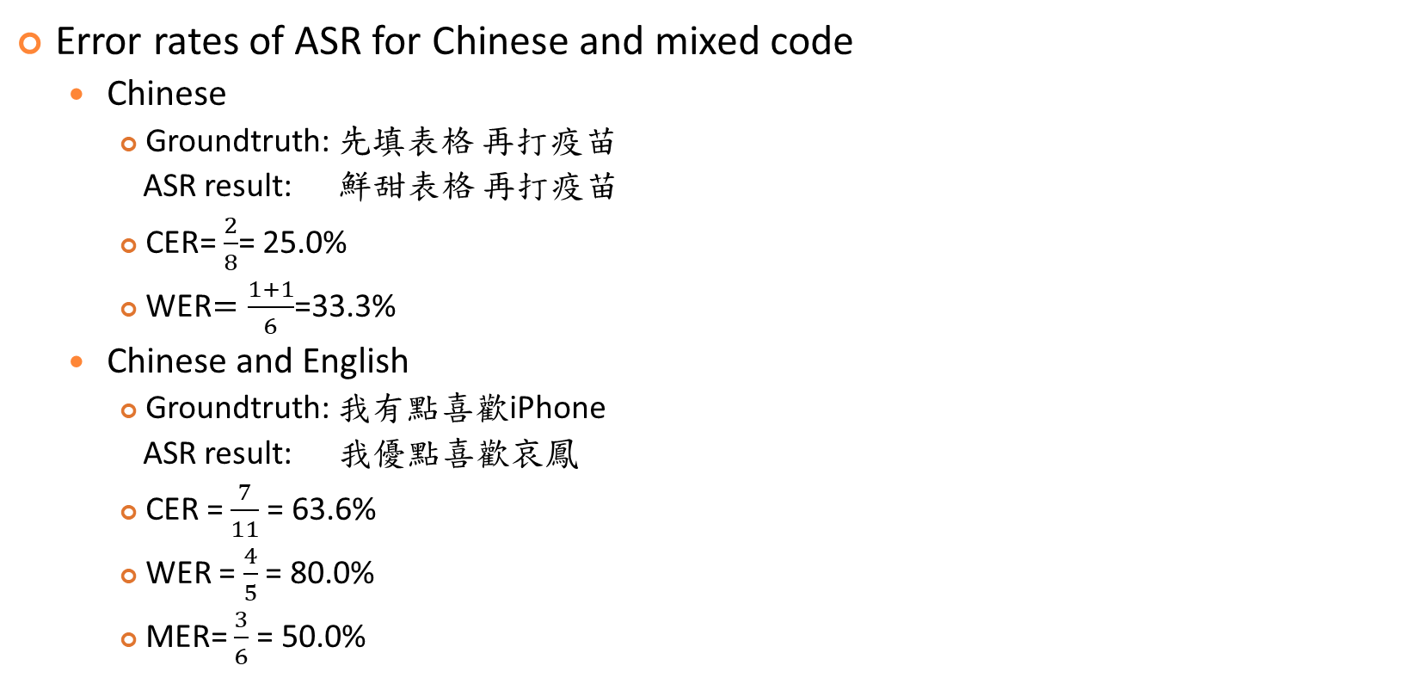
Error Rate of Sequence Decoding in Mix-code ASR
Quiz!
Error rates of ASR for Chinese and mixed code
Chinese
Groundtruth: 先填表格 再打疫苗
ASR result: 鮮甜表格 再打疫苗
CER= $\frac{2}{8}$= 25.0%
WER$=\frac{1+1}{6}$=33.3%
Chinese and English
Groundtruth: 我有點喜歡iPhone
ASR result: 我優點喜歡哀鳳
CER = $\frac{7}{11}$ = 63.6%
WER = $\frac{4}{5}$ = 80.0%
MER= $\frac{3}{6}$ = 50.0%
WER: Word error rate
(Chinese & English: word)
CER: Character error rate
(Chinese & English: character)
MER: mixed error rate
(Chinese: character, English: word)

Slide 5

Exercise: Error Rate of Sequence Decoding in ASR
Error rates of ASR for Chinese and mixed code
Chinese and English
Groundtruth: Typhoon 不 要 來 台灣
ASR result: 颱風 不 要 來 臺灣
CER = $\frac{2}{3}$($\frac{8}{12}$ originally)
WER = $\frac{2}{5}$
MER= $\frac{1}{2}\text{(}\frac{3}{6} \text{originally}\text{)}$

