Slide 1
Performance Indices for Ranking
J.-S. Roger Jang (張智星)
MIR Lab, CSIE Dept.
National Taiwan University
jang@mirlab.org, http://mirlab.org/jang

Slide 2
Outline
Mean reciprocal rank (mRR)
Mean average precision (mAP)
Normalized discounted cumulative gain (NDCG)
Notes:
我們會說明三項使用在 ranking 的 performance indices
第一項是 mean reciprocal rank，也就是使用第一個正確回傳的 item 的排名，再求其倒數。
第二項是 mean average precision，也就是使用每個排名位置的 precision，再求其平均。
第三項則是 NDCG，這是一個比較精細但是比較複雜的方法，在實務上常會被用到。

Slide 3
Two Types of Outputs of Retrieval Systems
Unranked output
  Output is not ranked
Example
  Covid detection
Performance indices
  Precision & recall
  F1-measure
  Accuracy
  AUROC & AUPRC
Ranked output
  Output is ranked according to relevancy
Example
  Google search
Performance indices
  Mean reciprocal rank
  Mean average precision
  Normalized discounted cumulative gain (NDCG)
Same as
binary classification
For single-value
relevancy
For multiple-value
relevancy

Slide 4

Reciprocal Rank (RR)
Query result: 8 items
  Position K: 1 2 3 4 5 6 7 8
Facts
  Only the first hit is considered.
  $RR@K=0$ if no hit within K outputs.
Typical applications
  Query by singing/humming
Red: Hit or relevant
$RR@K$ = $\frac{1}{Rank of first hit within K outputs} ⇒ RR@8=1/2$

Slide 5



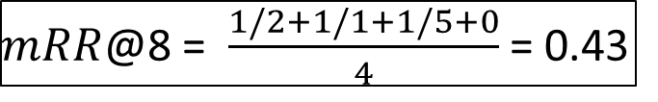

Mean Reciprocal Rank (mRR)
Example
  Result of query 1
    Position K: 1 2 3 4 5 6 7 8
  Result of query 2
    Position K: 1 2 3 4 5 6 7 8
  Result of query 3
    Position K: 1 2 3 4 5 6 7 8
  Result of query 4
    Position K: 1 2 3 4 5 6 7 8
Interpretation
  mRR=1 indicates perfect retrieval for all queries.
  mRR=0.5 indicates a relevant document is first found on average at position 2.
${RR}_{1}$@8 = 1/2
${RR}_{2}$@8 = 1/1
$mRR$@8 = $\frac{1/2+1/1+1/5+0}{4}$ = 0.43
${RR}_{3}$@8 = 1/5
${RR}_{4}$@8 = 0

Slide 6
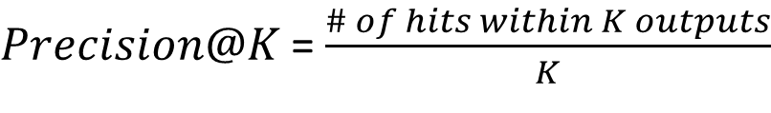
Precision and Average Precision
Red: relevant or hit
Query result: 8 items
  Position K: 1 2 3 4 5 6 7 8
  Precision@K: 0.00 0.50 0.33 0.50 0.60 0.50 0.57 0.50
  Rel_{k}: 0 1 0 1 1 0 1 0
Binary
Rel: Relevancy
$Precision@K$ = $\frac{\# of hits within K outputs}{K}$
$AP@K$ = $\frac{\sum_{k=1}^{K}{Precision@k∗{rel}_{k}}}{\sum_{k=1}^{K}{{rel}_{k}}}$ = $\frac{0.50+0.50+0.60+0.57}{4}$ = 0.54
AP: Average precision
Is it reasonable?
“y y n” and “y y y” have the same AP.
“y n n” has better AP than “y n y”.

Slide 7


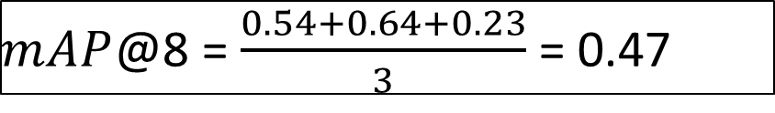

Mean Average Precision (mAP)
Result of query 1
  Position K: 1 2 3 4 5 6 7 8
  Precision@K: 0.00 0.50 0.33 0.50 0.60 0.50 0.57 0.50
Result of query 2
  Position K: 1 2 3 4 5 6 7 8
  Precision@K: 1.00 0.50 0.33 0.50 0.40 0.33 0.43 0.38
Result of query 3
  Position K: 1 2 3 4 5 6 7 8
  Precision@K: 0.00 0.00 0.00 0.00 0.20 0.17 0.14 0.25
${AP}_{1}$@8 = $\frac{0.50+0.50+0.60+0.57}{4}$=0.54
${AP}_{2}$@8 = $\frac{1.00+0.50+0.43}{3}$=0.64
${AP}_{3}$@8 = $\frac{0.20+0.25}{2}$=0.23
$mAP$@8 = $\frac{0.54+0.64+0.23}{3}$ = 0.47

Slide 8
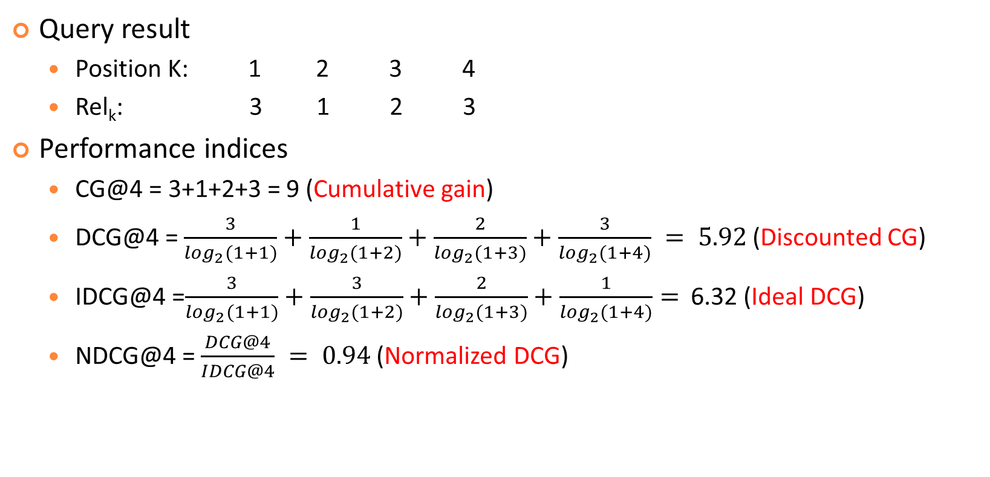
Examples of CG, DCG, IDCG, and NDCG
Query result
  Position K: 1 2 3 4
  Rel_{k}: 3 1 2 3
Performance indices
  CG@4 = 3+1+2+3 = 9 (Cumulative gain)
  DCG@4 = $\frac{3}{\log_{2}(1+1)}+\frac{1}{\log_{2}(1+2)}+\frac{2}{\log_{2}(1+3)}+\frac{3}{\log_{2}(1+4)} = 5.92$ (Discounted CG)
  IDCG@4 =$\frac{3}{\log_{2}(1+1)}+\frac{3}{\log_{2}(1+2)}+\frac{2}{\log_{2}(1+3)}+\frac{1}{\log_{2}(1+4)}=$ 6.32 (Ideal DCG)
  NDCG@4 = $\frac{DCG@4}{IDCG@4} = 0.94$ (Normalized DCG)
Relevance scores
Is it reasonable?
“1 1 1” has better NDCG than “3 1 2”.

Slide 9
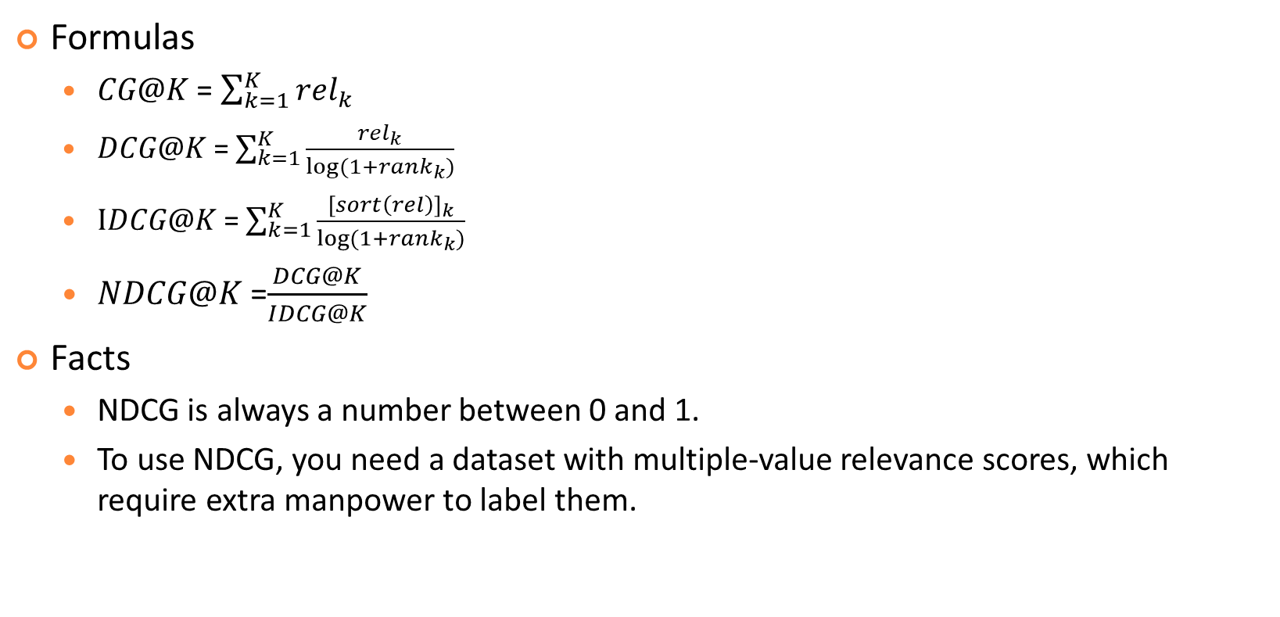
Formulas of CG, DCG, IDCG, and NDCG
Formulas
  $CG@K$ = $\sum_{k=1}^{K}{{rel}_{k}}$
  $DCG@K$ = $\sum_{k=1}^{K}{\frac{{rel}_{k}}{log⁡(1+{rank}_{k})}}$
  $IDCG@K$ = $\sum_{k=1}^{K}{\frac{{[sort\left(rel\right)]}_{k}}{log⁡(1+{rank}_{k})}}$
  $NDCG@K$ =$\frac{DCG@K}{IDCG@K}$
Facts
  NDCG is always a number between 0 and 1.
  To use NDCG, you need a dataset with multiple-value relevance scores, which require extra manpower to label them.
Sorted in descending order

Slide 10
References
Mean Reciprocal Rank (MRR): Evaluating a Retrieval System
  https://www.youtube.com/watch?v=8y9bi2vIG4U
Evaluation Measures for Search and Recommender Systems
  https://www.youtube.com/watch?v=BD9TkvEsKwM
Demystifying NDCG
  https://medium.com/data-science/demystifying-ndcg-bee3be58cfe0

Slide 11
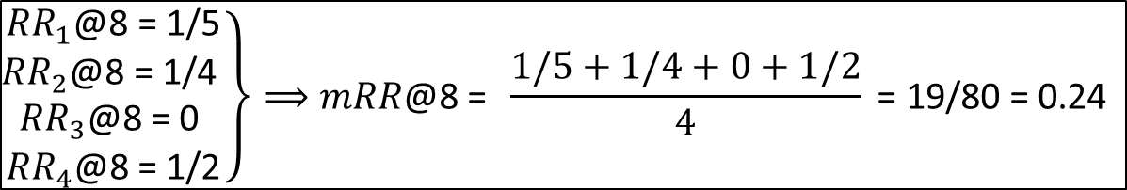
Exercise: mRR
What is the mRR@8 of the following query results?
  Result 1: 1 2 3 4 5 6 7 8
  Result 2: 1 2 3 4 5 6 7 8
  Result 3: 1 2 3 4 5 6 7 8
  Result 4: 1 2 3 4 5 6 7 8
Sol:
$$\left.\begin{matrix}{RR}_{1}\text{@8 }\text{=} \text{1/5} \\ {RR}_{2}\text{@8 }\text{=} \text{1/4 } \\ \begin{matrix}{RR}_{3}\text{@8 }\text{=} \text{0} \\ {RR}_{4}\text{@8 }\text{=} \text{1/2}\end{matrix}\end{matrix}\right\}⟹mRR\text{@8 }\text{= } \frac{1/5+1/4+0+1/2}{4}\text{ = }\text{19/80 = }\text{0.24}$$

Slide 12
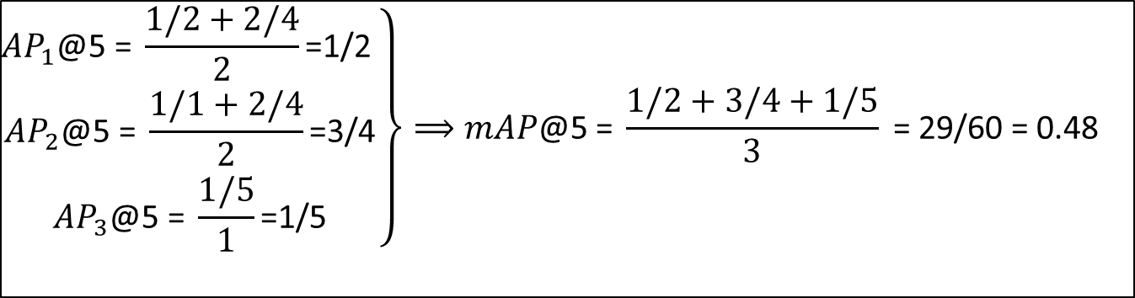
Exercise: mAP
What is the mAP@5 of the following query results?
  Result 1: 1 2 3 4 5
  Result 2: 1 2 3 4 5
  Result 3: 1 2 3 4 5
Sol:
$$\left.\begin{matrix}{AP}_{1}\text{@5 }\text{=} \frac{1/2+2/4}{2}\text{=}\text{1/}\text{2} \\ {AP}_{2}\text{@5 }\text{=} \frac{1/1+2/4}{2}\text{=}\text{3/4} \\ {AP}_{3}\text{@5 }\text{=} \frac{1/5}{1}\text{=}\text{1/5}\end{matrix}\right\}⟹mAP\text{@}\text{5} \text{=} \frac{1/2+3/4+1/5}{3}\text{ = }\text{29}\text{/}\text{6}\text{0 = 0.4}\text{8}$$

Slide 13
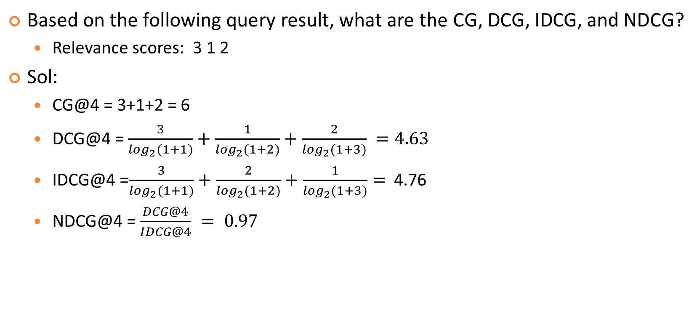
Exercise: CG, DCG, IDCG, and NDCG
Based on the following query result, what are the CG, DCG, IDCG, and NDCG?
  Relevance scores: 3 1 2
Sol:
  CG@4 = 3+1+2 = 6
  DCG@4 = $\frac{3}{\log_{2}(1+1)}+\frac{1}{\log_{2}(1+2)}+\frac{2}{\log_{2}(1+3)} =4.63$
  IDCG@4 =$\frac{3}{\log_{2}(1+1)}+\frac{2}{\log_{2}(1+2)}+\frac{1}{\log_{2}(1+3)}=$ 4.76
  NDCG@4 = $\frac{DCG@4}{IDCG@4} = 0.97$

