Slide 1
Performance Indices for Classification
J.-S. Roger Jang (張智星)
MIR Lab, CSIE Dept.
National Taiwan University
jang@mirlab.org, http://mirlab.org/jang

Slide 2
Outline
Confusion matrices
  Performance indices based on confusion matrix
ROC, DET and AUROC
  Cost-sensitive classification
PRC and AUPRC
  Lift charts
Exercises

Slide 3
Intro. to Performance Indices (PIs)
Performance index
  Purposes
    To indicate the performance of a ML model
    To form the loss function when training a ML model
  AKA performance metrics, figure of merit, etc.
Different situations require different PIs
  Tasks
    Classification
    Sequence decoding
    Regression
    Ranking
  Situations which require special care
    Imbalanced dataset for classification
    Binary or multi-class classification problems

Slide 4
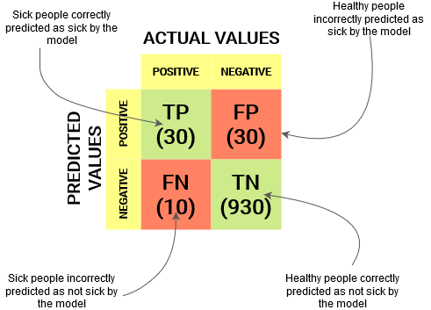
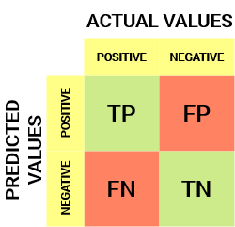
Confusion Matrix for Binary Classification
Confusion matrix for binary classification
  Can be extended to multi-class classification
Example: covid-19 detection
of 1000 cases
https://www.analyticsvidhya.com/blog/2020/04/confusion-matrix-machine-learning

Slide 5
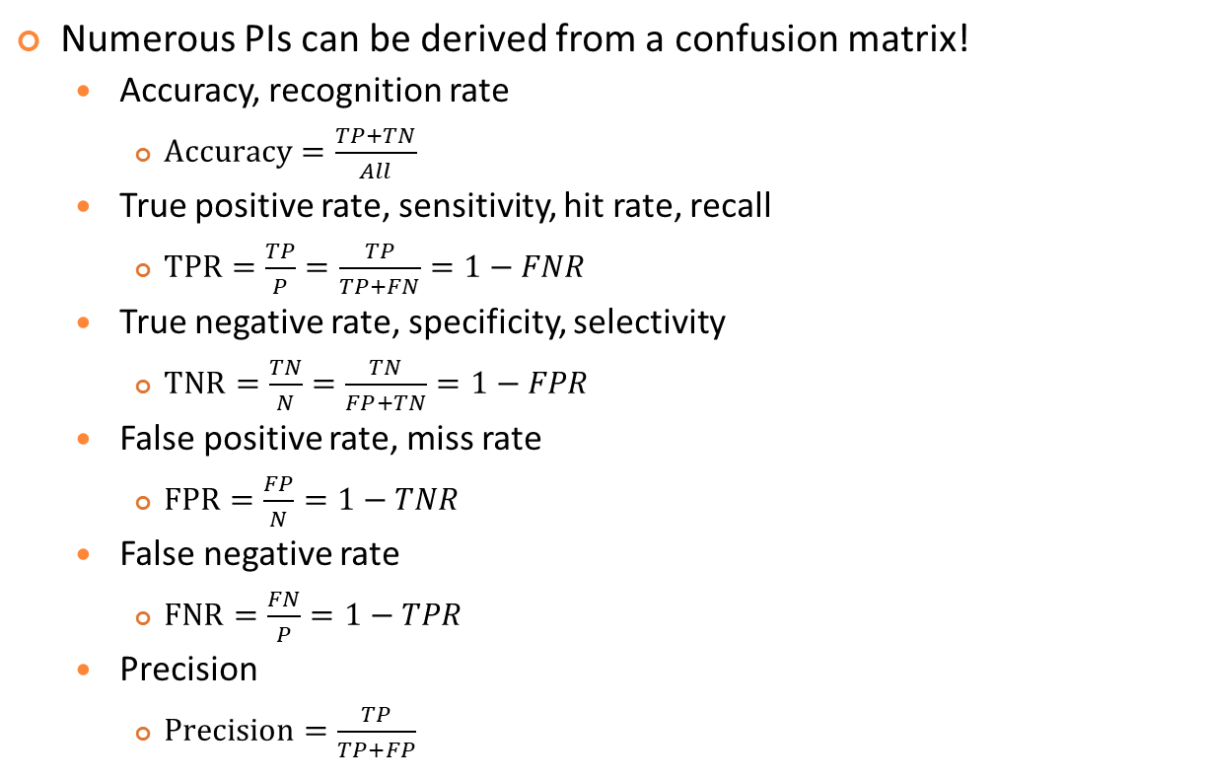
PIs Derived from Confusion Matrices
Quiz!
Numerous PIs can be derived from a confusion matrix!
  Accuracy, recognition rate
    $Accuracy=\frac{TP+TN}{All}$
  True positive rate, sensitivity, hit rate, recall
    $TPR=\frac{TP}{P}=\frac{TP}{TP+FN}=1−FNR$
  True negative rate, specificity, selectivity
    $TNR=\frac{TN}{N}=\frac{TN}{FP+TN}=1−FPR$
  False positive rate, miss rate
    $FPR=\frac{FP}{N}=1−TNR$
  False negative rate
    $FNR=\frac{FN}{P}=1−TPR$
  Precision
    $Precision=\frac{TP}{TP+FP}$
https://en.wikipedia.org/wiki/Confusion_matrix

Slide 6
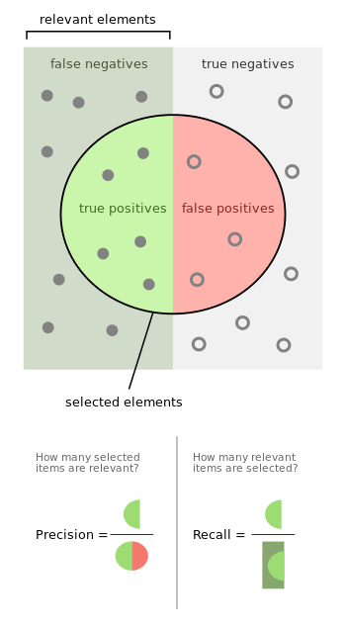
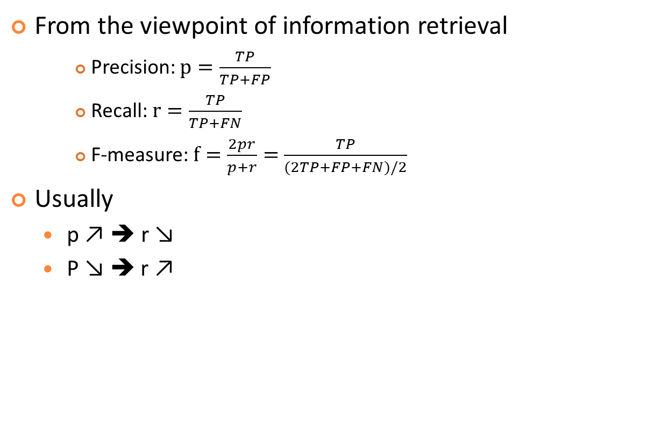
Precision and Recall
Quiz!
From the viewpoint of information retrieval
    Precision: $p=\frac{TP}{TP+FP}$
    Recall: $r=\frac{TP}{TP+FN}$
    F-measure: $f=\frac{2pr}{p+r}=$ $\frac{TP}{(2TP+FP+FN)/2}$
Usually
  p ↗ ➔ r ↘
  P ↘ ➔ r ↗
Harmonic mean
of p and r
Aka F1-score
https://en.wikipedia.org/wiki/Precision_and_recall

Slide 7
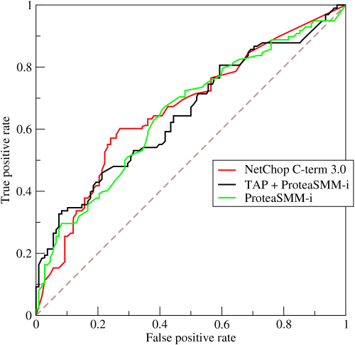
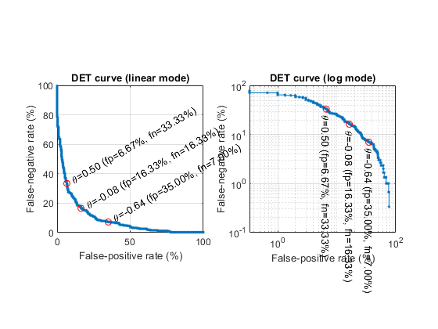
ROC and DET
Quiz!
ROC (Receiver Operating Characteristics) curve
  TPR vs. FPR when threshold is varying
  Endpoints at (0, 0) & (1, 1)
DET (Detection Error Tradeoff) curve
  FNR vs. FPR when threshold is varying
  Endpoints at (0, 1) & (1, 0)
ROC
Similarity, likelihood, etc
DET
https://en.wikipedia.org/wiki/Receiver_operating_characteristic

Slide 8
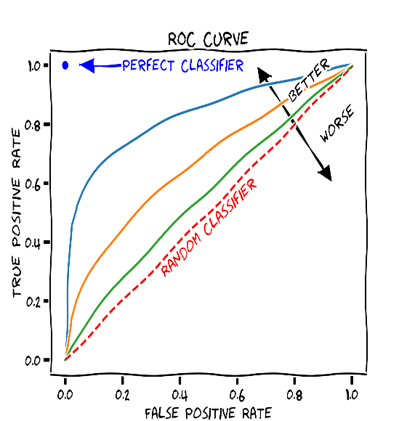
AUROC
Quiz!
AUROC: Area under ROC
  0.5 ≦ AUROC ≦ 1.0
    0.5 ➔ Random guess
    1.0 ➔ Perfect classification
  Suitable PI for imbalance datasets
  Determine the operating point based on cost
    For covid-19 detection, which classifier is better, A or B? At what operating points?
FNR
DET curves
A
B
FPR
https://en.wikipedia.org/wiki/Receiver_operating_characteristic

Slide 9
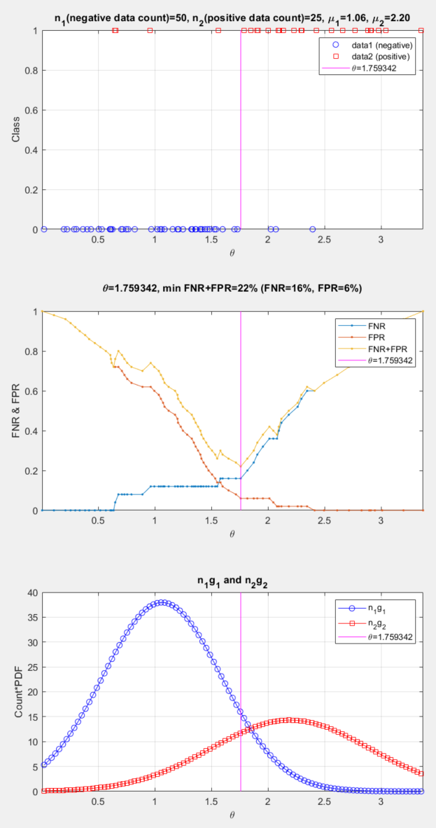
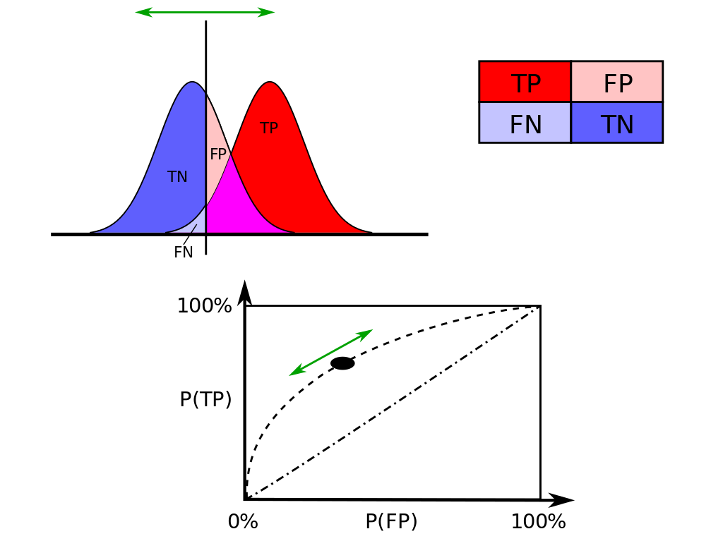
Two Ways to Plot ROC
Sample-point based
  Less smooth
  More realistic
Distribution based
  More smooth
  If the threshold is at the intersection
    FNR+FPR is minimized
    TPR+TNR is maximized

Slide 10

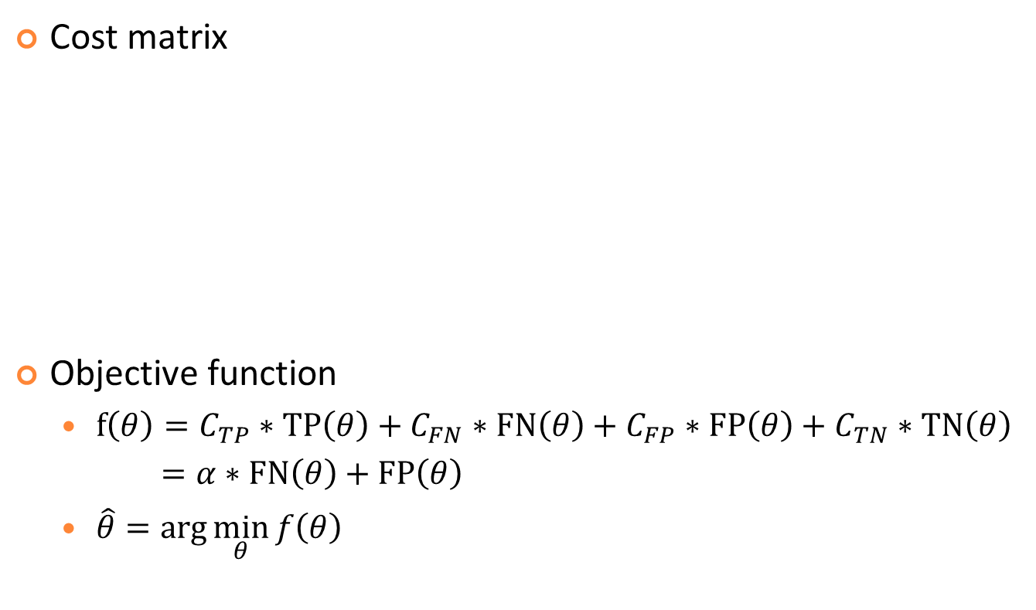

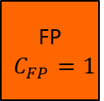
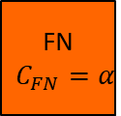
Cost-sensitive Classification
Quiz!
Cost matrix
Objective function
  $f\left(θ\right)={C_{TP}∗TP\left(θ\right)+C}_{FN}∗FN\left(θ\right)+C_{FP}∗FP\left(θ\right)+C_{TN}∗TN\left(θ\right)$
  $=α∗FN\left(θ\right)+FP\left(θ\right)$
  $\hat{θ}=\arg{\min_{θ}{f\left(θ\right)}}$
Prediction
Positive Negative
TP
$C_{TP}$=0
FN
$$C_{FN}=α$$
Usually a big number
Negative Positive
Groundtruth
FP
$$C_{FP}=1$$
TN
$C_{TN}$=0

Slide 11
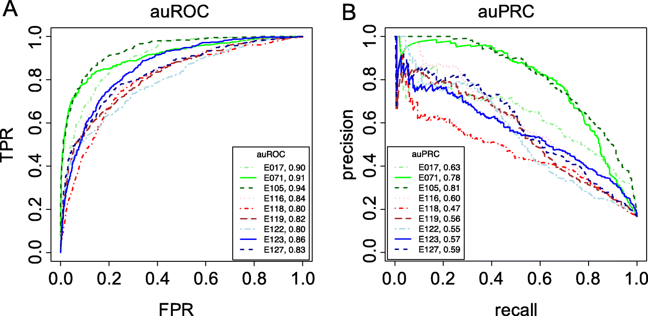
Precision-Recall Curve (PRC)
PRC
  Plot of precision vs. recall
AUPRC (area under PRC)
  Usually not smooth
  Where are the endpoints?
Quiz!

Slide 12
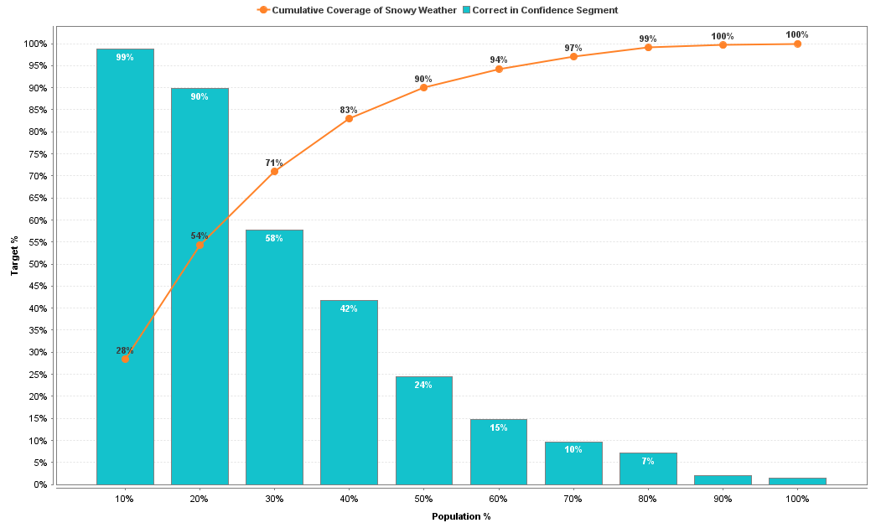
Lift Charts
Good for convincing people to appreciate power of ML
Example:
Cumulated Recall
Bin precision
⬅ 對40%人發送廣告，就可以抓到83%想出國的人！

Slide 13
Exercise: PIs Based on a Confusion Matrix
Derive various PIs based on the confusion matrix obtained from a detection method for covid-19:
Prediction
Positive Negative
TP
= 30
FN
= 10
Negative Positive
Groundtruth
FP
= 20
TN
= 940

Slide 14

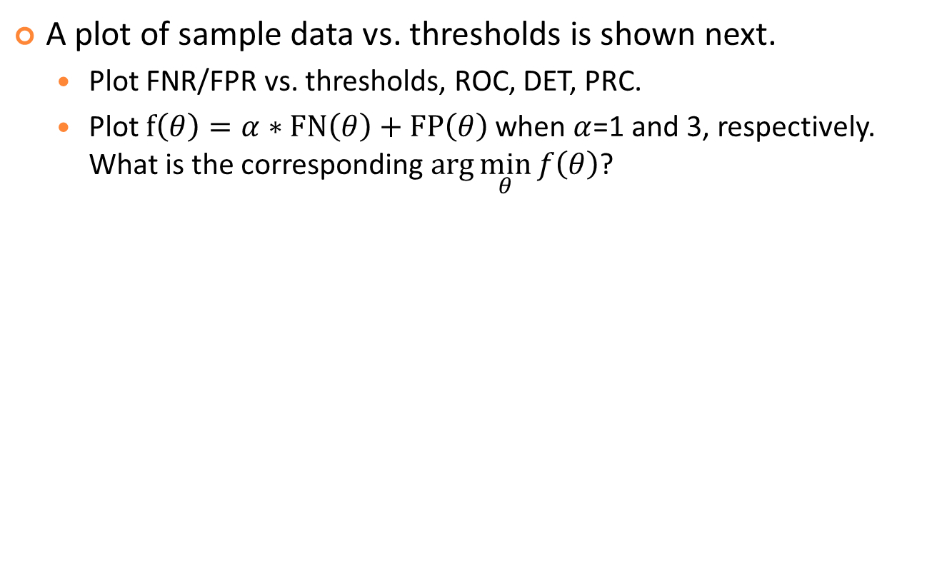
Exercise: ROC/DET/PRC
A plot of sample data vs. thresholds is shown next.
  Plot FNR/FPR vs. thresholds, ROC, DET, PRC.
  Plot $f\left(θ\right)=α∗FN\left(θ\right)+FP\left(θ\right)$ when $α$=1 and 3, respectively. What is the corresponding $\arg{\min_{θ}{f\left(θ\right)}}$?
Class
1: positive
o
o
o
0: negative
x
x
x
x
x
3
4
5
6
Threshold $θ$
7
8
9

Slide 15
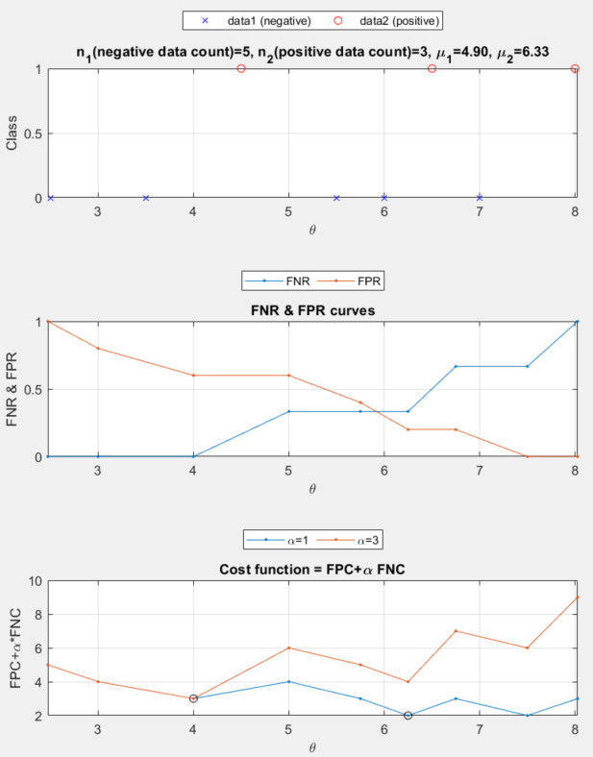
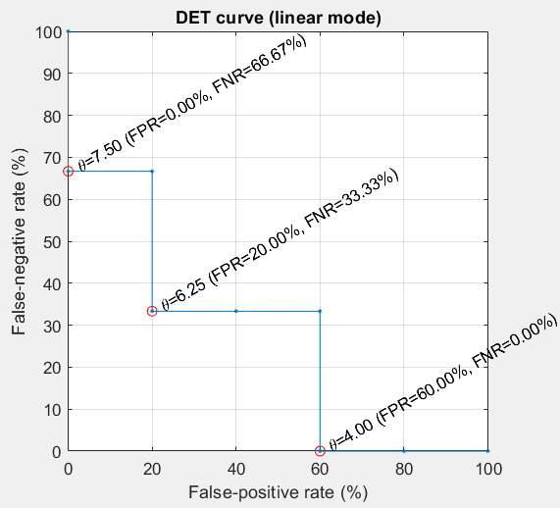
Exercise: DET/ROC
Another example
  FNR & FPR curves
  DET plots
  Cost function

Slide 16
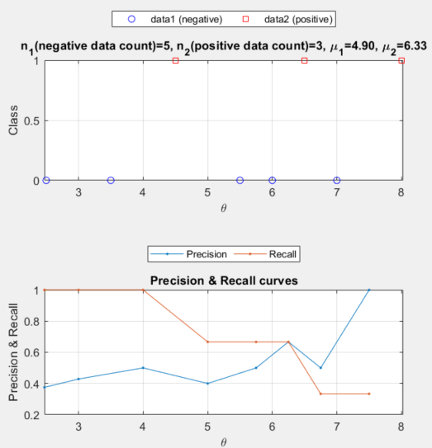
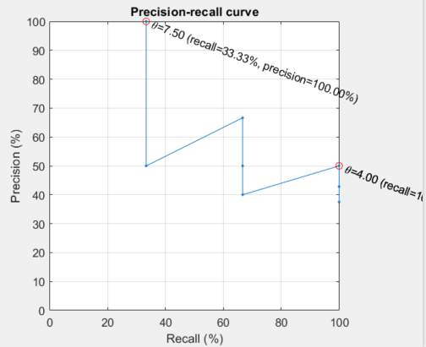
Exercise: PRC
Another example
  Precision & recall curves
  PRC plots

Slide 17
Exercise: DET/PRC
Increasing? Decreasing? Or none of the above?
  FNR vs. threshold
  FPR vs. threshold
  DET (FNT vs. FPR)
  Precision vs. threshold
  Recall vs. threshold
  PRC (precision vs. recall)
Endpoints?
  DET
  PRC

Slide 18
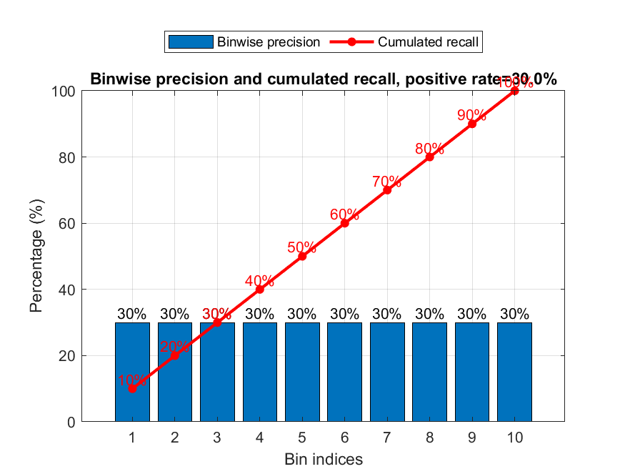
Exercise: Lift Chart
Plot the ideal lift chart of a random-guess classifier, with no. of bins equal to 10, and N:P=7:3 where N and P are numbers of negative and positive cases, respectively.

Slide 19
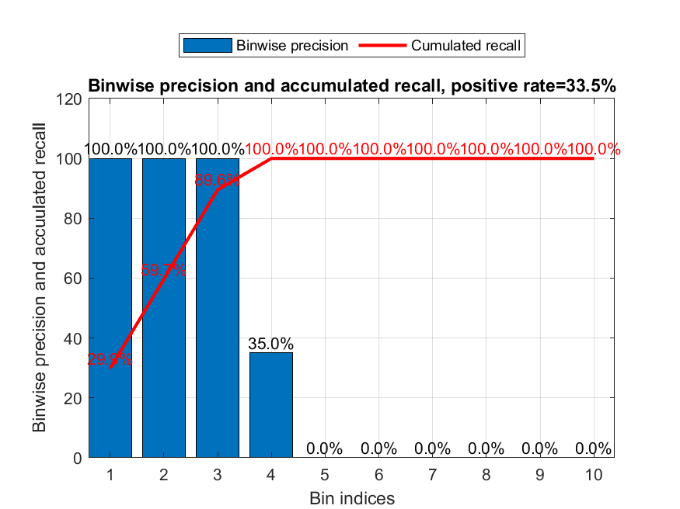
Exercise: Yet Another Lift Chart
Plot the lift chart of a perfect classifier when P=335 and N=665, with no. of bins equal to 10.

