Slide 1
Performance Evaluation for Time Series Prediction
J.-S. Roger Jang (張智星)
jang@mirlab.org
http://mirlab.org/jang
MIR Lab, CSIE Dept.
National Taiwan University
2025/12/13

Slide 2
Introduction to Time Series
What is a time series?
A time series is a sequence of data points (observations) collected in time order.
At each time instant, the observation could be a scalar or a vector.
Examples of time series
Average temperatures of summer days
Breath rate of a runner during a marathon
Daily OHLCV (open, high, low, close, volume) of a stock
…
Fact
Due to the time dependency of observations, we need a special cross validation (CV) for performance evaluation.

Slide 3
CV for Time Series Datasets
Basic principle
You can do whatever you want on the historical data for designing the model, but absolutely no peek into the future!
Historical data
Future data
Trn&Val
Test set
Train
Validate
Test
Time index
(Monotonically increasing)
Now!

Slide 4
Comparison of 4-fold CV
Datasets w/o time order
Time series datasets
Whole dataset
Whole dataset
Train&Val
Test
Train&Val
Test
Not used
Fold 1
Train&Val
Test
Train&Val
Train&Val
Test
Not used
Fold 2
Train&Val
Test
Train&Val
Train&Val
Test
Not used
Fold 3
Test
Train&Val
Train&Val
Test
Fold 4
Data index
(Permuted for stratified partition)
Time index
Train&Val = Training set + Validation set

Slide 5







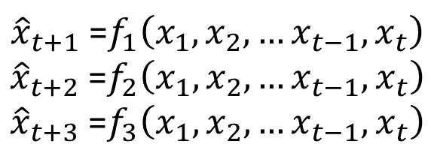

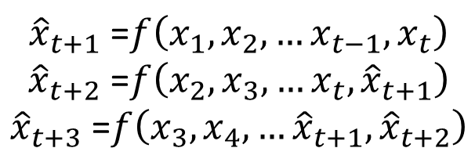
Two Types of Inference
Rolling inference with 1 model
Separate inference with 3 models
$${\hat{x}}_{t+1} \text{=}f\left(x_{1},x_{2}, …x_{t−1},x_{t}\right)$$
$${\hat{x}}_{t+2} \text{=}f\left(x_{2},x_{3}, …x_{t},{\hat{x}}_{t+1}\right)$$
$${\hat{x}}_{t+3} \text{=}f\left(x_{3},x_{4}, …{\hat{x}}_{t+1},{\hat{x}}_{t+2}\right)$$
$${\hat{x}}_{t+1} \text{=}f_{1}\left(x_{1},x_{2}, …x_{t−1},x_{t}\right)$$
$${\hat{x}}_{t+2} \text{=}f_{2}\left(x_{1},x_{2}, …x_{t−1},x_{t}\right)$$
$${\hat{x}}_{t+3} \text{=}f_{3}\left(x_{1},x_{2}, …x_{t−1},x_{t}\right)$$
$$x_{1}$$
$$x_{2}$$
$$…$$
$$x_{t−1}$$
$$x_{t}$$
$${\hat{x}}_{t+1}$$
$${\hat{x}}_{t+2}$$
$${\hat{x}}_{t+3}$$
Time index
Known historical data
for modeling building
Now!
Unknown future data

Slide 6
References
Cross validation in time series
https://medium.com/@soumyachess1496/cross-validation-in-time-series-566ae4981ce4
Using k-fold cross-validation for time-series model selection
https://stats.stackexchange.com/questions/14099/using-k-fold-cross-validation-for-time-series-model-selection
Cross-Validation: Unveiling Model Performance
https://statusneo.com/cross-validation-unveiling-model-performance/

Slide 7
Exercises
If running cross-validation (CV) on a dataset with d features costs k × d (where k is a constant),then what is the total cost of using sequential forward selection (SFS) to choose m features out of the d features?
Repeat the above question with sequential backward selection (SBS).

