Slide 1
Derivative-Free Optimization:
Simulated Annealing
Jyh-Shing Roger Jang (張智星)
MIR Lab, CSIE Dept.
National Taiwan University
http://mirlab.org/jang

Slide 2
Outline
Introduction
Basic concept of simulated annealing (SA)
Examples
Summary

Slide 3
Simulated Annealing
Analogy

Slide 4
Terminology in Simulated Annealing
Terminology:
  Objective function E(x): function to be minimized
  Move set: set of next points to explore
  Generating function: function for selecting the next point
  Acceptance function h(ΔE, T): probability to accept the selected point x_{new}, with ΔE=E(x_{new})-E(x) and h(ΔE, T) = 1/(1+exp(ΔE/(cT)).
  Annealing (cooling) schedule: schedule for reducing the temperature T

Slide 5
Flowchart for Simulated Annealing
SA flowchart
Select a new point xnew in the move sets
via generating function
Compute the obj. function E(xnew)
Set x to xnew with prob. determined
by h(ΔE, T)
Reduce temperature T

Slide 6
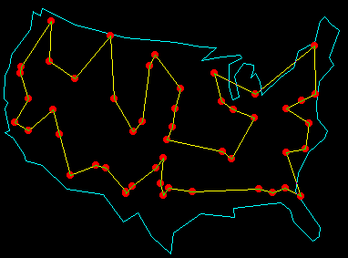
Example of TSP
Travel salesperson problem (TSP)
  How to traverse n cities once and only once with a minimal total distance?

Slide 7
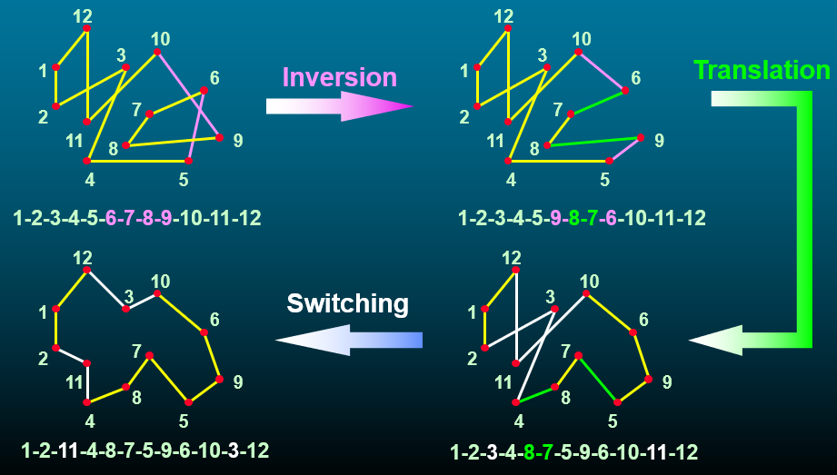
Move Sets for TSP
Typical move sets for TSP

Slide 8
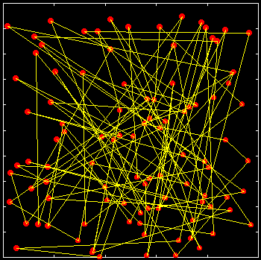
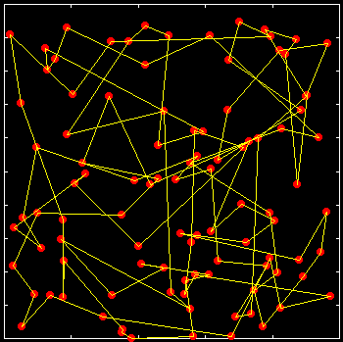
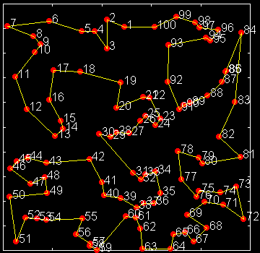
TSP with 100 Cities
A 100-city TSP using SA
Initial random path
During SA process
Final path

Slide 9
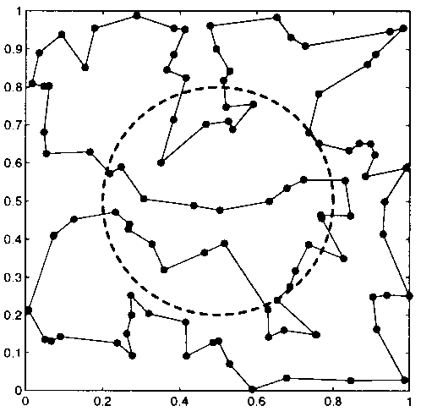
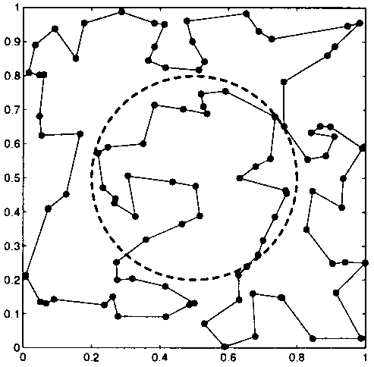
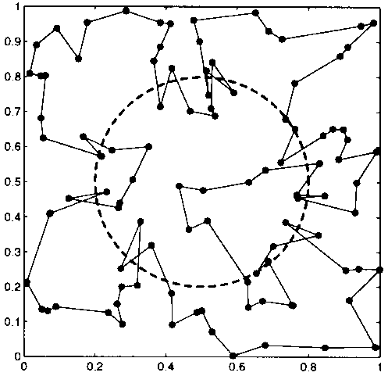
TSP with Penalty
100-city TSP with penalty when cross the circle
Penalty = 0
Penalty = 0.5
Penalty = -0.3

Slide 10
Summary: Properties of SA
Strength
  Simple & intuitive concept
  Easy in implementation, with many variants
  Inherent for parallel computing
Weakness
  Slow when compared with derivative-based methods
  Move sets highly dependent on tasks to be tackled
  No guarantee for global optimum

