Slide 1
Derivative-based Optimization: Gradient Descent 梯度下降法
J.-S. Roger Jang (張智星)
jang@mirlab.org
http://mirlab.org/jang
MIR Lab, CSIE Dept.
National Taiwan University

Slide 2
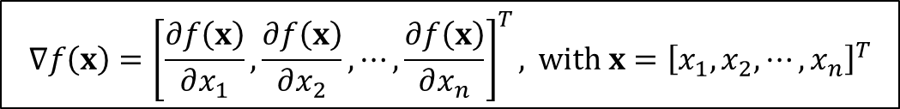
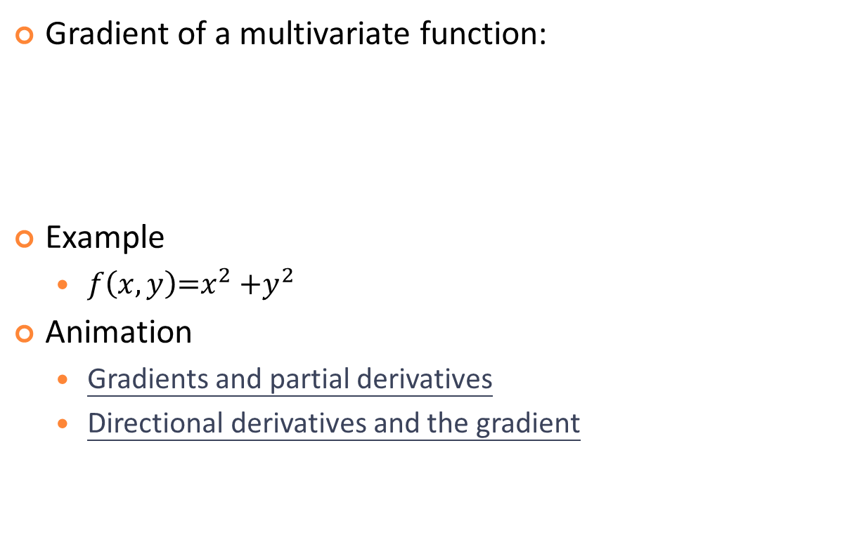
Gradient
Gradient of a multivariate function:
Example
$f\left(x,y\right)\text{=}x^{2}$ ${+y}^{2}$
Animation
Gradients and partial derivatives
Directional derivatives and the gradient
$$∇f\left(x\right)={\left[\frac{∂f\left(x\right)}{∂x_{1}},\frac{∂f\left(x\right)}{∂x_{2}},⋯,\frac{∂f\left(x\right)}{∂x_{n}}\right]}^{T}, \text{with} x={\left[x_{1},x_{2},⋯,x_{n}\right]}^{T}$$
Quiz inside!

Slide 3
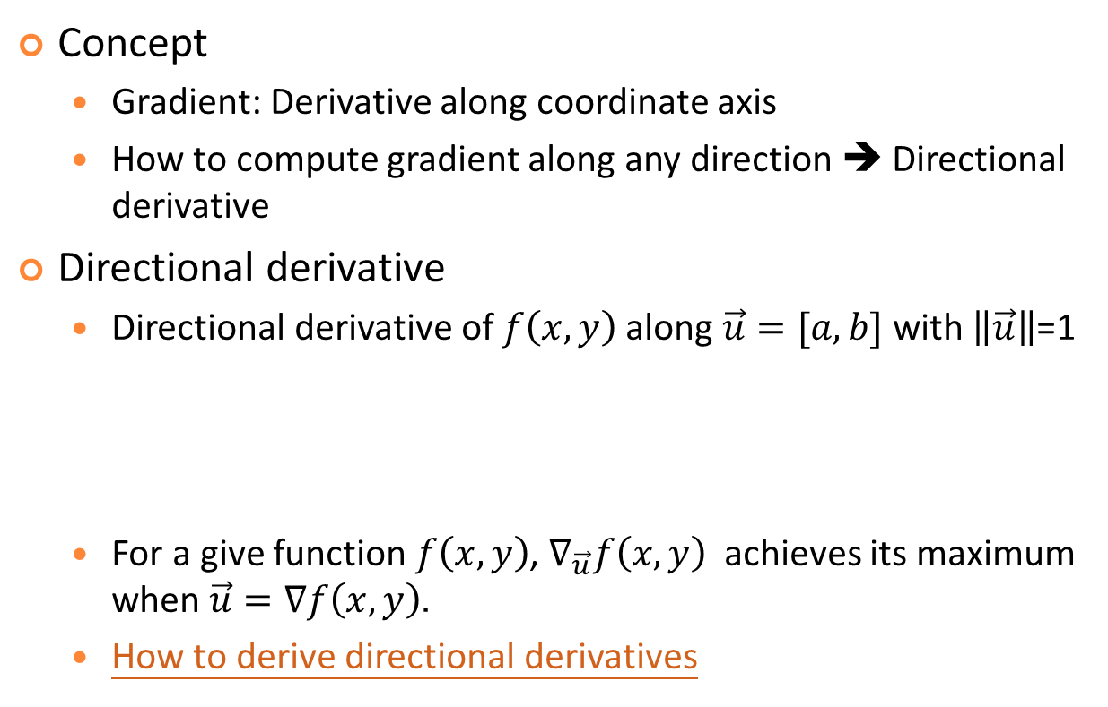
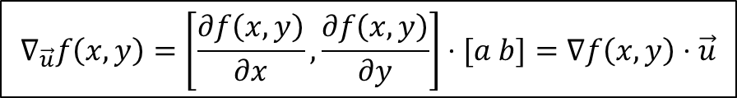
Directional Derivatives
Concept
Gradient: Derivative along coordinate axis
How to compute gradient along any direction ➔ Directional derivative
Directional derivative
Directional derivative of $f\left(x,y\right)$along$\vec{u}=[a,b]$ with $\left\|\vec{u}\right\|$=1
For a give function $f\left(x,y\right)$, $∇_{\vec{u}}f\left(x,y\right)$ achieves its maximum when $\vec{u}=∇f\left(x,y\right).$
How to derive directional derivatives
$$∇_{\vec{u}}f\left(x,y\right)=\left[\frac{∂f\left(x,y\right)}{∂x},\frac{∂f\left(x,y\right)}{∂y}\right]⋅[a b]=∇f\left(x,y\right)⋅\vec{u}$$
Quiz!
Clear explanation!

Slide 4
How to Derive Directional Derivatives?

Slide 5




Gradient Descent (GD)
Gradient descent (GD): AKA steepest descent (SD)
Goal: Minimize a function iteratively based on gradient
Formula for GD:
Normalized version
With momentum
Quiz!
$$Δx=−η∇f\left(x\right)$$
or
$$x_{next}=x_{now}−η∇f\left(x_{now}\right)$$
Vanilla GD
Step size or learning rate
$$Δx=−η\frac{∇f\left(x\right)}{\left\|∇f\left(x\right)\right\|}$$
$$Δx=−η∇f\left(x\right)+α(Δ{x)}_{prev}$$

Slide 6
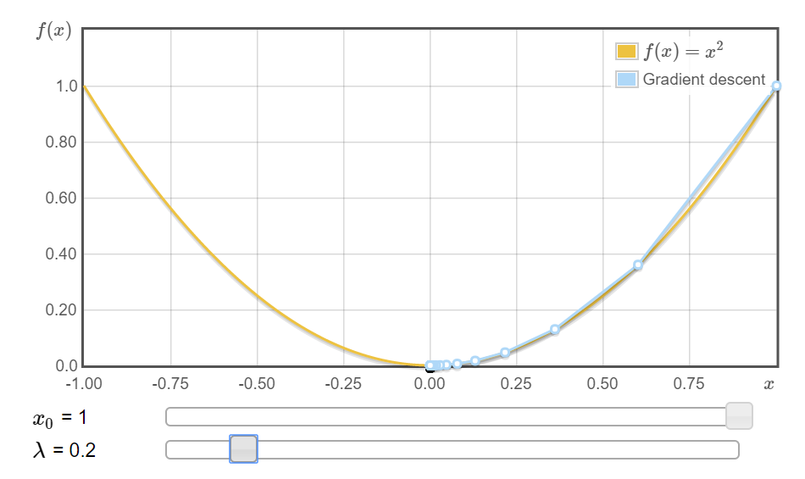
Example of Single-Input Functions
If n=1, GD reduces to the problem of going left or right.
Example
Animation:
http://www.onmyphd.com/?p=gradient.descent

Slide 7
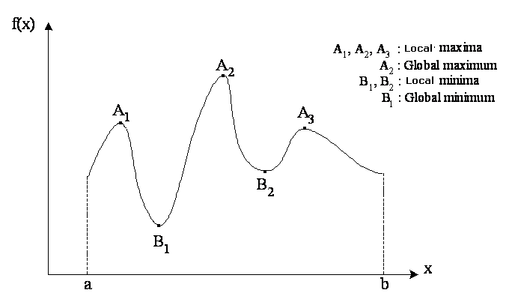
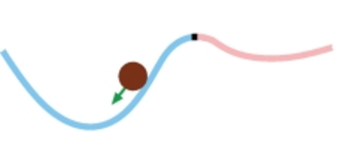
Basin of Attraction in 1D
Each point/region with zero gradient has a basin of attraction

Slide 8

Example of Two-input Functions
$z=f\left(x,y\right)\text{=}x^{2}$ ${+y}^{2}$

Slide 9
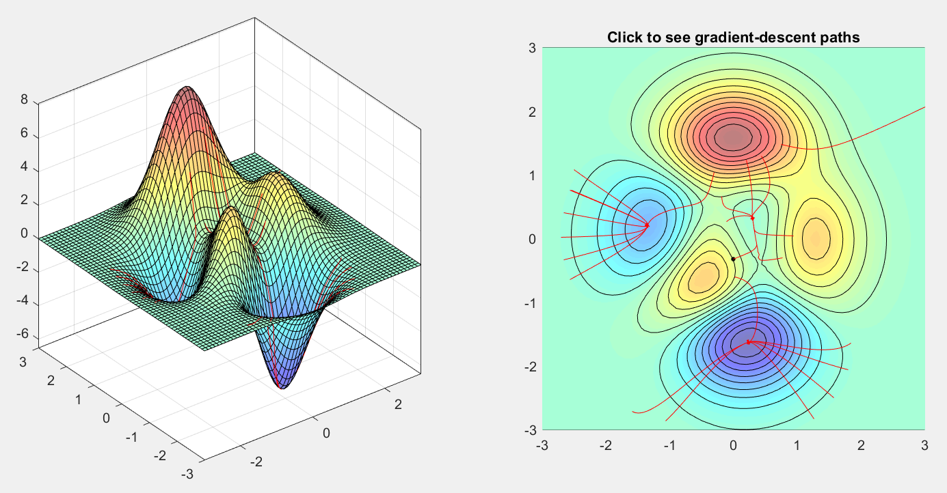
“Peaks” Functions (1/2)
If n=2, GD needs to find a direction in 2D plane.
Example: “Peaks” function in MATLAB
Animation: gradientDescentDemo.m
Gradients is
perpendicular
to contours, why?
3 local maxima
3 local minima

Slide 10
“Peaks” Functions (2/2)
Gradient of the “peaks” function
dz/dx = -6*(1-x)*exp(-x^2-(y+1)^2) - 6*(1-x)^2*x*exp(-x^2-(y+1)^2) - 10*(1/5-3*x^2)*exp(-x^2-y^2) + 20*(1/5*x-x^3-y^5)*x*exp(-x^2-y^2) - 1/3*(-2*x-2)*exp(-(x+1)^2-y^2)
dz/dy = 3*(1-x)^2*(-2*y-2)*exp(-x^2-(y+1)^2) + 50*y^4*exp(-x^2-y^2) + 20*(1/5*x-x^3-y^5)*y*exp(-x^2-y^2) + 2/3*y*exp(-(x+1)^2-y^2)
d(dz/dx)/dx = 36*x*exp(-x^2-(y+1)^2) - 18*x^2*exp(-x^2-(y+1)^2) - 24*x^3*exp(-x^2-(y+1)^2) + 12*x^4*exp(-x^2-(y+1)^2) + 72*x*exp(-x^2-y^2) - 148*x^3*exp(-x^2-y^2) - 20*y^5*exp(-x^2-y^2) + 40*x^5*exp(-x^2-y^2) + 40*x^2*exp(-x^2-y^2)*y^5 -2/3*exp(-(x+1)^2-y^2) - 4/3*exp(-(x+1)^2-y^2)*x^2 -8/3*exp(-(x+1)^2-y^2)*x

Slide 11
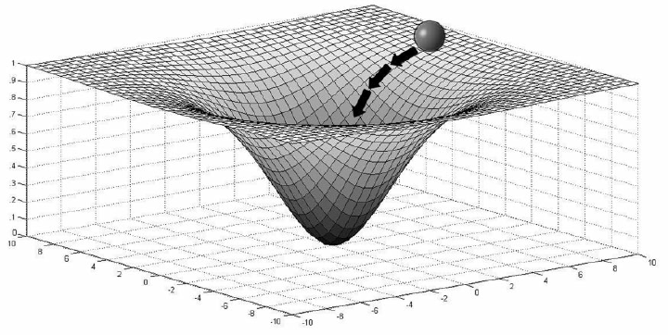
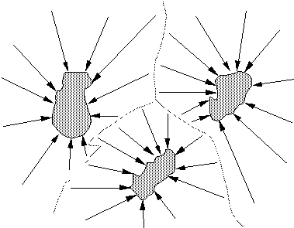
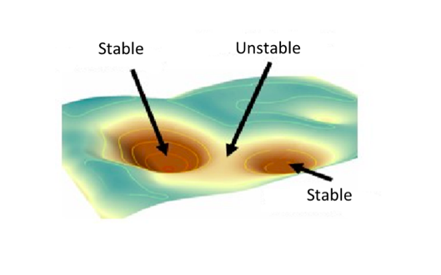
Basin of Attraction in 2D
Each point/region with zero gradient has a basin of attraction

Slide 12
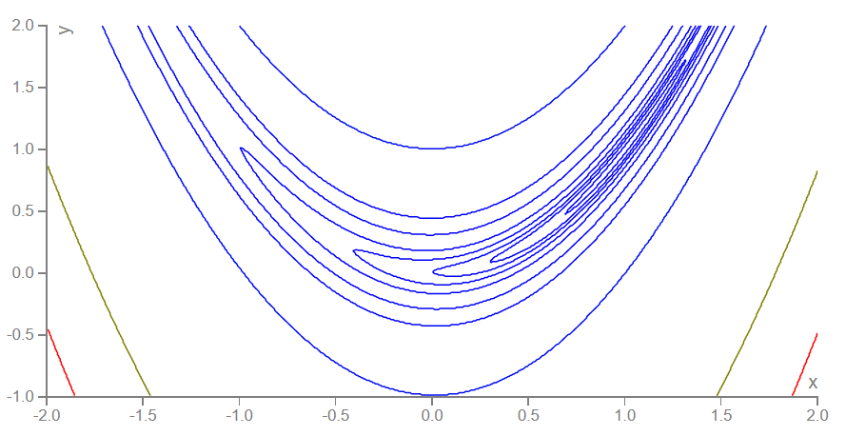
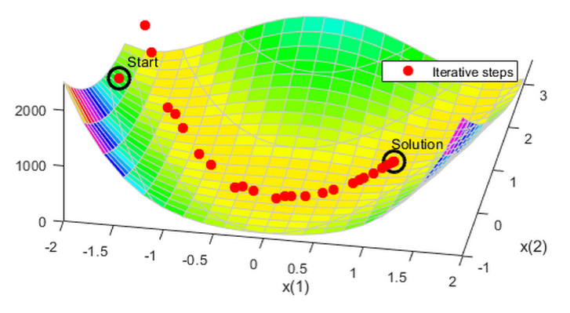
Rosenbrock Function
Rosenbrock function
More about this function
Animation: http://www.onmyphd.com/?p=gradient.descent
Document on how to optimize this function
Justification for using momentum terms

Slide 13
Properties of Gradient Descent
Properties
No guarantee for reaching global optimum
Feasible for differentiable objective functions (which can have finite number of non-differentiable points)
Performance heavily dependent on starting point and step size
Variants
Use adaptive step sizes
Normalize the gradient by its length
Use the momentum term to reduce zig-zag paths
Use line minimization at each iteration
Quiz!

Slide 14
Comparisons of Gradient-based Optimization
Gradient descent (GD)
Treat all parameters as nonlinear
Hybrid learning of GD+LSE
Distinguish between linear and nonlinear
Conjugate gradient descent
Try to reach the minimizing point by assume the objective function is quadratic
Gauss-Newton (GN) method
Linearize the objective function to treat all parameters as linear
Levenberg-Marquardt (LM) method
Switch smoothly between GD and GN

Slide 15
Gauss-Newton Method
Synonyms
Linearization method
Extended Kalman filter method
Concept:
General nonlinear model: y = f(x, θ)
linearization at θ = θnow:
y = f(x, θnow)+a1(θ1 - θ1,now)+a2(θ2 - θ2,now) + ...
LSE solution:
θnext = θnow + η(A^{T}A)⁻¹A^{T}B

Slide 16
Levenberg-Marquardt Method
Formula
θnext = θnow + η(A^{T}A+λI)⁻¹A^{T}B
Effects of λ
λ small ➔ Gauss-Newton method
λ big ➔ Gradient descent
How to update λ
Greedy policy ➔ Make λ small
Cautious policy ➔ Make λ big

Slide 17


Exercises (1/2)
Can we use GD to find the minimum of f(x)=|x|?
What is the gradients of the following functions? Can you express y’ in terms of y?
What are the basins of attraction of the following curve?
$$y=\frac{1}{1+e^{−x}}$$
$$y=\frac{1−e^{−x}}{1+e^{−x}}$$
Quiz: The gradient of y=e^{ax}
can be expressed in terms of y. Why?

Slide 18

Exercises (2/2)
What is the gradient of $f(x,y)=sin(x)e^{y}$ at (π, 0)?
Answer: (-1, 0)
Compute the directional derivative of $f(x,y)=sin(x)e^{y}$ at the point (π, 0) in the direction of (3, 4).
Answer: -0.6

