Slide 1
Derivative-Free Optimization:
Genetic Algorithms
Jyh-Shing Roger Jang (張智星)
MIR Lab, CSIE Dept.
National Taiwan University
http://mirlab.org/jang

Slide 2
Outline
Introduction
Basic concept of genetic algorithms (GA)
Examples
Summary

Slide 3
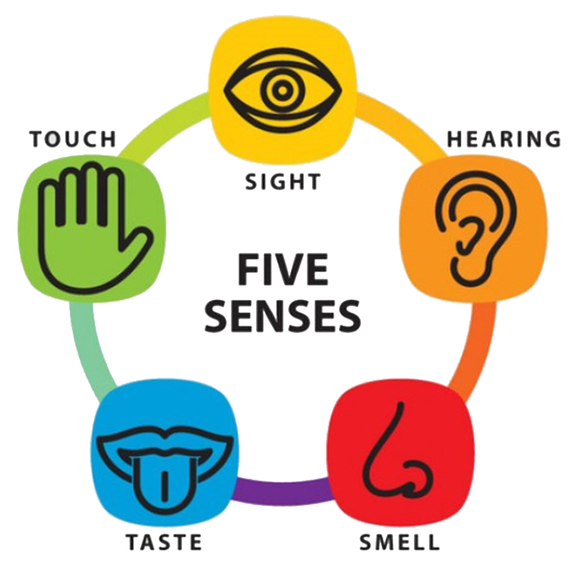

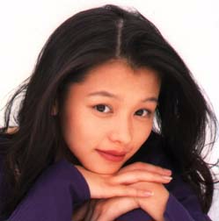
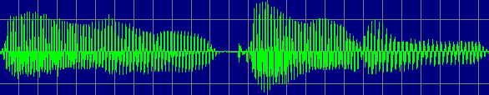
Motivation behind Genetic Algorithms
Look at what revolution brings us?
Can we emulate the evolutionary process with today’s fast computers?
+
Learning & reasoning

Slide 4
Terminology in Genetic Algorithms
Fitness function
  Objective function to be maximized
Population
  Samples within the parameter space
Encoding scheme
  How to encode a sample in the parameter space into a binary string
Selection
  How to select the best individuals
Crossover & mutation
  How to generate the next population for exploration
Elitism
  Always keep the best several samples for the next generation

Slide 5
Encoding, Crossover, and Mutation
Binary encoding
Crossover
Mutation
Chromosome
(11, 6, 9) 1011 0110 1001
Gene
Gene
1 0 0 1 1 1 1 0 0 1 1 1 1 1 1 0
0 1 1 1 0 0 1 0 1 0 0 1 0 0 1 0
Crossover point
1 0 0 1 1 1 1 0 1 0 0 1 1 0 1 0
Mutation bit

Slide 6
Reproduction
From one generation to the next one
10010110
01100010
10100100
10011001
01100101
. . .
. . .
. . .
. . .
Elitism
10010110
01100010
10100100
01111001
10000101
. . .
. . .
. . .
. . .
Selection
Crossover
Mutation
Current
generation
Sorted in descending order
of fitness value
Next
generation

Slide 7
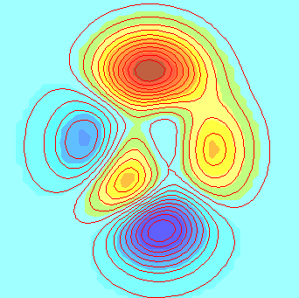
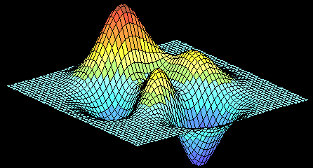
Example
Find the max. of the “peaks” function
  z = f(x, y) = 3*(1-x)^2*exp(-(x^2) - (y+1)^2) - 10*(x/5 - x^3 - y^5)*exp(-x^2-y^2) -1/3*exp(-(x+1)^2 - y^2).

Slide 8
Optimization based on Derivatives
Derivatives of the “peaks” function
  dz/dx = -6*(1-x)*exp(-x^2-(y+1)^2) - 6*(1-x)^2*x*exp(-x^2-(y+1)^2) - 10*(1/5-3*x^2)*exp(-x^2-y^2) + 20*(1/5*x-x^3-y^5)*x*exp(-x^2-y^2) - 1/3*(-2*x-2)*exp(-(x+1)^2-y^2)
  dz/dy = 3*(1-x)^2*(-2*y-2)*exp(-x^2-(y+1)^2) + 50*y^4*exp(-x^2-y^2) + 20*(1/5*x-x^3-y^5)*y*exp(-x^2-y^2) + 2/3*y*exp(-(x+1)^2-y^2)
  d(dz/dx)/dx = 36*x*exp(-x^2-(y+1)^2) - 18*x^2*exp(-x^2-(y+1)^2) - 24*x^3*exp(-x^2-(y+1)^2) + 12*x^4*exp(-x^2-(y+1)^2) + 72*x*exp(-x^2-y^2) - 148*x^3*exp(-x^2-y^2) - 20*y^5*exp(-x^2-y^2) + 40*x^5*exp(-x^2-y^2) + 40*x^2*exp(-x^2-y^2)*y^5 -2/3*exp(-(x+1)^2-y^2) - 4/3*exp(-(x+1)^2-y^2)*x^2 -8/3*exp(-(x+1)^2-y^2)*x
  d(dz/dy)/dy = -6*(1-x)^2*exp(-x^2-(y+1)^2) + 3*(1-x)^2*(-2*y-2)^2*exp(-x^2-(y+1)^2) + 200*y^3*exp(-x^2-y^2)-200*y^5*exp(-x^2-y^2) + 20*(1/5*x-x^3-y^5)*exp(-x^2-y^2) - 40*(1/5*x-x^3-y^5)*y^2*exp(-x^2-y^2) + 2/3*exp(-(x+1)^2-y^2)-4/3*y^2*exp(-(x+1)^2-y^2)

Slide 9
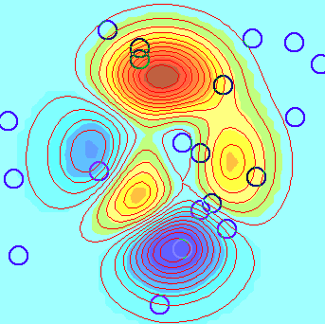
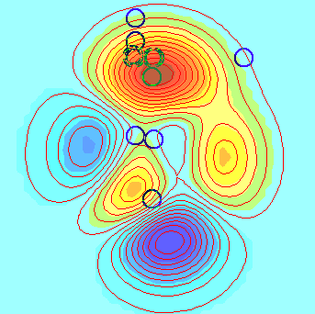
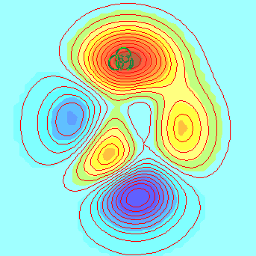
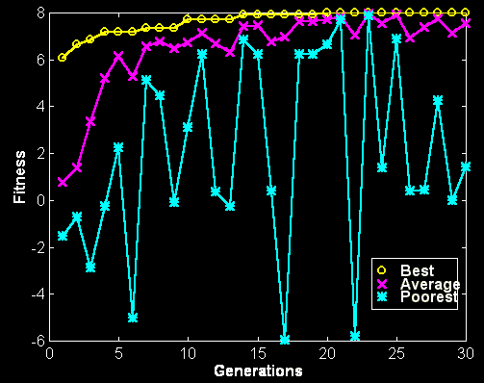
Generations of GAs
Population distribution of GA for the “peaks” function
Performance across generations
Initial population
5th generation
10th generation

Slide 10
Summary: Properties of GAs
Strength
  Simple concept which seems intuitive
  Easy in implementation, with many variants
  Inherent for parallel computing
Weakness
  Hard to analyze
  Slow when compared with derivative-based methods
  No guarantee for global optimum
  Success of GAs highly dependent on good encoding scheme
Quiz!

Slide 11
大文豪的智慧
有一位著名漂亮的女舞蹈家給大文豪蕭伯納寫了一封熱情洋溢的情書，言詞多在誇獎自己的美貌，想以此誘惑蕭伯納並獲得他的青睞。
她在信中反覆暗示，他倆天生美貌與智慧並存，適合在一起，她甚至毫不害羞地說，如果他倆能結婚，那將對優生是件好事：「將來，生個孩子能具有你那樣的智慧和我這樣的外貌，該有多麼美妙！」
蕭伯納在回信中表示不能接受這番好意。他說：「那個孩子如果只有我這樣的外貌和你那樣的智慧，就糟透了！」文學家的拒絕，幽默且充滿諷刺。

