Slide 1
Downhill Simplex Search (Nelder-Mead Method)
J.-S. Roger Jang (張智星)
jang@mirlab.org
http://mirlab.org/jang
MIR Lab, CSIE Dept.
National Taiwan University

Slide 2
Downhill Simplex Search (DSS)
DSS: A heuristic search method that tries to find the minimizing point in a function of several variables
Proposed by John Nelder & Roger Mead in 1965
AKA amoeba method, Nelder-Mead method
Concept
Use a simplex of n+1 points to explore the objective function with n inputs
Simplex: interval in 1D, triangle in 2D, tetrahedron in 3D, etc.
Operations for a Simplex to approach and pinpoint the minimum: reflection, expansion, contraction, shrink
Quiz!

Slide 3
Basic Operation: Reflection
Reflection toward downhill direction
location probed by reflection step
worst point (highest function value)

Slide 4
Basic Operation: Expansion
Try an expansion if reflection resulted in the lowest value
location probed by expansion step

Slide 5
Basic Operation: Contraction
Try a contraction if reflection resulted in the highest value
location probed by contration step

Slide 6
Basic Operation: Shrink
Shrink the simplex around the best point if all else fails.

Slide 7
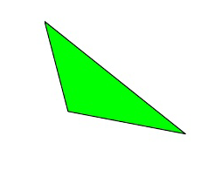
DSS
Parameters for DSS
R=1 (reflection)
E=2 (expansion)
K=0.5 (contraction)
S=0.5 (shrinkage)

Slide 8
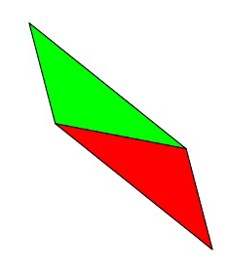
Steps in DSS (1/4)
Sort by function value: Order the vertices to satisfy f₁ < f₂ < … < f_{n+1}
Let x_{m} = the average of the points x₁ to x_{n.}
Reflection. Compute x_{r} = x_{m} + R(x_{m}-x_{n+1}) and evaluate f_{r} =f(x_{r}). If f₁ < f_{r} < f_{n} , accept x_{r} and terminate the iteration.

Slide 9
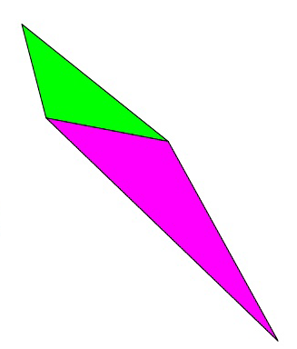
Steps in DSS (2/4)
Expansion. If f_{r} < f₁ calculate x_{e} = x_{m}+ E(x_{r} - x_{m}) and evaluate f_{e} =f(x_{e}). If f_{e} < f_{r} , accept x_{e} ; otherwise accept x_{r}. Terminate the iteration.

Slide 10
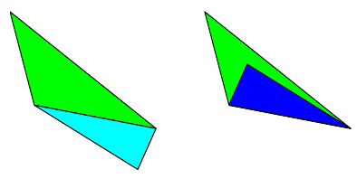
Steps in DSS (3/4)
Contraction. If f_{r} > f_{n}, perform a contraction between x_{m} and the better of x_{r} and x_{n+1}.
Outside. If f_{n} < f_{r} < f_{n+1} calculate x_{oc}= x_{m}+ K (x_{r} - x_{m}) and evaluate f(x_{oc}). If f_{oc}< f_{r}, accept x_{oc} and terminate the iteration; otherwise do a shrink.
Inside. If f_{r} > f_{n+1} calculate x_{ic} = x_{m} – K (x_{m}- x_{n+1}) and evaluate f(x_{ic}). If f_{ic}< f_{n+1} accept x_{ic} and terminate the iteration; otherwise do a shrink.

Slide 11
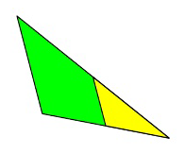
Steps in DSS (4/4)
Shrink. Evaluate f at the n points v_{i} = x_{i} + S (x_{i}-x₁), i = 2,….,n+1. The vertices of the simplex at the next iteration are x₁, v₂, …, v_{n+1}.

Slide 12



List of DSS Moves in 2D
DSS moves
Actions based on range of f_{r}
Contraction
(Outside)
Contraction
(Inside)
Expansion
Reflection
$$f_{1}$$
$$f_{n}$$
$$f_{n+1}$$

Slide 13
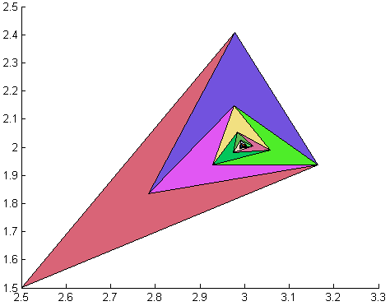
Example of DSS (1/2)

Slide 14
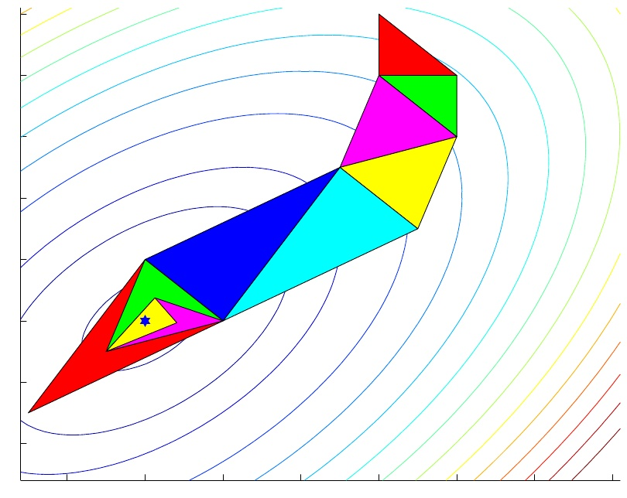
Example of DSS (2/2)

Slide 15
Functions for Optimization
MATLAB
Functions
Single variable: fminbnd
Multiple variables: fminsearch (which uses DSS)
Examples of using the above functions
請見「MATLAB 程式設計進階篇」的第8.4節「函數的極小值」
For more options, try the following toolboxes
Optimization Toolbox, Global Optimization Toolbox
Python
Functions
scipy.optimize.fmin

Slide 16
Summary of DSS
About DSS
Strengths
Intuitive concept
Easy to implement
No gradient or derivative needed
Does not care about smoothness of the objective function
Can be easily modified for various tasks
Weaknesses
Slow
Could be trapped in local minima
Hints
Start with various initial guesses to avoid local minima.
Improvise your own version of DSS.
Quiz!

Slide 17
References
DSS in Wikipedia
Many variants!
Some of our slides come from
http://physics.ujep.cz/~mmaly/vyuka/MPVT_II/Heuristiky/NelderMead.ppt
http://www.cs.princeton.edu/courses/archive/spr06/cos323/notes/lecture03_optimization/cos323_s06_lecture03_optimization.ppt

