Slide 1
Imputing Methods for Missing Data
缺漏資料的補值方法
J.-S. Roger Jang (張智星)
MIR Lab, CSIE Dept.
National Taiwan University
jang@mirlab.org, http://mirlab.org/jang

Slide 2
Outline
Introduction
Imputing methods
  Simple method
  MICE method
Summary

Slide 3
Format of Structured Dataset for Classification
Format of structured dataset
  Feature matrix: dxn
    d: feature dimension
    n: data count
  Class label: 1xn
    c: no. of classes
I/O pair
Column-major!
n I/O pairs
Features
Feature matrix (dxn)
Class label (1xn)
with values in 1~c
3
3
2
1
1
2
2
2
1
2
d = 6, n = 10, c=3
Class size ratio = 3:5:2

Slide 4
Anomaly in a Dataset
Outlier detection
  Via domain knowhow
    Body temperature 364 degrees
  Via box plot
  Via multiple ML models for leave-one-out CV
Other types of anomaly
  Two different-class I/O pairs with the same feature vectors
  A feature with the same value…
    Across a dataset ➔ We can delete the feature since it has not discriminant power.
    Across a class ➔ It will causes a error in naïve Bayes classifiers.
Why?

Slide 5
Simple Imputing Method for Missing Data
Simple imputing method
  Categorical feature: Use “mode” of the feature.
  Numerical feature: Use “mean” or “median” of the feature.
    Mean: Easily affected by extreme values (“income” for example)
Pros and cons of simple imputing
  Pros: Quick and easy
  Cons: Do not consider the correlation between features
    Example: “income” of a 20-years-old man
Extended simple imputing method
  Impute features based on “similar group”
    Impute “income” based on “similar-age group”
    Impute “height” based on “same-gender
    and similar-age group”
Quiz!
3
3
2
1
1
2
2

Slide 6
MICE Imputation for Missing Data
MICE: Multiple imputation by chained equations
  Use simple imputing at the beginning
  For each of the missing value, perform imputing one by one
    Categorical feature: Use “classification”
    Numerical feature: Use “regression”
  Repeat the above process until convergence.
Characteristics
  Iterative in nature ➔ Slow!
  Wide selection of classifiers/regressors
  For training set only, since we need to
    Use the whole dataset
    Use the labels as a feature
3
3
2
1
1
2
2
2
1
2

Slide 7
Missing Data Handling on Test/Validation Sets
Imputation for test/validation sets
  Duplicate the test input by adding each class labels ➔ c test inputs
  Perform regular classification based on the imputed training set and the imputed c test inputs
  Assign the class based on max. likelihood of these c inputs.
Duplicate
Impute
Classify
Class = arg max {P_{i} }
?
1
2
3
1
2
3
1
2
3
P₁
P₂
P₃

Slide 8
Caveat in Handling Missing Data during Cross Validation
Approximate method: Quick
  Impute missing data
  Perform cross validation
Exact method: Slow
  Hide a fold as the test set
  Impute the training set
  Use the hidden fold for evaluation (with imputation, if needed)
  Go back to step 1 until done.
3
3
2
1
1
2
2
2
1
2

Slide 9
Delete Features or I/O Pairs
If the missing data ratio is high and the dataset is large, we can simply delete features (rows) or data pairs (columns).
  Try to plot missing data ratio vs. features or I/O pairs
  For a given n, delete n features (or I/O pairs) to minimize overall missing data ratio ➔ Max coverage problem!
3
3
2
1
1
2
2
2
1
2
3
3
2
1
1
2
2
2
1
2
Missing data ratio = 21/60
Missing data ratio = 14/60

Slide 10
Summary
Missing data imputation is an important first task in handling real-world data.
We can use machine learning (classification or regression) for imputing missing data for the final machine learning task.
Evaluation of test input with missing data is not very straightforward.

Slide 11
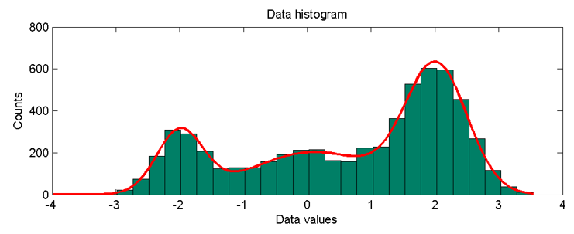
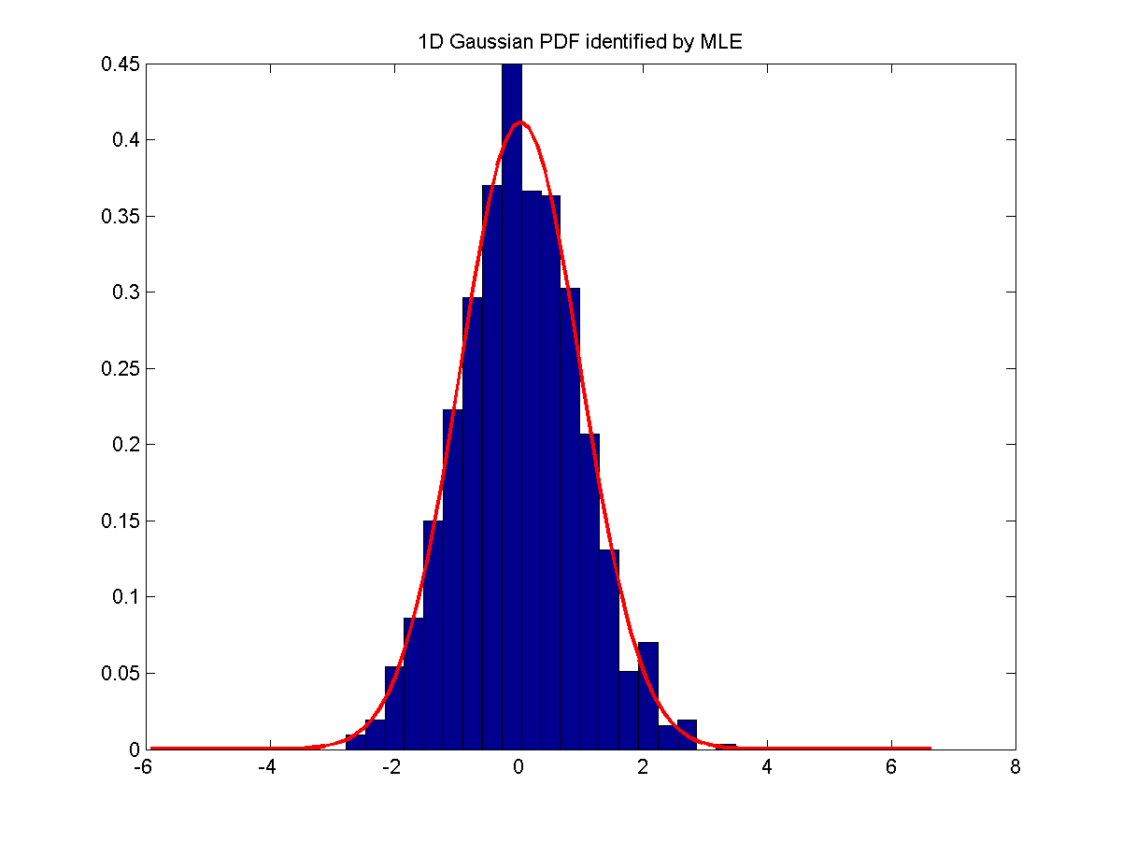
From Histogram to PDF
To create PDF
  Data ➔ Histogram ➔ PDF

Slide 12
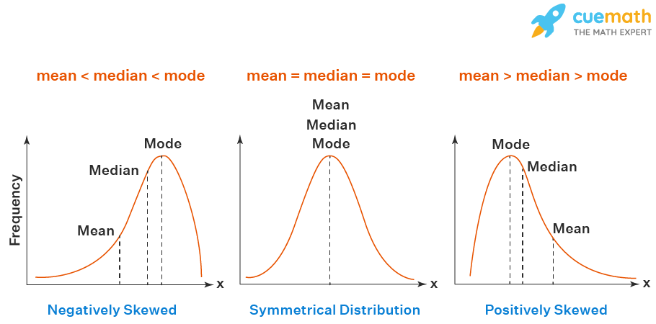
About Mean, Median, Mode
Representative numbers of distributions
  Mean: Average of samples
  Median: Middle number of sample after sorting
  Mode: Most-appearing number of samples
Quiz!
(Left Skewed)
(Right Skewed)
https://www.cuemath.com/data/relation-between-mean-median-and-mode

Slide 13
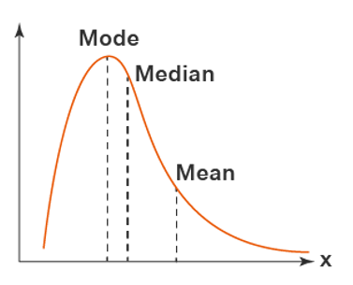


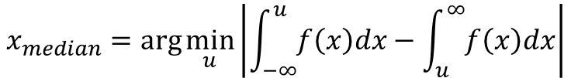
Definitions of Mean, Median, and Mode over Distributions
Given f(x), a PDF of a random variable x, then
$$x_{mode}=\arg{\max_{x}{f(x)}}$$
$$x_{median}=\arg{\min_{u}\left|\int_{−∞}^{u}{f\left(x\right)dx}−\int_{u}^{∞}{f\left(x\right)dx}\right|}$$
$$x_{mean}=\frac{\int_{−∞}^{∞}{xf\left(x\right)dx}}{\int_{−∞}^{∞}{f\left(x\right)dx}}$$
Always a single number!

Slide 14
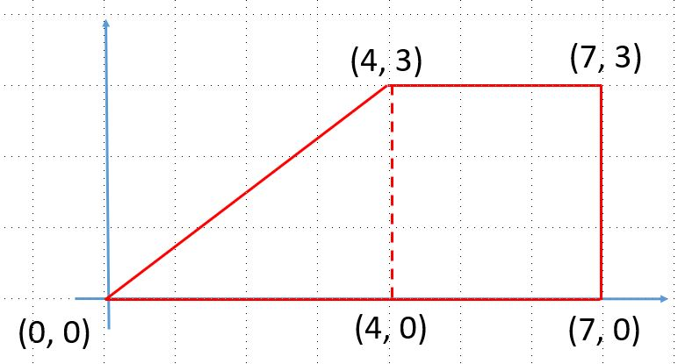
Exercise
Compute the mean, median, and mode of the following PDF-like histogram.

Slide 15
Visualization on Test Input Imputing
GHW (gender-height-weight) dataset
  Normal input
    (180, 85) ➔ Gender?
  Missing weight
    (180, NaN) ➔ Gender?
  Missing height
    (NaN, 85) ➔ Gender?

Slide 16
Visualization on Test Input Imputing
Y
X

Slide 17
Missing Value Imputation
Steps
  Determine neighborhood
  Derive the value
Neighborhood identification
  1D input
  2D input
  K-nearest neighbor
  All
Value determination
  Nearest
  Linear interpolation
  Model-based
Give examples…

Slide 18
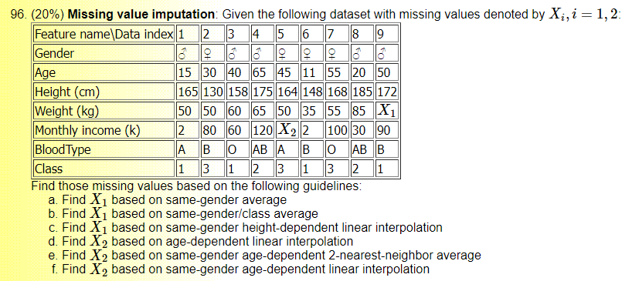
Missing Value Imputation: Example

