Slide 1
臺大醫神 MIRLAB Progress Report
Lim Wee Shin (林偉莘)
Advisor: J.-S. Roger Jang (張智星)
MIR Lab, CSIE Dept.
National Taiwan University
leo.lim@mirlab.org

Slide 2
Outline
Inheritance Retina Disease (陳達慶醫師)
Dataset
Hardware specs
Retinitis pigmentosa (RP) dataset
Training and evaluation models
Comparing finetune layers results
Training dataset results
Test dataset results
Error analysis
Heatmap

Slide 3
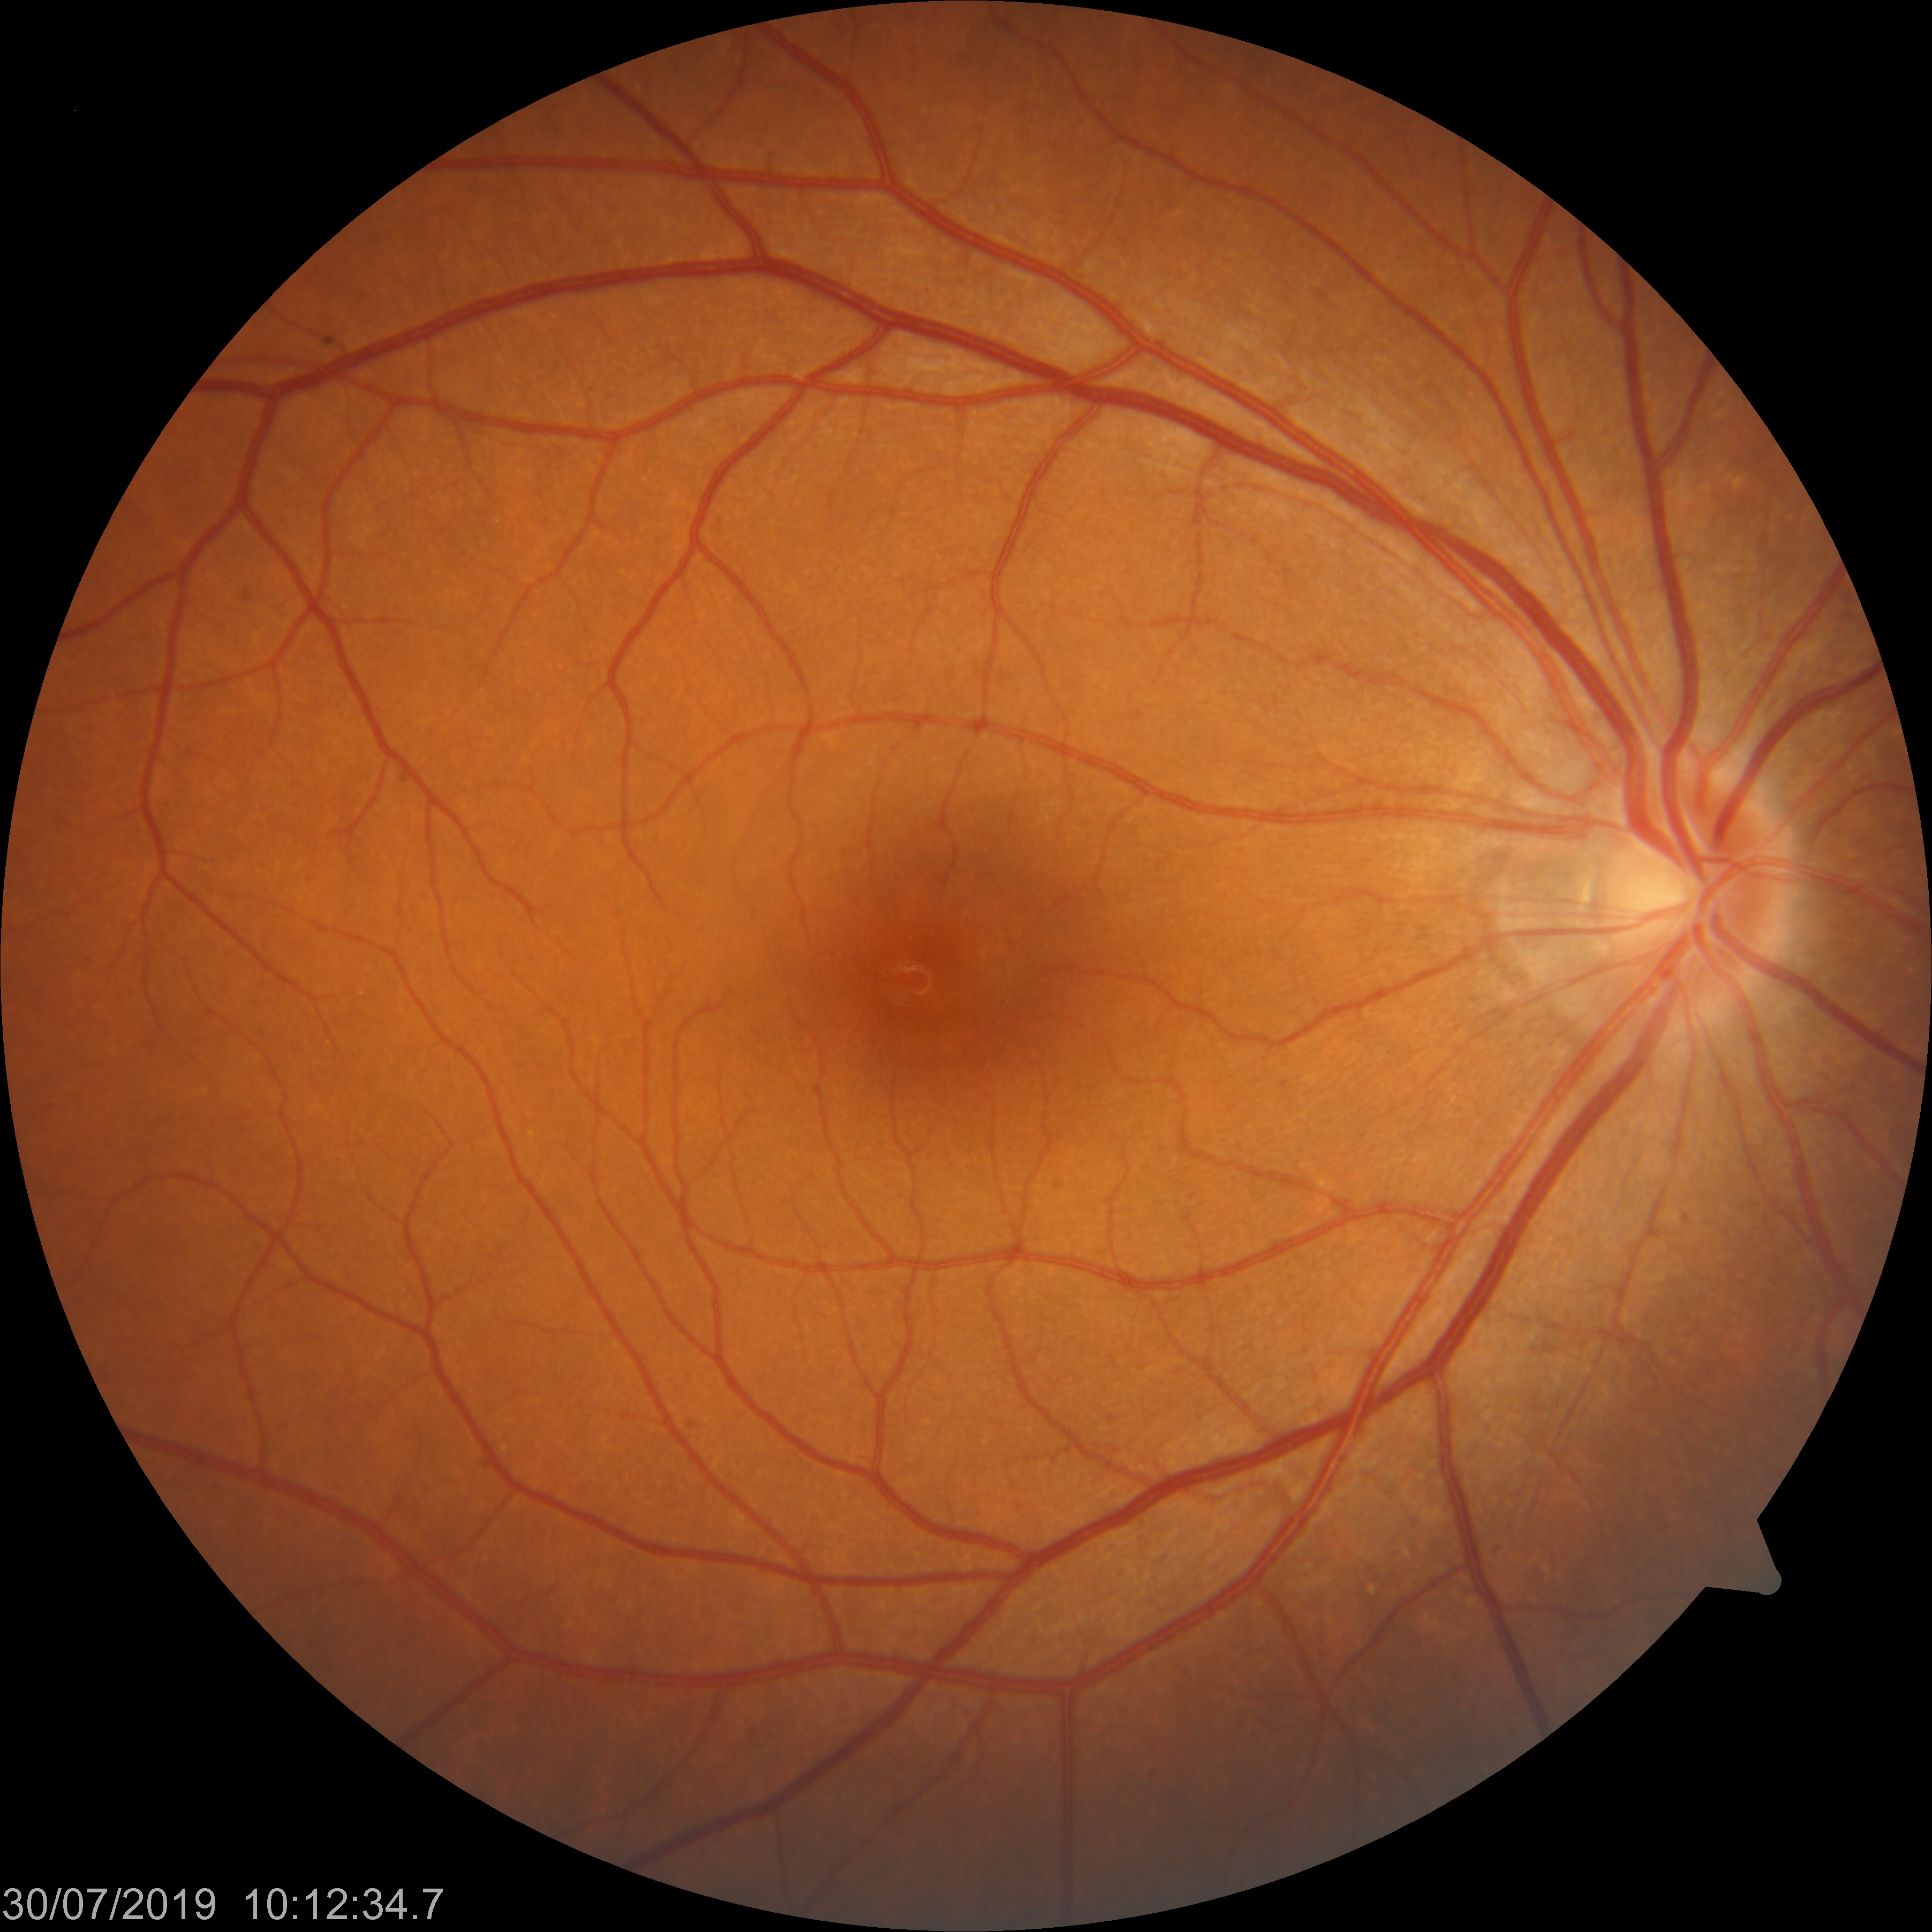
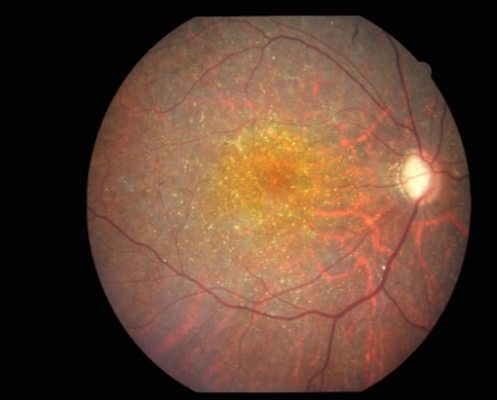
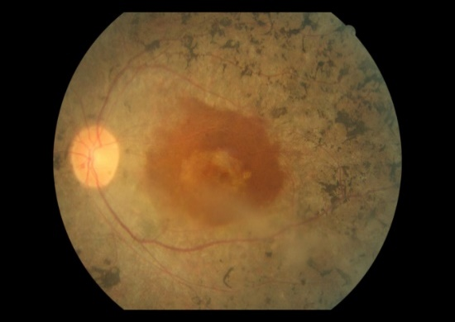
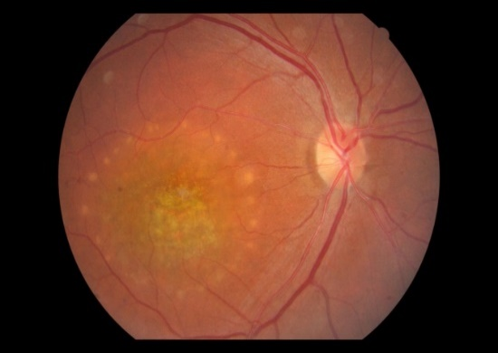
Dataset
Normal
521 number of images
Retinitis Pigmentosa (RP)
Major subtype of IRD
1,153 number of images
Color Fundus Images
Normal
IRD
IRD (RP)
IRD

Slide 4
Hardware specs
Hardware specs for our training machine
OS: Ubuntu
Processor: Intel(R) Core(TM) i7-7740X CPU @ 4.30GHz
Memory: 62GiB System memory
GPUs: GeForce GTX 1080 Ti (x2)
Storage: 2TB

Slide 5
Focus on RP study
Training dataset
Normal: 324
RP images: 960
Test dataset
Normal: 197 (Glaucoma Normal)
RP images: 193

Slide 6
Training Setting (RP)
CNN models
Xception, Inception v3, Inception Resnet v2
Training hyperparameters
Number of finetune layers: 0, 20, 40, 80, all
Optimizer: Adam (learning rate: 0.0001, decay: 0.001)
Input size: 300, 375, 3
Epoch: 80
Batch size: 30
Loss: binary cross-entropy
Data argumentations
Rotation
Vertical and horizontal flip

Slide 7
Retinitis pigmentosa (RP) dataset ROC cruve
960 RP images
324 normal images
Best model
Xception 80 % AUROC

Slide 8
Comparing Finetuning and without Finetuning Results
Fine-tuning 20 to 40 layers: AUROC decreased from 85% to 78%
Fine-tuning more than 60 layers: bounce back and increase to 99%
5-fold cross validation
Compute time: 6hrs

Slide 9
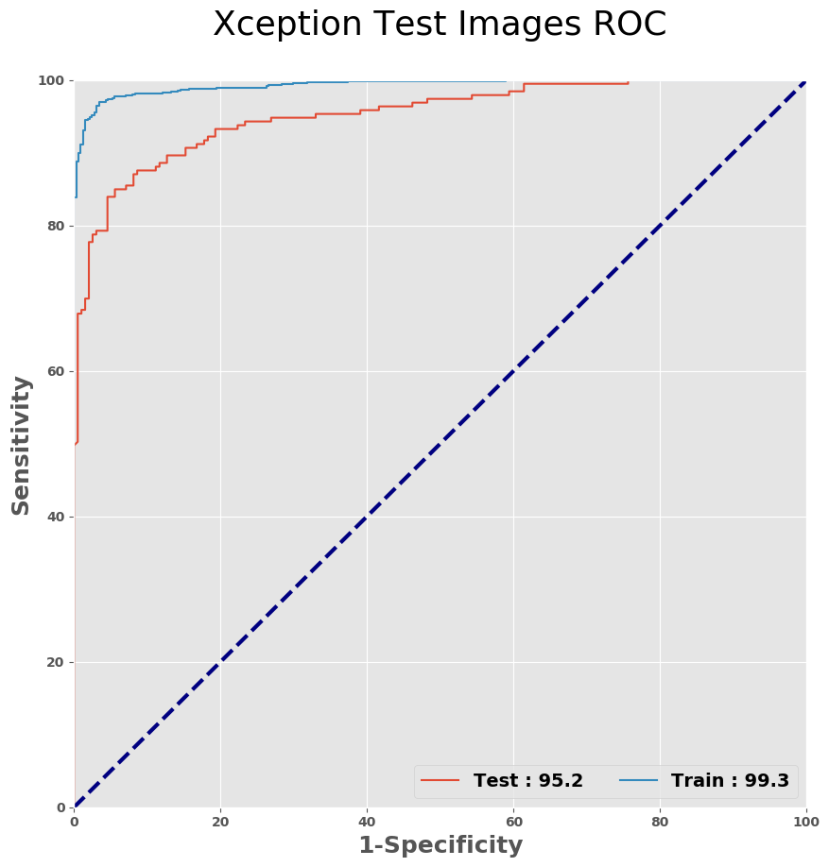
RP Test Dataset Results
ROC Curve
True
Test dataset confusion matrix
 | Normal | RP
Normal | 188 | 31
RP | 9 | 162
Predicted
Test dataset
Accuracy | F1 | F3
90 % | 89 % | 85 %

Slide 10
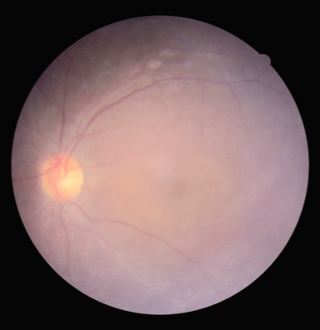
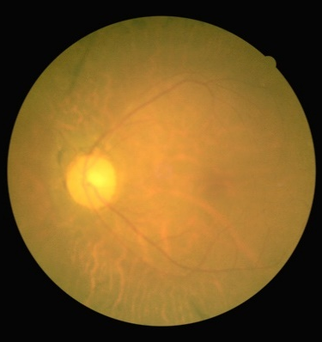
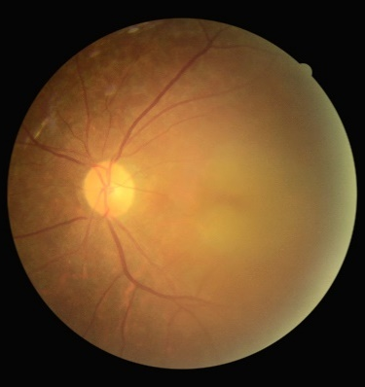
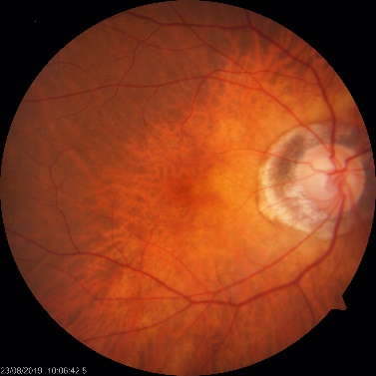
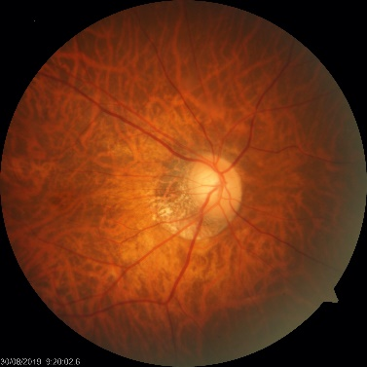
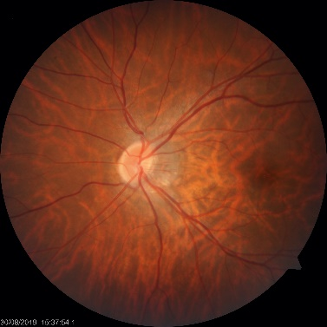
Error Analysis
False Negative
多數為白内障
False Positive
多數為高度近視

Slide 11
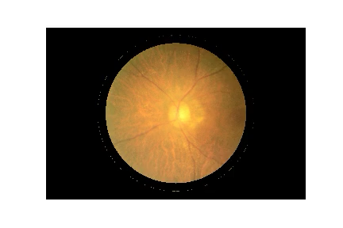
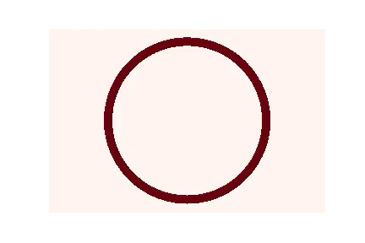
Inward Circle Heatmap
We generate rings shape to mask out the color fundus from outer circumference toward inner center
This method might be more suitable for circle shape objects
Occlusion heatmap
Example of Heatmap result

Slide 12
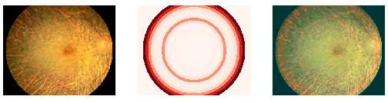
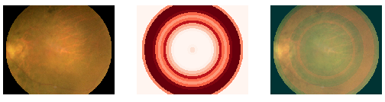
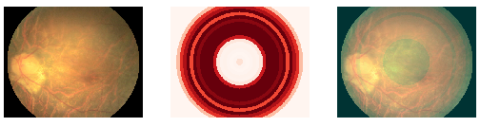
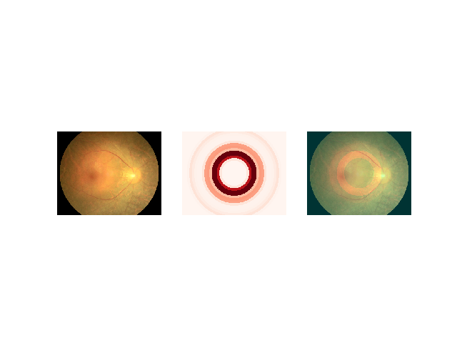
Inward Circle Heatmap – RP images
Heatmap result
Dr. Chen’s comments
RP pattern was detected within the heatmap’s area
Focus on the outer part of the color fundus images
Limitation
Can’t differentiate which part of the circle was more important
No all the optical disc is located at the center
Original
Merge

Slide 13
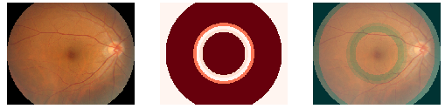
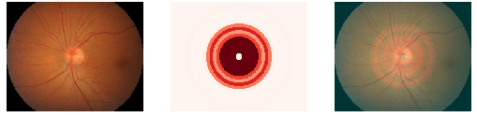
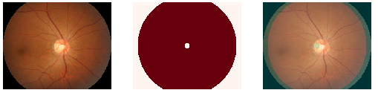
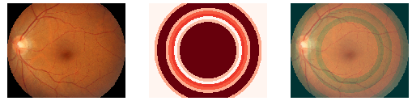
Inward Circle Heatmap – Normal Images
Heatmap result
Original
Merge
Most of the color fundus center area have high values
Differentiate normal from RP
With more orange color area

Slide 14

Other methods
Heatmap result
Inward circle occlusion could not specifically map area of degenerated area.
Alternative method for inward circle occlusion
Original
Alternative method

Slide 15
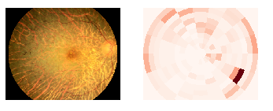
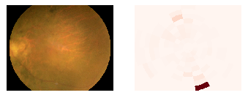
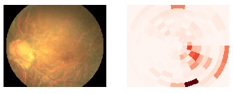
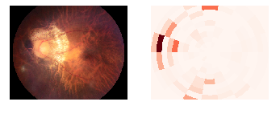
Alternative Inward Circle Occlusion – RP
Original
Heatmap result
Heat map pattern was not clear
Generate black box in most of the area did not alter the prediction

Slide 16
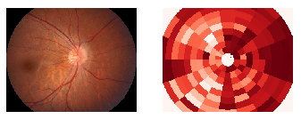
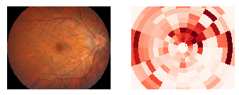
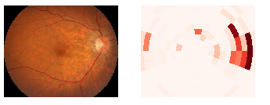
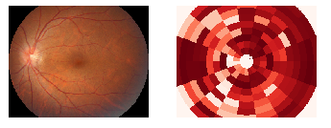
Alternative Inward Circle Occlusion – RP
Original
Heatmap result
Most areas are important for classifying normal image
Might due to
Generate single black box was easy to fool the model to predict image as RP

Slide 17
Gradient-CAM RP
True Positive
Activation map pattern
Focus more on the outer part of the color fundus
Focus more on the orange color area
Original
CAM
False negative

Slide 18
Gradient Class Activation Map Normal
True negative
Activation map pattern
Focus more on the outer part of the color fundus
Predict normal with more orange area in the images
Original
CAM
False positive

Slide 19
Heatmap Conclusion
Integrated-gradient heatmap
Can not detect RP features
Noisy
Occlusion heatmap
Inward circle occlusion
Can detect parts of the RP pattern
Can’t differentiate which part was more important
Generated black box might not have impact on RP images
Grad-CAM
Model differentiate RP from normal
Orangish area in the images
Focus more on the outer part of the color fundus
Dr Chen prefer using this method

Slide 20
Future work
RP
Finalize our work and publish paper

