Slide 1
臺大醫神 MIRLAB Glaucoma Report
Speaker: Lim Wee Shin (林偉莘)
Advisor: J.-S. Roger Jang (張智星)
MIR Lab, CSIE Dept.
National Taiwan University
http://mirlab.org/

Slide 2
Study Aims
Aims
To grade the dataset with accurate glaucoma detection, based on the combination of clinical examinations and various tests for structural and functional optic nerve head damage, including fundus photography, a VF test, optical coherence tomography (OCT), and optical coherence tomography angiography (OCTA).
To provide a tool that can help diagnose glaucoma by using color fundus images
Can be applied in areas with a low level of medical resources or areas where many people have myopia.

Slide 3
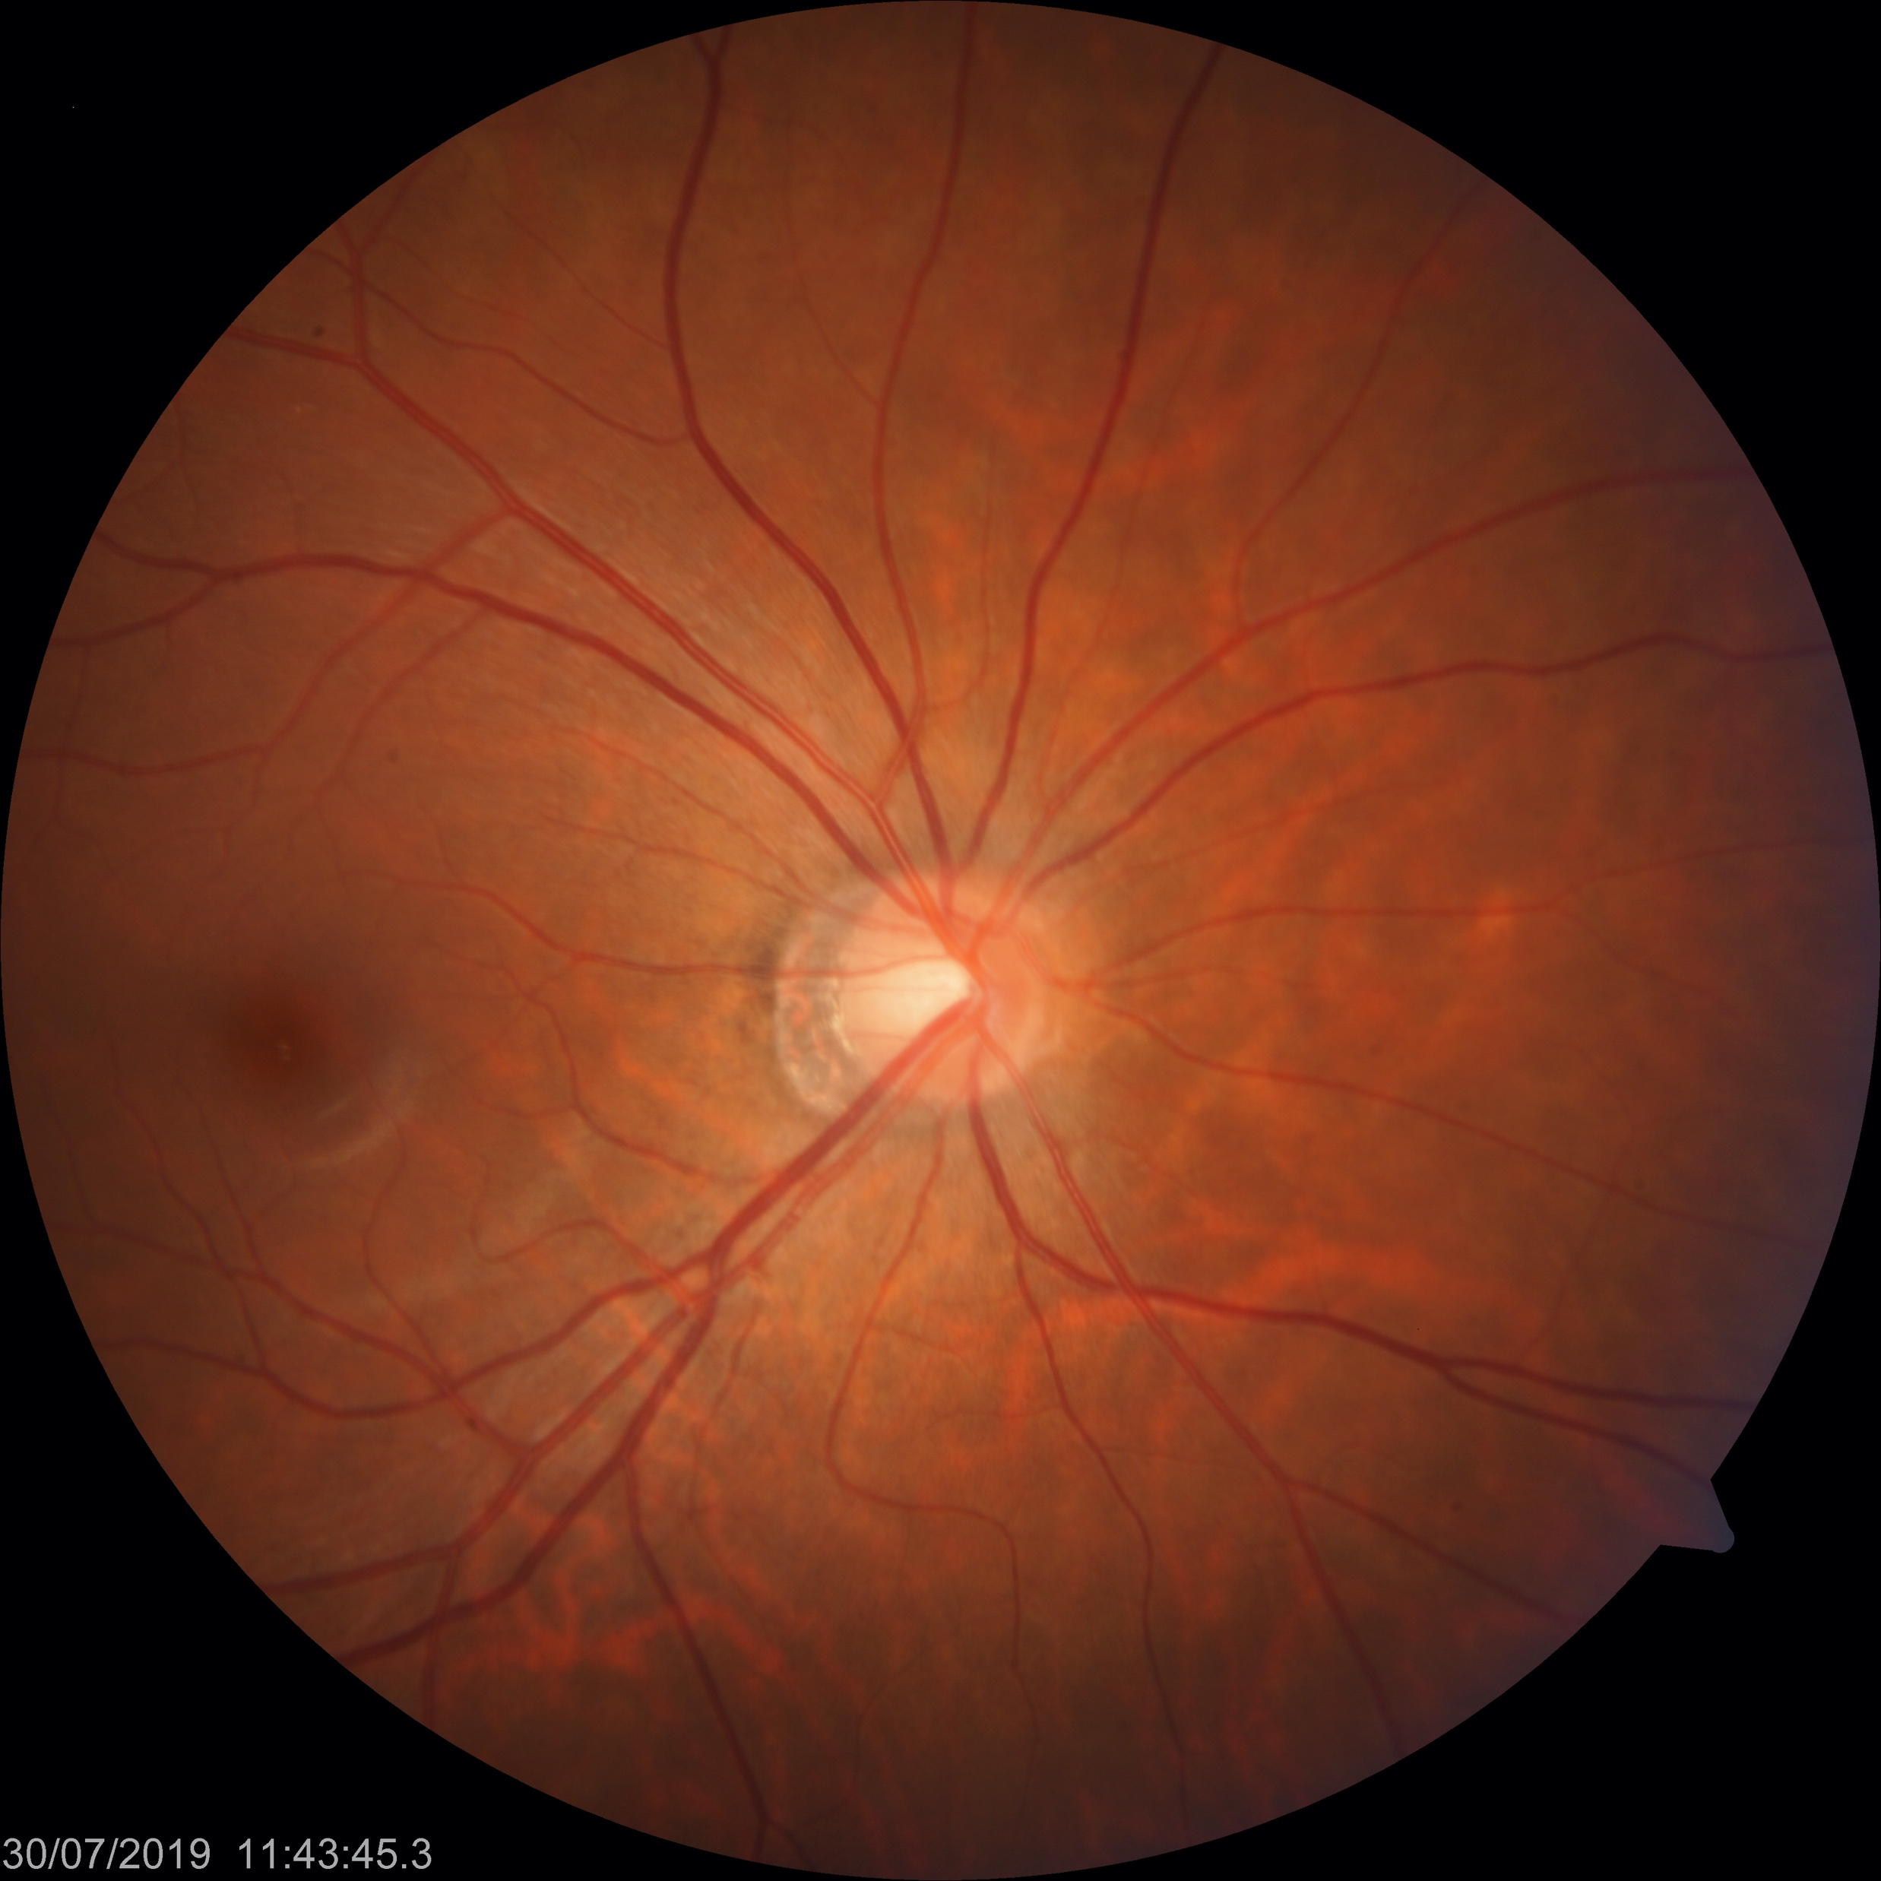
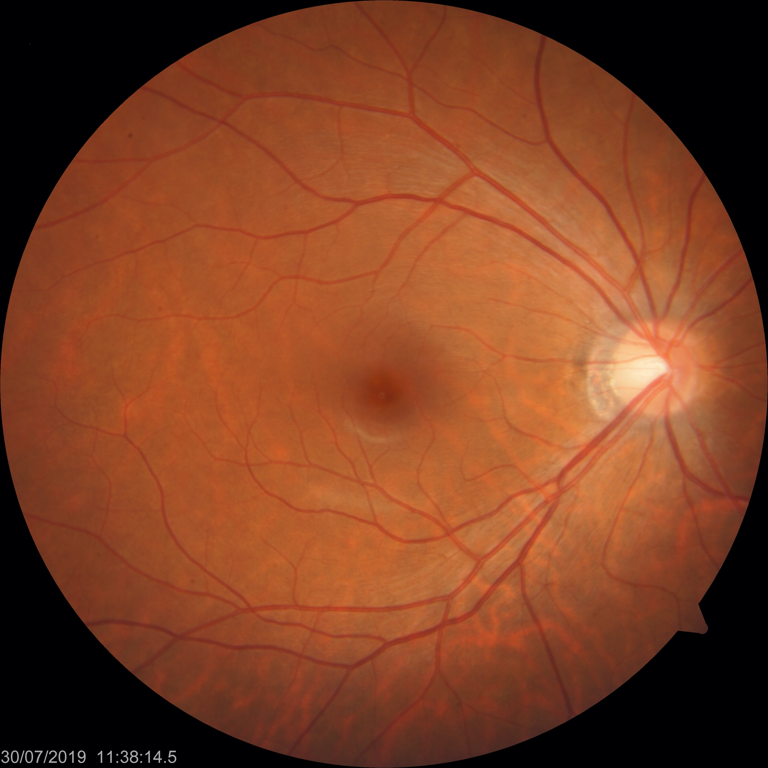
Glaucoma Color Fundus Images Dataset
The glaucoma dataset was collected and graded by Dr. Mei-Lan Ko team in NTU Hospital
Color fundus, optical coherence tomography angiography (OCTA), patients’ demographical data
Total number of patients: 667 (eyes: 1,155)
Grading
Glaucoma (G)
Pre-perimetric glaucoma (PPG)
Normal (N)
Disc view
Macular view
Groups | No. of eyes
N | 596
PPG | 66
N | 493
Optic Disc
Macular

Slide 4
Fig1A: Glaucoma Study Flow Chart

Slide 5
Fig2: Three Groups Difference in Image Classification Model

Slide 6
Table 2: Collapsed Three Groups into Binary Groups in Images Classification Model
Table 2. Binary classification results after collapsed three groups into binary groups
Metrics | Validation data |  | Test data
 | (N, PPG+G) | (N+PPG, G) | (N, PPG+G) | (N+PPG, G)
AUROC, % | 95.91 | 96.42ª | 95.45^{b} | 95.24
Accuracy, % | 89.96 | 90.57ª | 88.88^{b} | 86.11
Sensitivity, % | 89.93 | 90.54ª | 88.63^{b} | 86.77
Specificity, % | 89.99 | 90.59ª | 89.17^{b} | 85.49
Precision, % | 87.92 | 94.13ª | 96.53^{b} | 95.46
F3, % | 89.73 | 89.80ª | 88.77^{b} | 86.56
G: glaucoma, N: normal, PPG: pre-perimetrical glaucoma, AUROC: area under the receiver operator characteristic curve, ª: best metrics value in the validation set, ^{b}: best metrics value in the test set.

Slide 7
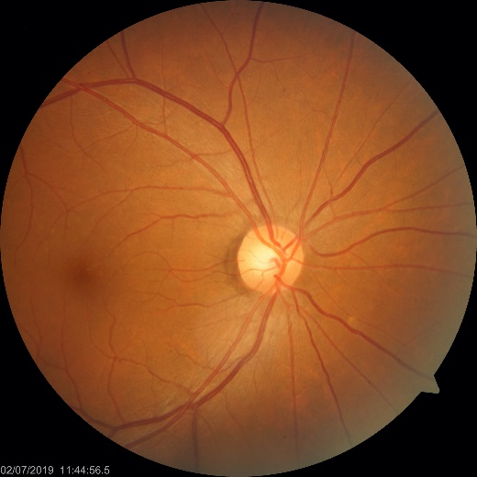
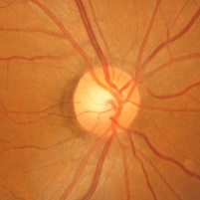
Segmented Optic Head Images and Regression Model
Segmented images:
Predict values (these values are from OCTA images):
Cup/Disk ratio (CD v ratio (%))
Average Retinal Nerve Fiber Layer (RNFL)
Mean value of RNFL inferior and RNFL superior
Ref: Medeiros, F. A., Jammal, A. A., & Thompson, A. C. (2019). From machine to machine: an OCT-trained deep learning algorithm for objective quantification of glaucomatous damage in fundus photographs. Ophthalmology, 126(4), 513-521.
Pixel
(1500 x 1500)

Slide 8
Fig 3: Regression Model Results

Slide 9
Fig 1B: Multimodal Model Structure

Slide 10
Fig 4 :Result of Multimodal Model on Three-groups Classification

Slide 11
Fig 5: Multimodal Models Results (Binary-groups)

Slide 12
Fig 5: Multimodal Models Results (Binary-groups)

Slide 13
Table 3: All Models Comparisons after Collapsing Three-groups into Binary-groups

Slide 14
Supplymentaly results: Glaucoma Color Fundus Image Features Labeling
Important features on the images
Disc area, cup vertical line, disc vertical line, fovea, RNFL defect
Tool: LabelMe
Workers (student: 2, part-time: 2)
Labeled data can provide more option for AI model design
Detection of RNFL defect
Include fovea area for classification (GCC area)
Image segmentation

Slide 15
S1: Labeling Important Features in Glaucoma Color Fundus Images

Slide 16
Glaucoma AI webpage
Glaucoma AI webpage
demo webpage on MIRLab server http://140.112.91.59:9000/

Slide 17
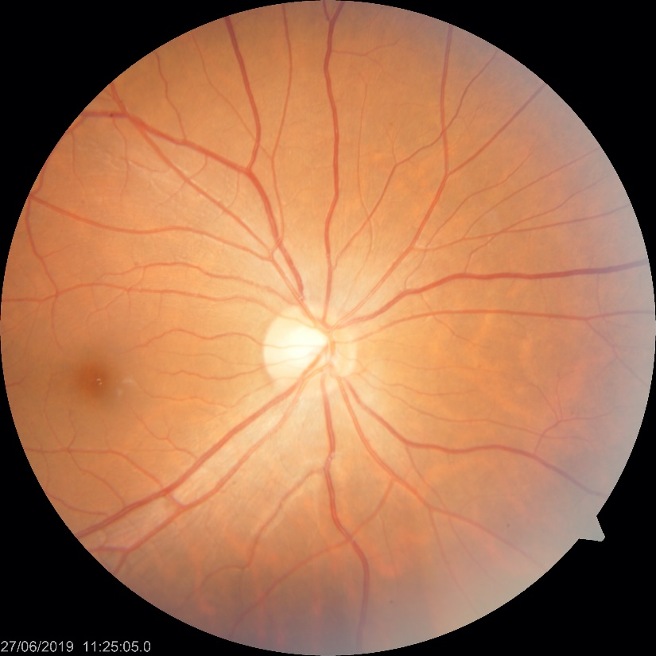
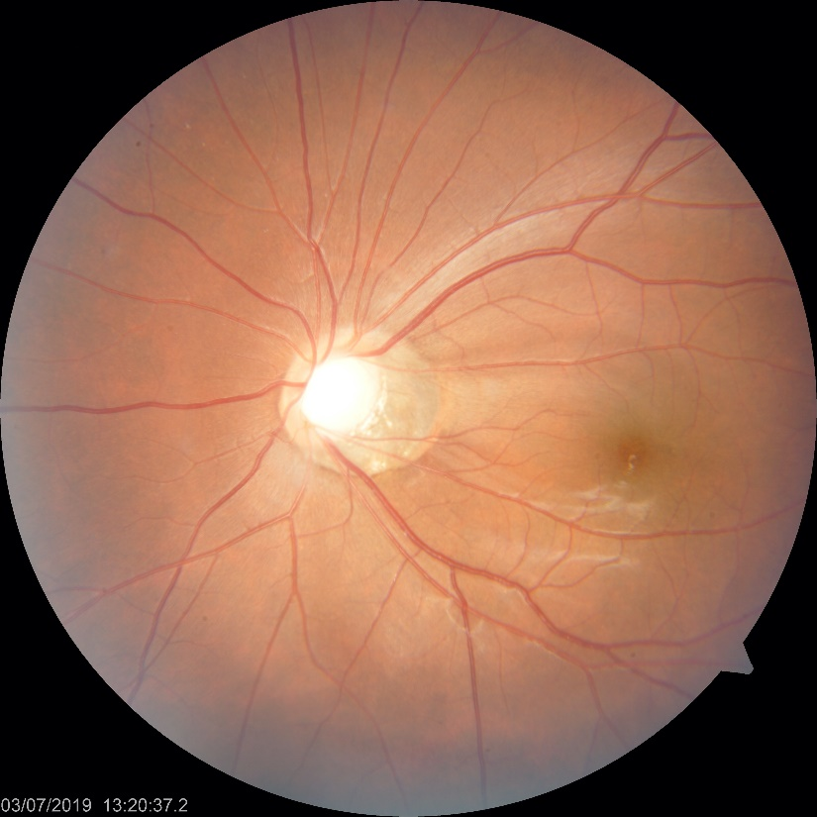
Features of Glaucoma in Color Fundus Images
Normal
Glaucoma
Cup
Optic Disk
Nerve fiber defect
Change of Cup/Disk ratio

Slide 18
Images Classification Training Setting
Transfer learning model
Xception, Inception Resnet V2, Inception V3
Training hyperparameters
Number of finetune layers: all
Optimizer: Adam (learning rate: 0.0001, decay: 0.001)
Input size: 299, 299, 3
Epoch: 50
Batch size: 15
Loss: categorical cross-entropy
Data argumentations
Rotation
Vertical and horizontal flip

