Slide 1
Jensen’s Inequality
(AM-GM Inequality)
Jyh-Shing Roger Jang (張智星)
CSIE Dept, National Taiwan University

Slide 2
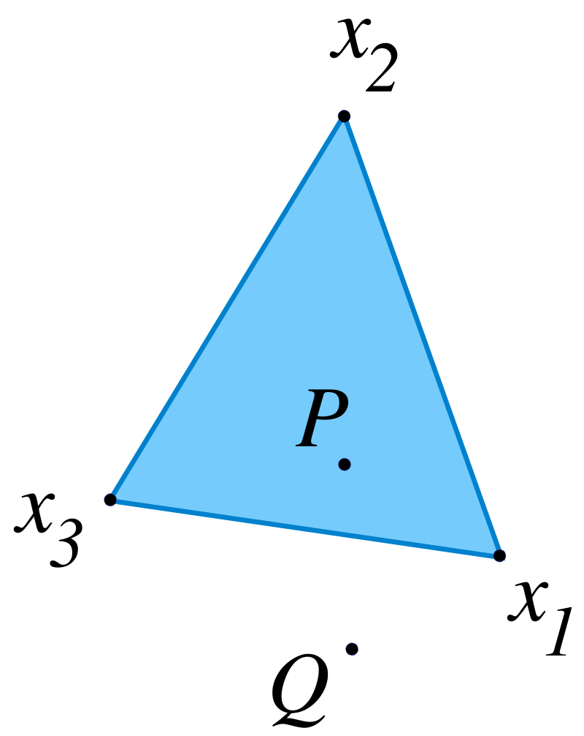

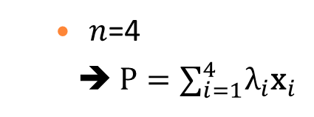
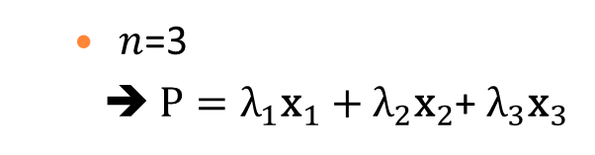
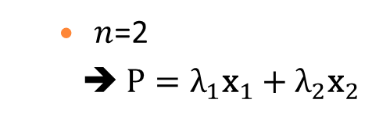
Convex Combination
Convex combination of $n$ points (${\text{x}}_{i}, i=1\sim n)$ in a $d$-dim space is ${{\text{∑}}_{i=1}^{n}\text{λ}}_{i}{\text{x}}_{i}$, with ${\text{λ}}_{i}≥0$ and ${{\text{∑}}_{i=1}^{n}\text{λ}}_{i}=1$.
  $n$=2
  ➔ $P={\text{λ}}_{1}{\text{x}}_{1}+{\text{λ}}_{2}{\text{x}}_{2}$
  $n$=3
  ➔ $P={\text{λ}}_{1}{\text{x}}_{1}+{\text{λ}}_{2}{\text{x}}_{2}$+ ${\text{λ}}_{3}{\text{x}}_{3}$
  $n$=4
  ➔ $P={{\text{∑}}_{i=1}^{4}\text{λ}}_{i}{\text{x}}_{i}$

Slide 3
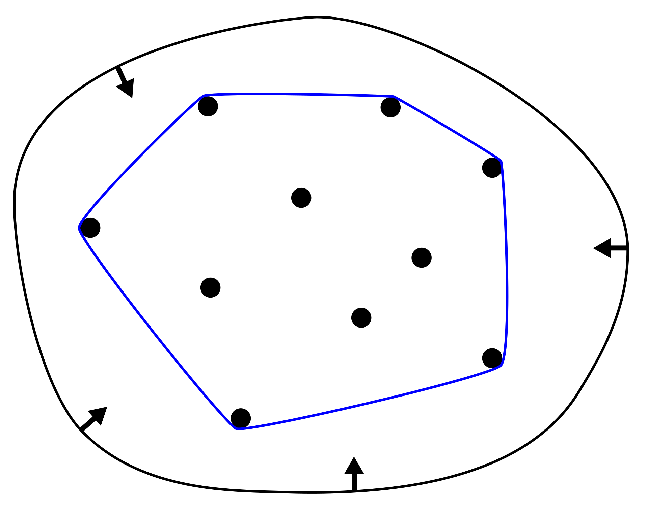
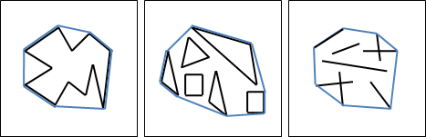
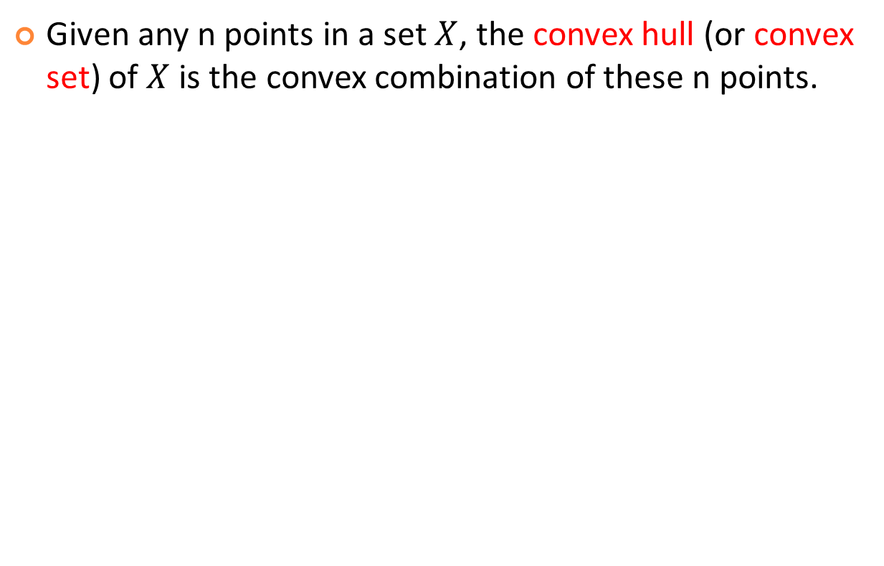

Convex Hull
Given any n points in a set $X$, the convex hull (or convex set) of $X$ is the convex combination of these n points.
Rubber band analogy
Various sets of $X$
http://web.ntnu.edu.tw/~algo/ConvexHull.html

Slide 4
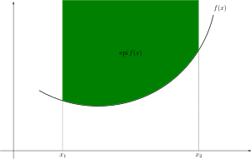
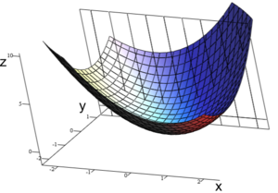
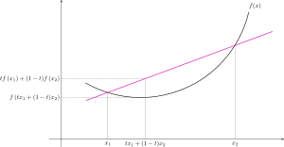
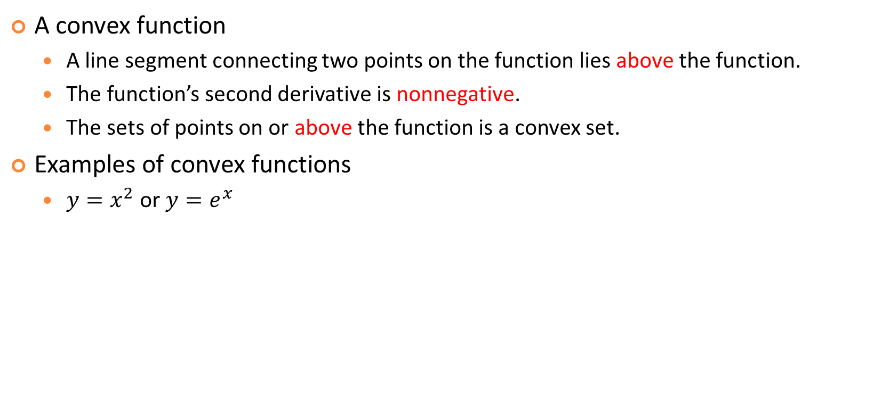
Convex Functions
A convex function
  A line segment connecting two points on the function lies above the function.
  The function’s second derivative is nonnegative.
  The sets of points on or above the function is a convex set.
Examples of convex functions
  $y=x^{2}$ or $y=e^{x}$

Slide 5
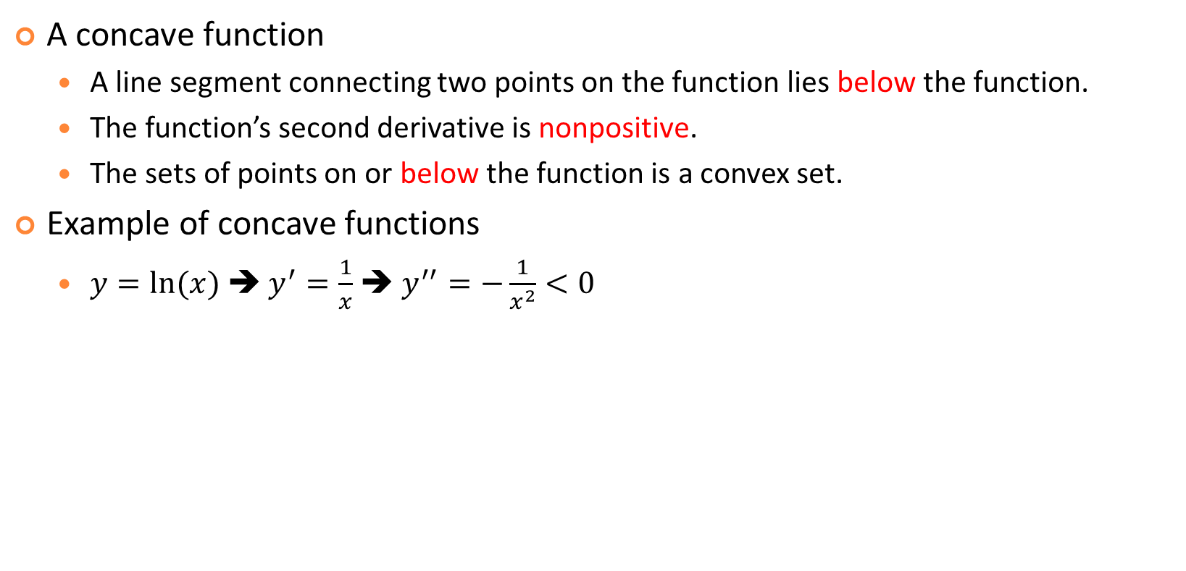
Concave Functions
A concave function
  A line segment connecting two points on the function lies below the function.
  The function’s second derivative is nonpositive.
  The sets of points on or below the function is a convex set.
Example of concave functions
  $y=ln⁡(x)$ ➔ $y^{′}=\frac{1}{x}$ ➔ $y^{′′}=−\frac{1}{x^{2}}<0$

Slide 6
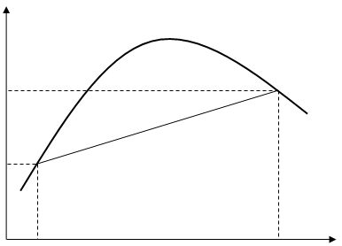

Jensen’s Inequality when n=2
If f(x) is a concave function, then
  $\text{f}\left({{\text{λ}}_{1}\text{x}}_{1}+{\text{λ}}_{2}{\text{x}}_{2}\right)≥{\text{λ}}_{1}\text{f}\left({\text{x}}_{1}\right)$+${\text{λ}}_{2}\text{f}\left({\text{x}}_{2}\right)$, with ${\text{λ}}_{1}+{\text{λ}}_{2}=1$ and ${\text{λ}}_{1}, {\text{λ}}_{2}≥0.$

Slide 7

Jensen’s Inequality in General
If f(x) is a concave function, then
  $\text{f}\left(\sum_{i=1}^{n}{{{\text{λ}}_{i}\text{x}}_{i}}\right)≥\sum_{i=1}^{n}{{\text{λ}}_{i}\text{f}\left(x_{i}\right)}$, with $\sum_{i=1}^{n}{{\text{λ}}_{i}}=1$ and ${\text{λ}}_{i}≥0, ∀i.$

Slide 8

Inequality of Arithmetic and Geometric Means
AM-GM inequality
Proof by Wikipedia
Proof by Jensen’s inequality
  Take $f\left(x\right)=ln\left(x\right)$ and ${\text{λ}}_{i}=\frac{1}{n}, ∀i$
  ➔ $\text{ln}\left(\frac{\sum_{i=1}^{n}{{\text{x}}_{i}}}{n}\right)≥\frac{1}{n}\sum_{i=1}^{n}{\text{ln}\left(x_{i}\right)}=\text{ln}\left({\left(\prod_{i=1}^{n}{x_{i}}\right)}^{1/n}\right)$ Q.E.D.
Quiz!
Cumbersome!

Slide 9

Proof by Induction:
$$\frac{\sum_{i=1}^{n}{x_{i}}}{n}≥{\left(\prod_{i=1}^{n}{x_{i}}\right)}^{1/n}$$
2
Q.E.D.

Slide 10
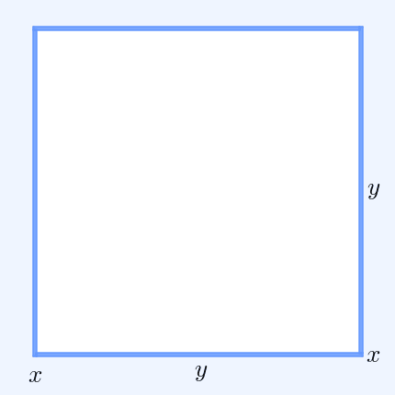
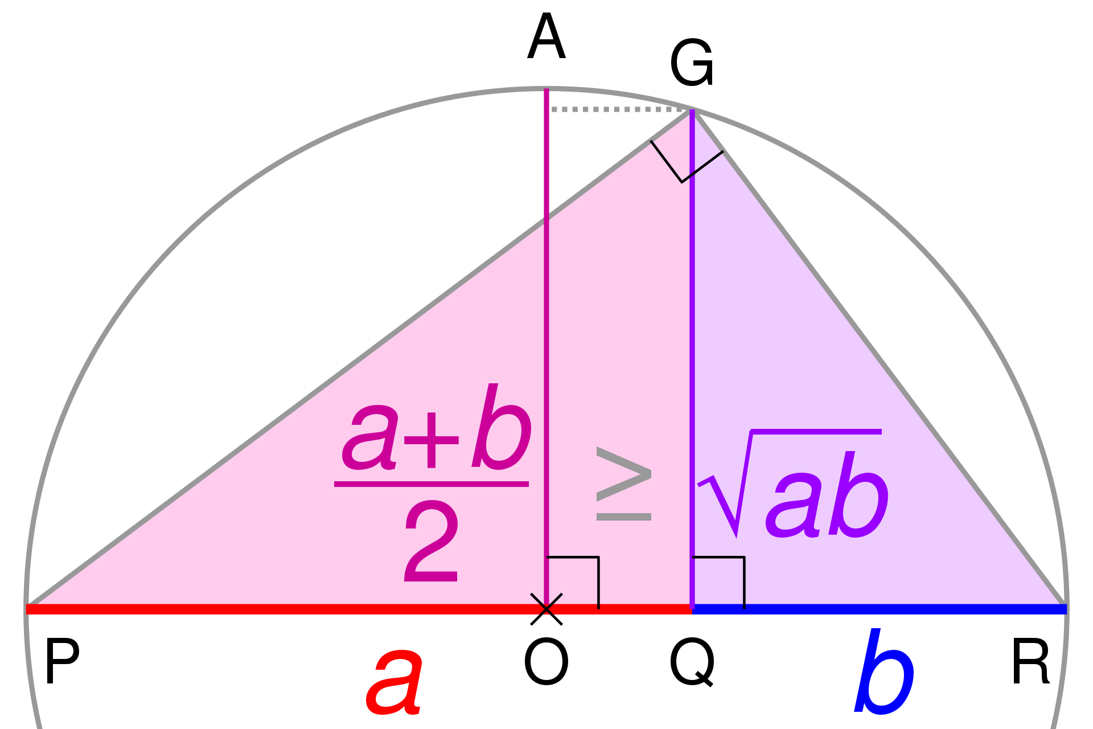


Summary
AM-GM inequality can be derived by Jensen’s inequality.
Jensen’s inequality can be proved by convex combination. ➔ Seeing the insight is the key to math!
$$\frac{a+b}{2}≥\sqrt{ab}$$
$${\left(x+y\right)}^{2}≥4xy$$

Slide 11
Exercises
What is the maximum volume for a rectangular box (no top) made from 12 square meters of cardboard?
What is the maximum volume for a cylinder (no top) made from 12 square meters of cardboard?
A rectangular box without a top (a topless box) is to be made from 12 square foot of cardboard. Let x, y, and z be the length (in foot) of each side of the box. What is x+y+z when the volume of the box is maximized?

