Slide 1
Feature Selection
Jyh-Shing Roger Jang (張智星)
MIR Lab, CSIE Dept.
National Taiwan University
jang@csie.ntu.edu.tw , http://mirlab.org/jang

Slide 2
Outlines
Introduction to feature selection
Heuristic search
One-pass ranking
Sequential forward selection
Exhaustive search
Examples

Slide 3
Intro. to Feature Selection
Feature selection
Also known as input selection, variable selection, etc.
Goal
To select a subset from the original feature set for better accuracy
Items to be specified before feature selection
Model, such as a classifier or a regressor, etc.
Performance index, such as accuracy
Performance evaluation method, such as k-fold CV
Benefits
Better accuracy
Less computation
Explainability between features and the output
Quiz!

Slide 4
Feature Selection vs. Extraction
Common part
Both known collectively as dimensionality reduction
Goal: Reduced model complexity with improved accuracy
Feature selection: select the best subset from the original features
Feature extraction: Extract new features by a linear or nonlinear combination of all original features
Lack of physical meanings for the extracted features
Examples of linear feature extraction
PCA (principal component analysis): Unsupervised
LDA (linear discriminant analysis): Supervised

Slide 5
Heuristic Search
A number of heuristic search methods for feature selection
One-pass ranking
Sequential forward selection (SFS)
Sequential backward selection (SBS)
Generalized sequential forward selection
Select the best k features at each iteration (k=1 for SFS)
Generalized sequential backward selection
Delete the best k features at each iteration (k=1 for SBS)
Sequential forward floating selection (SFFS)
Sequential backward floating selection (SBFS)
‘Add m, remove n’ selection
Generalized ‘add m, remove n’ selection

Slide 6
One-pass Ranking
Steps
Sort the given d features in descending order of their accuracy based on a single feature only
Select the top-k features (k=1 to d) from the sorted list that has the best performance
Complexity
If the dataset has d features, we need to perform 2d-1 CV.
Properties
Advantages
Extremely fast
Disadvantages
Feature correlation is not considered
Selected features are not always optimal
Quiz!
Quiz!

Slide 7
Example of One-Pass Ranking
One-pass ranking with 5 features
Original order
x1
x2
x3
x4
x5
After ranking
x3
x1
x5
x2
x4
Models with top-k features, k=1 to 5

Slide 8
Sequential Forward Selection (SFS)
Steps for sequential forward selection
Select the first feature that has the best accuracy.
Select the next feature (among all unselected features) that, together with the selected features, gives the best accuracy.
Repeat the previous step until all features are selected.
Complexity
If the dataset has d features, we need to perform d(d+1)/2 CV.
Properties
Advantage: Fast
Disadvantage: Selected features are not always optimal.
Quiz!
Quiz!

Slide 9
Example of SFS
SFS with 4 features
1 input
x1
x2
x3
x4
x5
2 inputs
x2, x1
x2, x3
x2, x4
x2, x5
3 inputs
x2, x4, x1
x2, x4, x3
x2, x4, x5
4 inputs
x2, x4, x3, x1
x2, x4, x3, x5
.
.
.

Slide 10
Exhaustive Search
Steps for exhaustive search (ES)
Generate all combinations of features and evaluate them one-by-one
Select the feature combination that has the best accuracy.
Drawback
d features ➔ 2^{d}-1 CV for performance evaluation
d = 10 ➔ 1023 CV for evaluation ➔ Time consuming!
Properties
Advantage: Optimal feature set can be identified.
Disadvantage: Extremely slow if no. of features is slightly large.
Quiz!

Slide 11
Exhaustive Search
Exhaustive search with 5 features
1 input
x1
x2
x3
x4
x5
x1, x2
x1, x3
x1, x4
x1, x5
x2, x3
.
.
.
2 inputs
x1, x2, x3
x1, x2, x4
x1, x2, x5
x1, x3, x4
.
.
.
3 inputs
4 inputs
x1, x2, x3, x4
x1, x2, x3, x5
x1, x2, x4, x5
.
.
.
.
.
.

Slide 12
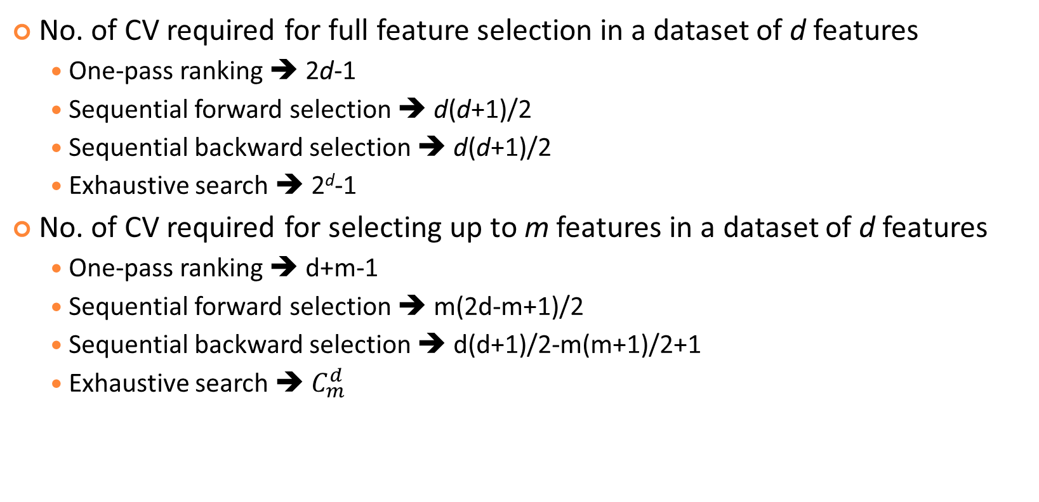
Summary of Computational Complexity
Quiz!
No. of CV required for full feature selection in a dataset of d features
One-pass ranking ➔ 2d-1
Sequential forward selection ➔ d(d+1)/2
Sequential backward selection ➔ d(d+1)/2
Exhaustive search ➔ 2^{d}-1
No. of CV required for selecting up to m features in a dataset of d features
One-pass ranking ➔ d+m-1
Sequential forward selection ➔ m(2d-m+1)/2
Sequential backward selection ➔ d(d+1)/2-m(m+1)/2+1
Exhaustive search ➔ $C_{m}^{d}$

Slide 13
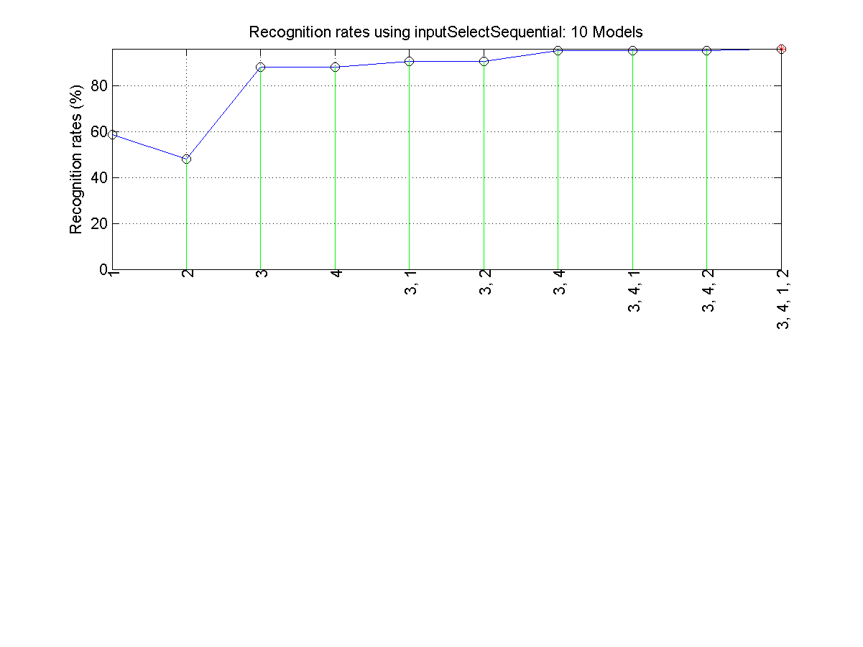
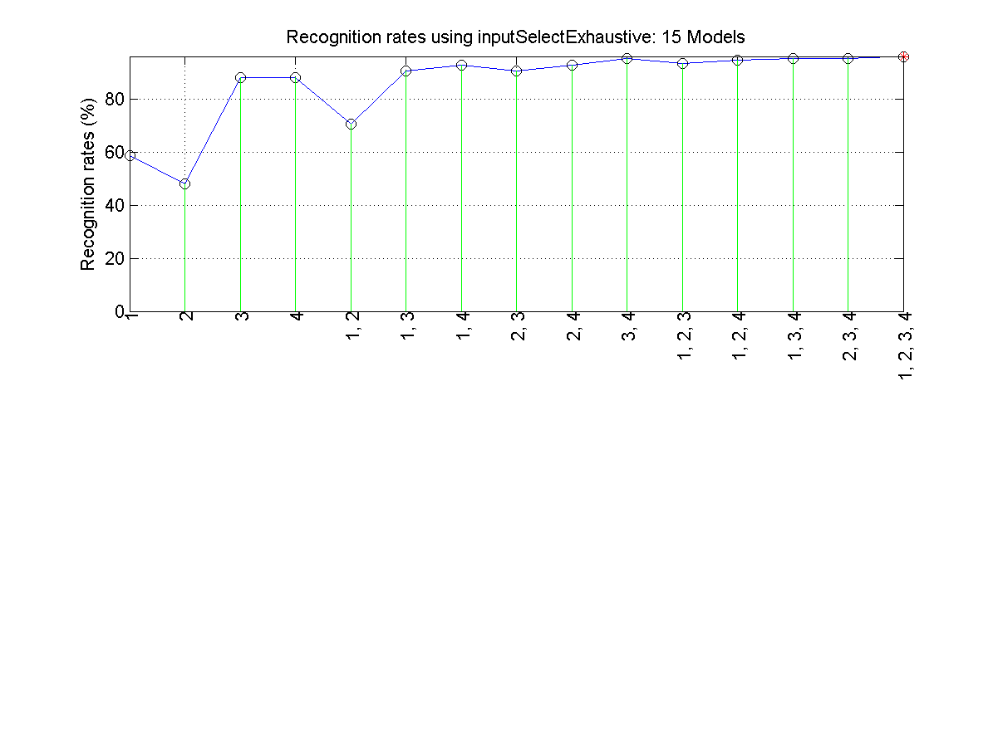
Feature Selection for Iris Dataset
SFS
Exhaustive search

Slide 14
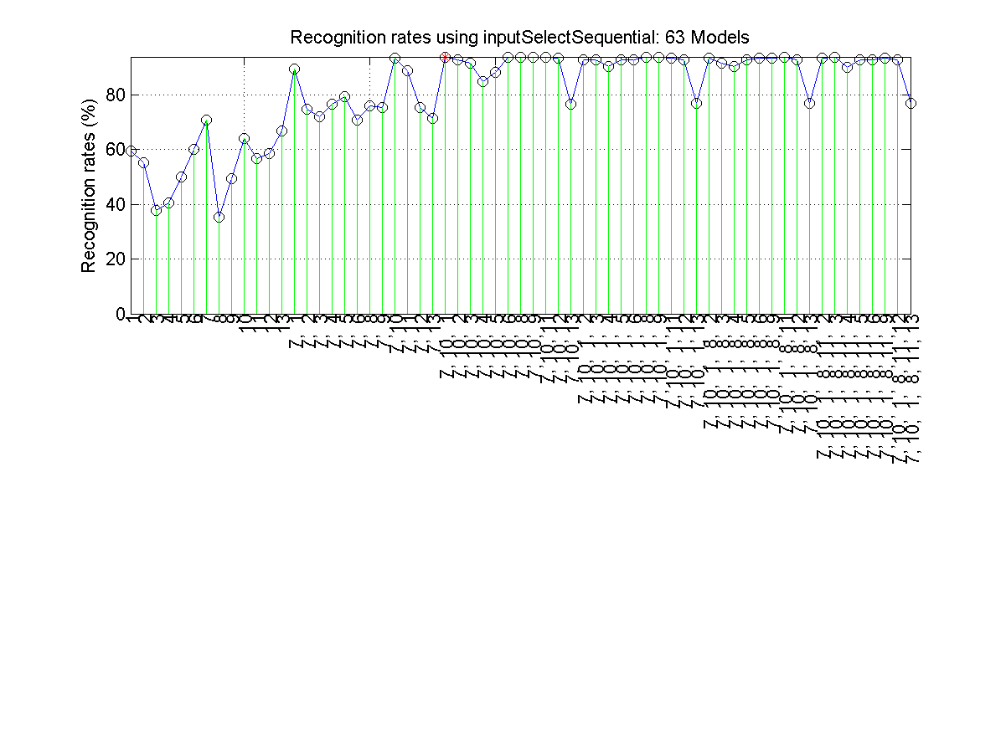
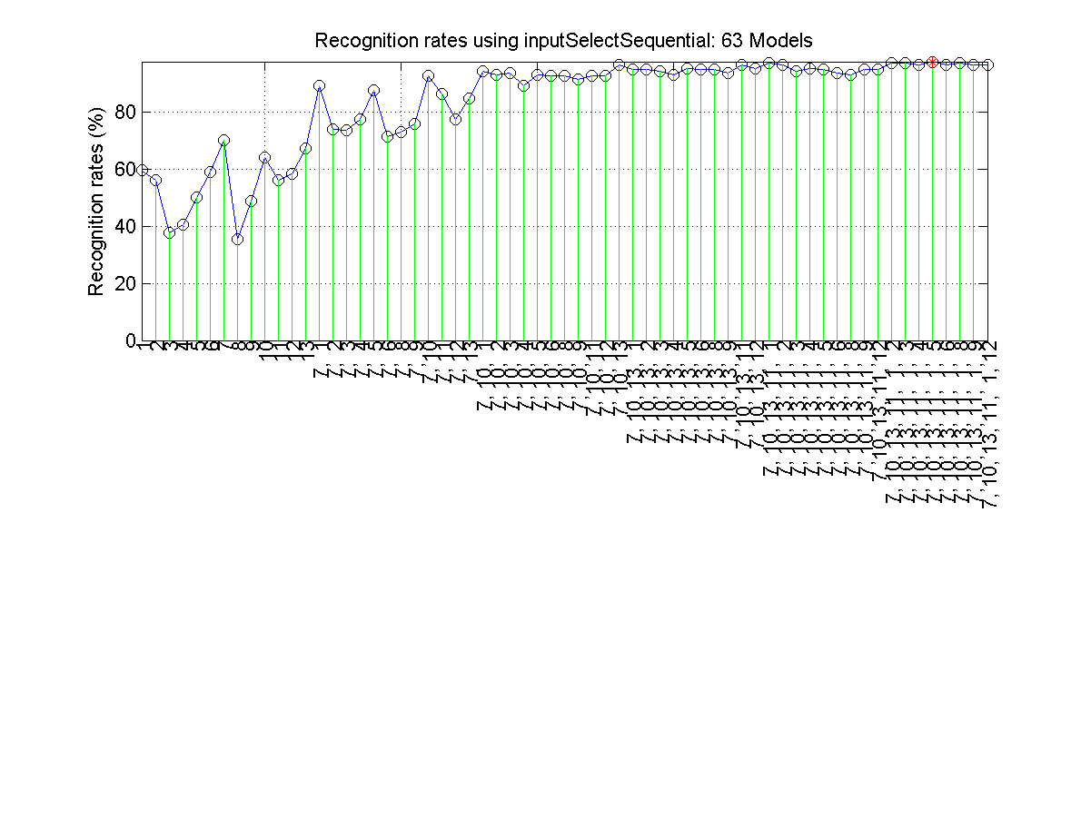
Feature Selection for Wine Dataset
SFS
SFS with input normalization
Summary
SFS ➔ 3 selected features, LOO accuracy=93.8%
SFS with feature normalization ➔ 6 selected features, LOO accuracy=97.8%
ES with feature normalization ➔ 8 selected features, LOO accuracy=99.4%

Slide 15
Proper Use of Feature Selection
Common use of feature selection
Increase model complexity sequentially by adding more features
Select the model that has the least validation error
Typical curve of error vs. model complexity
Determine the model’s complexity with the least validation error
Validation error
Training error
Optimal structure
Error rate
Model complexity (# of selected inputs)

Slide 16
References
Feature Selection Techniques in Machine Learning – GeeksforGeeks
https://www.geeksforgeeks.org/machine-learning/feature-selection-techniques-in-machine-learning/
Day29 - Feature Selection -- 2. Wrapper Methods(包裝器法)
https://ithelp.ithome.com.tw/articles/10246251

