Slide 1
Ensemble Learning
J.-S. Roger Jang (張智星)
MIR Lab, CSIE Dept.
National Taiwan University
jang@mirlab.org, http://mirlab.org/jang

Slide 2
Outline
Intro to ensemble learning
Two types of ensemble learning
Bagging
Random forests
Boosting
Gradient boosting
Extreme gradient boosting (XGBoost)
Conclusions

Slide 3
Ensembles Learning
Models or learners
Any math functions that can be trained or tuned to perform a specific tasks
Classifiers for classification
Regressors for regression
ranking machines for ranking, etc
Ensemble Learning
Combine a set of models to reach a better prediction
Models can be same (bagging & boosting) or different types
How to combine models
Parallel: (weighted) majority vote, (weighted) average
Serial: One after another
Ensemble: a group objects

Slide 4
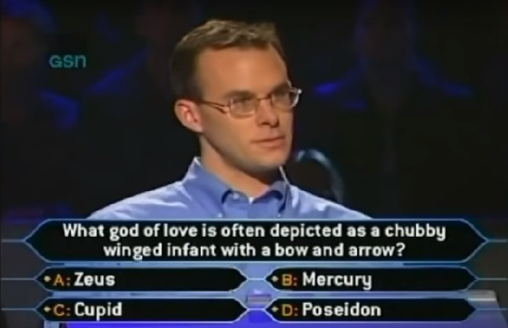


Advantages of Ensembles
Who Wants to Be a Millionaire?
More opinions are better: Wisdom of the crowd
Options for getting help
Notes:
“Who Wants to Be a Millionaire?” is an famous television game show back in 1998. A contestant needs to answer a series of multiple-choice questions to win a large cash prize. As the questions are getting harder, the prize is getting bigger. And the maximum cash prize is a million dollars. When the contestant needs help, he has two options….

Slide 5
Ensemble of Parallel Connection
Parallel combination, or “committees”
Majority vote
Weighted majority vote
Simple/weighted
majority vote
M1
Input
M2
Aggregator
Output
M3

Slide 6
Ensembles of Serial Connection
Train a classifier based on other classifiers’ output
Treat the classifiers’ output a feature for the next-level classifier
Similar to the idea of MLP (multi-layer perceptrons) or GMDH (group method of data handling)
Top classifier is linear ➔ Weighted majority vote
Input
M1
M2
M3
Output
M1
Input
M2
M4
Output
M3

Slide 7
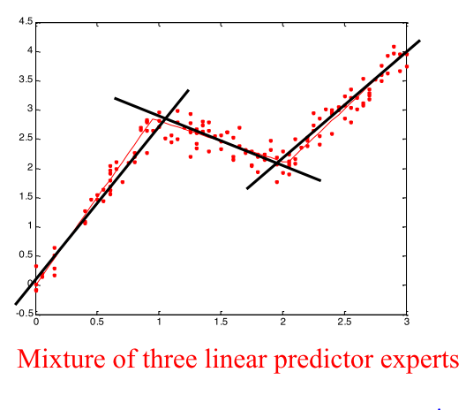
Other Examples
Mixtures of experts
Weights are crisp interval on x
Fuzzy version ➔ Fuzzy inference systems
Weights are fuzzy interval on x

Slide 8
Concept of Bagging
Concept
Learn many classifiers, each with only a part of the data
Combine models via vote or averaging
Major goal: Reduce overfitting
Since each classifier only “sees” part of the data ➔ No way to “memorize” the data ➔ Less likely to overfit

Slide 9
Bootstrapping
Bootstrapping (from Wikipedia)
A statistical test or metric that relies on random sampling of with replacement.
Can be used to estimate properties of an estimator (such as mean or variance) by measuring those properties when sampling from an approximating distribution
In practice
Create a random subset of a dataset by sampling ➔ Draw n’ of the n samples (n’<n) with replacement

Slide 10
Bagging in Practice
Bagging = bootstrap aggregation
Bootstrap: Create a random subset and train a model
Aggregation: Repeat k times to have k models for aggregation
Aggregation
For classification ➔ Majority vote of k classifiers
For regression ➔ Average of k regressors
Illustration: Decision boundary classification

Slide 11
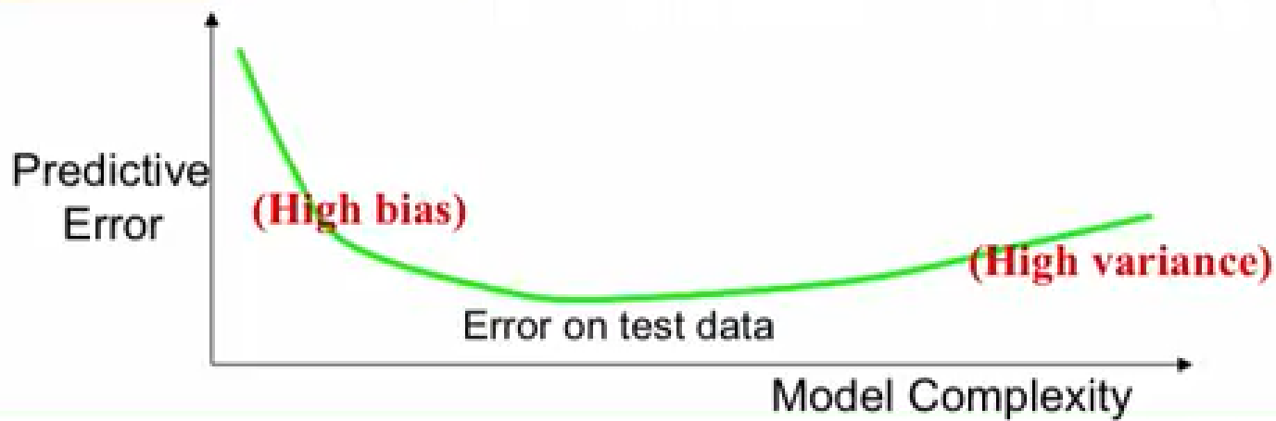
Bias/Variance Tradeoff
Error types
Bias: error due to model choice
Can our model represent the true best prediction?
Gets better with model complexity
Variance: error due to randomness of data
Gets better with more data
Gets worse with more model complexity ➔ overfitting
Source

Slide 12
Cross Validation
Cross validation
A way to estimate the true error for model selection
K-fold cross validation in practice
Split the dataset into k parts
Use k-1 parts for model construction, 1 part for validation
Repeat k times to construct k classifiers to estimate training and validation errors. ➔ Can we combine them to build a better classifier?

Slide 13
Strategies for Reducing Overfitting
Various strategies to reduce overfitting (and improve generalization)
Bagging ➔ drop data
Deep neural networks ➔ drop weights
Others ➔ Add regularization term

Slide 14
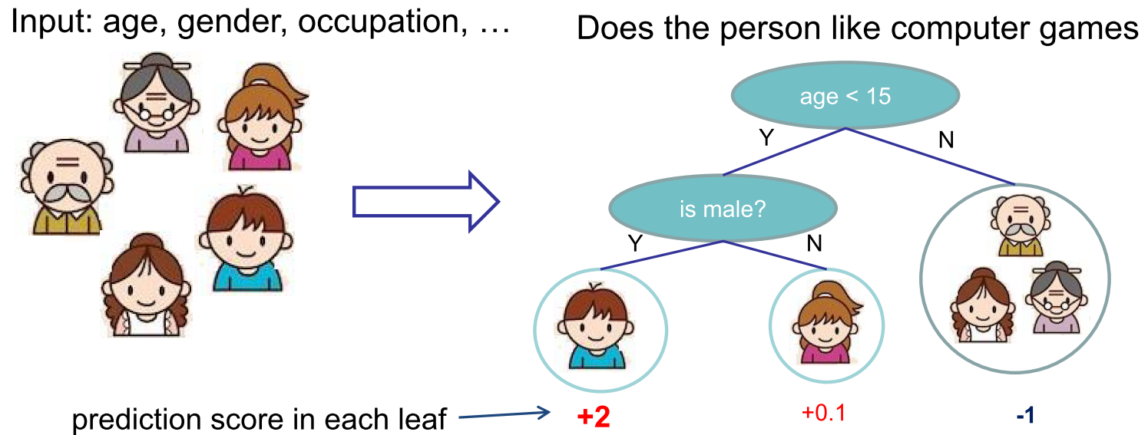
Decision Trees: Concept
Classification and regression trees (CART)
Internal node: decision
External node (or leaf) : score or class
Source

Slide 15
Bagging for Trees: Random Forests
Random forests
Train classifiers based on a subset of features
Aggregate output of trees (majority vote or averaging)
Advantages
Efficient
Diversity (since each classifier only see a part of features) to reduce overfitting

Slide 16
Summary of Bagging
Bagging: Bootstrap aggregation
Reduces complexity of a model class prone to overfit
Plays on bias/variance trade-off
Strength and weakness
Strength: Better generalization, easy coding
Weakness: More computation
References
Concept and illustration

Slide 17
Ensembles: Boosting
Boosting
Build a sequence of classifiers
Earlier classifiers can have some “hard” examples that are misclassified.
Later classifiers try to get these “hard” examples right
Combine the whole set in the end ➔ Leverage “weak” classifiers into a “strong” one.
Examples
AdaBoost
BrownBoost
LogitBoost
Gradient Boosting

Slide 18
Ensembles: Gradient Boosting
Gradient boosting
Gradient descent + Boosting
Good for classification, regression, ranking, etc.
Concept
Train a set of models sequentially
Overall model is progressively accurate
Overall model is progressively complex

Slide 19

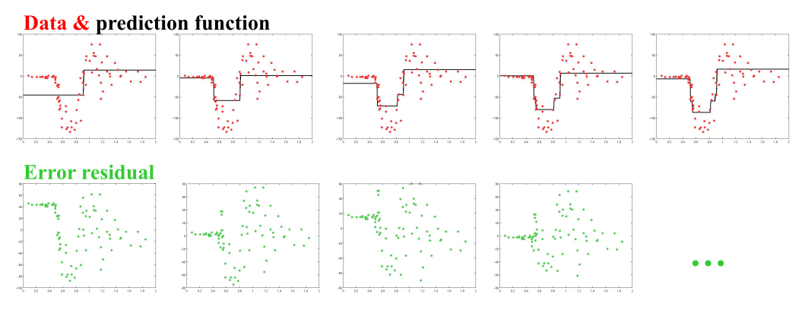
Gradient Boosting: A Simple Example
Steps
Train a model
Compute the error
Train another model to predict the error, and repeat till convergence
Example using decision stumps (one-level decision trees)
Source

Slide 20

Math in Gradient Boosting
Gradient descent
How it’s related?
The objective (square loss, or SSE) to be minimized
Negative gradient ➔ Residual
Update F(x) by adding h(x) that fits to negative gradient
$$dataset=\{({\vec{x}}_{i},y)|i=1\sim n\}$$

Slide 21
How Gradient Descent Is Related?
For objective of SSE (sum of squared error)
Residual = Negative gradient
Fit h(x) to residual = Fit h(x) to negative gradient
Update F(x) based on residual = Update F(x) based on negative gradient ➔ We are actually updating our model via gradient descent!
Why taking all the trouble to make it gradient descent?
To care of other objectives in the same manner.

Slide 22
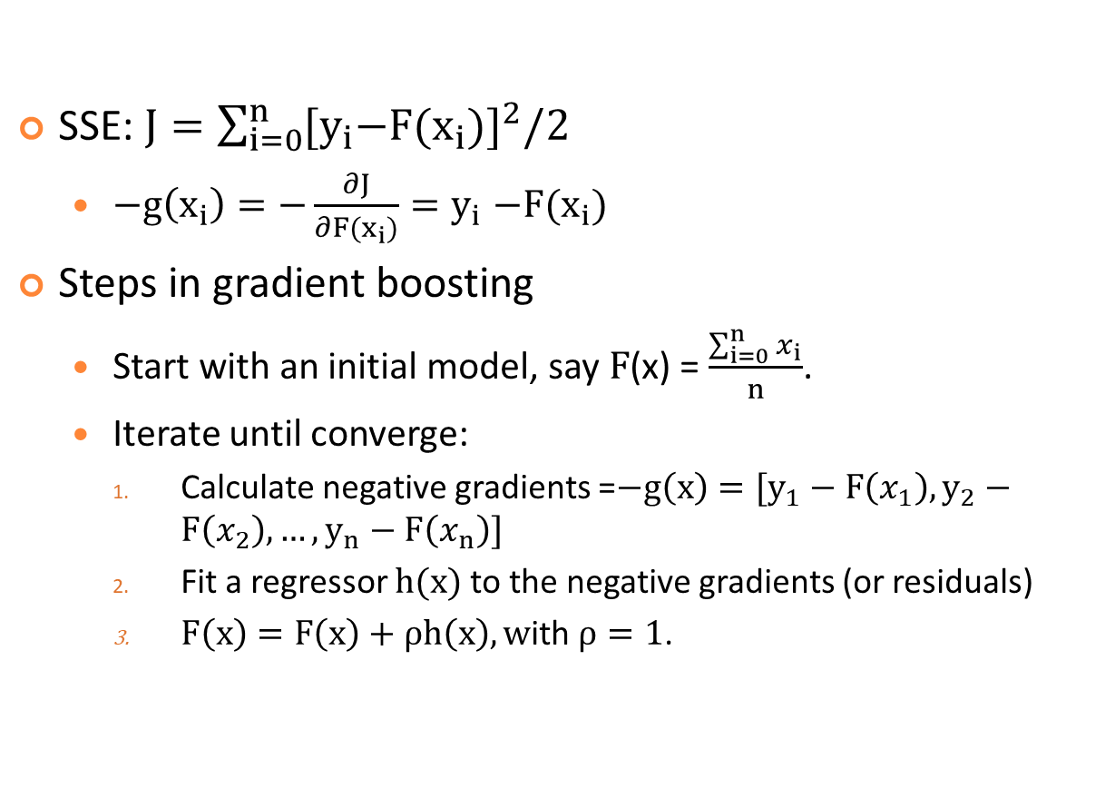
Gradient Boosting for Regression with SSE
SSE: $J=\sum_{i=0}^{n}{{{[y}_{i}−F(x_{i})]}^{2}/2}$
$−g\left(x_{i}\right)=−\frac{∂J}{∂F(x_{i})}{=y}_{i}−F(x_{i})$
Steps in gradient boosting
Start with an initial model, say $F$(x) = $\frac{\sum_{i=0}^{n}{x_{i}}}{n}$.
Iterate until converge:
Calculate negative gradients =$−g\left(x\right)=[y_{1}−F\left(x_{1}\right),y_{2}−F\left(x_{2}\right), …, y_{n}−F\left(x_{n}\right)]$
Fit a regressor $h(x)$ to the negative gradients (or residuals)
$F\left(x\right)=F\left(x\right)+\text{ρ}h\left(x\right), w$ith $\text{ρ}=1$.
Further optimization possible

Slide 23
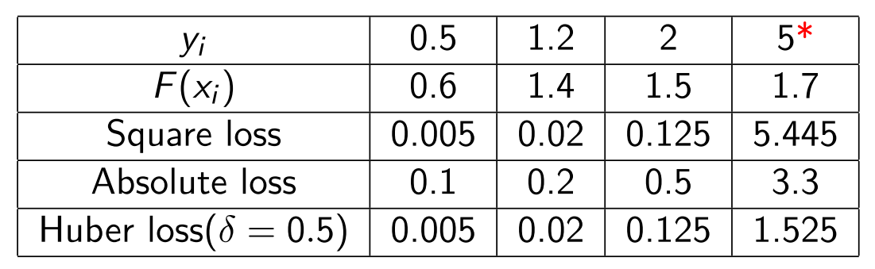
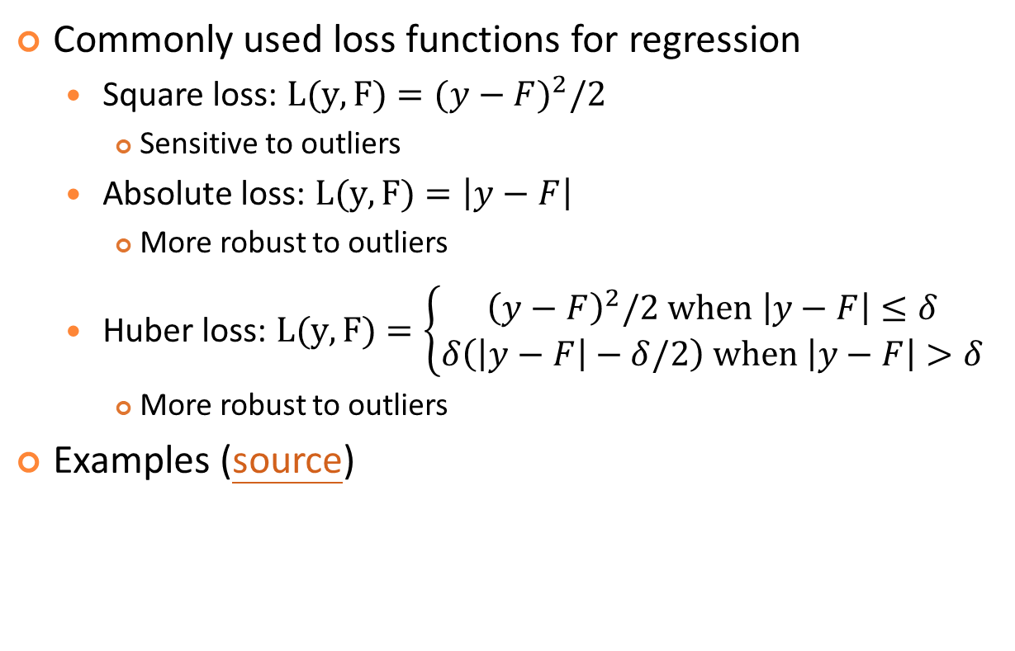
Loss Functions for Regression
Commonly used loss functions for regression
Square loss: $L(y, F)={(y−F)}^{2}/2$
Sensitive to outliers
Absolute loss: $L(y, F)=\left|y−F\right|$
More robust to outliers
Huber loss: $L(y, F)=\left\{\begin{matrix}{\left(y−F\right)}^{2}/2 when \left|y−F\right|≤δ \\ δ\left(\left|y−F\right|−δ/2\right) when \left|y−F\right|>δ\end{matrix}\right.$
More robust to outliers
Examples (source)

Slide 24
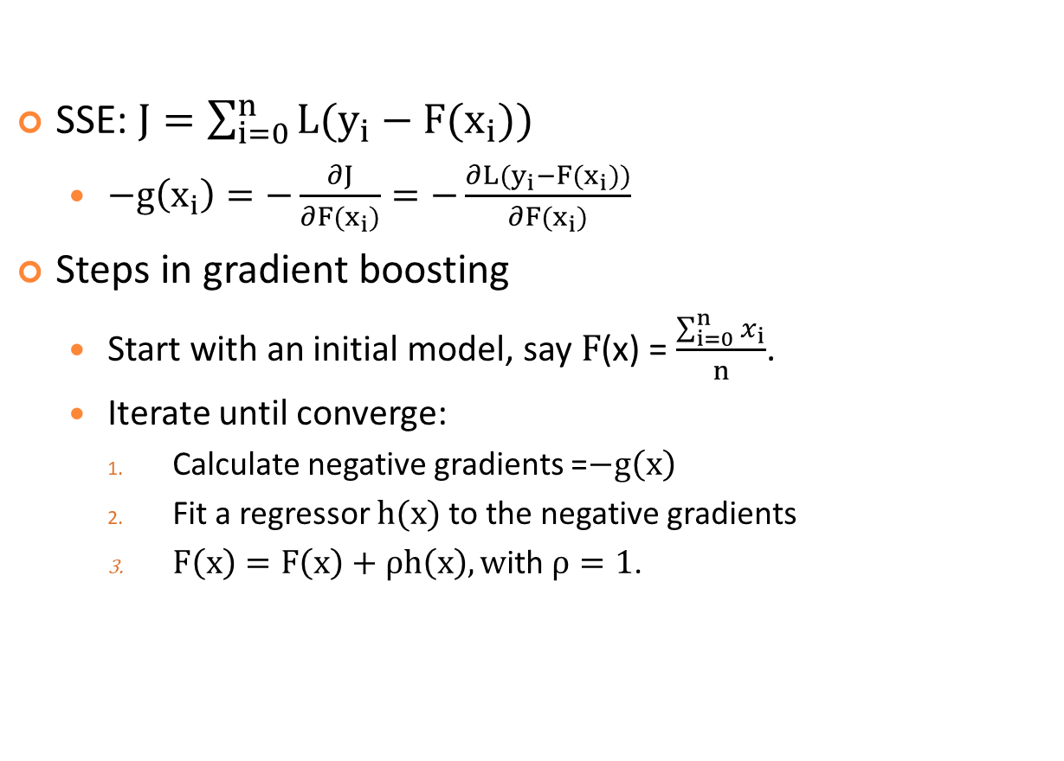
Gradient Boosting for Regression with a General Loss Function
SSE: $J=\sum_{i=0}^{n}{{L(y}_{i}−F(x_{i}))}$
$−g\left(x_{i}\right)=−\frac{∂J}{∂F(x_{i})}=−\frac{∂{L(y}_{i}−F(x_{i}))}{∂F(x_{i})}$
Steps in gradient boosting
Start with an initial model, say $F$(x) = $\frac{\sum_{i=0}^{n}{x_{i}}}{n}$.
Iterate until converge:
Calculate negative gradients =$−g\left(x\right)$
Fit a regressor $h(x)$ to the negative gradients
$F\left(x\right)=F\left(x\right)+\text{ρ}h\left(x\right), w$ith $\text{ρ}=1$.
By following negative gradients instead of residuals,
the model will pay less attention to outliers.

Slide 25
Summary for Gradient Boosting
Summary for GB
Fit an additive model in a forward stage-wise manner
In each stage, introduce a new model to improve the existing model by following the negative gradients
Any differentiable loss function can be used.
References
A Gentle Introduction to Gradient Boosting
Ensembles (3): Gradient Boosting
A Kaggle Master Explains Gradient Boosting

Slide 26
Decision Trees: Strengths and Weaknesses
Strengths
Easy to comprehend
Fast to train
Nonlinear
Invariant to feature scaling
Robust to
Feature types (numerical & categorical, etc.)
Correlated features
Missing values
Weaknesses
Poor accuracy
Inefficient to fit linear relationships

Slide 27
Improving Decision Trees: Ensembles
Random forest
Bagging
Fit a set of trees on different samples of the data
Take tree average as output
Parallel in nature
Gradient boosting
Boosting
Fit a sequence of trees where each tries to reduce error from prior trees
Take cascaded tree output as putput
Cascaded in nature

Slide 28
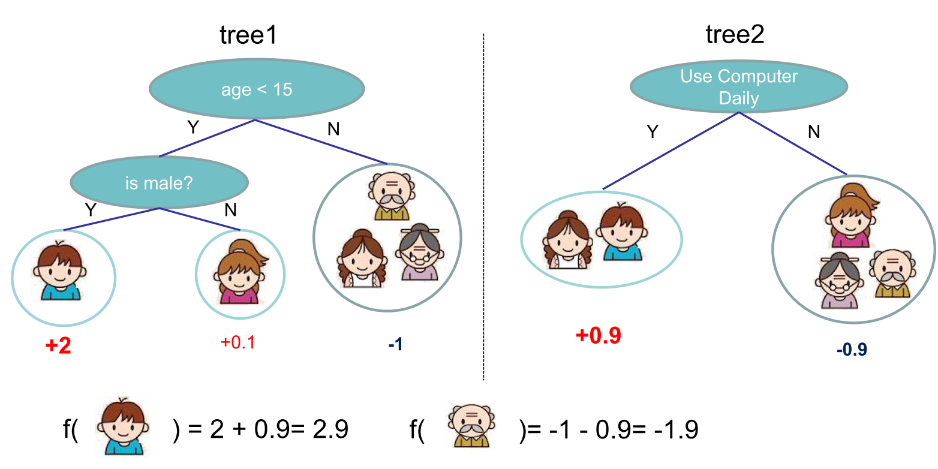
An Simple Example of Tree Ensemble
The overall prediction is the sum or average of each tree’s prediction.
Source

Slide 29
More about Tree Ensembles
Fact
Almost half of data mining competition are won by using some variants of tree ensemble methods!
Advantages
All advantages of decision tress are inherited.
Better accuracy than a single tree
Learn higher-order interactions between features
Can be scalable
Used practically in industry

Slide 30
Tree Ensemble: XGBoost
XGBoost: Extreme Gradient Boosting
Based on the concept of gradient boosting
Tree boosting, with regularization term
Supports regression, classification, ranking and user defined objectives.
Flexible code available
Supports multiple languages and platforms
Distributed on various clouds
Wins many ML competitions
Highly scalable
Reference
Scalable and Flexible Gradient Boosting
Intro to Boosted Trees (pdf) by Tianqi Chen
In 2015, 17 out of 29 Kaggle champions
used XGBoost in their solutions.

Slide 31
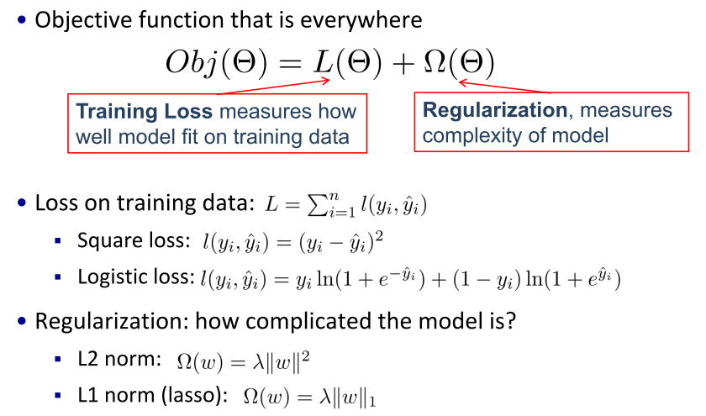
Objective Functions for ML

Slide 32
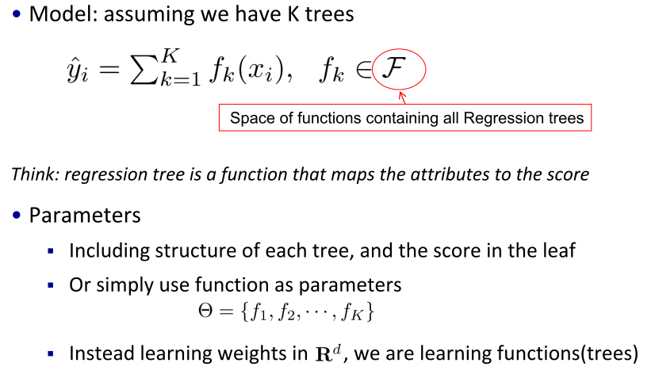
Boosting by Learning a Tree Sequence

Slide 33
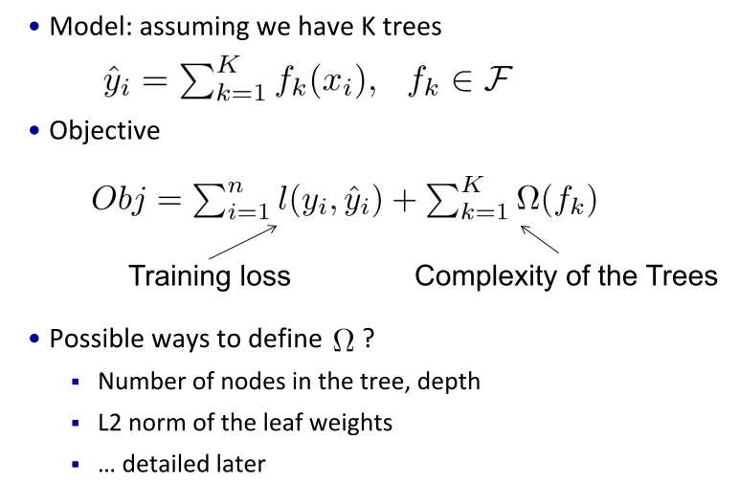
Objective for Tree Ensemble

Slide 34
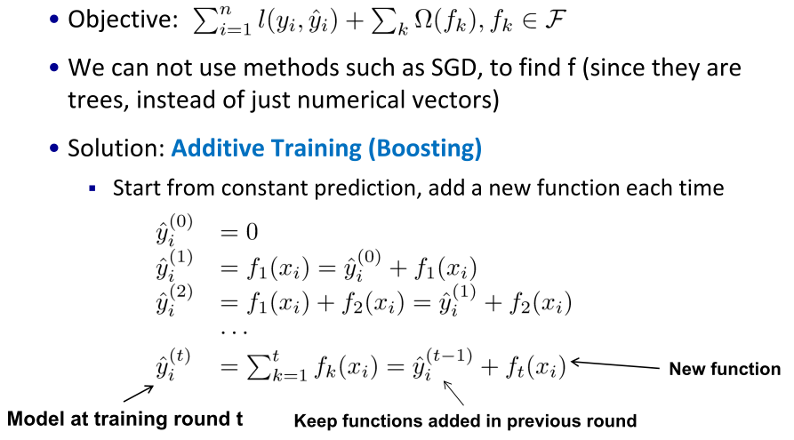
Boosting

Slide 35
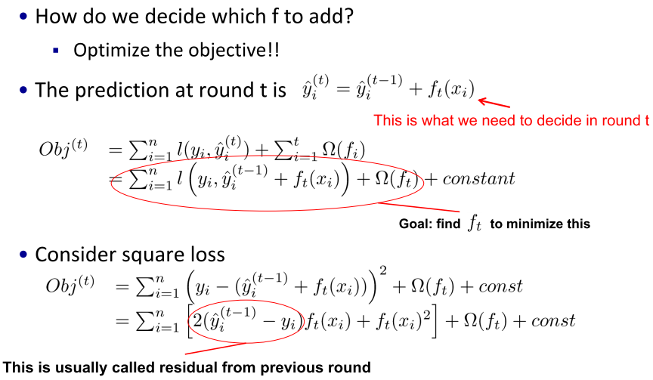
Additive Training

Slide 36
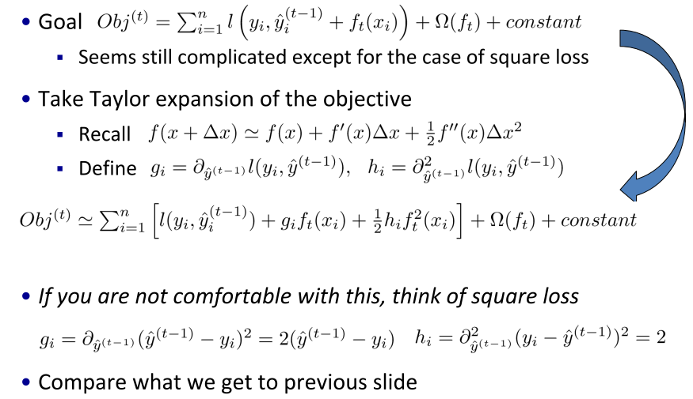
Taylor Expansion of Loss Function

Slide 37
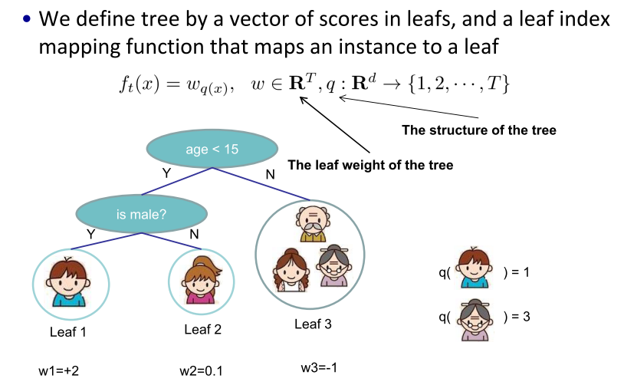
Refine Tree Definition

Slide 38
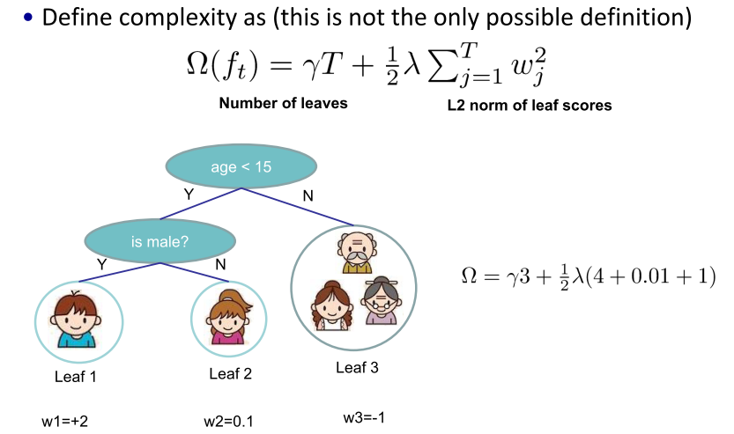
Define Tree Complexity

Slide 39
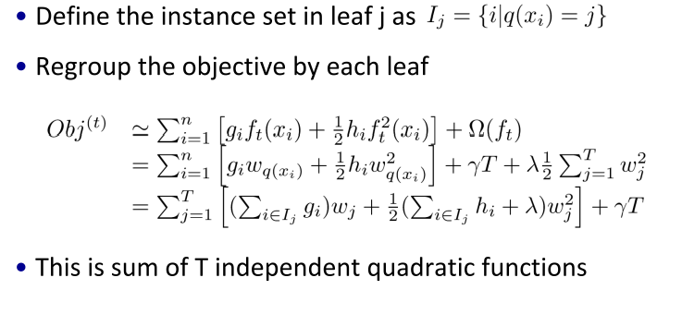
Rewrite the Objectives

Slide 40
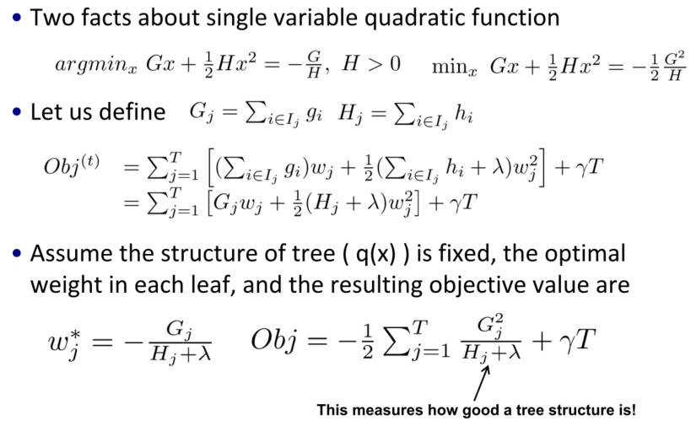
Tree Structure Score

Slide 41
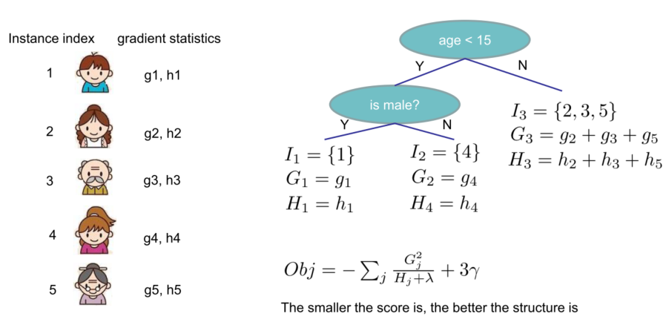
Example of Tree Structure Score

Slide 42
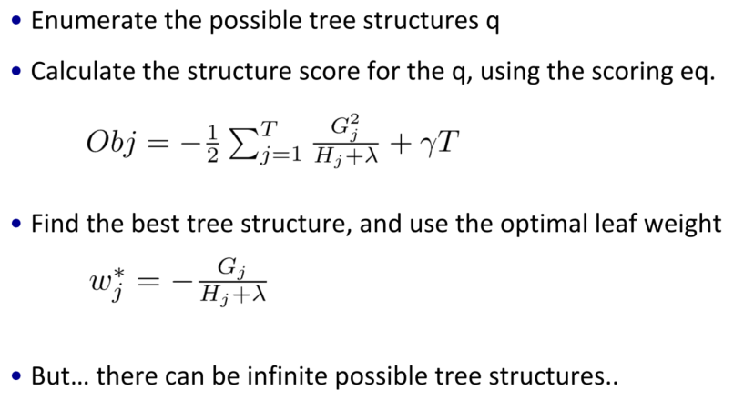
Search for a Single Tree

Slide 43
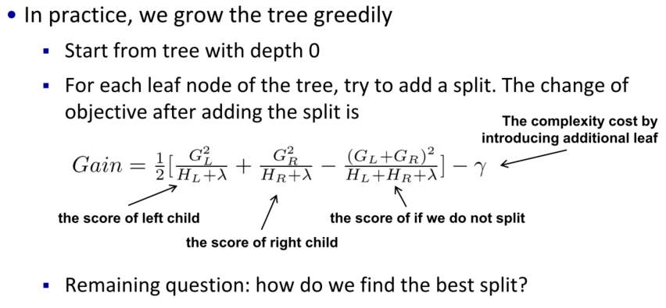
Greedy Search in Tree Construction

Slide 44
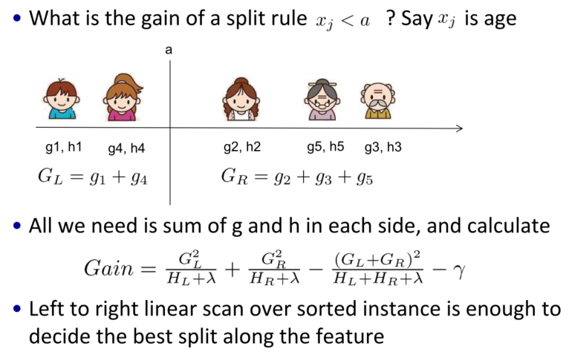
Efficient Search for the Best Split

Slide 45
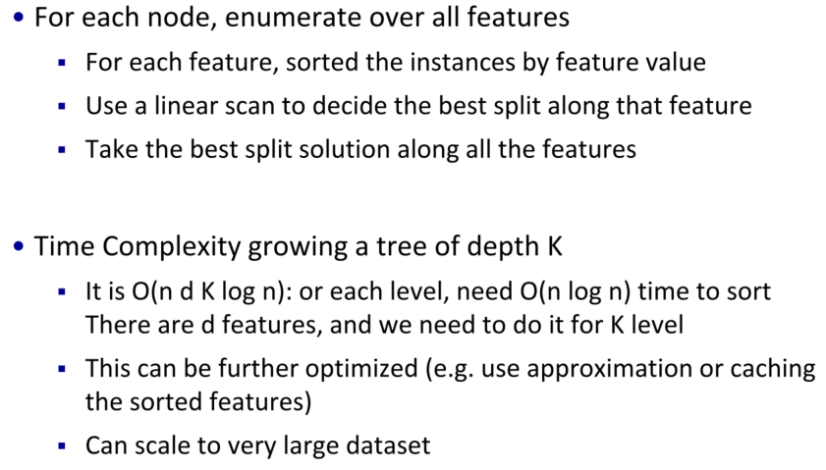
Algorithm for Finding Split

Slide 46
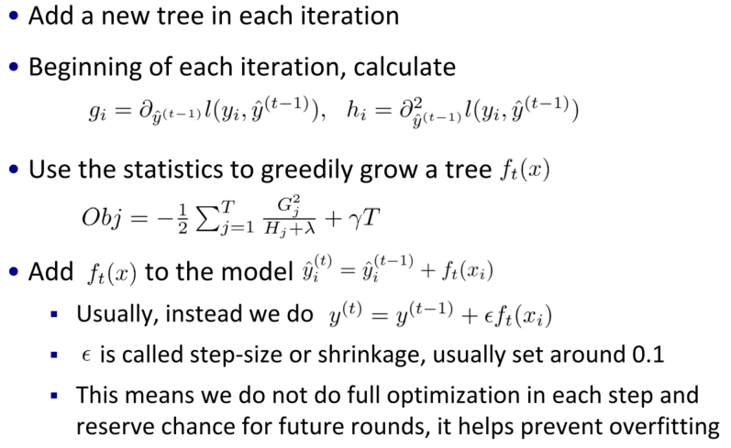
Recap: Boosted Tree Algorithm

Slide 47
Conclusions by Comparison
Modeling on big data
Large number of examples
High dimensionality
Two successful paradigms of modeling
Start with a complex model from the very beginning and fit the model parameters iteratively ➔ Deep neural networks
Slow
Good for image classification, with transfer learning available
Build the overall model iteratively, with each step adding a simple model for fast training ➔ Boosting
Faster and more scalable
Good for general data prediction w/o transfer learning

Slide 48
References
References & resources
Intro to Boosted Trees (pdf) by Tianqi Chen
Scalable and Flexible Gradient Boosting
Kaggle Winning Solution Xgboost Algorithm - Learn from Its Author, Tong He

