Slide 1
Visualization in EDA for ML on Structured Data
J.-S. Roger Jang (張智星)
jang@mirlab.org, http://mirlab.org/jang
MIR Lab, CSIE Dept.
National Taiwan University
2024/3/12

Slide 2
Basic Steps in EDA (Exploratory Data Analysis)
Data cleansing
Integrity check
Feature-based, I/O-based
Outlier detection & handling
Missing data imputation
Feature engineering
Feature encoding
Feature selection
Manual selection
Automatic selection
Visualization
Basic statistics
Univariate analysis
Distribution analysis
Bivariate analysis
Distribution & correlation analysis
Multivariate analysis
Focus of
this deck!

Slide 3
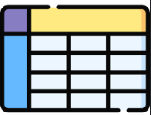




Structured Data vs. Unstructured Data
Structured data
A dataset that can be represented as a table
May contains NaN (not a number)
Examples
Row-major
Column-major
Unstructured data
A dataset that cannot be represented as a table
Examples
Texts
Images, video
Speech, music, audio

Slide 4
Structured Data: Table Formats
d (feature dim) = 6, n (data count) = 10, c (no of classes) = 3, class size ratio = 3:5:2
Row-major
Column-major
Features
I/O pair
n I/O pairs
3
3
2
Features
1
dxn Feature matrix
n I/O pairs
1
2
2
2
1xn class labels
in 1~c
I/O pair
3
3
2
1
1
2
2
2
1
2
1
2
nxd feature matrix
nx1 class labels
in 1~c

Slide 5
Data Integrity Check
Check if something wrong with the data
Same-value features
Across classes ➔ Delete
Within a class ➔ Cause problem in NBC
Same feature vector for I/O pairs
Same class ➔ Delete one?
Different classes ➔ Contradiction?
Singular covariance matrix ➔ Cause problem in QC
Missing value
Imputation
Features
3
3
2
1
n I/O pairs
1
2
2
2
I/O pair
1
2
nxd feature matrix
nx1 class labels
in 1~c

Slide 6
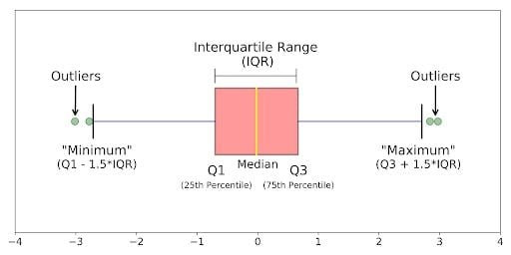
Box Plot: Intro
Box plot (aka whisker plot)
A standardized way of displaying the distribution of numerical data based on its five-number summary (“minimum”, first quartile [Q1], median, third quartile [Q3] and “maximum”)
Useful for checking
Outliers
If your data is symmetrical
How tightly your data is grouped
If and how your data is skewed
Source: https://builtin.com/data-science/boxplot

Slide 7
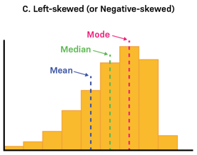
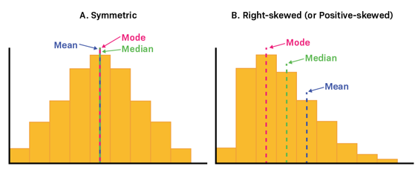
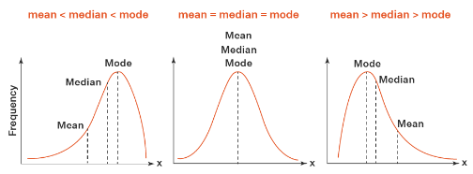
Mean, Median, and Mode
On top of histogram
On top of PDF
Left-skewed Symmetric Right-skewed
Source: https://www.labxchange.org/library/items/lb:LabXchange:d8863c77:html:1
Examples of skewed distributions:
https://www.youtube.com/watch?v=0djtjjy12fI
Source: https://www.cuemath.com/data/relation-between-mean-median-and-mode/

Slide 8
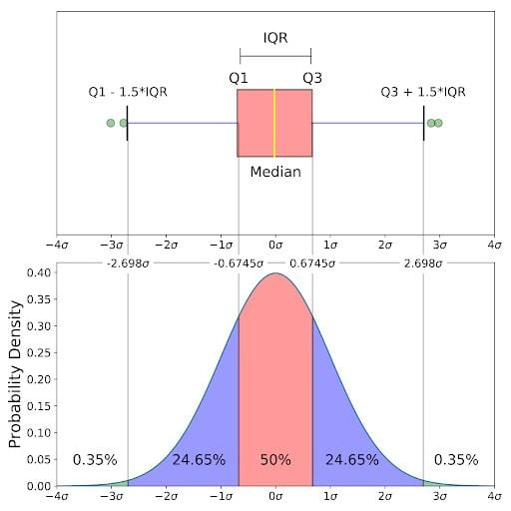
Box Plot on Normal Distribution
Box plot vs. Normal distribution
Facts
True normal distributed data is rare.
Transformation is usually needed to create normal distributed data.
Source: https://builtin.com/data-science/boxplot

Slide 9
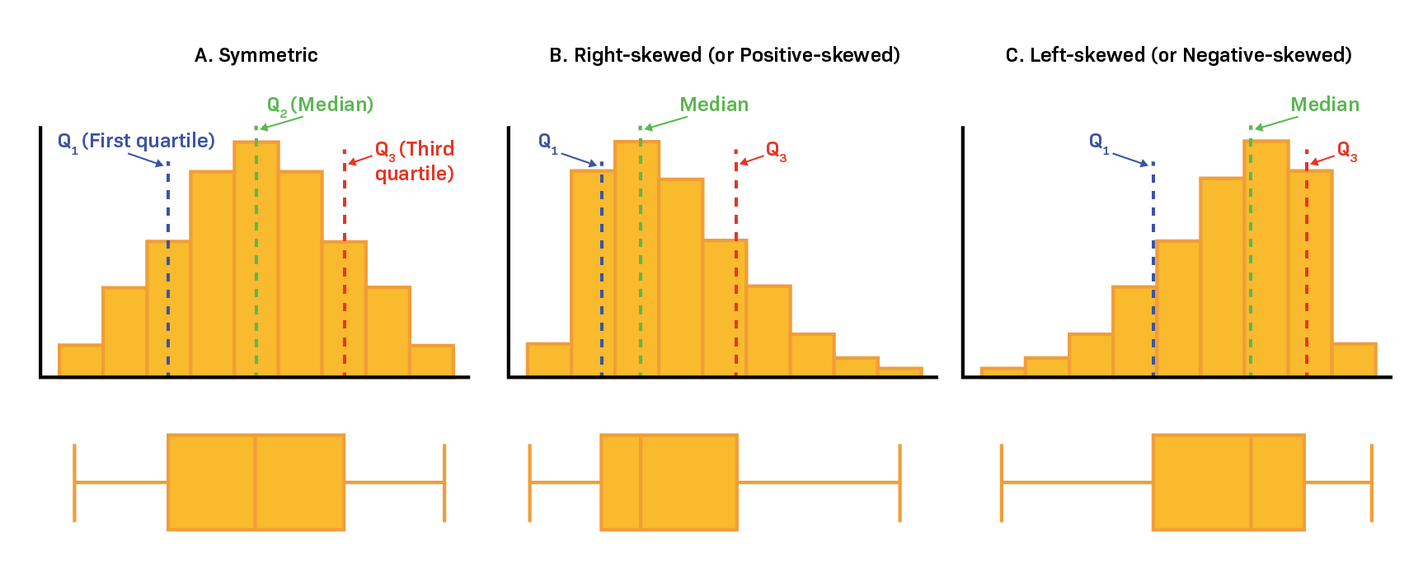
Box Plot on Skewed Data
Example: Income of people in Taiwan
Skew to right or left?
Mean or median for data summary?
Source: https://www.labxchange.org/library/items/lb:LabXchange:d8863c77:html:1

Slide 10

UCI Dataset: Wine
Source
Institute of Pharmaceutical and Food Analysis and Technologies, Via Brigata Salerno, 16147 Genoa, Italy.
Goal
Using 13 chemical constituents to determine the origin of wines
Dataset specs
178 instances, 3 classes, 13 attributes

Slide 11
Univariate Analysis: Introduction
Goal
Analyze/Visualize the dataset by taking one variable at a time
Plots
Categorical features: Count plot by bar chart, pie plot, etc.
Numerical features: Histogram, box plot, PDF (probability density function) plot, violin plot, etc.

Slide 12
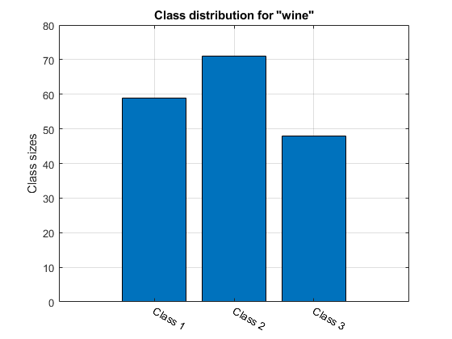
Univariate Analysis: Class (Output) Histogram
Class (output) histogram
Can be used to
Check if imbalanced dataset, if yes…
Select a reasonable loss function
Cost-sensitive classification
Perform data augmentation (which I do not recommend)
Example of imbalanced dataset:
Covid-19 detection

Slide 13
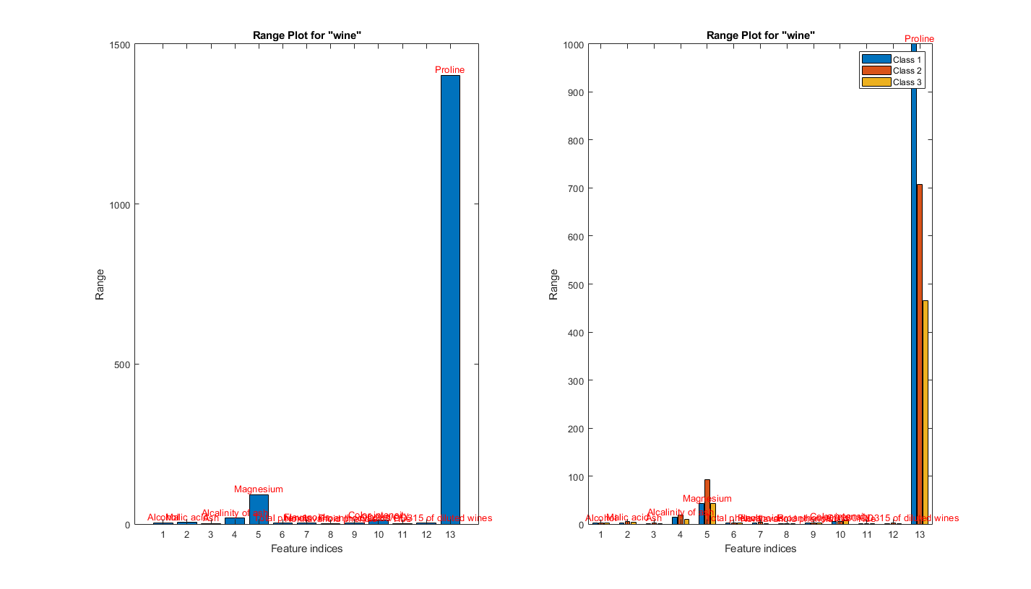
Univariate Analysis: Range for Raw Features
Can be used to
Check if data normalization necessary
Check if outliers exist

Slide 14
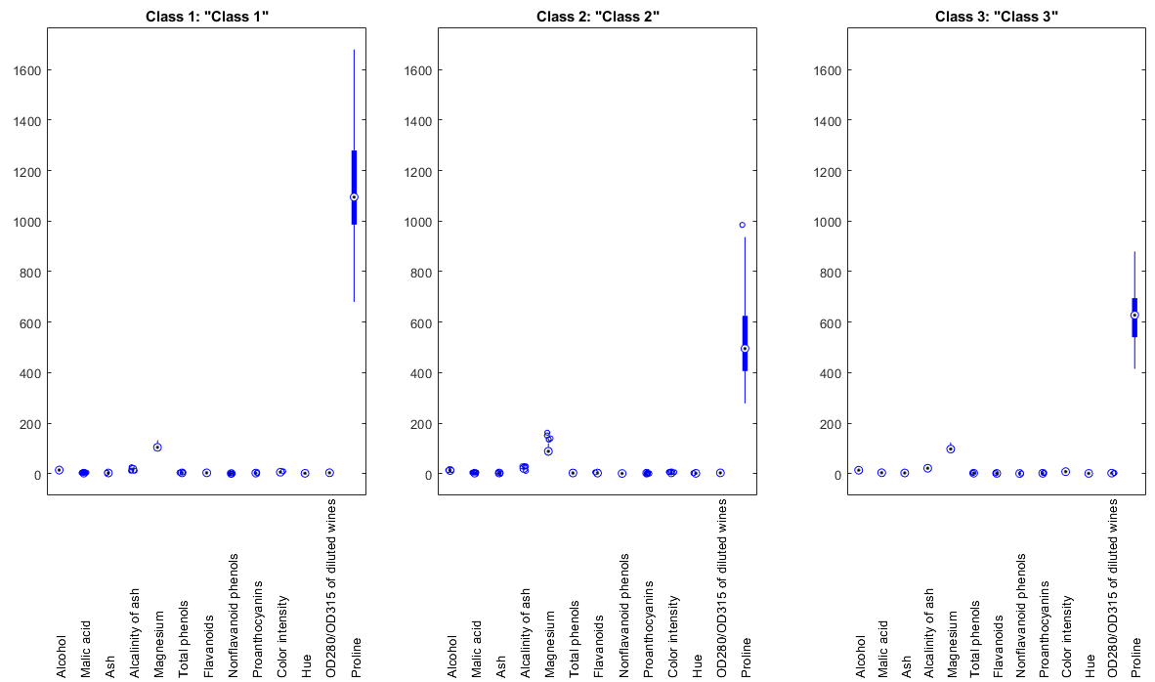
Univariate Analysis: Box Plots for Raw Features
Can be used to
Detect outliers
Represent data distribution

Slide 15
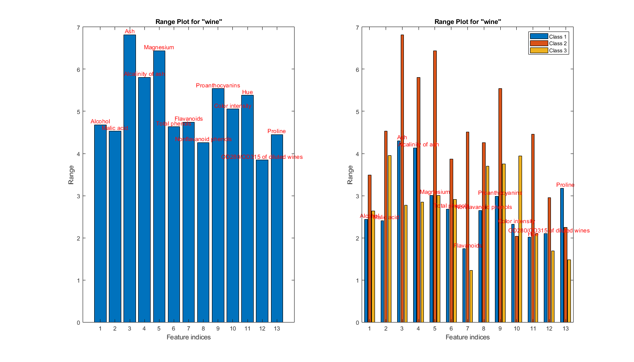
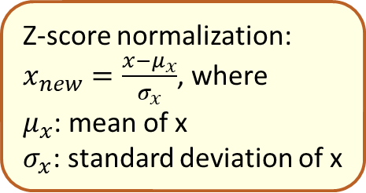
Univariate Analysis: Range Plots for Normalized Features
Z-score normalization:
$x_{new}=\frac{x−μ_{x}}{σ_{x}}$, where
$μ_{x}$: mean of x
$σ_{x}$: standard deviation of x

Slide 16
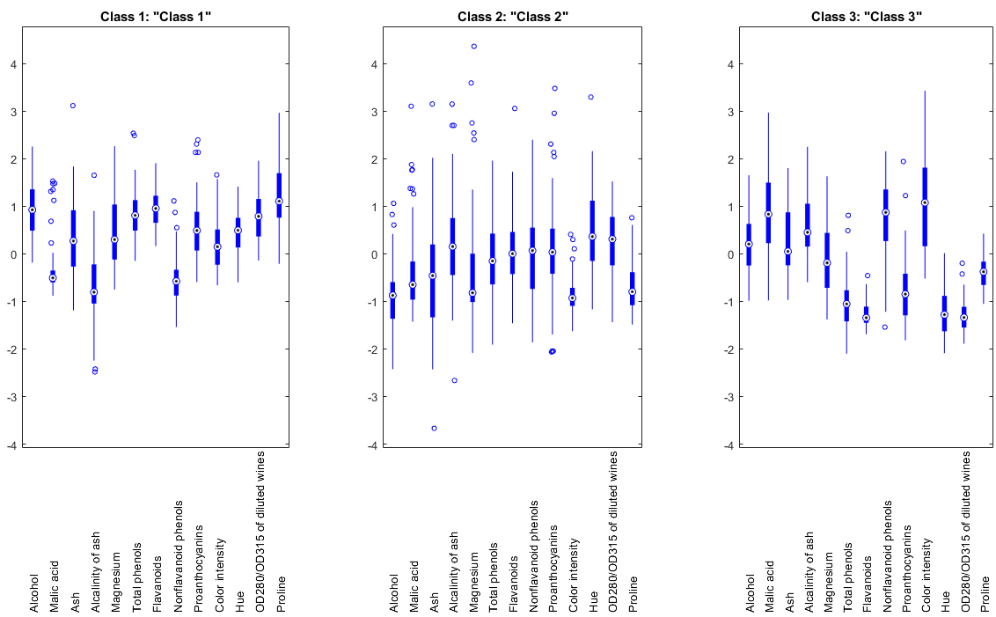
Univariate Analysis: Box Plots for Normalized Features
Can still be used for outlier detection
(Box plots keep the same shape.)

Slide 17
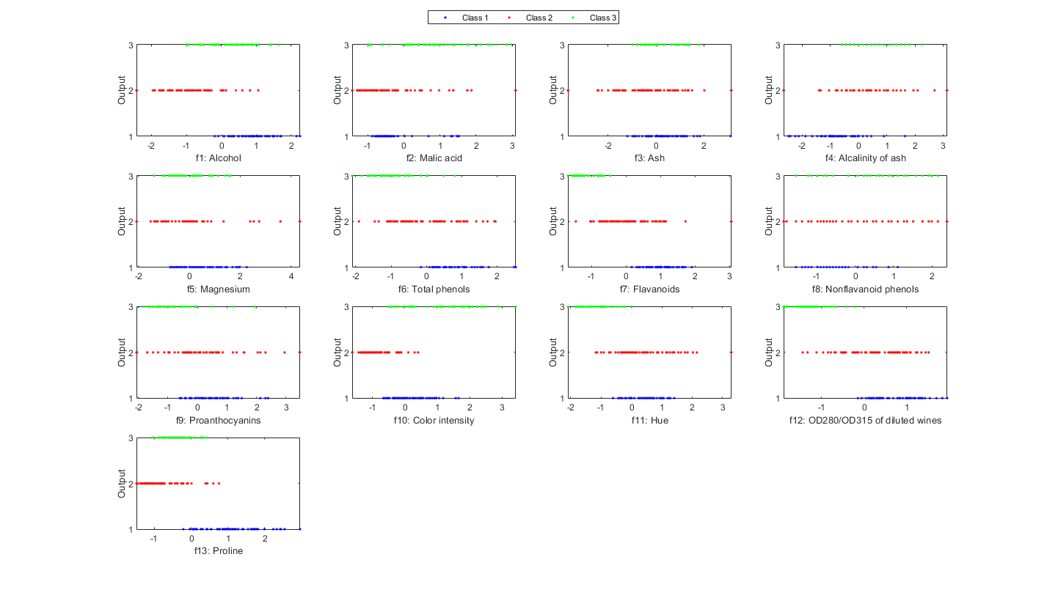
Univariate Analysis: Output vs. Features
No. of plots = 13
Can be used to
Check if a single feature is good for classification by class-based separation.
Verify feature selection

Slide 18
Bivariate Analysis: Introduction
Goal
Analyze/Visualize the dataset by taking two variables at a time
Plots
Categorical features: 2D count plot by bar chart, etc.
Numerical features: 2D histogram by bar chart, 2D PDF surface plot, pairwise correlation, etc.
Problem
What if one feature is categorical while the other is numerical?

Slide 19
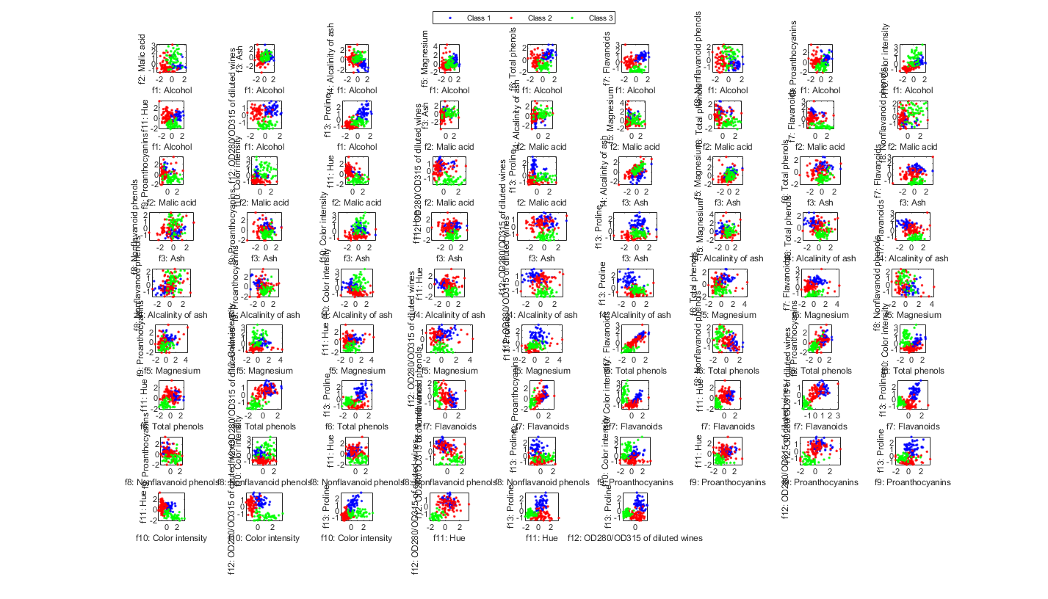

Bivariate Analysis: Output vs. Features
No. of plots = $C_{2}^{13}=78$
Can be used to
Check if a feature pair is good for classification by class-based separation.
Verify feature selection

Slide 20
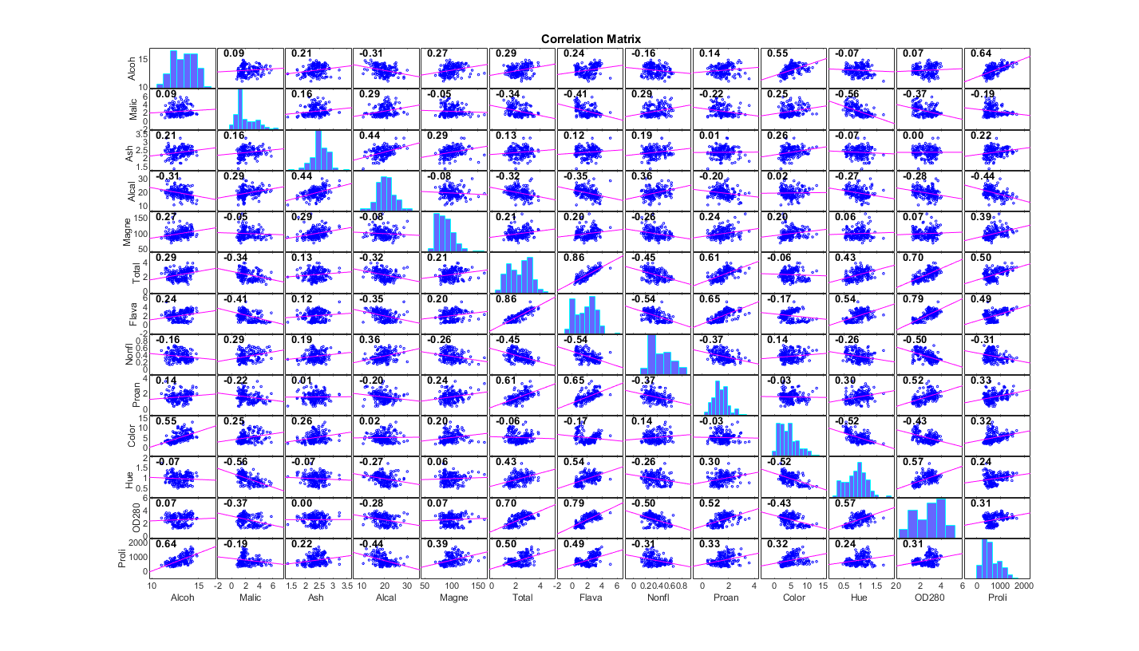
Bivariate Analysis: Scatter Plots and Correlation of Feature Pairs
No. of plots = 13x13
Symmetric matrix of plots
Histograms at diagonal
Scatter plots at off-diagonal

Slide 21
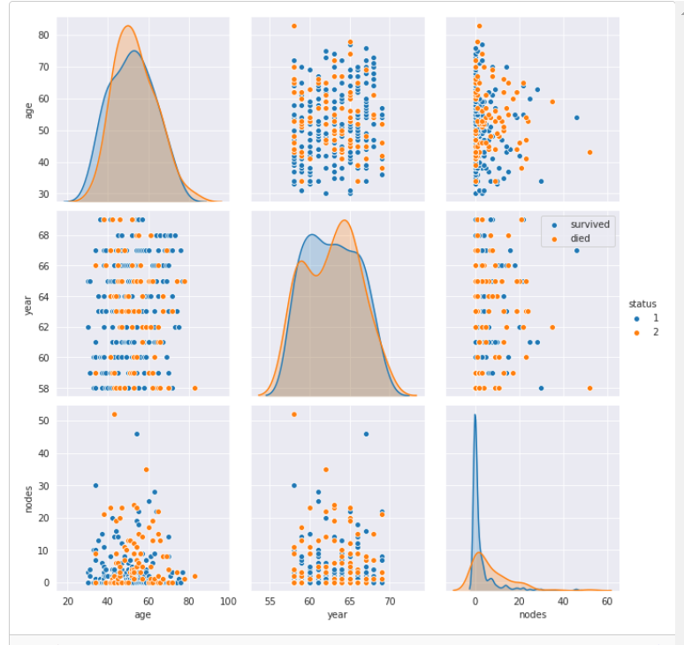
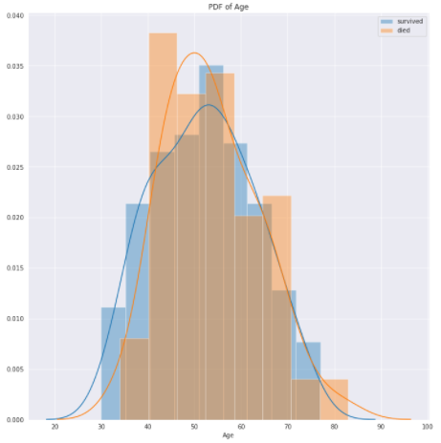
Bivariate Analysis: Other Examples
Use PDFs instead of histograms in the diagonal
Display both histograms
and PDFs
Source: https://www.analyticsvidhya.com/blog/2022/03/exploratory-data-analysis-with-an-example

Slide 22
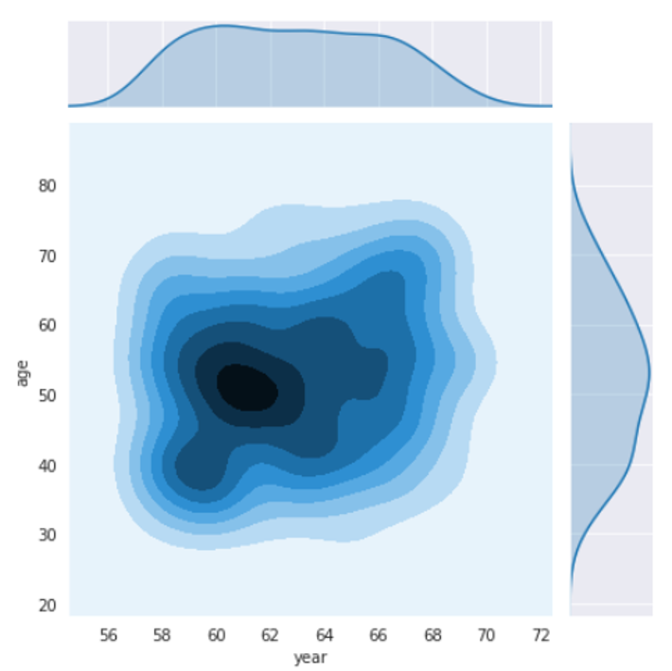
Bivariate Analysis: Other Examples
Use both one and two-dimensional PDFs
The PDFs can be determined by
Nonparametric approach, such as histogram or Parzen estimator
Parametric approach, such as GMM (Gaussian mixture mode) identified by MLE (maximum likelihood estimate)
Source: https://www.analyticsvidhya.com/blog/2022/03/exploratory-data-analysis-with-an-example

Slide 23
Summary of EDA in ML
An important preprocess of ML on structured data
Visual inspection
Visual representation
Statistics
Univariate analysis
Bivariate analysis
Feature normalization
Domain knowhow required for
Outlier removal
Data deletion/modification
Manual feature selection
…

Slide 24
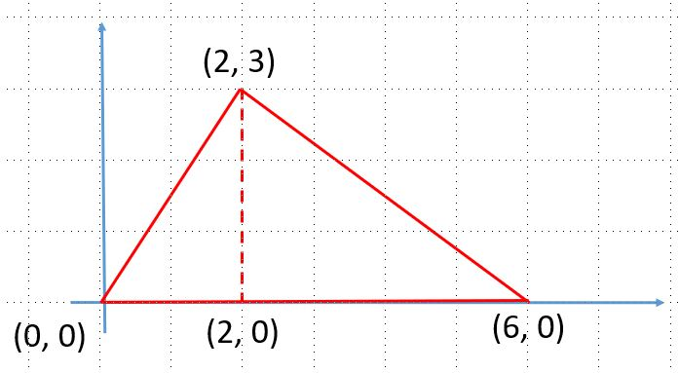
Exercises
What (and why) is the relationship between mean, median, and mode if the PDF is
Symmetric
Right-skewed
Left-skewed
Draw a PDF with the following conditions:
median < mode < mean
median < mean < mode
Compute median, median, and mode for the following PDF-like distribution:

