Slide 1
Dynamic Time Warping (DTW)
J.-S Roger Jang (張智星)
jang@mirlab.org
http://mirlab.org/jang
MIR Lab, CSIE Dept
National Taiwan University

Slide 2
Dynamic Time Warping
Goal
To align two sequences of time under certain constraints, such that the distance between these two sequences is as small as possible.
Method
Dynamic programming (DP)

Slide 3
Distance between Same-length Sequences
Distance between can be denoted by L_{p} norm:
Alignment
Quiz!

Slide 4
Distance between Different-length Sequences

Slide 5
Type-1 DTW: Alignment Constraints
Temporal constraints
Alignment constraints
One-to-one mapping
One skip at most
x1
x2
x3
x4
x5
y1
y2
y3
y4
y5
y6
y7
y8

Slide 6
Type-1 DTW: Alignment Path
Alignment path (mapping path)
j
x1
x2
x3
x4
x5
8
7
y1
y2
y3
y4
y5
y6
y7
y8
6
5
4
3
2
1
i
1
2
3
4
5

Slide 7
Type-1 DTW: Local Path Constraints
27-45-63 local paths

Slide 8
Type-1 DTW: 3-Step DP Formula
x, y: input vector/matrix
Local paths: 27-45-63 degrees
3-step DP formulation:
j
Quiz!
y(j)
y(j-1)
x(i-1)
x(i)
i

Slide 9
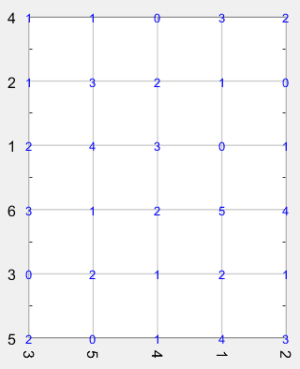

Slide 10
Type-2 DTW: Alignment Constraints
Temporal constraints
Alignment constraints
1-to-1, 1-to-many, or many-to-1 mapping
No skips at all
x1
x2
x3
x4
x5
y1
y2
y3
y4
y5
y6
y7
y8

Slide 11
Type-2 DTW: Alignment Path
Alignment path
j
x1
x2
x3
x4
x5
8
7
y1
y2
y3
y4
y5
y6
y7
y8
6
5
4
3
2
1
i
1
2
3
4
5

Slide 12
Type-1 DTW: Local Path Constraints
0-45-90 local paths

Slide 13
Type-2 DTW: 3-Step DP Formula
x, y: input vector/matrix
Local paths: 0-45-90 degrees
3-step DP formulation:
j
Quiz!
y(j)
y(j-1)
x(i-1)
x(i)
i

Slide 15
Comparison of Local Path Constraints
Type 1:
27-45-63 local paths
Type 2:
0-45-90 local paths

Slide 16
DTW Visualization via Machine Learning Toolbox (1/2)
dtw (for type 1)
dtwPathPlot (for types 1 & 2)
0º and 90º are seldom!
45º is seldom!

Slide 17
DTW Visualization via Machine Learning Toolbox (2/2)
dtwBridgePlot
2D view
3D view
Type 1
Type 2

Slide 18
Path Penalty for Type-1 DTW
Alignment path of type-1 DTW
45-degree paths are likely to be avoided since we are minimizing the total distance.
So we can add penalty for paths deviated from 45-degree.

Slide 19
Path Penalty for Type-2 DTW
Alignment path of type-2 DTW
45-degree paths are likely to be taken since we are minimizing the total distance.
So we can add penalty for paths of 45-degree.

Slide 20
Comparison of Type-1 and Type-2
Time complexity is both O(mn).
Type-1 DTW is more efficient due to the global path constraint induced by local path constraints
Quiz!

Slide 21
Comparison
Quiz!
Type-1 DTW
Tends to take 27º or 63º
More efficient
Type-2 DTW
Tends to take 45º
Less efficient
Feasible region
Feasible region

Slide 22
More about DTW
Typical applications
Speech recognition: MFCC matrices as inputs (where x(i) is the MFCC vector of frame i)
Query by singing/humming: Pitch vectors as inputs (where x(i) is the pitch value of frame i)
Abundant variants of DTW
Recurrent formulas
Local path constraints
Speaker dependent!

Slide 23
Applications
Applications of DTW
DTW for speech recognition
DTW for query by singing/humming

