Slide 1
文件分類 Automatic Document Classification (ADC)
J.-S. Roger Jang (張智星)
jang@mirlab.org
http://mirlab.org/jang
MIR Lab, CSIE Dept.
National Taiwan University
2022/8/27

Slide 2
Introduction to ADC
Goal of ADC
To classify a given document into a class
Applications
Spam filtering
News classification
Sentiment analysis
Opinion mining
靠北台大
Election prediction
Donald Trump vs. Hillary Clinton
Customer labeling
…

Slide 3
General Approach to ADC
Preprocessing
Text normalization
Word segmentation
…
Feature extraction
One-hot representation
TF-IDF
Word embedding
…
Fixed-dim classifiers
Decision trees
Deep neural networks
Support vector machines
Naïve Bayes classifiers
Nearest neighbor classifiers
…
Variable-dim or sequence classifiers
HMM
RNN
LSTM
…

Slide 4
Word Segmentation (WS、斷詞、分詞)
English
Words: Separated by spaces
Exceptions: San Francisco, de facto, de jure, a priori, a posteriori
Chinese
Much harder due to no space in-between
Methods
Dictionary search
HMM based on BIES labeling
POS tagging
…

Slide 5
Chinese WS via Dictionary Search
Maximum matching (最大比對、長詞優先)
Forward maximum matching (FMM, 正向最大比對)
Backward maximum matching (BMM , 反向最大比對)
FMM and BMM may have different results due to 搶詞！
我們三人參加會議
FMM: 我們|三|人參|加|會議
BMM: 我們|三|人|參加|會議
到基隆廟口吃小吃
FMM: 到|基隆|廟口|吃|小吃
BMM:到|基隆|廟|口吃|小吃
除夕即將來臨時
FMM: 除夕|即將|來臨|時
BMM: 除夕|即|將來|臨時
Quiz!
搶詞！
多重搶詞！

Slide 6
Tools for WS or POS Tagging
中研院 CKIP 中文斷詞系統
交通大學語音實驗室線上繁體中文剖析器
Stanford Word Segmenter for Chinese
結巴中文斷詞（Jieba）
SAS

Slide 7
Text Normalization
Stemming: Find the root form of an inﬂected word
Go, going, went, gone, goes ➔ go
Stop words: Words to be removed
the, a, an, etc.
的、了、啊, etc.
Synonym
NTU = National Taiwan University
國高 = 國家高速電腦中心
FBI, IRS, CDC, …
Multi-term
動力 火車 ➔ 動力火車
San Francisco, a priori, …

Slide 8
Word Sense Disambiguation
Word sense disambiguation (WSD): The task of determining the correct meaning of a word in a sentence
Chinese example
哥哥終於考上台大 ⬅➔ 媽媽在台大開刀
English example
An apple on the tree ⬅➔ Apple personal computers
A bat flying in the sky ⬅➔ A bat for baseball
River bank ⬅➔ Financial bank

Slide 9
Term-Document Incidence Matrix
T(t, d)=1 if term t is in doc d.
Each doc is represented by a binary vector.
Docs
Terms

Slide 10
Term-Document Count Matrix
T(t, d)=k if term t appears k times in doc d.
Each doc is represented by an integer vector.

Slide 11
Two Types of Models for ADC
Bag-of-words models
Does not consider the word order in a document
John is taller than Mary and Mary is taller than John have the same vectors
Example: TFIDF
Sequence models
Does consider word order
Example: RNN, LSTM…

Slide 12
TF and IDF
Quiz!
TF (term frequency)
tf(t, d) of term t in document d is defined as the number of times that t occurs in d, divided by the total number of terms in d.
Observation
Rare terms are more important ➔ Introduction of the inverse document frequency
IDF (inverse document frequency):
Document frequency df(t) = no. of documents in which term t occurs
IDF idf(t) = log (N/df(t)), where N is the no. of docs
TF-IDF weight = tf(t, d)*idf(t)
Many variants exist!

Slide 13
TF-IDF Weighting
Binary ➔ Count ➔ TF-IDF weight
Each column ➔ Vector for a doc ➔ Ready for doc classification
Each row ➔ Vector for a term ➔ Ready for term clustering
Unstructure data ➔ Structure data!

Slide 14
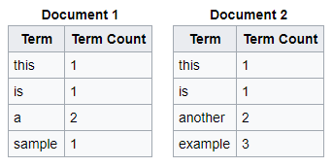



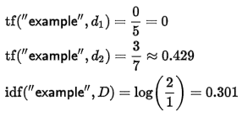
Example 1: TF-IDF
Quiz!

Slide 15
Example 2: TF-IDF
Quiz!
Given a collection of 5 documents with 4 tokens (or words), as shown next, what is their TF-IDF? Which token(s) is/are useless for classification?
Doc 1: ABCDD
Doc 2: CA
Doc 3: AACDA
Doc 4: BCD
Doc 5: CCAA
Term count
TF
IDF
 | 1 | 2 | 3 | 4 | 5
A | 1 | 1 | 3 |  | 2
B | 1 |  |  | 1
C | 1 | 1 | 1 | 1 | 2
D | 2 |  | 1 | 1
 | 1 | 2 | 3 | 4 | 5
A | 1/5 | 1/2 | 3/5 |  | 2/4
B | 1/5 |  |  | 1/3
C | 1/5 | 1/2 | 1/5 | 1/3 | 2/4
D | 2/5 |  | 1/5 | 1/3
A | log(5/4)
B | log(5/2)
C | log(5/5)
D | log(5/3)

Slide 16
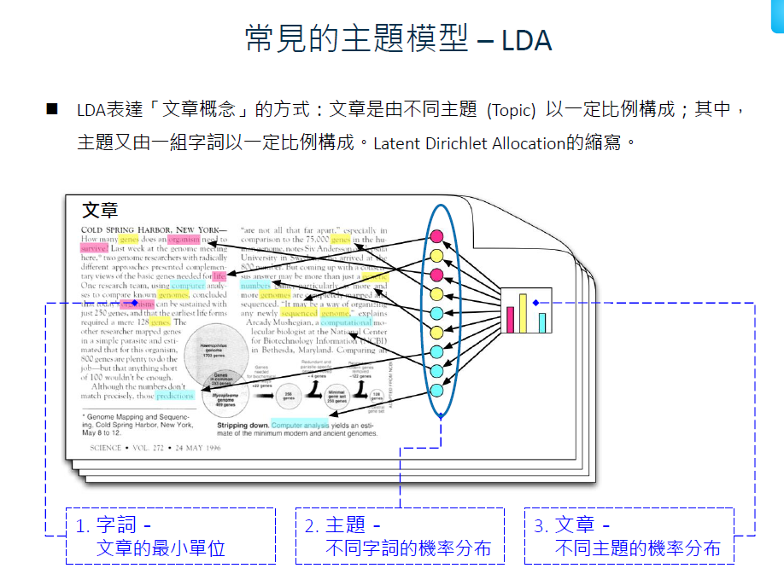

Slide 17
Example of Topic Modeling
Documents
Doc 1: You had a peanut butter sandwich for breakfast.
Doc 2: I like to eat almonds, peanuts and walnuts.
Doc 3: My neighbor got a little dog yesterday.
Doc 4: Cats and dogs are mortal enemies.
Doc 5: You mustn’t feed peanuts to your dog.
Topics (clusters)
Topic 1: 30% peanuts, 15% almonds, 10% breakfast
Topic 2: 20% dogs, 10% cats, 5% peanuts
Documents ➔ Vectors
Documents 1 and 2: 100% Topic 1 ➔ [1, 0]
Documents 3 and 4: 100% Topic 2 ➔ [0, 1]
Document 5: 70% Topic 1, 30% Topic 2 ➔ [0.7, 0.3]

Slide 18
Singular Value Decomposition
Singular value decomposition (SVD)
Interpretation
Each document and term can be reduced to dim k, which is the no. of clusters (topics, themes) for text mining.

Slide 19
SVD for LDA
SVD（singular value decomposition）主要用於拆解特定文章的主題結構及其主題的字詞結構，為主題模型最常見的矩陣分解方法 ➔ A = UΣV^{T}
Docs
Topics
Docs
Terms
Terms
Topics

Slide 20
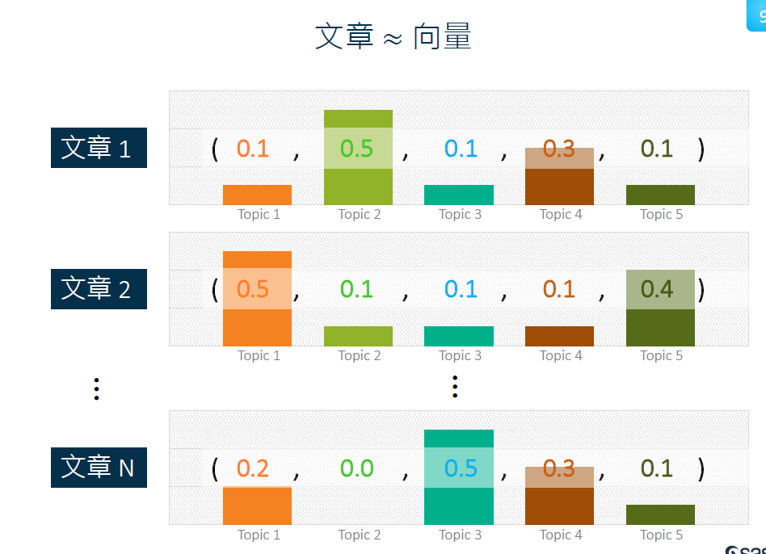

Slide 21
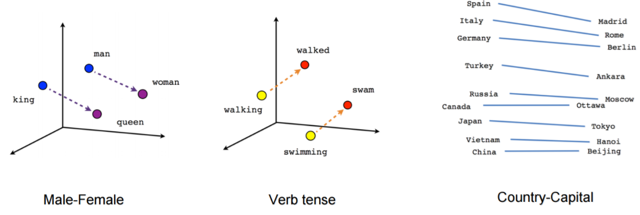
Word to Vector
Goal: To embed a word into a high-dimensional space
Example
queen - king = woman - man
Source: Vector Representations of Words
Source: 玩轉文字探勘以 word2vec 以及 ptt 資料為例

Slide 22
Classifiers for ADC
Fixed-dim classifiers
Nearest-neighbor classifiers
Naïve Bayes classifiers
Quadratic classifiers
GMM classifiers
Linear classifiers
Decision trees
Neural networks
Sparse representation classifiers
SVM
Logistic regression classifiers
…
Variable-dim (sequence) classifiers
HMM
RNN
LSTM
…

Slide 23
淘寶應用範例：產品類別預測
標籤
以淘寶網頁內建的商品類別為標籤，例如
流行女裝
鞋包配飾
流行數碼
家電家裝
美妝保健
資料
每個標籤各4800項商品描述
訓練資料：70%
測試資料：30%

Slide 24
淘寶應用範例：資料範例
以淘寶網頁內建的商品類別為GT，例如：
流行女裝
吊帶背心女春夏百搭莫代爾韓版修身黑色外穿緊身上衣打底小吊帶衫
鞋包配飾
男女士通用帆布腰帶休閒商務 牛仔褲針扣皮帶 戶外青少年學生韓版
流行數碼
OPPO R9S plus全網通指紋識別6G大運存旗艦拍照4G手機r9splus正品
家電家裝
奧林格 ZX-200B6電熱水壺304食品級不鏽鋼家用燒水壺自動斷電煮茶
美妝保健
吹風機家用大功率吹風機負離子髮廊理髮店宿舍冷熱風吹風機靜音

Slide 25
淘寶應用範例：自動貼標方法
目標
輸入：商品描述
輸出：標籤（商品類別）
流程
資料處理（文字轉成結構化資料）
中文斷詞
計算 TF-IDF 矩陣
經由 SVD 轉成特徵向量 ➔ Topic model
分類、優化及效能評估
Decision trees, DNN, SVM, etc.
K-fold cross validation
Many other methods exist,
Including word embedding, etc.

Slide 26
淘寶應用範例：初步分類結果
分類結果 (when no. of clusters = 10)
Decision trees
辨識率：訓練資料 96.18%、測試資料 94.94%
建模耗費時間：約2分鐘
Neural networks
辨識率：訓練資料 94.77% 、測試資料 96.24%
建模耗費時間：約20分鐘
比較
辨識率接近，但評估可能不準確
建模時間差異甚大 ➔ 大量資料應採用 decision trees

Slide 27
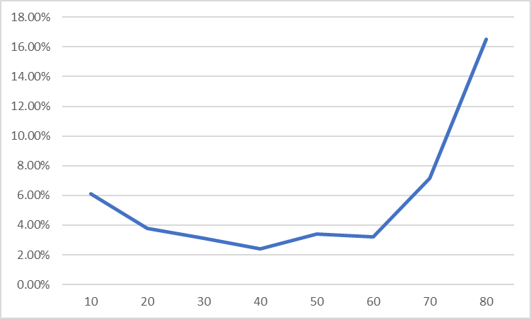
淘寶應用範例：特徵抽取之優化
Exhaustive search on parameters for topic models
No of clusters = 10, 20, …, 80
Training: test = 70%: 30%
Result
Classifier: decision trees
Best test accuracy = 97.58%
Exhaustive search on
neural networks is not feasible!
Error rate
Number of clusters

Slide 28
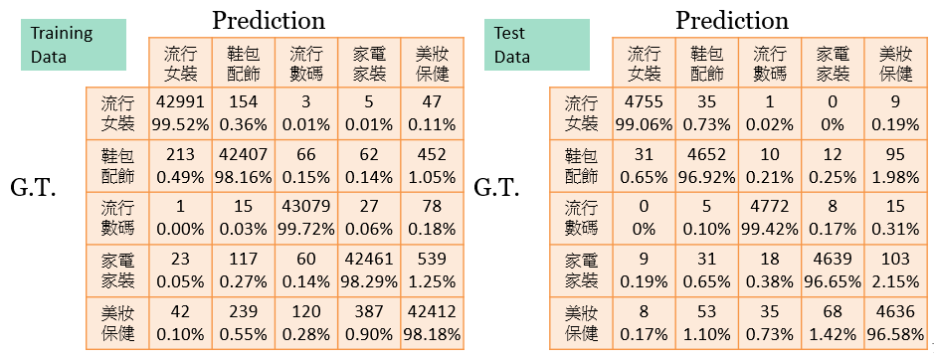
淘寶應用範例：效能評估及混淆矩陣
Decision trees
建模之各項參數由系統自動調整 ➔ Auto ML!
10-fold cross-validation
辨識率：訓練資料 98.774%、測試資料 97.724%
整體執行耗時：約8分鐘
Confusion matrices:

Slide 29
Exercise
請以正向及反向的「長詞優先法」來進行斷詞（假設詞庫的最長詞為四個字）
今天真熱
汽水不如果汁好喝
爸爸昨天才回來家裡
這條馬路真難過
Compute TF-IDF of the documents shown next.
Doc 1: You had a peanut butter sandwich for breakfast.
Doc 2: I like to eat almonds, peanuts and walnuts.
Doc 3: My neighbor got a little dog yesterday.
Doc 4: Cats and dogs are mortal enemies.
Doc 5: You mustn’t feed peanuts to your dog.

