Slide 1
Distance & Similarity Functions
J.-S. Roger Jang (張智星)
jang@mirlab.org
http://mirlab.org/jang
MIR Lab, CSIE Dept.
National Taiwan University

Slide 2
Distance/Similarity Functions
Definition
A distance/similarity function can compute the distance/similarity between two given vectors
Applications
K-nearest-neighbor classifiers
K-means clustering
Objection functions (loss functions) for regression/classification
Many more…

Slide 3
Distance & Similarity Functions
Vectors with same dim.
L_{p} –norm
Mahalanobis distance
Cosine similarity
Pearson’s correlation coefficient
Vectors with different dim.
Dynamic time warping
Linear scaling
Edit distance (for strings)
Longest common subsequence (for strings)
Usually requires more computation!

Slide 4

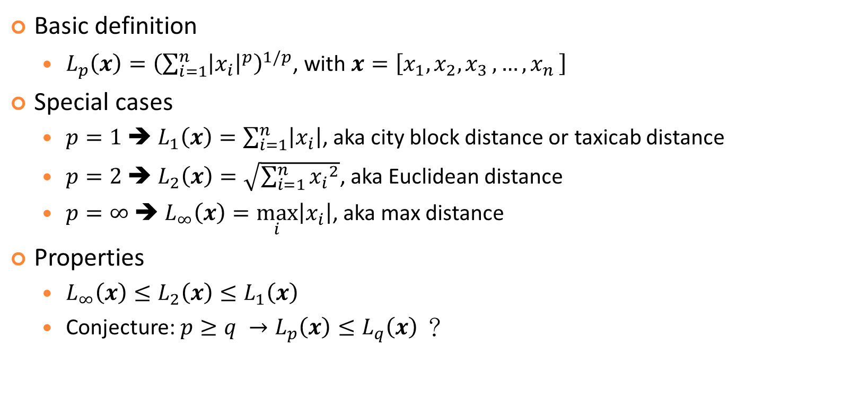
Distance Function: $L_{p}$-norm
Basic definition
$L_{p}\left(x\right)={\left(\sum_{i=1}^{n}{{\left|x_{i}\right|}^{p}}\right)}^{1/p}$, with $x=\left[x_{1},x_{2}{,x}_{3}, …{,x}_{n}\right]$
Special cases
$p=1$➔ $L_{1}\left(x\right)=\sum_{i=1}^{n}{\left|x_{i}\right|}$, aka city block distance or taxicab distance
$p=2$➔ $L_{2}\left(x\right)=\sqrt{\sum_{i=1}^{n}{{x_{i}}^{2}}}$, aka Euclidean distance
$p=∞$➔ $L_{∞}\left(x\right)=\max_{i}\left|x_{i}\right|$, aka max distance
Properties
$L_{∞}\left(x\right)≤L_{2}\left(x\right)≤L_{1}\left(x\right)$
Conjecture: $p≥q →L_{p}\left(x\right)≤L_{q}\left(x\right)$ ？

Slide 5
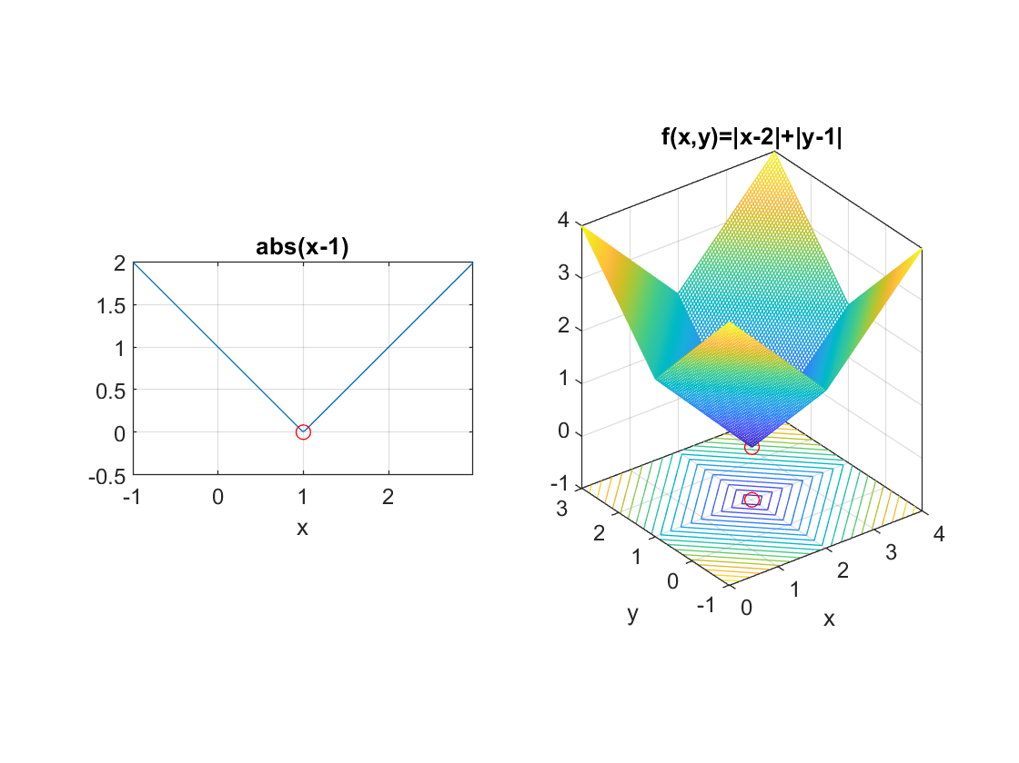

Examples: $L_{1}$-norm

Slide 6
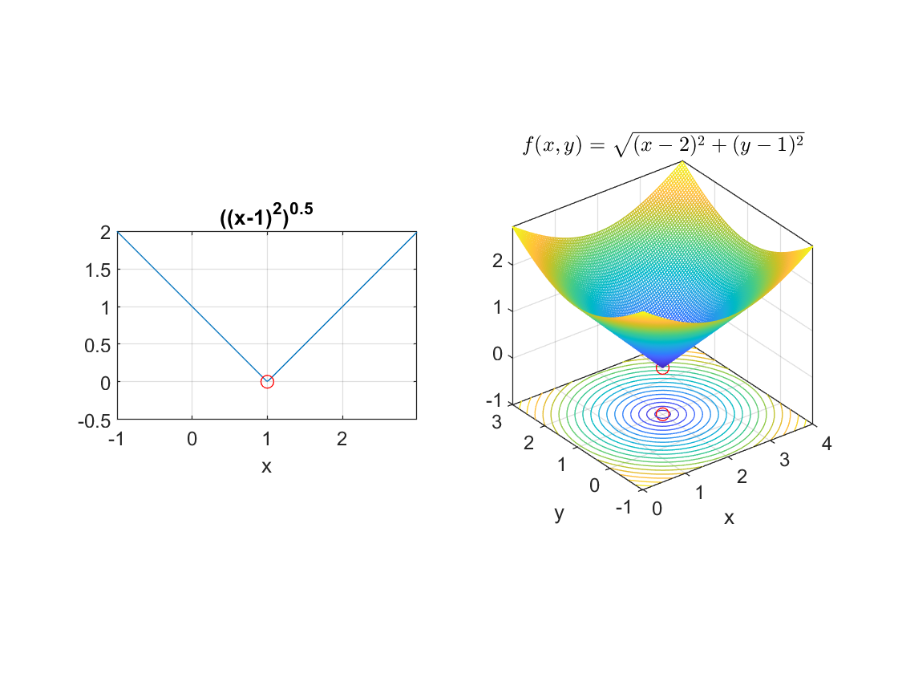

Examples: $L_{2}$-norm

Slide 7
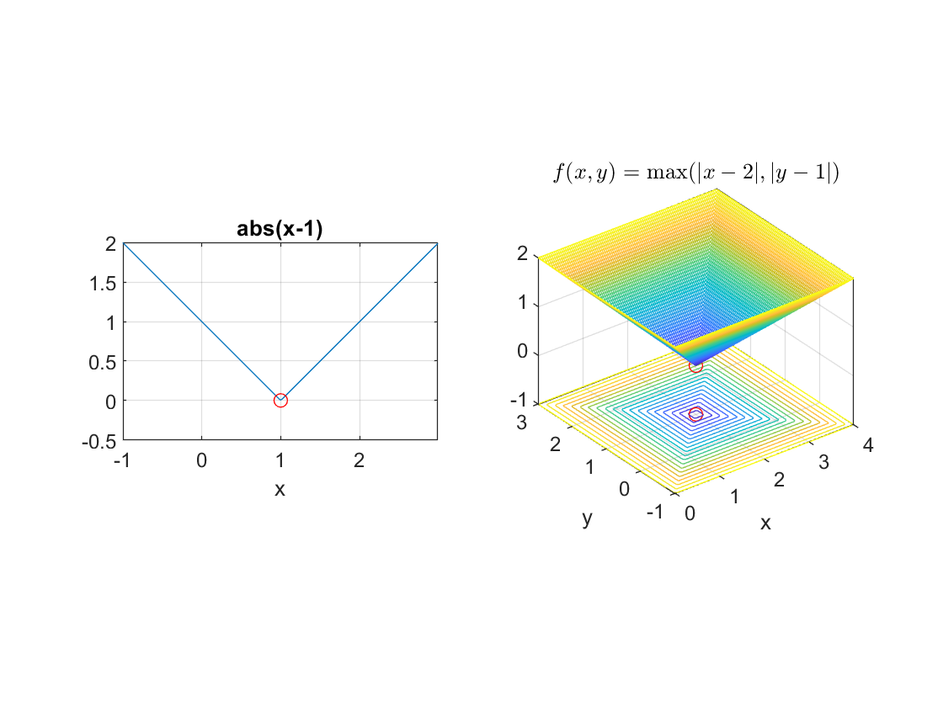

Examples: $L_{∞}$-norm

Slide 8


Contours of $L_{p}$-norm
Contours
$\left\{x | L_{p}\left(x\right)=c\right\}$
Examples when dim=2 and c=1
$p=1$➔ $\left\{\left(x,y\right) | \left|x\right|+\left|y\right|=1\right\}$
$p=2$➔ $\left\{\left(x,y\right) | \sqrt{x^{2}+y^{2}} =1\right\}$
$p=∞$➔ $\left\{\left(x,y\right) | max(\left|x\right|, \left|y\right|)=1\right\}$

Slide 9
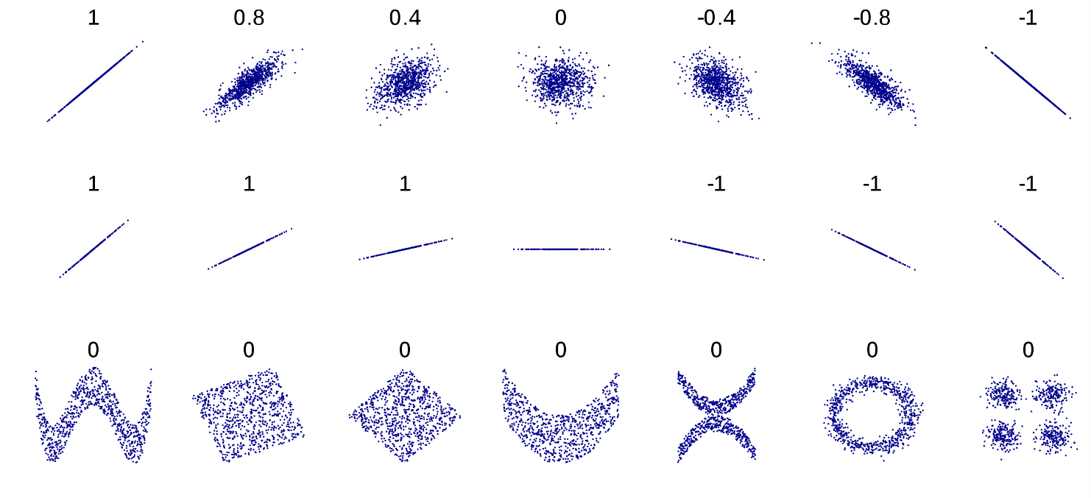

Cosine Similarity & Pearson’s Correlation Coefficient
Cosine similarity
Similarity between two same-length numerical vectors:
$$sim\left(x,y\right)=cosθ=\frac{x∙y}{\left|x\right|\left|y\right|}$$
Pearson’s correlation coefficient
$$r_{xy}=\frac{\left(x−μ_{x}\right)∙\left(y−μ_{y}\right)}{\left|x−μ_{x}\right|\left|y−μ_{y}\right|}$$
Between -1 and 1.
Source: https://en.wikipedia.org/wiki/Pearson_correlation_coefficient

Slide 10

Loss Functions for Regression
Mean square error (MSE)
$$Loss\left(\overset{⃑}{c},\overset{⃑}{d}\right)=\frac{\sum_{i}{{\left(c_{i}−d_{i}\right)}^{2}}}{\text{n}}$$
Mean absolute error (MAE)
$$Loss\left(\overset{⃑}{c},\overset{⃑}{d}\right)=\frac{\sum_{i}{|c_{i}−d_{i}|}}{\text{n}}$$
Mean absolute percentage error
$$Loss\left(\overset{⃑}{c},\overset{⃑}{d}\right)=\frac{\sum_{i}{\left|c_{i}−d_{i}\right|/\left|d_{i}\right|}}{\text{n}}$$
Root mean square error (RMSE)
= square root of MSE

Slide 11
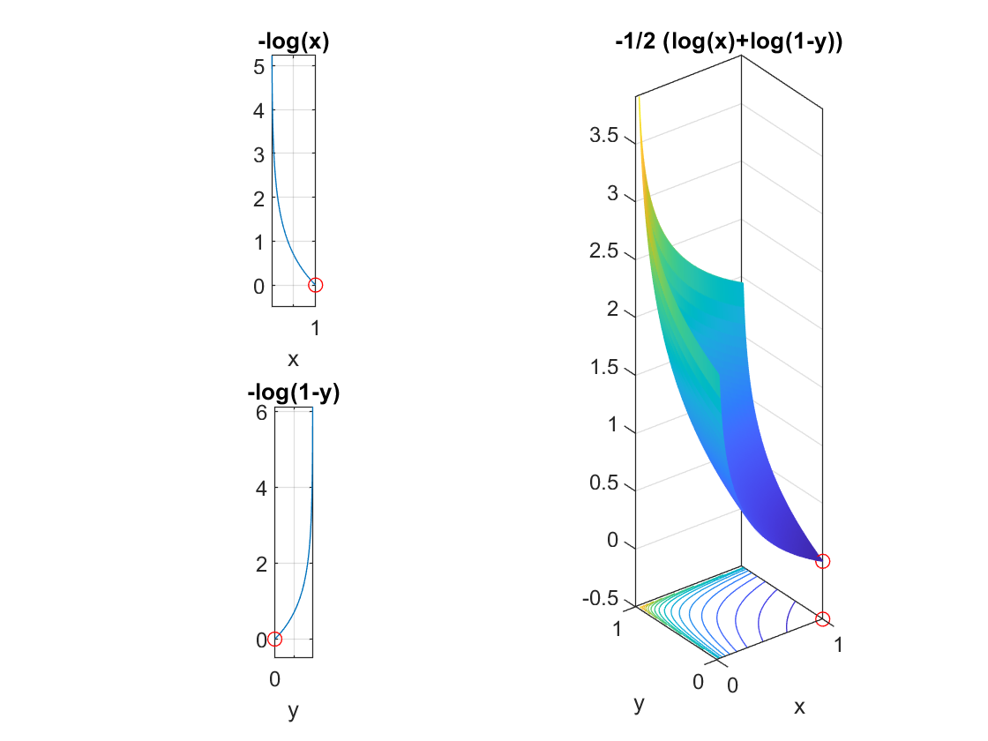
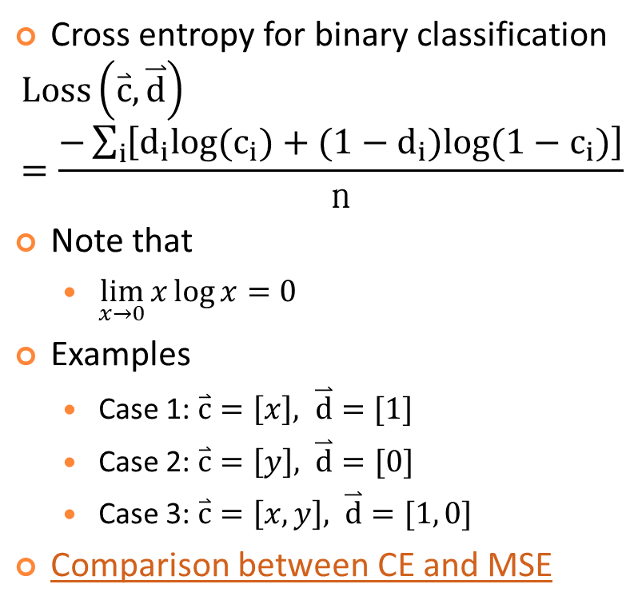
Loss Functions for Classification: Cross Entropy (CE)
Cross entropy for binary classification
$$Loss\left(\overset{⃑}{c},\overset{⃑}{d}\right)=\frac{−\sum_{i}{\left[{d_{i}log(c}_{i})+{{(1−d}_{i})log(1−c}_{i})\right]}}{\text{n}}$$
Note that
$\lim_{x→0}{x\log{x}=0}$
Examples
Case 1: $\overset{⃑}{c}=\left[x\right], \overset{⃑}{d}=[1]$
Case 2: $\overset{⃑}{c}=\left[y\right], \overset{⃑}{d}=[0]$
Case 3: $\overset{⃑}{c}=\left[x, y\right], \overset{⃑}{d}=[1, 0]$
Comparison between CE and MSE
Case 1:
Case 3:
Case 2:

Slide 12
Dynamic Time Warping (DTW)
DTW
Goal: To compute the distance between two vectors of possibly different lengths.
Approach: Dynamic programming
Applications
Speech recognition
Melody recognition
…

Slide 13
Linear Scaling
Linear scaling
Goal: To compute the distance between two vectors of possibly different lengths.
Approach: Interpolation to have same-length input vectors
Applications
Speech recognition
Melody recognition
…

Slide 14
Edit Distance
Goal: To find the min. number of operators required to convert one string into another
Example

Slide 15
Longest Common Subsequence (LCS)
Goal: To find the longest common subsequence between two strings
Example:

