Slide 1
Principal Component Analysis (PCA)
J.-S. Roger Jang (張智星)
MIR Lab, CSIE Dept.
National Taiwan University
jang@mirlab.org, http://mirlab.org/jang

Slide 2
Intro. to PCA
PCA (Principal Component Analysis)
  An effective method for reducing a dataset’s dimensionality while keeping spatial characteristics as much as possible
Characteristics:
  For unlabeled data
  A linear transform with solid mathematical foundation
Applications
  Line/plane fitting
  Face recognition
  Machine learning
  ...

Slide 3

Comparison:
PCA & K-Means Clustering
Common goal: Reduction of unlabeled data
  PCA: dimensionality reduction
    Objective function: Variance ↑
  K-means clustering: data count reduction
    Objective function: Distortion ↓
Quiz!
$$X=\left[\begin{matrix}| & | & … & | \\ x_{1} & x_{2} & … & x_{n} \\ | & | & … & |\end{matrix}\right]$$

Slide 4

Examples of PCA Projections
2D ➔ 1D
3D ➔ 2D

Slide 5
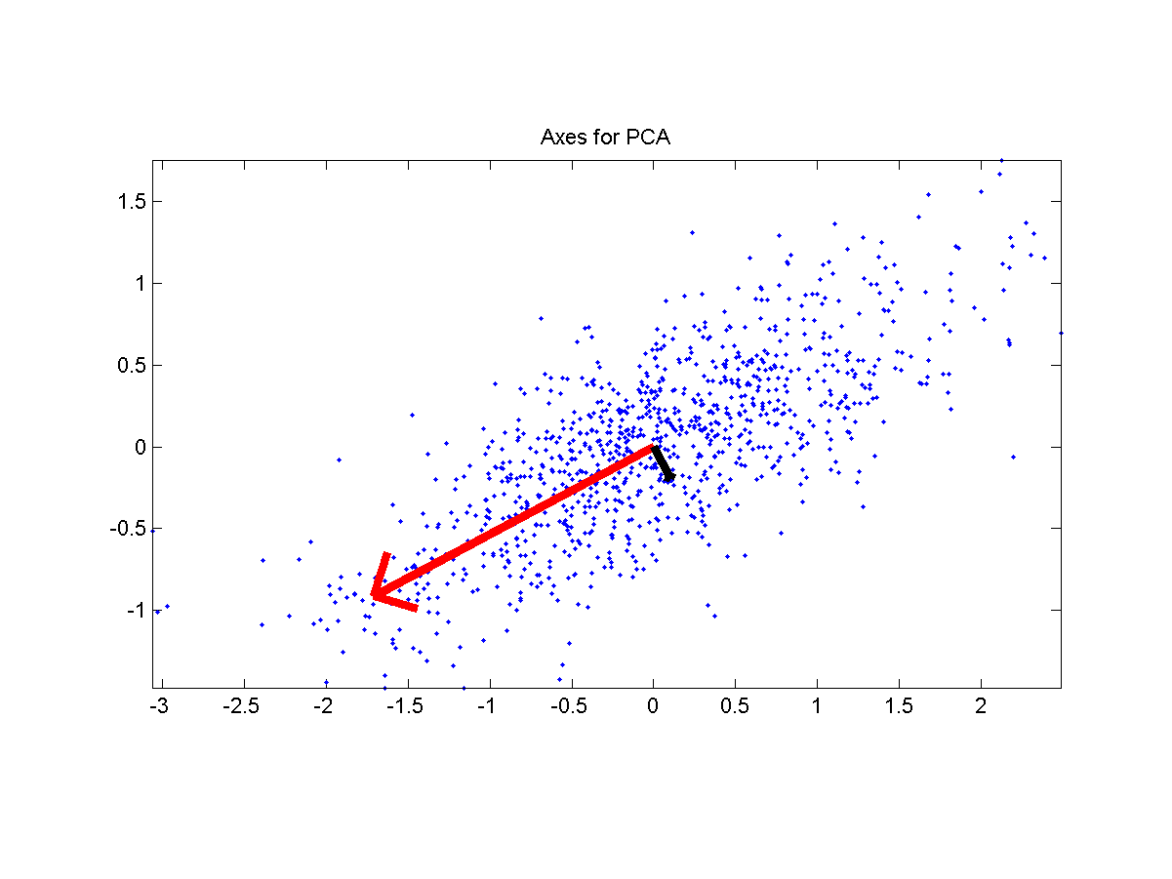

Problem Definition
Quiz!
Input
  A dataset X of n d-dim points which are zero justified:
Output
  A unity vector u such that the square sum of the dataset’s projection onto u is maximized.
$$\text{Dataset}\text{:}X=\left\{x_{1},x_{2},...,x_{n}\right\} \\ \text{Zero} \text{justified}\text{: }\sum_{i=1}^{n}{x_{i}}=0$$

Slide 6
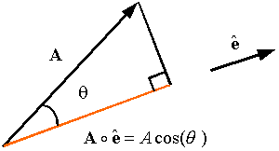


Projection
Angle between vectors
Projection of x onto u
$$\cos{θ}=\frac{x^{T}u}{\left\|x\right\|\left\|u\right\|}$$
$$\left\|x\right\|\cos{θ}=\frac{x^{T}u}{\left\|u\right\|}=x^{T}u \text{if} \left\|u\right\|=1$$
Extension: What is the projection of x onto
the subspace spanned by u₁, u₂, …, u_{m}?

Slide 7

Eigenvalue & Eigenvector
Quiz!
Definition of eigenvector x and eigenvalue λ of a square matrix A:
$$Ax=λx \text{or} \left(A−λI\right)x=0$$
x is non-zero ➔ $A−λI$ is singular ➔ $\left|A−λI\right|=0$

Slide 8
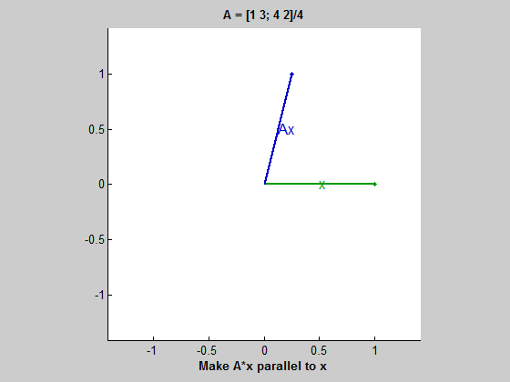
Demo of Eigenvectors and Eigenvalue
Try “eigshow” in MATLAB to plot trajectories of a linear transform in 2D
Cleve’s comments
Quiz: When x sweeps from 0 to 360 degrees, how many times will
x and Ax have the same (or exactly the opposite) direction?

Slide 9


Mathematical Formulation
Dataset representation:
  X is d by n, with n>d
Projection of each column of X onto u:
Square sum:
Objective function with a constraint on u:
$$J\left(u\right)={\left\|p\right\|}^{2}=p^{T}p={\left(X^{T}u\right)}^{T}\left(X^{T}u\right)=u^{T}XX^{T}u$$
$$X=\left[\begin{matrix}| & | & … & | \\ x_{1} & x_{2} & … & x_{n} \\ | & | & … & |\end{matrix}\right]$$
Lagrange multiplier
Lagrange Multipliers | Geometric Meaning & Full Example

Slide 10

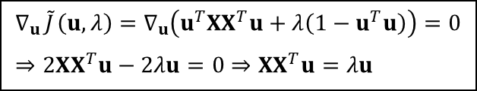

Optimization of the Obj. Function
Set the gradient to zero:
  ➔ u is the eigenvector while λ is the eigenvalue
When u is the eigenvector:
Arrange the eigenvalues:
  Max of J(u) is λ1, which occurs at u=u1
  Min of J(u) is λd, which occurs at u=ud
$$∇_{u}\underset{}{\tilde{J}}\left(u,λ\right)=∇_{u}\left(u^{T}XX^{T}u+λ\left(1−u^{T}u\right)\right)=0 \\ ⇒2XX^{T}u−2λu=0⇒XX^{T}u=λu$$
$$λ_{1}≥λ_{2}≥⋯≥λ_{d}$$
XX^{T} = Covariance matrix multiplied by n-1.
$$J\left(u\right)={\left\|p\right\|}^{2}=u^{T}XX^{T}u=u^{T}λu=λ$$

Slide 11
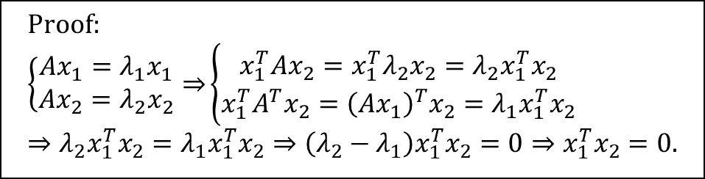
Facts about Symmetric Matrices
A symmetric matrix have orthogonal eigenvectors corresponding to different eigenvalues.
Quiz!
$$\text{Proof}\text{:} \\ \left\{\begin{matrix}Ax_{1}=λ_{1}x_{1} \\ Ax_{2}=λ_{2}x_{2}\end{matrix}⇒\right.\left\{\begin{matrix}x_{1}^{T}Ax_{2}=x_{1}^{T}λ_{2}x_{2}=λ_{2}x_{1}^{T}x_{2} \\ x_{1}^{T}A^{T}x_{2}={\left(Ax_{1}\right)}^{T}x_{2}=λ_{1}x_{1}^{T}x_{2}\end{matrix}\right. \\ ⇒λ_{2}x_{1}^{T}x_{2}=λ_{1}x_{1}^{T}x_{2}⇒\left(λ_{2}−λ_{1}\right)x_{1}^{T}x_{2}=0⇒x_{1}^{T}x_{2}=0.$$
Quiz: Does a symmetric matrix always have orthogonal eigenvectors?
Answer: No! (Can you give an example?)

Slide 12
Basis Conversion
Conversion between orthonormal bases
Projection of x onto u₁, u₂, …

Slide 13

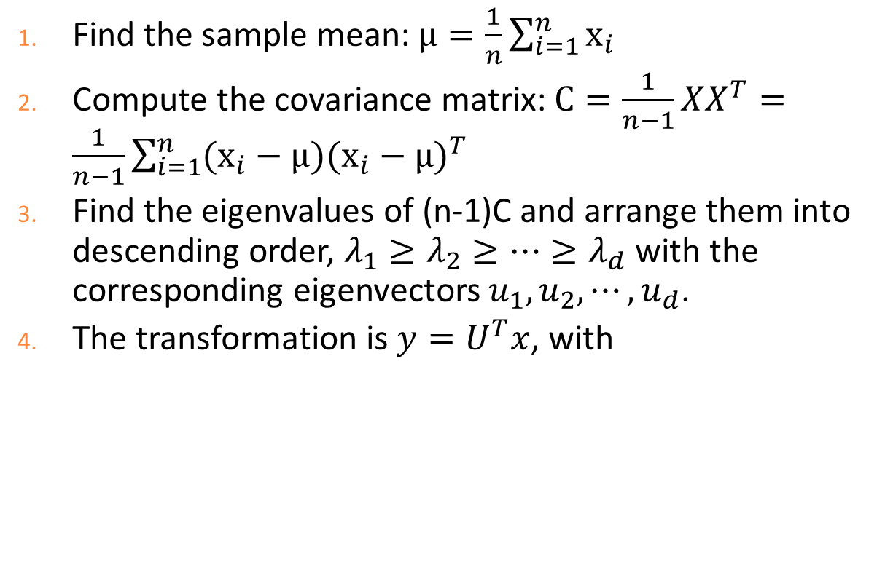
Steps for PCA
Find the sample mean: $μ=\frac{1}{n}\sum_{i=1}^{n}{x_{i}}$
Compute the covariance matrix: $C=\frac{1}{n−1}XX^{T}=\frac{1}{n−1}\sum_{i=1}^{n}{(x_{i}−μ)(x_{i}−μ)^{T}}$
Find the eigenvalues of (n-1)C and arrange them into descending order, $λ_{1}≥λ_{2}≥⋯≥λ_{d}$ with the corresponding eigenvectors $u_{1},u_{2}, ⋯,u_{d}$.
The transformation is $y=U^{T}x$, with
$$U=\left[\begin{matrix}| & | & … & | \\ u_{1} & u_{2} & … & u_{d} \\ | & | & … & |\end{matrix}\right]$$

Slide 14
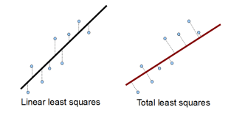
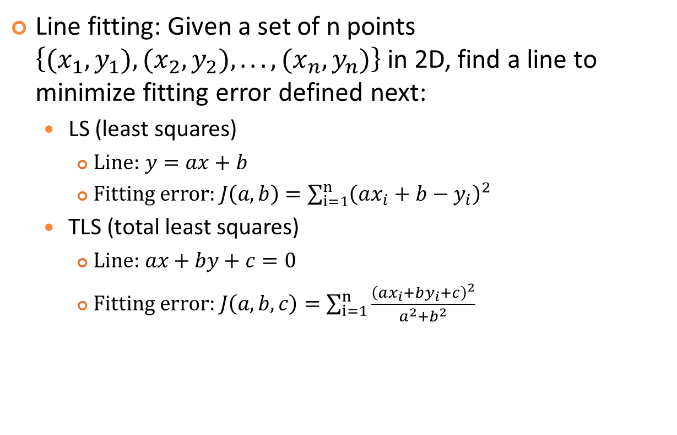
LS vs. TLS
Quiz!
Line fitting: Given a set of n points $\left\{(x_{1},y_{1}),(x_{2},y_{2}),...,(x_{n},y_{n})\right\}$in 2D, find a line to minimize fitting error defined next:
  LS (least squares)
    $\text{Line}\text{: }y=ax+b$
    $\text{Fitting} \text{error}\text{: }J\left(a,b\right)=\sum_{i=1}^{n}{{\left(ax_{i}+b−y_{i}\right)}^{2}}$
  TLS (total least squares)
    $\text{Line}\text{: }ax+by+c=0$
    $\text{Fitting} \text{error}\text{: }J\left(a,b,c\right)=\sum_{i=1}^{n}{\frac{{\left(ax_{i}+by_{i}+c\right)}^{2}}{a^{2}+b^{2}}}$
Not robust if the line is vertical!
Quiz: Prove that both LS and TLS lines
go through the average of these n points.
Source

Slide 15
Three Steps of PCA for TLS
Quiz!
2D
  Set data average to zero.
  Find u₁ & u₂ via PCA. Use u2 as the normal vector of the fitting line.
  Use the normal vector and the data average to find the fitting line.
3D
  Set data average to zero.
  Find u₁, u₂, & u₃via PCA. Use u₃ as the normal vector of the fitting plane.
  Use the normal vector and the data average to find the fitting plane.

Slide 16
More about PCA
Comparison of methods for dim. reduction
  PCA: For unlabeled data ➔ Unsupervised leaning
  LDA (linear discriminant analysis): For classifying labeled data ➔ Supervised learning
If d>>n, then we need to have a workaround for computing the eigenvectors

Slide 17
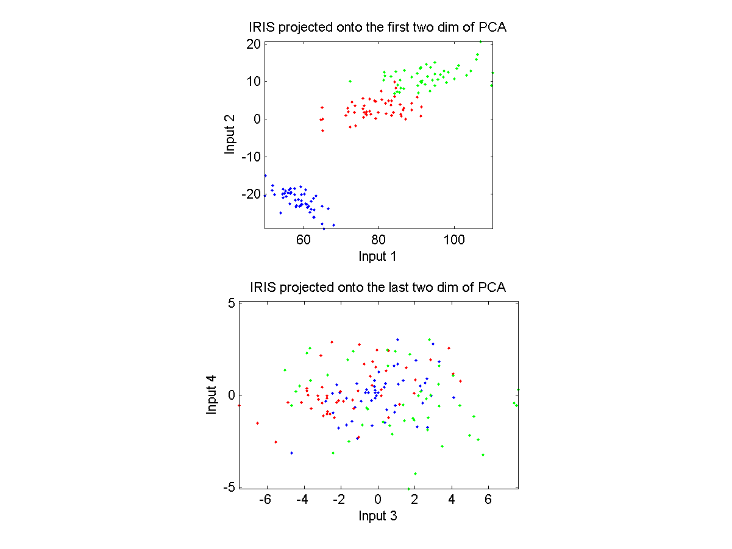
Example of PCA
IRIS dataset projection

Slide 18
PCA Not for Classification
PCA is not designed for classification directly.
Ideal situation
Adversary situation

Slide 19
LDA for Classification
LDA projection onto directions that can best separate data of different classes.
Adversary situation
for PCA
Ideal situation
for LDA

Slide 20
Exercise 1
Given two vectors x=[3, 4], y=[5, 5], find the projection of y onto x.

Slide 21
Exercise 2
Given a point [1 2 3] and a plane x+2y+2z=14, find the distance between the point and the plane.

Slide 22
Exercise 3
Find the eigenvalues and eigenvectors of A=[0 3; 1 2].

Slide 23
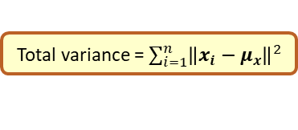
Exercise 4
Given a data matrix X=[2 0 3 -1; 0 -2 -3 1], compute the total variance after projecting the dataset onto its first principal component.
Total variance = $\sum_{i=1}^{n}{{\left\|x_{i}−μ_{x}\right\|}^{2}}$

