Slide 1
K-means Clustering
J.-S. Roger Jang (張智星)
jang@mirlab.org
http://mirlab.org/jang
MIR Lab, CSIE Dept.
National Taiwan University

Slide 2
Problem Definition
Quiz!
Input
  A dataset in d-dim space
  m: Number of clusters
Output
  M cluster centers:
Requirement
  The difference between X and C should be as small as possible (since we want to use C to represent X)

Slide 3
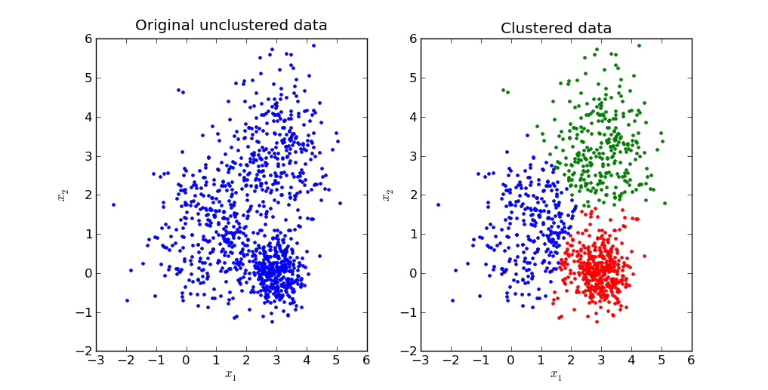
Goal of K-means Clustering
Example of k-means clustering in 2D

Slide 4
Objection Function
Objective function (aka distortion)
  No of parameters: d*m (for C) plus n*m (for A, with constraints)
  NP-hard problem if exact solution is required.
Quiz!

Slide 5
Example of n=100, m=3, d=2

Slide 6
Strategy for Minimizing the Objective Function
Observation
  J(X; C, A) is parameterized by C and A
  Joint optimization is hard, but separate optimization with respective to C and A is easy
Strategy
  Fix C and find the best A to minimize J(X; C, A)
  Fix A and find the best C to minimize J(X; C, A)
  Repeat the above two steps until convergence
AKA “coordinate optimization”

Slide 7
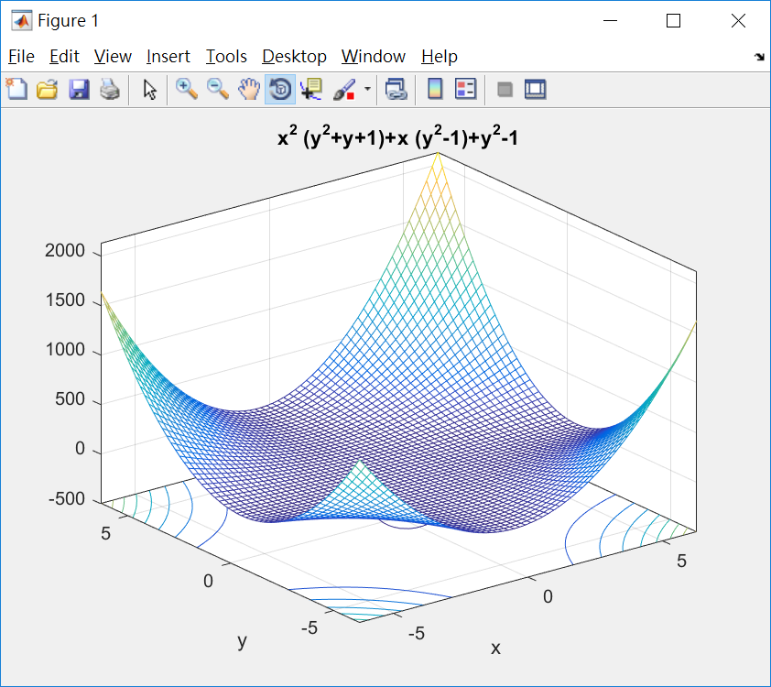
Example of Coordinate Optimization
Quiz!
ezmeshc(@(x,y) x.^2.*(y.^2+y+1)+x.*(y.^2-1)+y.^2-1)

Slide 8
Task 1: How to Find Assignment A?
Goal
  Find A to minimize J(X; C, A) with fixed C
Fact
  Analytic (close-form) solution exists
Quiz!

Slide 9
Task 2: How to Find Centers in C?
Goal
  Find C to minimize J(X; C, A) with fixed A
Fact
  Analytic (close-form) solution exists:
Quiz!

Slide 10
Algorithm
Quiz!
Initialize
  Select initial centers in C
Find clusters (assignment) in A
  Assign each point to its nearest centers
  That is, find A to minimize J(X; C, A) with fixed C
Find centers in C
  Compute each cluster centers as the mean of the cluster’s data
  That is, find C to minimize J(X; C, A) with fixed A
Stopping criterion
  Stop if “change is small”. Otherwise go back to step 2.
Start with initial centers

Slide 11
Another Algorithm
Quiz!
Initialize
  Select initial clusters in A
Find centers in C
  Compute each cluster centers as the mean of the cluster’s data
  That is, find C to minimize J(X; C, A) with fixed A
Find clusters (assignment) in A
  Assign each point to its nearest centers
  That is, find A to minimize J(X; C, A) with fixed C
Stopping criterion
  Stop if “change is small”. Otherwise go back to step 2.
Start with initial clusters

Slide 12
More about Stopping Criteria
Possible stopping criteria
  Distortion improvement over previous iteration is small
  No more change in clusters
  Change in cluster centers is small
Fact
  Convergence is guarantee since J is reduced repeatedly.
  For algorithm that starts with initial centers:
Quiz!

Slide 13
Properties of K-means Clustering
Properties
  Always converges
  No guarantee to converge to global minimum
  To increase the likelihood of reaching the global minimum
    Start with various sets of initial centers
    Start with sensible choice of initial centers
  Potential distance functions
    Euclidean distance
    Taxicab distance
  How to determine the best choice of k
    Cluster validation

Slide 14
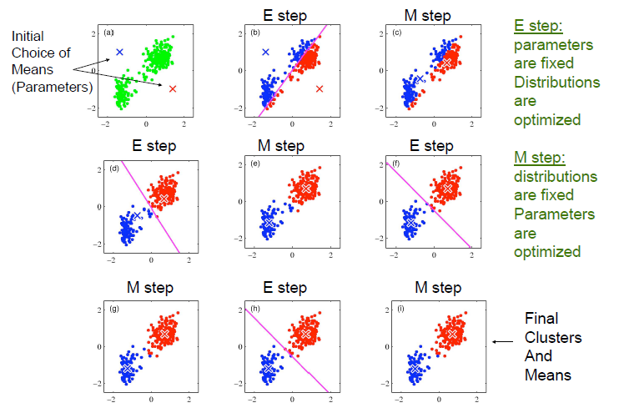
Snapshots of K-means Clustering

Slide 15
Demos of K-means Clustering
Required toolboxes
  Utility Toolbox
  Machine Learning Toolbox
Demos
  kMeansClustering.m
  vecQuantize.m
    Center splitting to reach 2^{p} clusters

Slide 16
Demo of K-means Clustering
Required toolboxes
  Utility Toolbox
  Machine Learning Toolbox
Demos
  kMeansClustering.m
  vecQuantize.m
    Center splitting to reach 2^{p} clusters

Slide 17
Application: Image Compression
Goal
  Convert an image from true colors to index colors with minimum distortion
Steps
  Collect pixel data from a true-color image
  Perform k-means clustering to obtain cluster centers as the indexed colors
Compression ratio
Quiz!

Slide 18
True-color vs. Index-color Images
Quiz!
True-color image
  Each pixel is represented by a vector of 3 components [R, G, B].
  Advantage
    More colors
Index-color image
  Each pixel is represented by an index into a color map of 2^{b} colors.
  Advantage
    Less storage

Slide 19
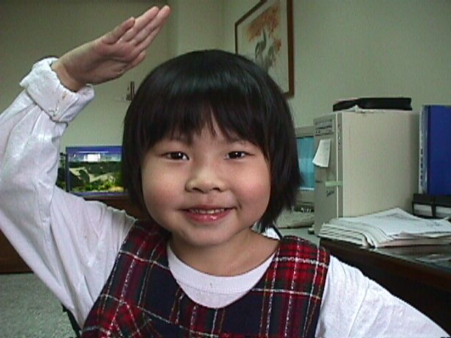
Example of Image Compression
Date: 1998/04/05
Dimension: 480x640
Raw data size: 480*640*3 bytes = 900KB
File size: 49.1KB
Compression ratio = 900/49.1 = 18.33

Slide 20
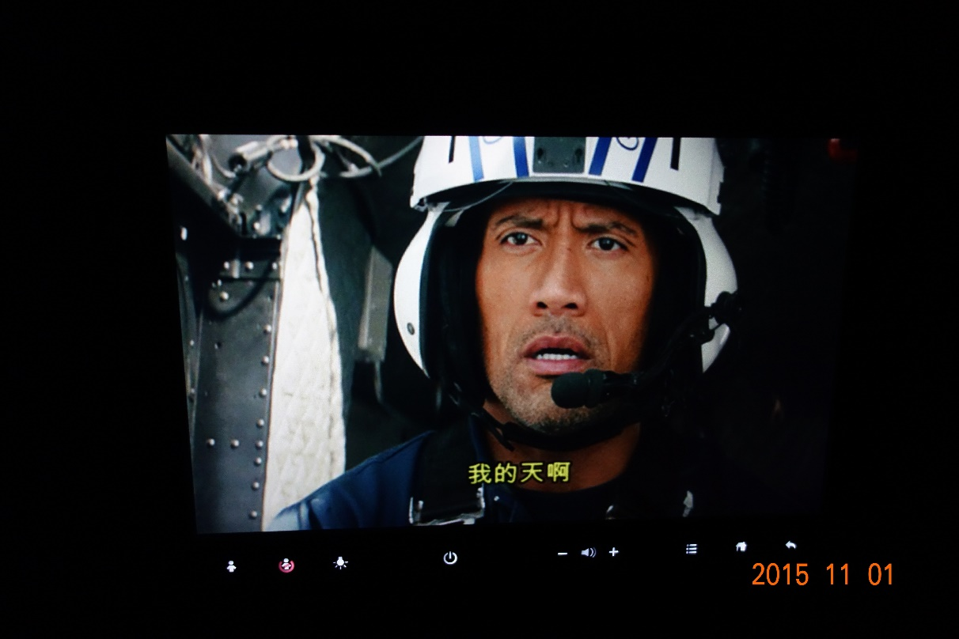
Example of Image Compression
Date: 2015/11/01
Dimension: 3648x5472
Raw data size: 3648*5472*3 bytes = 57.1MB
File size: 3.1MB
Compression ratio = 57.1/3.1 = 18.42

Slide 21
Image Compression Using K-Means Clustering
Some quantities of the k-means clustering
  n = 480x640 = 307200 (no of vectors to be clustered)
  d = 3 (R, G, B)
  m = 256 (no. of clusters)

Slide 22
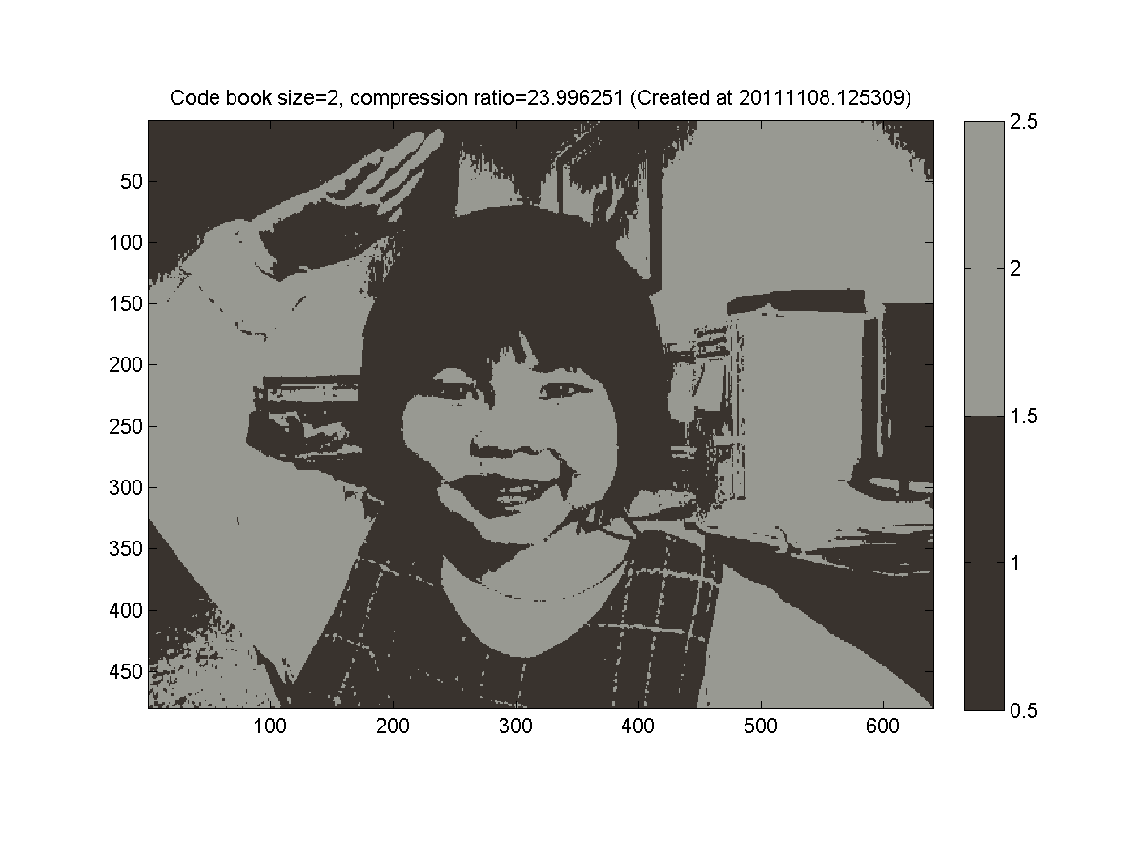
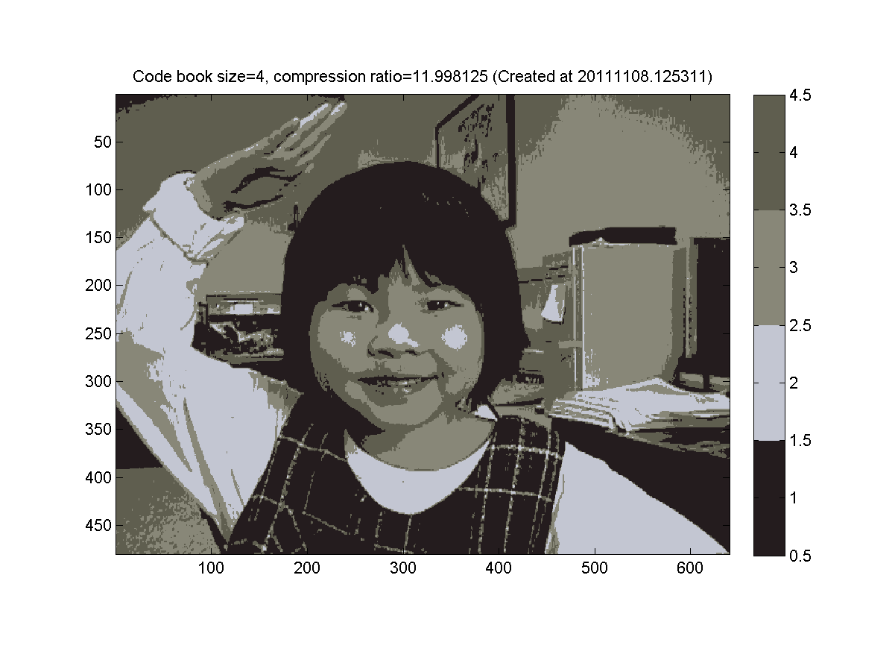
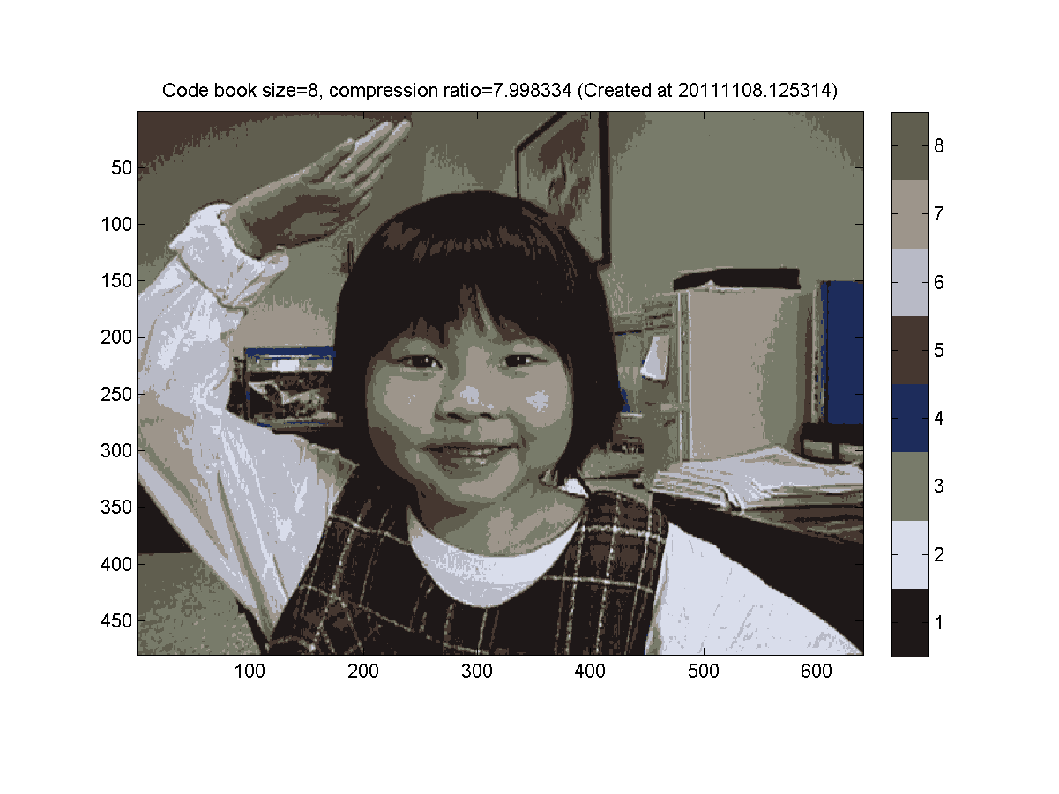
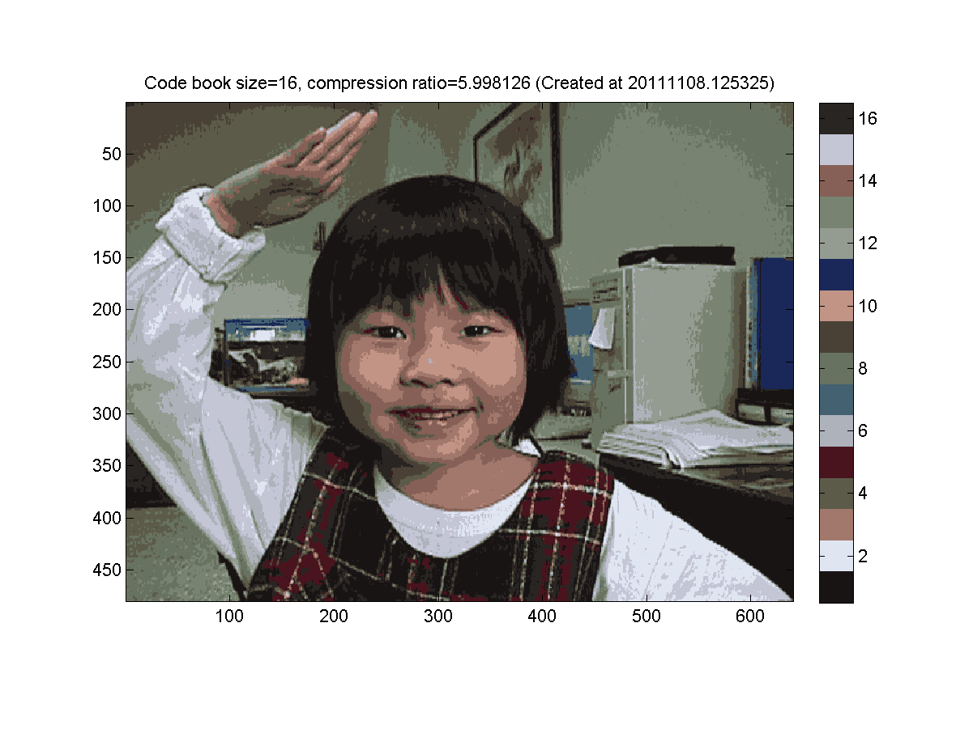
Example: Image Compression Using K-means
2025/9/24
22

Slide 23
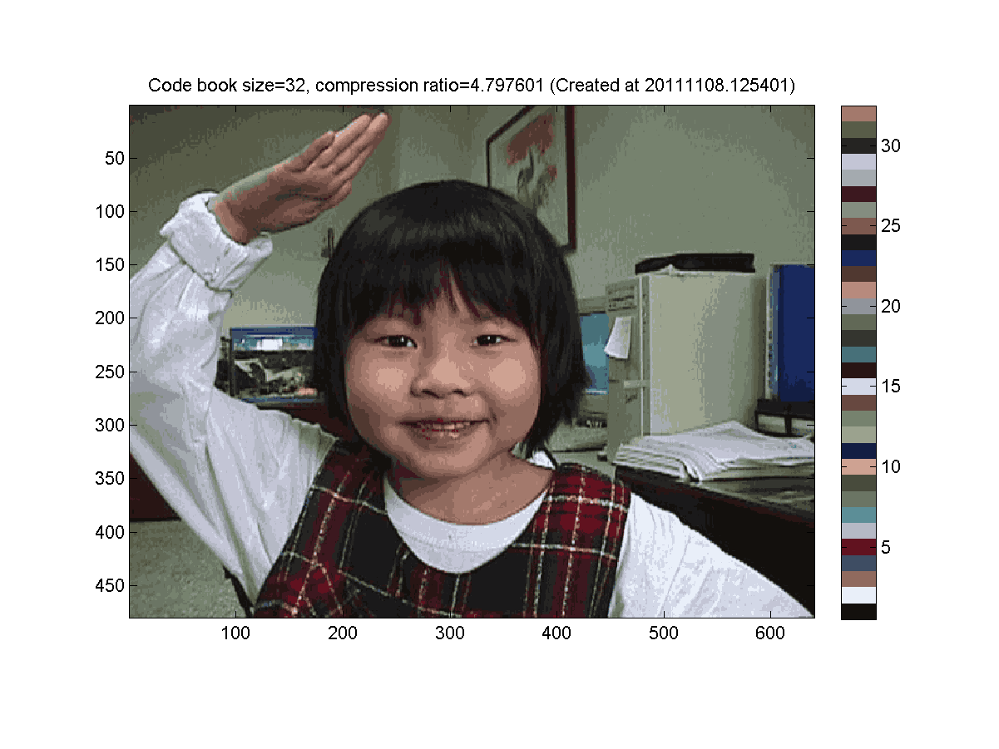
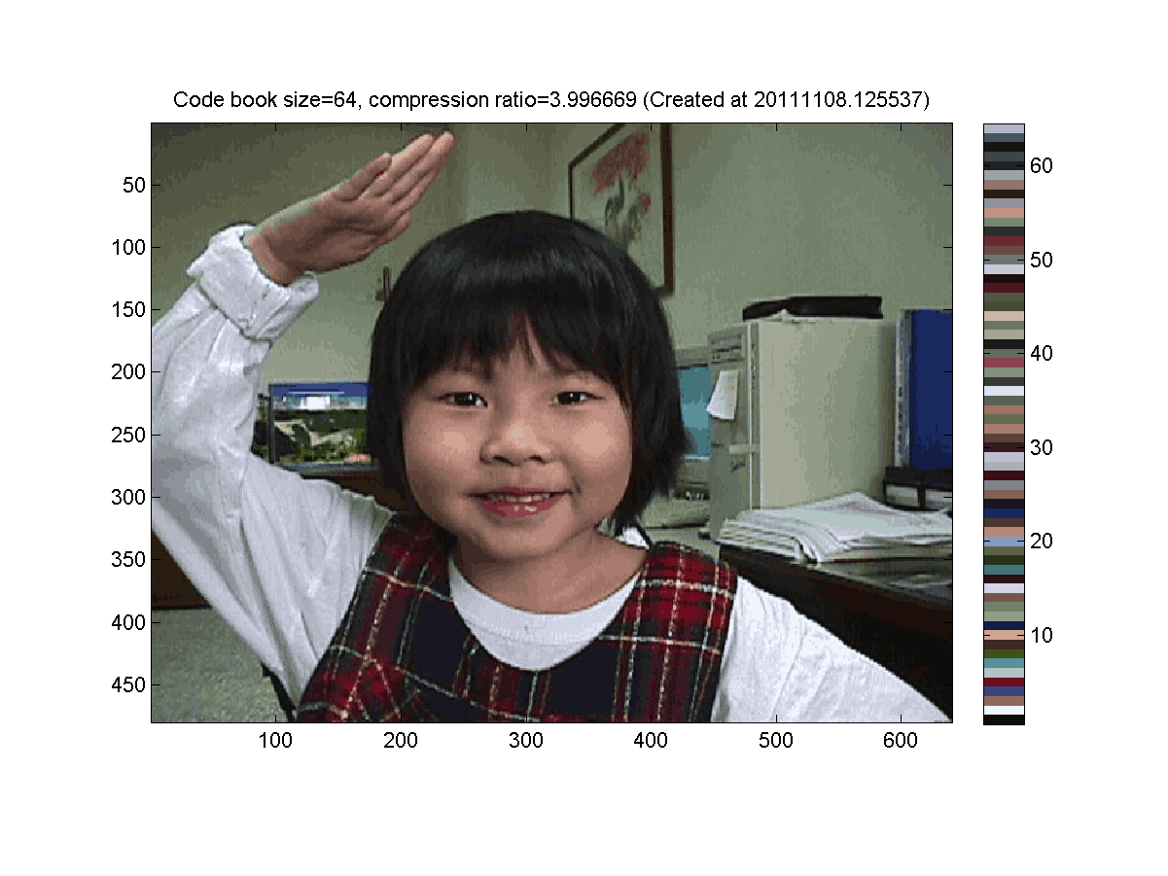
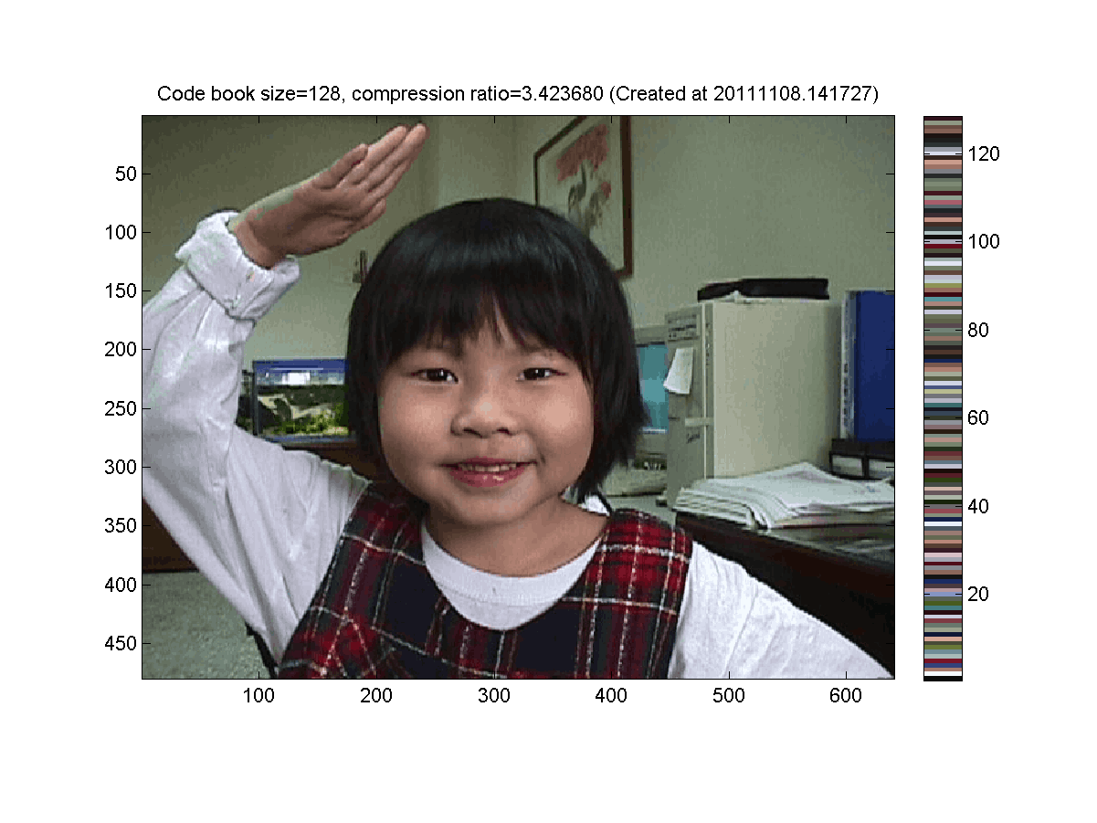
Example: Image Compression Using K-means
2025/9/24
23

Slide 24
Indexing Techniques
Indexing of pixels for a 2x3x3 image
Related command: reshape
  X = imread('annie19980405.jpg');
  image(X);
  [m, n, p]=size(X);
  index=reshape(1:m*n*p, m*n, 3)';
  data=double(X(index));
13 | 15 | 17
14 | 16 | 18
7 | 9 | 11
8 | 10 | 12
1 | 3 | 5
2 | 4 | 6

Slide 25
Code Example
X = imread('annie19980405.jpg');
image(X)
[m, n, p]=size(X);
index=reshape(1:m*n*p, m*n, 3)';
data=double(X(index));
maxI=6;
for i=1:maxI
centerNum=2^i;
fprintf('i=%d/%d: no. of centers=%d\n', i, maxI, centerNum);
center=kMeansClustering(data, centerNum);
distMat=distPairwise(center, data);
[minValue, minIndex]=min(distMat);
X2=reshape(minIndex, m, n);
map=center'/255;
figure; image(X2); colormap(map); colorbar; axis image; drawnow;
end

Slide 26
Extensions to Block-based Image Compression
Extensions to image data compression via clustering
  Use qxq blocks as the unit for VQ (see exercise)
    Smart indexing by creating the indices of the blocks of page 1 first.
    True-color image display (No way to display the compressed image as an index-color image)
  Use separate code books for RGB
Quiz!

Slide 27
Extension to L₁-norm
Use L₁-norm instead of L₂-norm in the objective function
Optimization strategy
  Same as k-means clustering, except that the centers are found by the median operator
Advantage
  Less susceptible to outliers
Quiz!
Quiz!

Slide 28
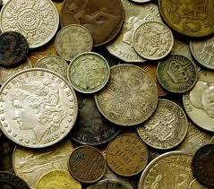
Extension to Circle Fitting
Find circles via k-means clustering

