Slide 1
Hierarchical Clustering
J.-S. Roger Jang (張智星)
jang@mirlab.org
http://mirlab.org/jang
MIR Lab, CSIE Dept.
National Taiwan University

Slide 2
Hierarchical Clustering
Two types of hierarchical clustering
Bottom-up: Agglomerative clustering
Top-down: Divisive clustering
Agglomerative clustering
Begin with n clusters, each containing one sample
Merge the most similar two clusters into one.
Repeat the previous step until done
Quiz!

Slide 3
Distance between Clusters
Single-linkage algorithm (minimum method)
Complete-linkage algorithm (maximum method)
Average-linkage algorithm (average method)
Ward’s method (minimum-variance method)

Slide 4
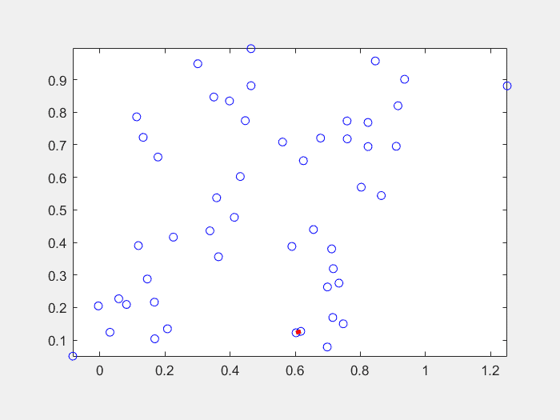
Animation of Hierarchical Clustering (1/2)
Single-linkage algorithm (minimum method)
AKA the minimum spanning tree!
小者恆小、大者恆大！
hierClusteringAnim.m in Machine Learning Toolbox

Slide 5
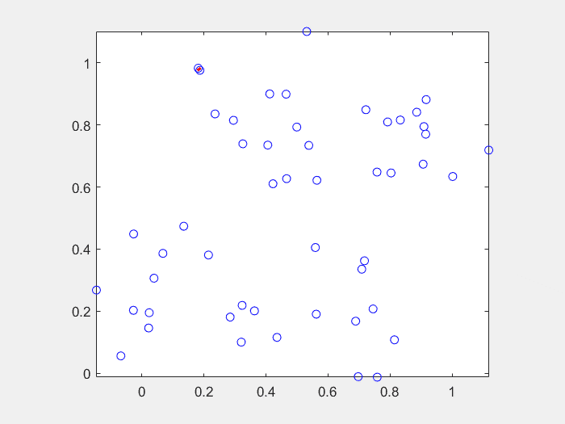
Animation of Hierarchical Clustering (2/2)
Complete-linkage algorithm (maximum method)
勢均力敵、齊頭並進！
hierClusteringAnim.m in Machine Learning Toolbox

Slide 6
Comparisons
K-means clustering
Algorithm: Harder, with objective function to be minimized
Objects for clustering: Points in a high-dimensional space
Computation: Slow
No. of clusters: Fixed
Visualization: Scatter plot for 2D/3D datasets
Hierarchical clustering
Algorithm: Easier, with heuristics to combine clusters
Objects for clustering: Any objects as long as their distance is defined
Computation: Fast
No. of clusters: Variable
Visualization: Dendrogram

