Slide 1
Tips in Corpus Preparation (and High-citation Papers)
J.-S. Roger Jang (張智星)
MIR Lab, CSIE Dept.
National Taiwan University
jang@mirlab.org, http://mirlab.org/jang

Slide 2
Why You Care about Corpus Preparation?
Why you care?
Advance human’s research frontier
Increase your paper’s citations!
Corpus sources
Self made
Home brewed
Based on a platform
From collaborating industry/companies
You need to convince them!

Slide 3
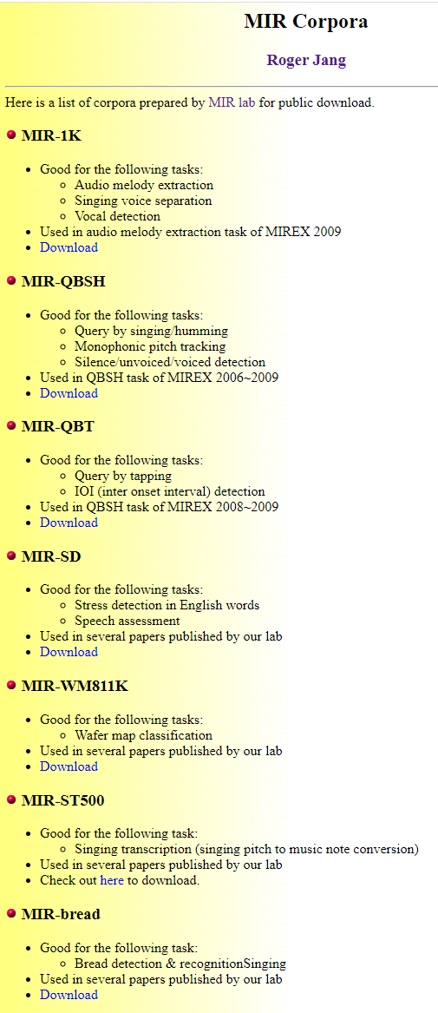
Tips for Corpus Preparation
Basic tip: A readme file to provide
Version number and change log
How to cite the corpus and the first paper using the corpus
Advanced tips
Provide tools/code for corpus processing and update
List subsequent papers using the corpus
Construct a dedicated website for the corpus
Our corpus site:
http://mirlab.org/dataSet/public

Slide 4
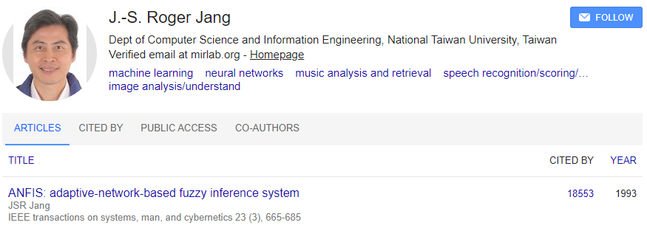
Three Tips for High-Citation Papers
Release everything
Keep code and corpus available
Choose “methods” of general interests as paper’s focus
Let people try your methods on their applications
Try not to perfect your paper
Leave room for improvement for others

