Slide 1
Caveats for Conventional Machine Learning
張智星
玉山金控

Slide 2
Outline
Introduction
Caveats of conventional machine learning
Dataset anomaly
Cross validation
Feature selection
Imbalanced dataset
Missing value handling
Conclusions

Slide 3
Dataset Format for Classification
Conventional ML
Structure data in tabular format
Feature matrix: dxn
n: data count
d: feature dimension
Class label: 1xn
c: no. of classes
n I/O pairs
Column-major!
d features
Class label
(1 to c)
3
3
2
1
1
2
2
2
1
2
d = 6, n = 10
Class size ratio = 3:5:2

Slide 4
Dataset Anomaly
Outlier check via domain knowhow ➔ Remove or modify it
Detection by box plot
Example: body temperature 363 degrees
Two i/o pairs with the same feature vectors ➔ Check data
A same-value feature within the dataset ➔ Remove it
A same-value feature within a class
Cause error in naïve Bayes classifiers

Slide 5
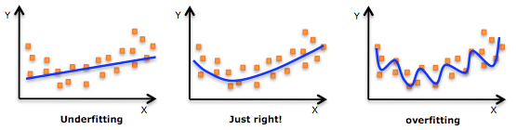
Performance Evaluation: Underfitting and Overfitting
For regression:
For classification
How to determine the order
of the fitting polynomial?
How to determine the complexity
of the classifier?

Slide 6
Dataset Partitioning
To make the best use of the dataset for model construction & evaluation
Training set: For model construction
Validation set: For model evaluation & selection
Test set: For final model evaluation
Whole dataset
Training set
90%
Validation set
10%
Test set
Rotate to have
10-fold cross validation
Strictly
disjoint!

Slide 7
M-fold Cross Validation with M=2
Dataset A
construction
Model A
evaluation
RRB➔A
Model B
evaluation
RRA➔B
Dataset B
construction
Outside test!

Slide 8
M-fold Cross Validation
construction
.
.
.
m
disjoint
sets
.
.
.
Model k
evaluation
.
.
.
Outside test!

Slide 9
Leave-one-out Cross Validation (LOOCV, with m=n)
construction
.
.
.
.
.
.
Either 0% or 100%!
n input/output
pairs
Model k
evaluation
.
.
.
Outside test!

Slide 10
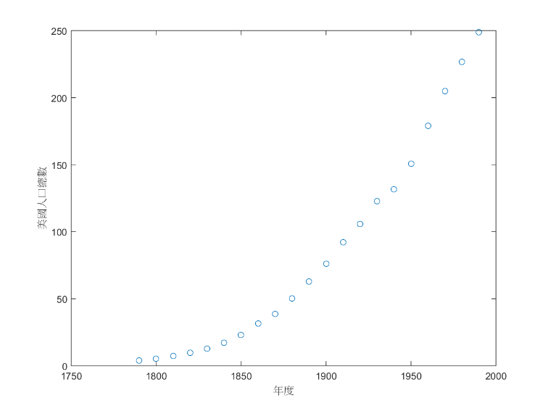
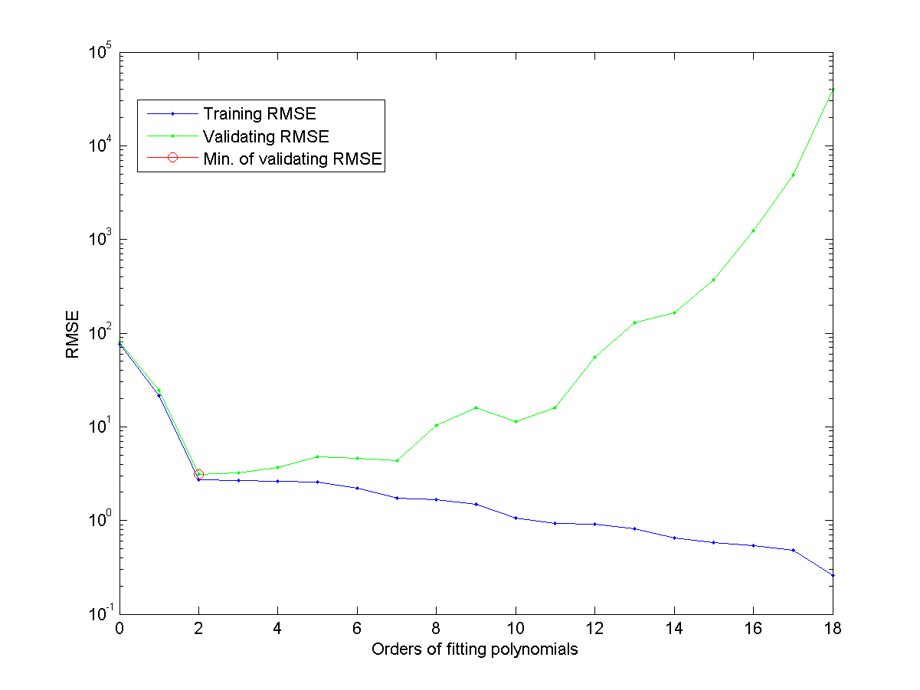
Applications of Cross Validation
Input (feature) selection
Model complexity determination, for instance:
Polynomial order in polynomial fitting
Number of prototypes for VQ-based 1-NNC
Performance comparison among different models
RMSE vs. polynomial orders
US population vs. years

Slide 11
Heads-up for M-fold Cross Validation
The evaluation becomes more reliable as M is getting larger
Stratified partitioning
Keep ratio of class sizes about the same for each fold (Not a concern for LOOCV)
For imbalanced dataset, LOO on the smallest class
Class 1
Class 2
Fold 1
Fold 2
Fold 3

Slide 12
Feature Selection
Common types of feature selection from d features
One-pass ranking (OPR)
➔ d CV
Sequential forward selection (SFS)
➔ d(d+1)/2 CV
Exhaustive selection
➔ 2^{d}-1 CV
OPR
1 input
x1
x2
x3
x4
x5
2 inputs
x2, x1
x2, x3
x2, x4
x2, x5
SFS
3 inputs
x2, x4, x1
x2, x4, x3
x2, x4, x5
4 inputs
x2, x4, x3, x1
x2, x4, x3, x5
.
.
.

Slide 13
Proper Use of Feature Selection
Common use of feature selection
Increase model complexity sequentially by adding more features
Select the model that has the least validation error
Typical curve of error vs. model complexity
Determine the model structure with the least validation error
Validation error
Training error
Optimal model obtained at
smallest validation error
Error rate
Model complexity (# of selected inputs)

Slide 14
Caveat: Feature Selection for a Random Dataset
A random dataset for feature selection
Feature dim = 100
Data count=50
Binary classification with class size ratio = 1:1
Caveat
It is a random dataset, so the accuracy should be around 50%.
In fact, this is the SFS using KNNC and LOOCV

Slide 15
Caveat in Feature Extraction via PCA/LDA
Common practice
PCA to reduce dimensionality
LDA to extract features
Our implementation
PCA to reduce dimensionality to 33
LDA to project to 2D

Slide 16
Caveat in using PCA/LDA
Approximate way
PCA
LDA
LOOCV
Exact way
PCA
Hide one i/o pair
LDA on the rest data
Use the hidden pair for evaluation
Go back to step 2 till done

Slide 17
Missing Value Handling
Common (and easy) ways of handling missing values
Categorical variable: Impute using mode of “similar” data
Numerical variable: Impute using mean of “similar” data
A more dedicated way of imputing missing values
Take an i/o pair as the test data
Use “mode” or “mean” to impute missing values in the rest data
Impute the test data
Use a classifier to predict a categorical variable
Use a regressor to predict a numerical variable
Go back to step 2 until all missing values reach stable values.

Slide 18
Caveat in Handling Missing Values
Approximate way
Missing value imputation
LOOCV
Exact way
Hide one i/o pair
Imputation using the rest data
Use the hidden pair for evaluation
Go back to step 2 till done

Slide 19
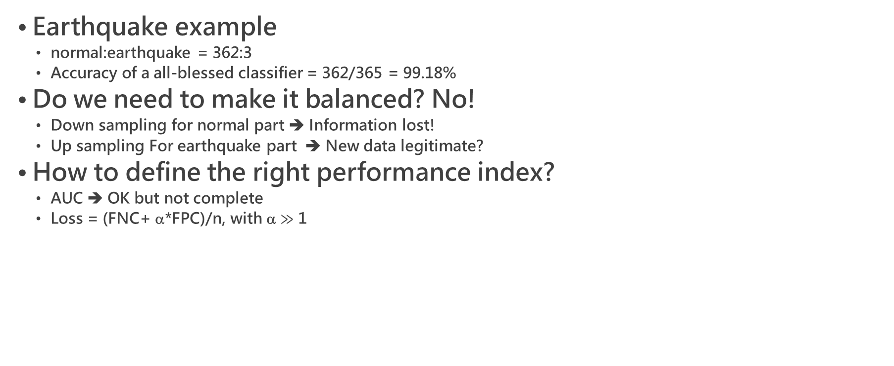
Imbalanced Dataset
Earthquake example
normal:earthquake = 362:3
Accuracy of a all-blessed classifier = 362/365 = 99.18%
Do we need to make it balanced? No!
Down sampling for normal part ➔ Information lost!
Up sampling For earthquake part ➔ New data legitimate?
How to define the right performance index?
AUC ➔ OK but not complete
Loss = (FNC+ α*FPC)/n, with α $≫$ 1
Not recommended!

Slide 20
Conclusions
Pay special attention to small-size or high-dimensional datasets
Follow the strict rule of cross validation for performance evaluation
Dimensionality reduction
Missing value imputation
Even following the strict rule could lead to overfitting!
Feature selection
Preprocessing to avoid overfitting
PCA (which does not require the class information)

