Slide 1
  Caveats for Conventional Machine Learning
張智星
玉山金控

Slide 2
Outline
Introduction
Caveats of conventional machine learning (ML)
  Dataset anomaly
  Cross validation
  Feature selection
  Imbalanced dataset
  Missing value handling
玉山專案分享
  票據影像辨識
  AML黑名單偵測
  信用卡冒用偵測
  房屋自動估價
Conclusions
1

Slide 3
Dataset Format for Classification
Conventional ML
  Structure data in tabular format
Feature matrix: dxn
  n: data count
  d: feature dimension
Class label: 1xn
  c: no. of classes
n I/O pairs
Column-major!
d features
Class label
(1 to c)
3
3
2
1
1
2
2
2
1
2
d = 6, n = 10
Class size ratio = 3:5:2

Slide 4
Dataset Anomaly
Outlier check via domain knowhow ➔ Remove or modify it
  Detection by box plot
  Example: body temperature 363 degrees
Two i/o pairs with the same feature vectors ➔ Check data
A same-value feature within the dataset ➔ Remove it
A same-value feature within a class
  Cause error in naïve Bayes classifiers

Slide 5
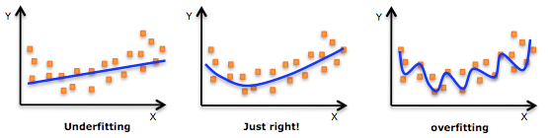
Performance Evaluation: Underfitting and Overfitting
For regression:
For classification
How to determine the order
of the fitting polynomial?
How to determine the complexity
of the classifier?

Slide 6
Dataset Partitioning
To use the dataset unbiasedly for model construction & evaluation
  Training set: For model construction
  Validation set: For model evaluation & selection
  Test set: For final model evaluation
Sometimes we use validation error to estimate test error, which is risky!
Whole dataset
Training set
90%
Validation set
10%
Test set
If missing, use
validation set as test set.
(Risky!)
Rotate to have
10-fold cross validation
Strictly
disjoint!
Rotate to have robust evaluation

Slide 7
M-fold Cross Validation with m=2
Dataset A
construction
Model A
evaluation
RRB➔A
Model B
evaluation
RRA➔B
Dataset B
construction
Outside test!
6

Slide 8
M-fold Cross Validation
construction
.
.
.
m
disjoint
sets
.
.
.
Model k
evaluation
.
.
.
Outside test!
7

Slide 9
Leave-one-out Cross Validation (LOOCV, with m=n)
construction
.
.
.
.
.
.
Either 0% or 100%!
n
input/output
pairs
Model k
evaluation
.
.
.
Outside test!
8

Slide 10
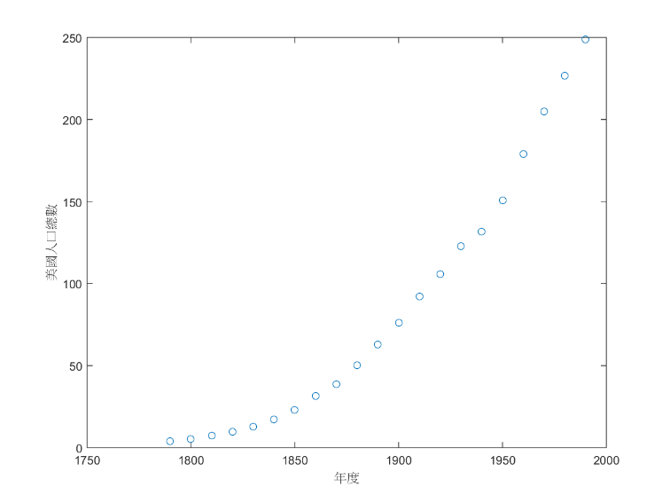
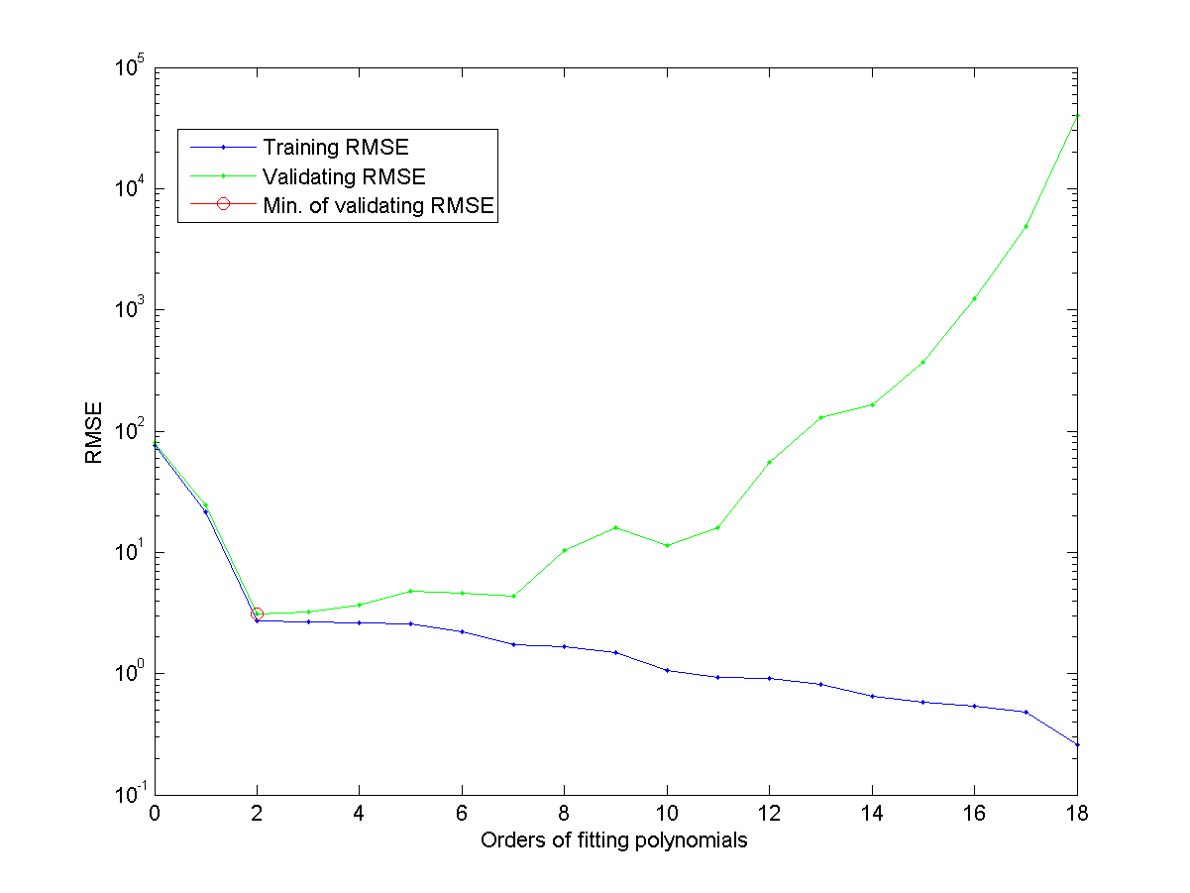
Applications of Cross Validation
Input (feature) selection
Model complexity determination, for instance:
  Polynomial order in polynomial fitting
  Number of prototypes for each class in 1-NNC (nearest neighbor classifier)
Performance comparison among different models
RMSE vs. polynomial orders
US population vs. years

Slide 11
Heads-up for M-fold Cross Validation
The evaluation becomes more reliable as M is getting larger
  LOOCV is the most unbiased way for CV
Stratified partitioning
  Keep ratio of class sizes about the same for each fold (Not applicable for LOOCV)
Class 1
Class 2
Fold 1
Fold 2
Fold 3

Slide 12
Feature Selection
Common types of feature selection from d features
  One-pass ranking (OPR)
    ➔ d CV
  Sequential forward selection (SFS)
    ➔ d(d+1)/2 CV
  Exhaustive selection
    ➔ 2^{d}-1 CV
OPR
1 input
x1
x2
x3
x4
x5
2 inputs
x2, x1
x2, x3
x2, x4
x2, x5
SFS
3 inputs
x2, x4, x1
x2, x4, x3
x2, x4, x5
4 inputs
x2, x4, x3, x1
x2, x4, x3, x5
.
.
.

Slide 13
Proper Use of Feature Selection
Common use of feature selection
  Increase model complexity sequentially by adding more features
  Select the model that has the least validation error
Typical curve of error vs. model complexity
  Determine the model structure with the least validation error
Validation error
Training error
Optimal model obtained at
smallest validation error
Error rate
Model complexity (# of selected inputs)

Slide 14
Caveat in Feature Selection for a Random Dataset
A random dataset for feature selection
  Feature dim = 100
  Data count=50
  Binary classification with class size ratio = 1:1
Caveat
  It is a random dataset, so the accuracy should be around 50%.
  In fact, this is the SFS using KNNC and LOOCV

Slide 15
Caveat in Feature Extraction via PCA/LDA
Feature extraction (linear transformation)
  PCA: Principal component analysis
  LDA: Linear discriminant analysis
Common practice
  PCA to reduce dimensionality
  LDA to extract features
Our implementation
  PCA to reduce dimensionality to 33
  LDA to project to 2D

Slide 16
Caveat in using PCA/LDA
Approximate way
  PCA
  LDA
  LOOCV
Exact way
  PCA
  Hide one i/o pair
  LDA on the rest data
  Use the hidden pair for evaluation
  Go back to step 2 till done

Slide 17
Missing Value Handling on Training Set
Common ways of missing value imputation
  Categorical variable: Use mode of “similar” data
  Numerical variable: Use mean of “similar” data
MICE (Multiple Imputation by Chained Equations )
  An iterative method for imputing missing values
  For imputing the training set only!
3
3
2
1
1
2
2
2
1
2

Slide 18
Missing Value Handling on Test/Validation Sets
Imputing on test and validation sets
Duplicate
Impute
Classify
?
1
2
3
1
2
3
1
2
3
P₁
P₂
P₃
Class = arg max {P_{i} }

Slide 19
Caveat in Handling Missing Values
Approximate way
  Missing value imputation
  LOOCV
Exact way
  Hide one i/o pair
  Impute the rest data
  Use the hidden pair for evaluation
  Go back to step 2 till done
3
3
2
1
1
2
2
2
1
2

Slide 20
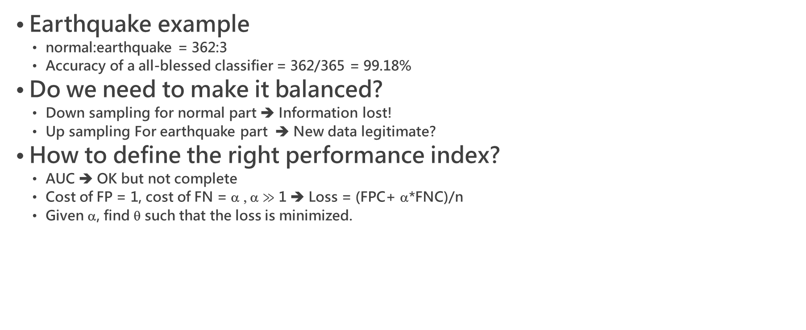
Imbalanced Dataset
Earthquake example
  normal:earthquake = 362:3
  Accuracy of a all-blessed classifier = 362/365 = 99.18%
Do we need to make it balanced?
  Down sampling for normal part ➔ Information lost!
  Up sampling For earthquake part ➔ New data legitimate?
How to define the right performance index?
  AUC ➔ OK but not complete
  Cost of FP = 1, cost of FN = α , α $≫$ 1 ➔ Loss = (FPC+ α*FNC)/n
  Given α, find θ such that the loss is minimized.
Not recommended!
FNR
FNR
ROC: Receiver operating characteristic curve
DET: Detection error tradeoff curve
PRC: Precision-recall curve
B
B
A
A
FPR
FPR

Slide 21
Data Leakage
Data leakage
  Result leaks into features: 倒果為因
Examples
  Task:預測罹患前列腺可能性，Feature: 三個月內是否接受前列腺手術
  Task:預測電信用戶是否流失，Feature: 三個月內的繳費記錄
Reference: https://zhuanlan.zhihu.com/p/24357137

Slide 22
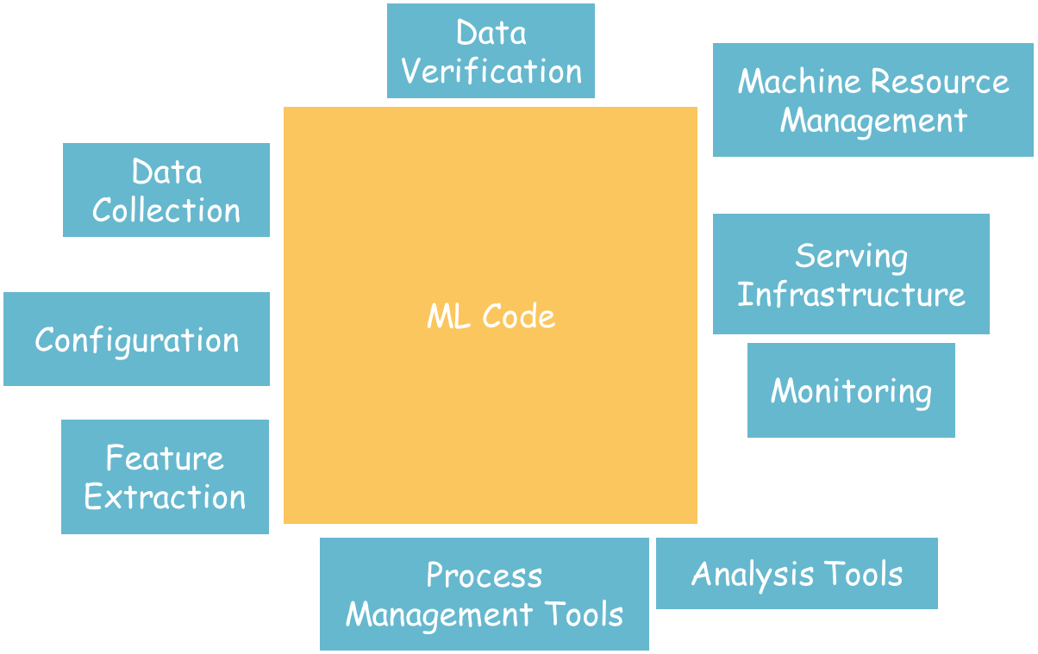
Perception: ML Products Are All about ML

Slide 23
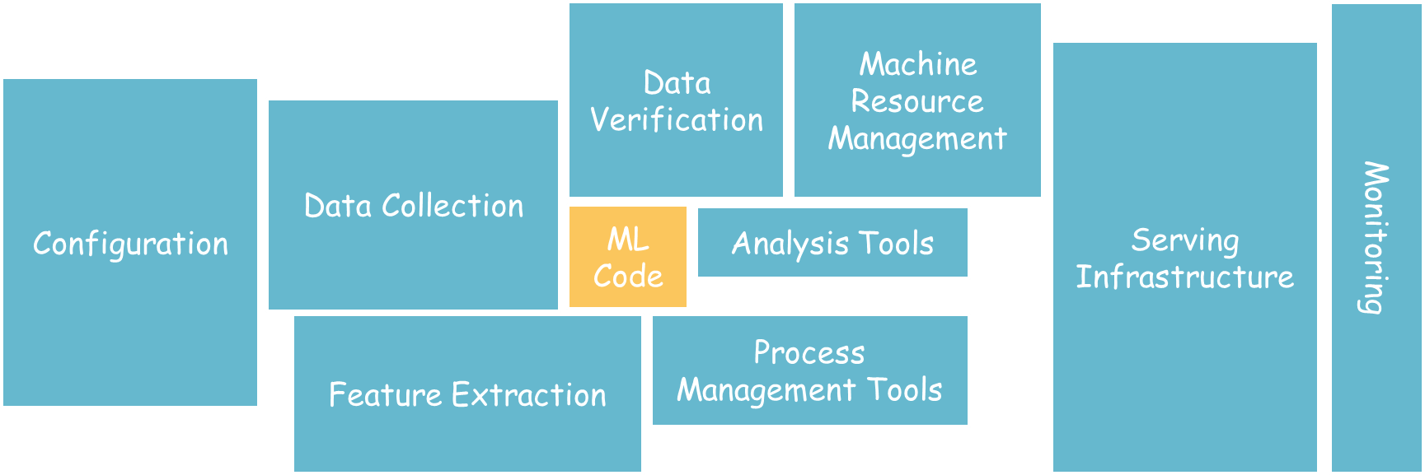
In Reality: ML Products Require MLOps, A Lot of It…

Slide 24



玉山專案分享
票據影像辨識
AML黑名單偵測
信用卡冒用偵測
房屋自動估價

Slide 25
票據影像辨識

Slide 26





專案背景
痛點
耗費人力與工時
票據
分行
集中作業部
票據交換所
支票
匯款單
審核
建檔 (簡單資訊)
影像掃描
建檔 (完整資訊)
    人工確認
願景: 利用票據影像辨識自動化，輔助人員登打

Slide 27
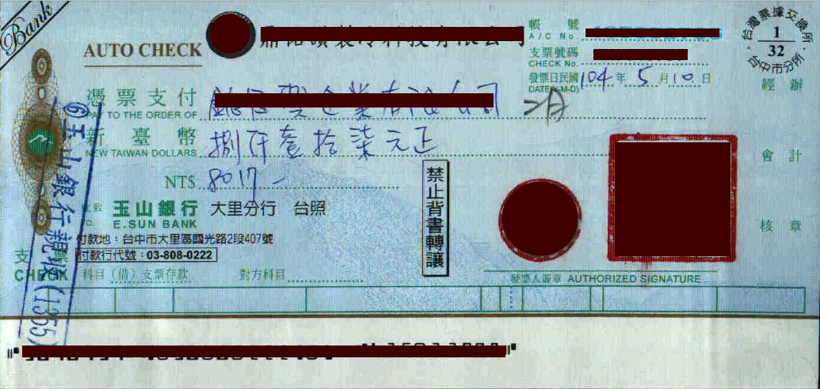
支票一張

Slide 28
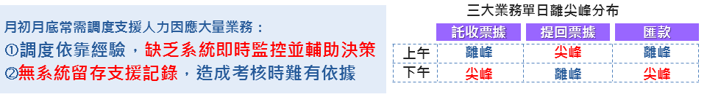
專案目標與範疇
業務
痛點
票據影像辨識自動化
機器學習
任務
支票大寫金額辨識
匯款單受款人姓名辨識
支票式憑印鑑辨識
支票日期辨識

Slide 29
NLP

Slide 30
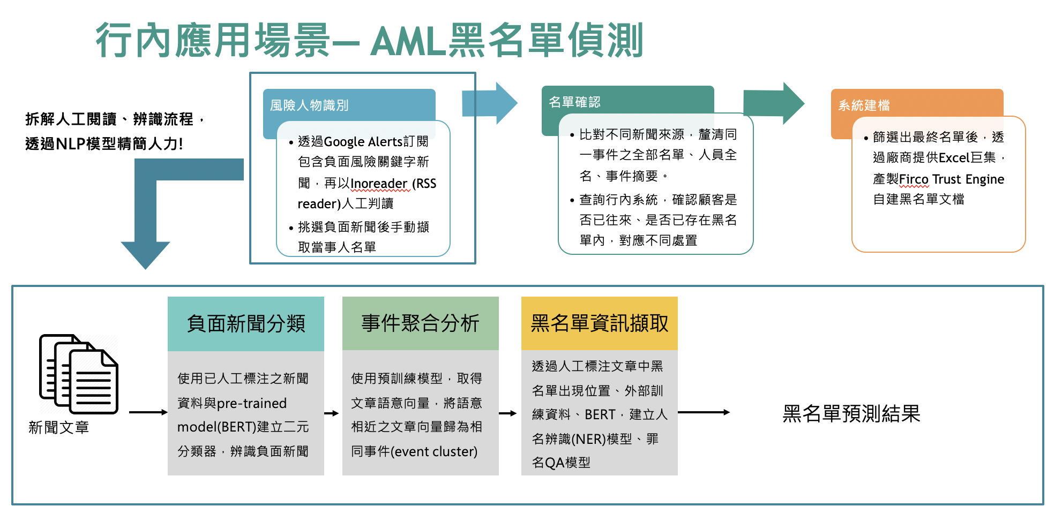

Slide 31
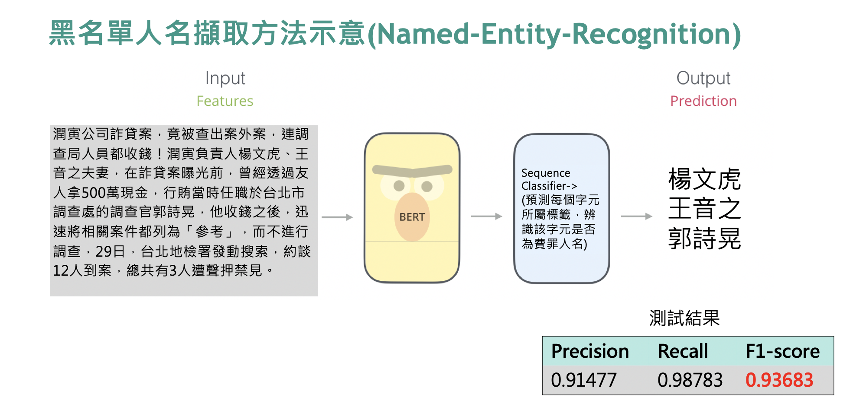

Slide 32
信用卡冒用偵測

Slide 33





專案背景
裡面有131條規則，規則數
與參數大約一個月調整一次
刷卡交易
EFPS 2.0系統
偵測異常交易
業務痛點
專案目的
固定人工規則
不易捕捉快速
變動冒用行為
AI 因子自動挑選
掌握冒用行為變動
Outbound Call
名單量較大
人力配置
效率提升
模型上線開發
時間成本較高
模型上線時間
節省50%
現況
機器學習
專案目的
32
Notes:
首先在專案背景的部分，過去在冒用偵測中，是以專家經驗設立條件進行偵測，這套系統EFPS2.0，而這次專案主要將透過機器學習演算，進行冒用交易的偵測。

Slide 34



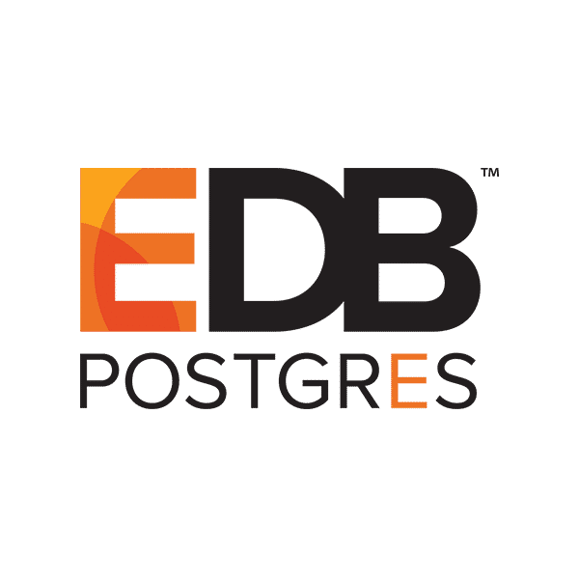





模型使用流程
即時資料
嗶！
透過Machine learning as a service (MLaaS) 即時運算且快速切換AI模型
回傳結果僅1秒
卡處系統
AS400
MLaaS
Feature Server 資料流
Inference Server 資料流
1
Call API
傳遞參數
4
API回傳
結果
Feature Server
Inference Server
取Feature
Inference Server
2
1
Raw Data
2
Features DB
3
使用模型
計算結果
ODS
加密寫入
Raw Data
進行Feature
Engineering
3
存入Features
2019/1
2019/2
訓練區間
預測區間
批次資料
33

Slide 35
房屋自動估價模型專案

Slide 36
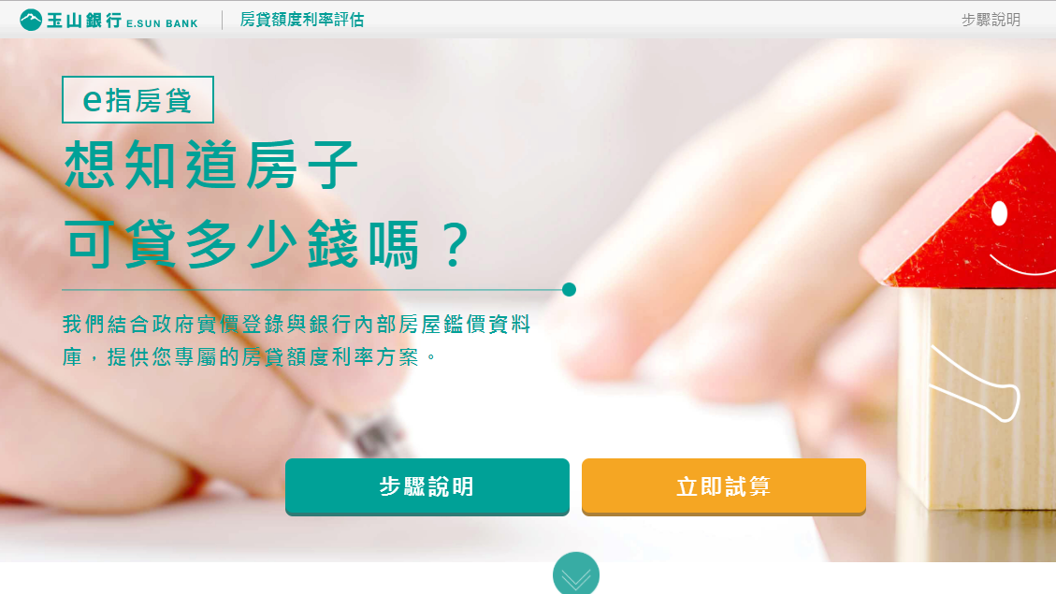
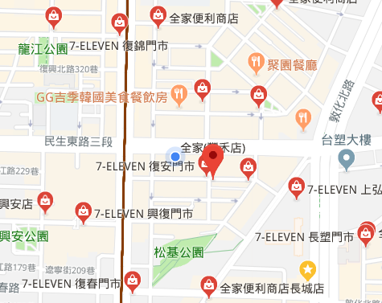

專案緣起
增加e指房貸模型應用範圍（六都 → 全臺）
模型從迴歸 + 特徵比較法 → 機器學習演算法
嘗試使用 POI 資料、Open data（收入資料、人口密度等）
提升精準度
e指房貸
35
Notes:
將可應用至資產重估，節省成本

Slide 37
模型新舊比較
  AVM模型新版與現行版本差異：
項目 | e指房貸模型 | 新版房屋估價模型
資料源 | 實價登錄資料 行內估價師鑑價資料 | 另增加POI (Points of Interest)點位資料，強化模型對於環境影響房價敏感度 另增加外部資料(收入中位數、教育程度、人口密度)
建模方式 | 線性迴歸+特徵比較法 (僅限六都縣市可使用模型) | 非線性機器學習方法 (全台皆可使用新版模型)
  註1：外部資料：該擔保品座落區域之月收入中位數、教育程度、人口密度。
  註2：POI點位資料：該擔保品方圓10公里內含有某類別建物的件數、該擔保品與某類別建物的最小距離；
  建物類別包含政府機關、學校、鄰避設施等共190種。
36

Slide 38
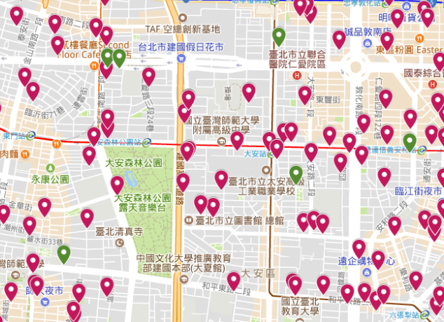
POI（Point of Interest）介紹
特定位置（房屋）之周邊
資訊（便利商店）
特定位置（房屋）之周邊
鄰避設施點位
建立便利生活因子
建置鄰避設施因子
其他影響房價顯著之 POI 類別：房仲、便利商店、寺廟神壇、ATM … 等
37

Slide 39
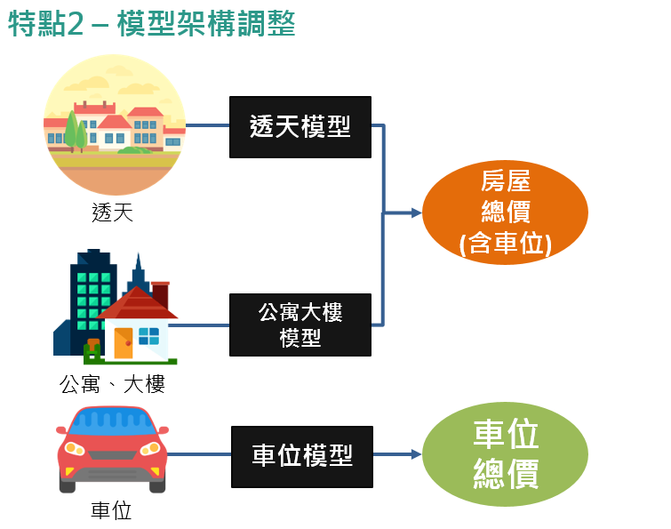
模型調整 – 模型架構調整
預測房屋含車位價格
透天獨立建模
準確度提升!
車位誤差從18%→10%
38

Slide 40
Conclusions
Pay special attention to small-size or high-dimensional datasets
Follow the strict rule of cross validation for performance evaluation
  Dimensionality reduction
  Missing value imputation
Even following the strict rule could lead to overfitting!
  Feature selection
Preprocessing to avoid overfitting
  PCA (which does not require the class information)

Slide 41

感謝聆聽 敬請指教
智慧財產權聲明
本資料各項內容之各項權利及智慧財產權（包括但不限於著作權、專利權、商標權等）均屬玉山商業銀行股份有限公司（以下簡稱「玉山銀行」）所有。除非獲得玉山銀行事前書面同意外，均不得擅自以任何形式複製、重製、修改、發行、上傳、張貼、傳送、散佈、公開傳播、販售或其他非法使用本資料。除非有明確表示，本資料之提供並無明示或暗示授權貴方任何著作權、專利權、商標權、商業機密或任何其他智慧財產權。
Intellectual Property Rights
The rights and the intellectual property rights (including but not limited to the copyrights, patents and trademarks, and etc.) of the Material belongs to E.SUN Commercial Bank, Ltd. (hereinafter referred to as “E.SUN”). Any copy, reproduction, modification, upload, post, distribution, transmission, sale or illegal usage of the Material in any way shall be strictly prohibited without the prior written permission of E.SUN. Except as expressly provided herein, E.SUN does not, in providing this Material, grant any express or implied right to you under any patents, copyrights, trademarks, trade secret or any other intellectual property rights.

