Slide 1
麵包影像辨識 Bread Image Recognition
Nealson Liu (劉濬慶)
MIR Lab, CSIE Dept.
National Taiwan University
jang@mirlab.org, http://mirlab.org/jang

Slide 2
Outline
Intro to bread image dataset
Three tasks
麵包位置偵測
麵包種類分類
使用Generative Adversarial Network增加訓練用的的圖像，以提高辨識率

Slide 3
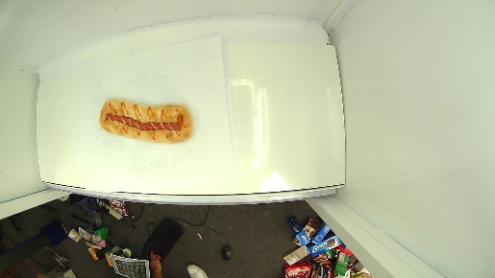
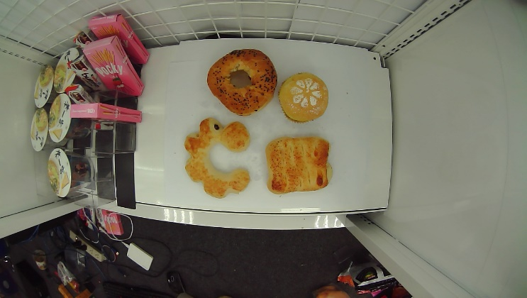
Image Dataset
麵包
共17類，分別A店拍攝以及B店拍攝
解析度1280x720
單一麵包圖片：7408張
A店：5850張（長條圖）
B店：1558張
多個麵包圖片: 230張
210張麵包不相黏，20張麵包相黏
有兩至四種麵包組合

Slide 4
Hardware Specs
Hardware specs for our training machine
OS: Ubuntu
CPU: Intel(R) Core(TM) i9-7900X CPU @ 3.30GHz
GPU: 1080Ti 2張
RAM: 11GB
HD: 3.6TB

Slide 5
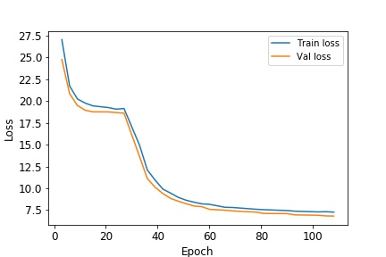
麵包位置偵測
Model
YOLO V3
Input image size （範例圖）
704x704
Image preprocessing
將單張的圖片從中心點crop成704x704
Training & validation data
隨機合成麵包4000張,單張麵包圖片7408張
training : validation = 7:3
Training
118 epochs
Training/validation loss = 7.266/ 6.816

Slide 6
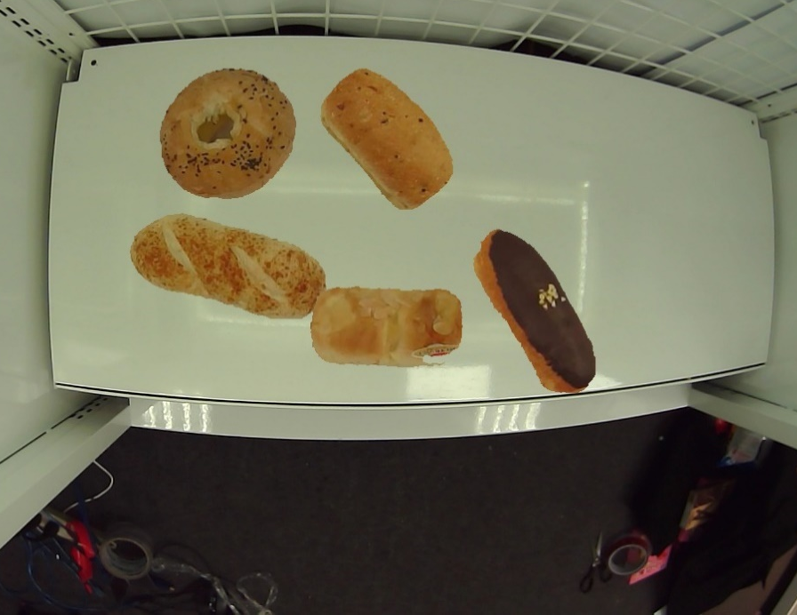
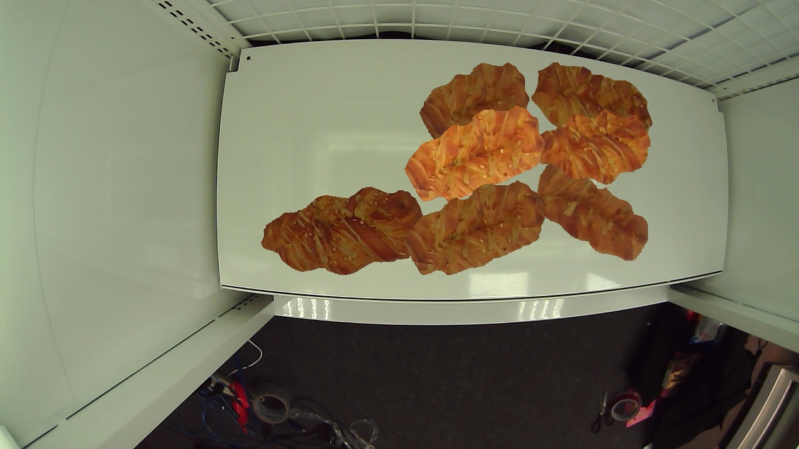
隨機合成麵包的範例
Most important step
Create fake multiple bread image to boost the recall rate from 95.00% to 100%.

Slide 7
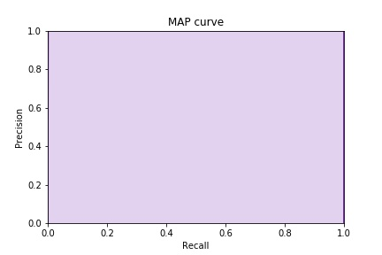
麵位置偵測
Criteria for bread detection
IoU(Intersection over Union) 超過 40%當作true positive
Confidence threshold 70%以上採信
Bounding box area 12800以下移除
Performance: 100% of MAP (Mean Average Precision) curve

Slide 8
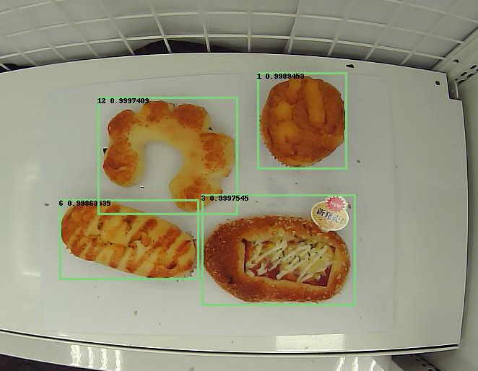
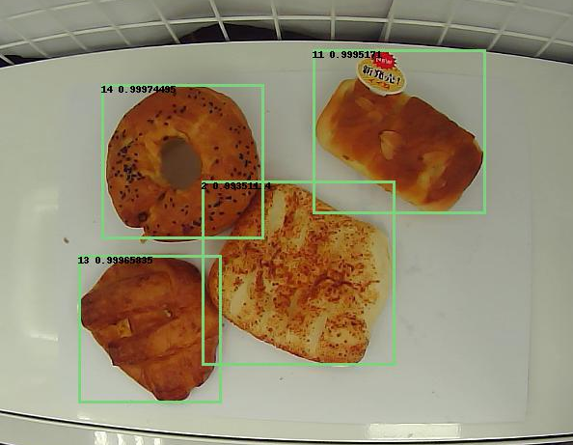
麵包位置偵測：輸出範例

Slide 9
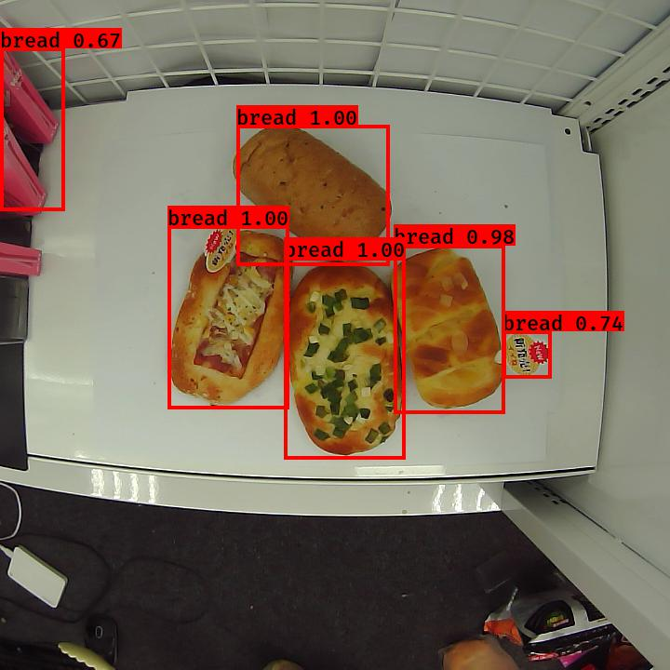
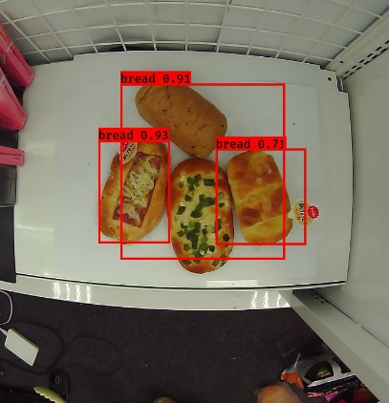
麵包位置偵測：分析比較
分析比較
相黏麵包偵測結果比較
(a)有random merge data (b)無random merge data
Training data | 有加入合成麵包 | 只用單張麵包圖片
Detection (被偵測框出來的麵包%數) | 100% | 95%

Slide 10
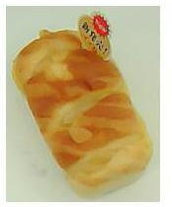
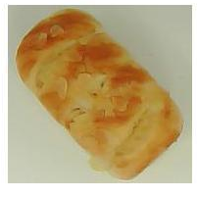
麵包種類分類
Data
有3種data型態分別為case1，case2，case3
case1
店A的17類麵包, training: validation: test = 6:2:2
case2
店A的10類麵包, Day1 Day2拍攝的當訓練資料，Day3當測試資料
case3
case2中出現的10類麵包,店A拍攝的當訓練資料, 店B當測試資料
A,B店最大差異
蘋果號麵包的標籤有無 (A) (B)

Slide 11
麵包種類分類
Model
Inception ResNet V2
Input image size 299x299 for Inception ResNet
Preprocessing
將麵包對應的xml檔中的bounding box crop，記錄所有麵包中最大的長與寬(330)，利用White padding的方式去將每張圖片增加至330x330，resize成299x299
Data augmentation
Rotation, width shift, height shift, shear, zoom up & down, horizontal flip

Slide 12
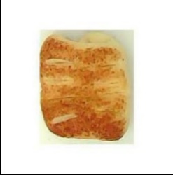
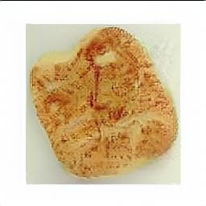
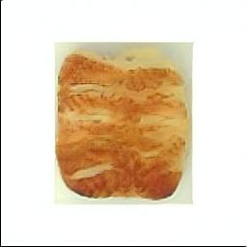
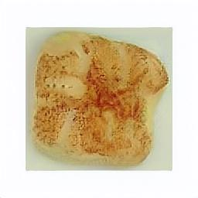
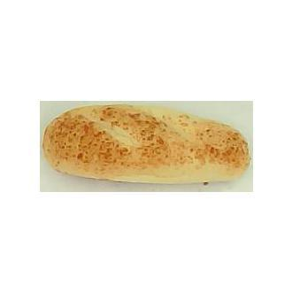
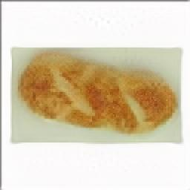
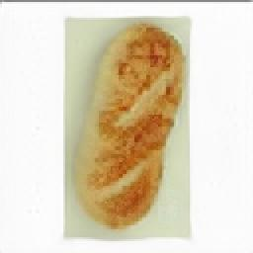
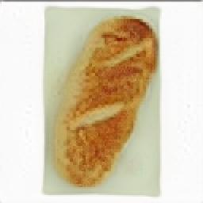
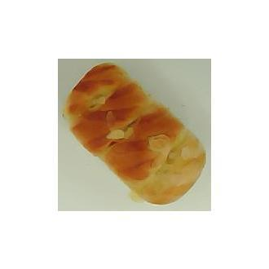
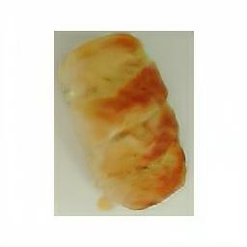
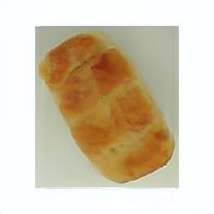
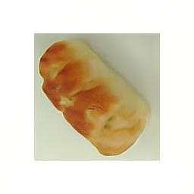
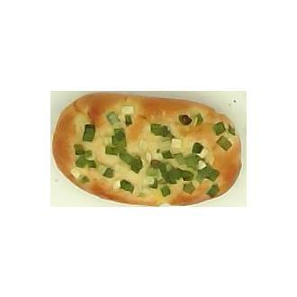
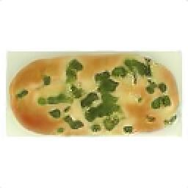
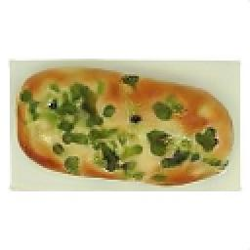
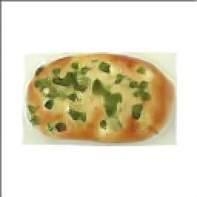
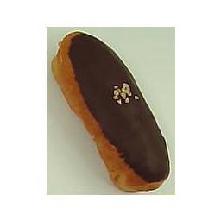
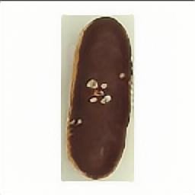
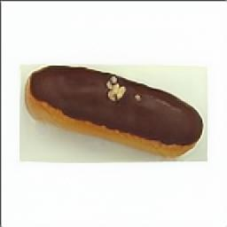
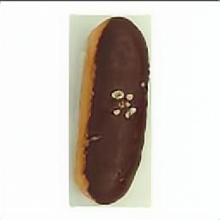
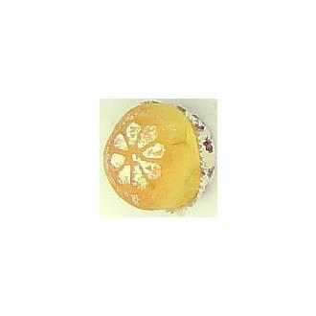
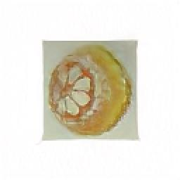
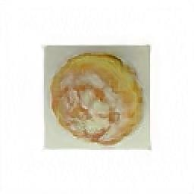
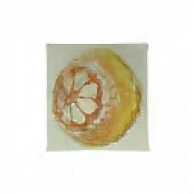
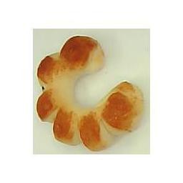
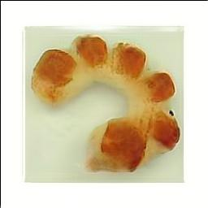
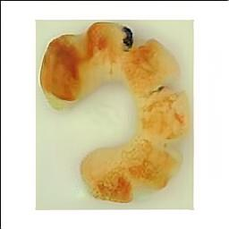
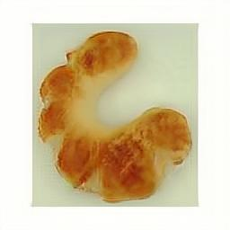
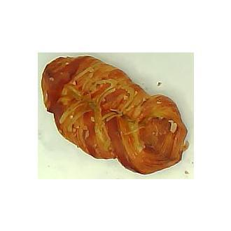
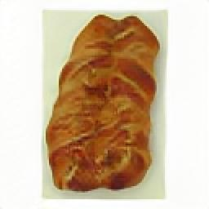
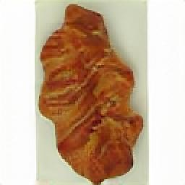
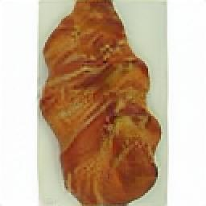
StyleGAN generate bread 256x256
原圖 StyleGAN generated 原圖 StyleGAN generated

Slide 13
麵包種類分類
Performance
Case | 1 |  | 2 | 3
Testing data class | 17 |  | 10 | 10
Training data class | 17 |  | 10 | 10 | 17 | 18 | 10
Black padding |  | 
White padding |  |  |  |  |  |  | 
使用StyleGAN生成的蘋果麵包 |  |  |  |  |  |  | 
使用有標籤的 蘋果麵包 |  |  |  |  |  | 
photoshop去除蘋果麵包標籤 |  |  |  |  |  |  | 
Epoch | 500 | 500 | 500 | 1000 | 1000 | 1000 | 1000
Training accuracy | 100% | 100% | 100% | 100% | 100% | 100% | 100%
Validation accuracy | 100% | 82.5% | 100% | 97.5% | 92.3% | 97.9% | 93.8%
Testing accuracy | 98.23% | 85.9% | 99.31% | 95% | 87.65% | 99.3% | 97.3%

Slide 14
Plot confusion matrix
List some error cases

Slide 15
使用Generative Adversarial Network增加Training的圖像
Model
StyleGAN
Training Time
Typically, 3 days for each class
GPU
1080ti 2張

Slide 16
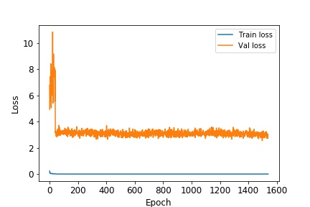
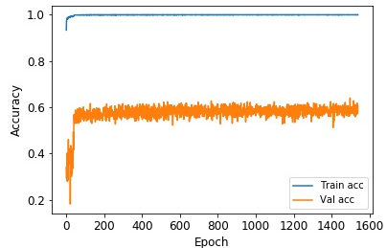
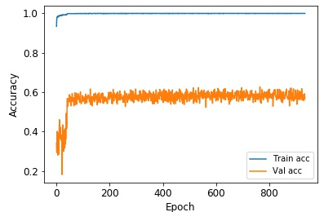
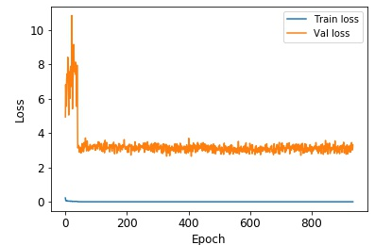
Classification model with StyleGAN
Model Inception-ResNet-v2
Data
10 classes
Each class has 6500 images
Curve
Max validation accuracy 64%
Training accuracy 100%

Slide 17
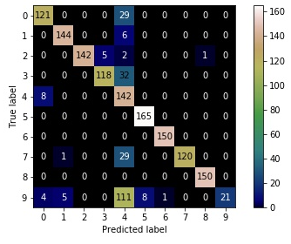
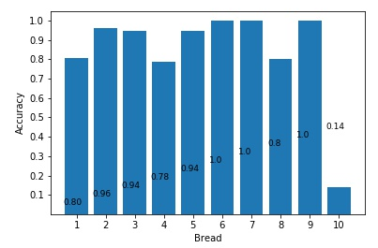
Classification model with StyleGAN
Testing Accuracy 84.03%
10號麵包效果只有14%

Slide 18
候鳥影像偵測 Bird Image Detection
Nealson Liu (劉濬慶)
MIR Lab, CSIE Dept.
National Taiwan University
jang@mirlab.org, http://mirlab.org/jang

Slide 19
Outline
Intro to image dataset
Image pre-processing
Split to 1000x1000
Yolo v3 detection

Slide 20

Image Dataset
Original image size 4000x3000
Total 80 張

Slide 21













Image Preprocessing
Image size 4000x3000
Image size 1000x1000 12張

Slide 22

Yolo v3 detection
Data
training : validation 7:3
detecting image size 992x992
Training
Epoch 110
Training minimum loss 84.964
Validation minimum loss 88.072

Slide 23


Yolo v3 detection
Testing results

Slide 24


Yolo v3 detection
Testing results

Slide 25


Yolo v3 detection
Testing results

