Slide 1
AI: Dilemma in Ethics and Laws
人工智慧：道德與法律的難題
J.-S. Roger Jang (張智星)
MIR Lab, CSIE Dept.
National Taiwan University
jang@mirlab.org, http://mirlab.org/jang

Slide 2
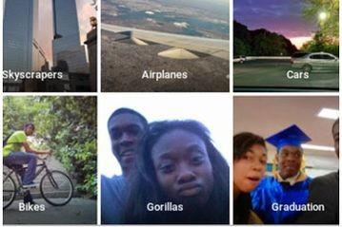
人工智慧的難題：對種族與膚色的偏見
AI Dilemma: Race/Color Discrimination?
2015 年 7 月，谷歌旗下照片應用 Google Photo 把兩名黑人「誤認」成了大猩猩引發了熱議，隨後谷歌連忙致歉，並表示正在改進算法以解決這一問題。
https://kknews.cc/tech/pxgnaqp.html

Slide 3
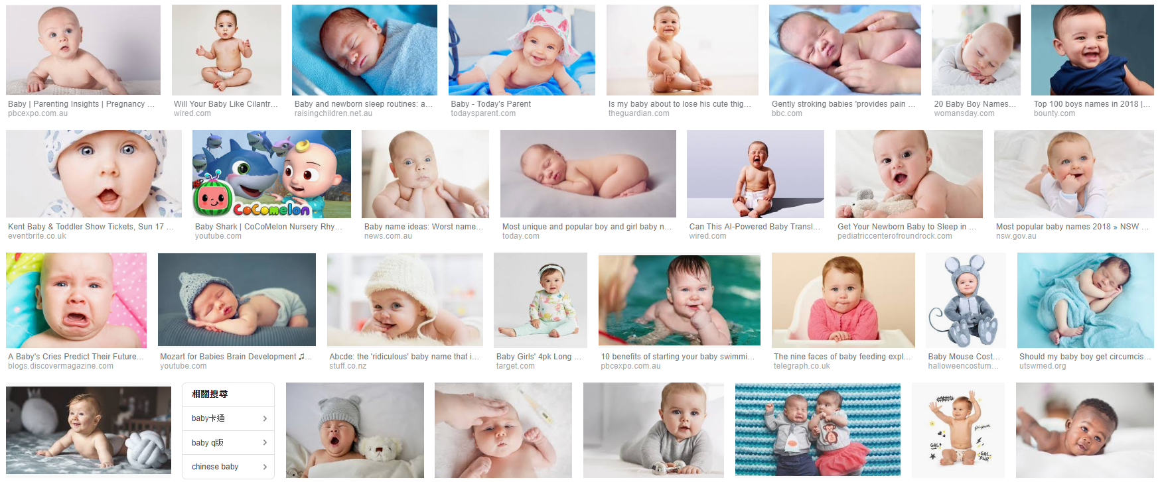
人工智慧的難題：對種族與膚色的偏見
AI Dilemma: Race/Color Bias
2015年，Johanna Burai在谷歌上搜索「手」的圖片，發現谷歌搜索最前面的結果只有白皮膚的手。隨後，她發起了「全球白網」（World White Web）計劃。
https://kknews.cc/tech/oyjkejq.html
Result of search for “baby” over Google

Slide 4
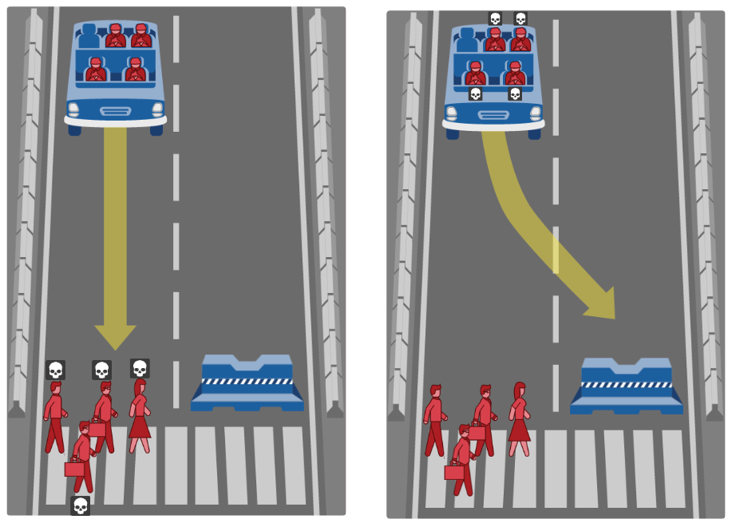
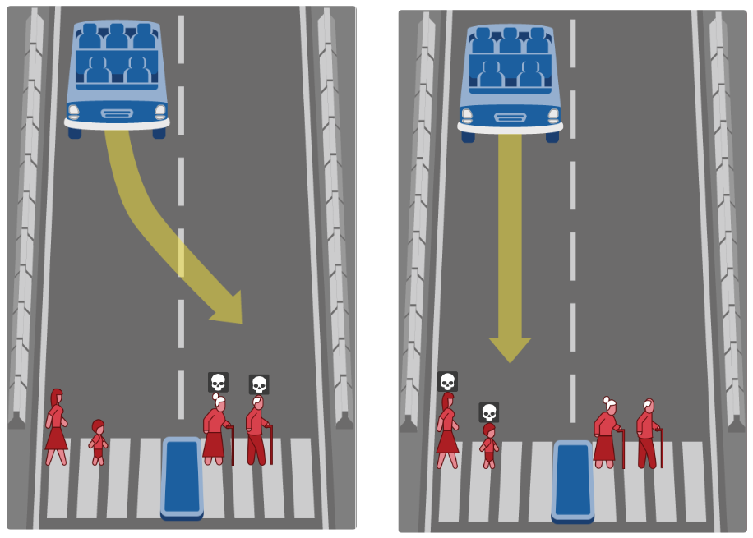
人工智慧的兩難：倫理與道德 (1/2)
AI Dilemma: Ethics & Morality
What should the self-driving car do?
Save you or others?
Judge people (to kill) by what?
http://moralmachine.mit.edu

Slide 5
人工智慧的兩難：倫理與道德 (2/2)
AI Dilemma: Ethics & Morality
想看看…
  如果你是軟體設計者，你的決策標準是？
  如果你是自駕車商，你要如何說明這輛車的決策？
  如果你是立法諸公，你要如何規範處理至些情況？

Slide 6
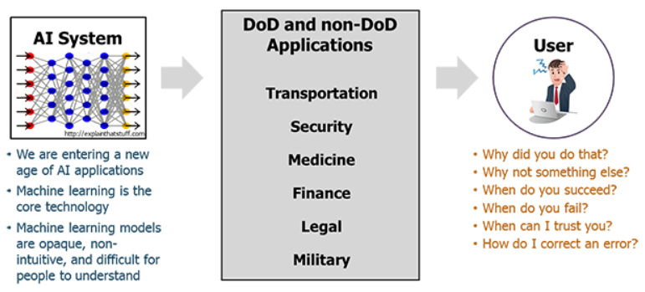
人工智慧難題: 可被解讀與信任嗎？
AI Dilemma: Explainability and Trustability
This is especially important for
  Precision medicine, healthcare analytics, financial applications
XAI (explainable AI) is becoming important
  DARPA’s 15-year XAI project
  Workshop on XAI at IJCAI-2017
https://www.darpa.mil/program/explainable-artificial-intelligence

Slide 7
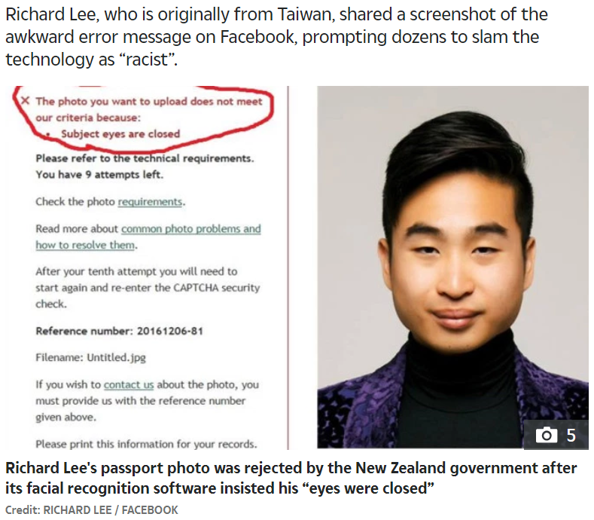
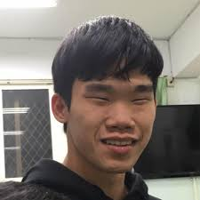
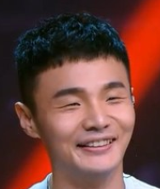
人工智慧難題: 無心的錯誤
AI Dilemma: Innocent Mistake
https://edition.cnn.com/2016/12/07/asia/new-zealand-passport-robot-asian-trnd/index.html

Slide 8


偽造的圖片、影片與聲音
DeepNude
  濫用AI技術偽造女性裸照 打擊復仇式色情「DeepNude」在美遭下架 (2019/06/30)
  實測人工智能「脫衣」軟件DeepNude，真的那麼強大嗎？ (2019/07/03)
DeepFake

Slide 9
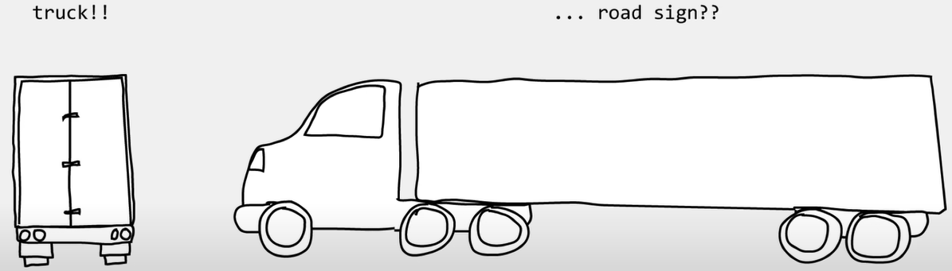
Mistakes by AI/ML: Biased Data
Tesla accident
Source

Slide 10
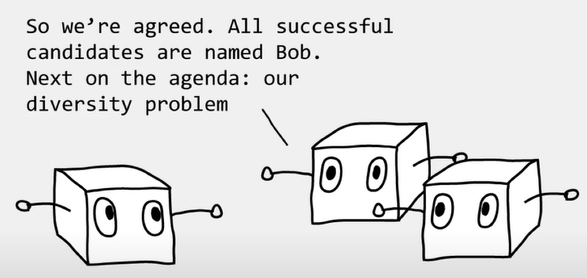
Mistakes by AI/ML: Biased Data
Amazon HR
Source

Slide 11

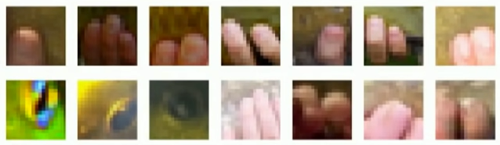

Mistakes by AI/ML: Biased Data
Highlighted part of Tench
Tench
丁鱥
When you google “tench”…

Slide 12

Mistakes by AI/ML: Biased Data
Tench
丁鱥
When you google “丁鱥”…

Slide 13
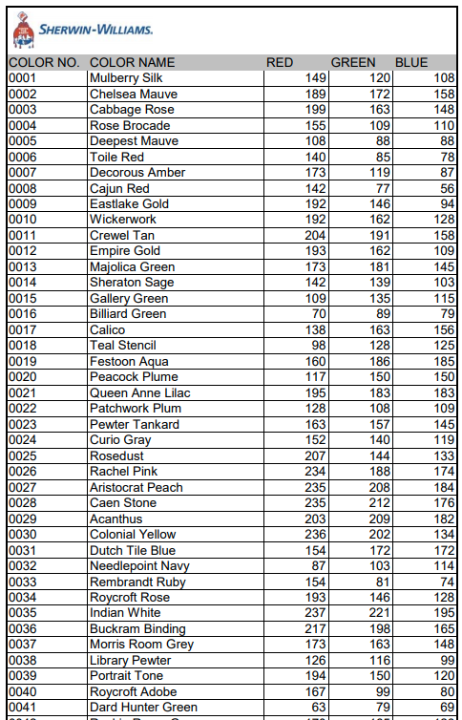
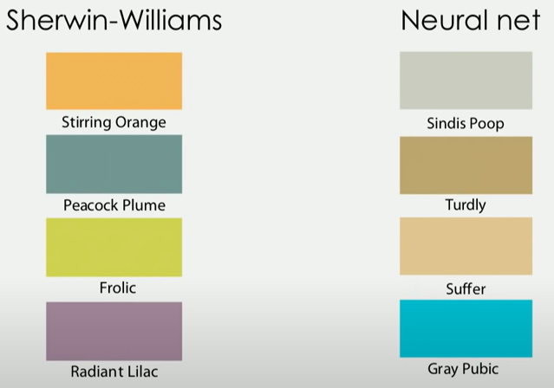
Mistakes by AI/RL: Unspecified Goal
Command: Name a given color
  Training set: 7,700 Sherwin-Williams paint colors
Training set
Goal
歪樓啦！
The danger of AI is weirder than you think

Slide 14
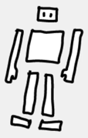
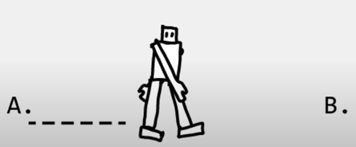
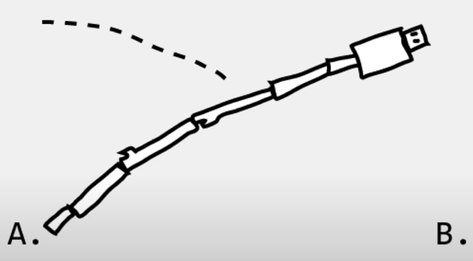
Mistakes by AI/RL: Under-specified Goals
Command: Assembly the pieces and go from A to B
Goal
歪樓啦！
The danger of AI is weirder than you think

Slide 15
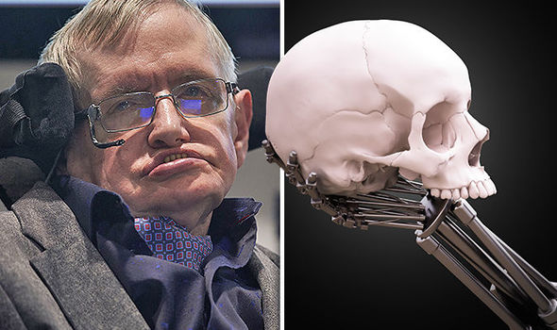
人工智慧將摧毀人類嗎？
How AI Destroys Human?
Humanity’s days are NUMBERED and AI will cause mass extinction, warns Stephen Hawking (2017/11/03)

Slide 16
Conclusions
AI’s development needs people from all disciplines.
AI will not be fully utilized without the support of ethics and laws.

