Slide 1
StarGAN v2: Diverse Image Synthesis for Multiple Domains Translation
Yunjey Choi^{1,2}, Youngjung Uh, Jaejun Yoo , and Jung-Woo Ha
Clova AI Research, NAVER Corp.
In arXiv
Ming-Chi Yen （顏明祺）

Slide 2
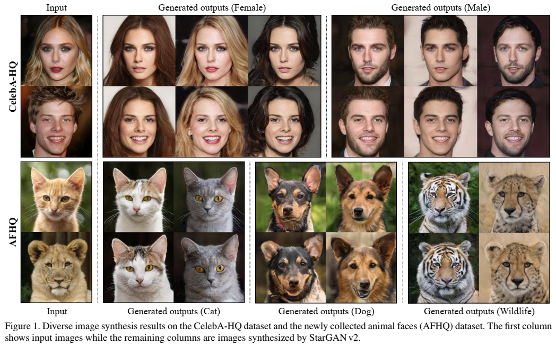

Slide 3
StarGAN: Unified Generative Adversarial Networks for Multi-Domain Image-to-Image Translation
Yunjey Choi^{1,2}, Minje Choi^{1,2}, Munyoung Kim^{2,3}, Jung-Woo Ha², Sunghun Kim^{2,4}, and Jaegul Choo^{1,2}
¹Korea University
² Clova AI Research, NAVER Corp
³The College of New Jersey
⁴Hong Kong University of Science & Technology
In proc. CVPR 2018

Slide 4
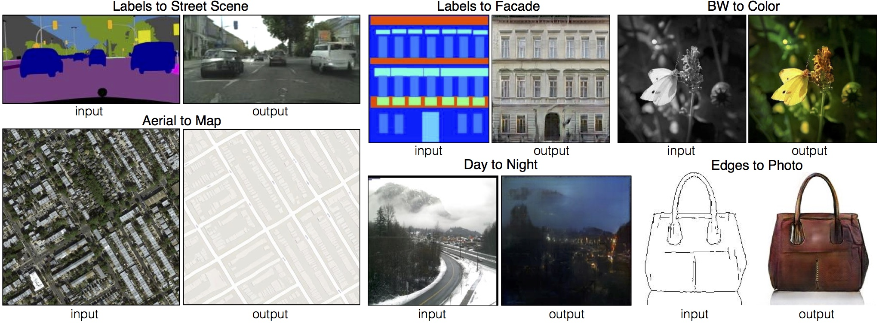
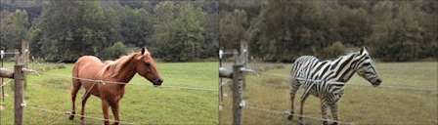

Introduction
Multi-Domain Image-to-Image Translation
Horse to Zebra
Face off (credit: TJ Wei)
Pix2pix (Isola et al. 2017)
CycleGAN (Zhu et al. 2017)
Notes:
Describe the definition of transfer in this paper is image-to-image
Pix2pix
Cycle gan
Credit: TJ Wei

Slide 5
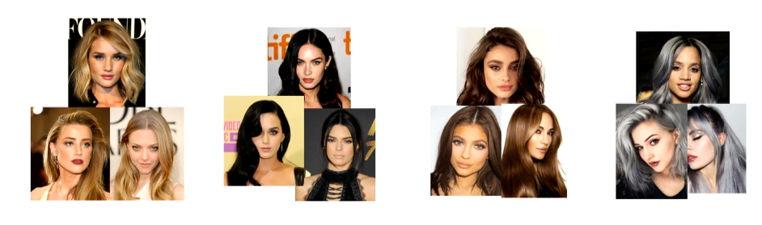
Multi-Domain Image-to-Image Translation
Example: hair color
Blond
Black
Brown
Gray
Domain 1
Domain 2
Domain 3
Domain 4

Slide 6
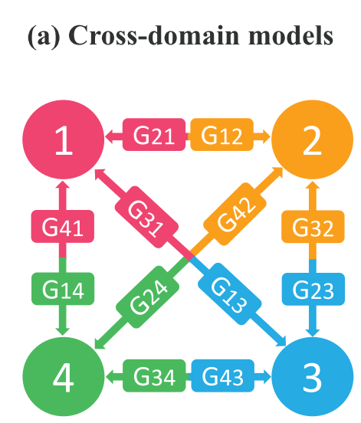
Problems
For K domains translation, K(K-1) Generators should be built
Domain 1
G₁₂
Domain 2
G₁₃
Domain 3
G₁₄
Domain 4

Slide 7
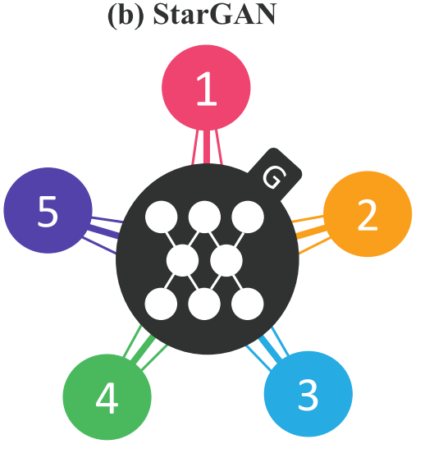
Proposed Method: StarGAN
Single generator for multiple-domain translation
Target
Domain
Domain 1
Shared
Generator
0 | 1 | 0 | 0
G
Domain 2
G
Domain 3
0 | 0 | 1 | 0
G
Domain 4
0 | 0 | 0 | 1

Slide 8
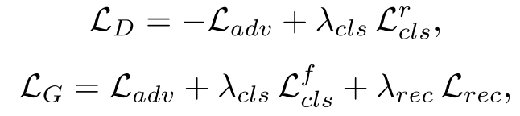
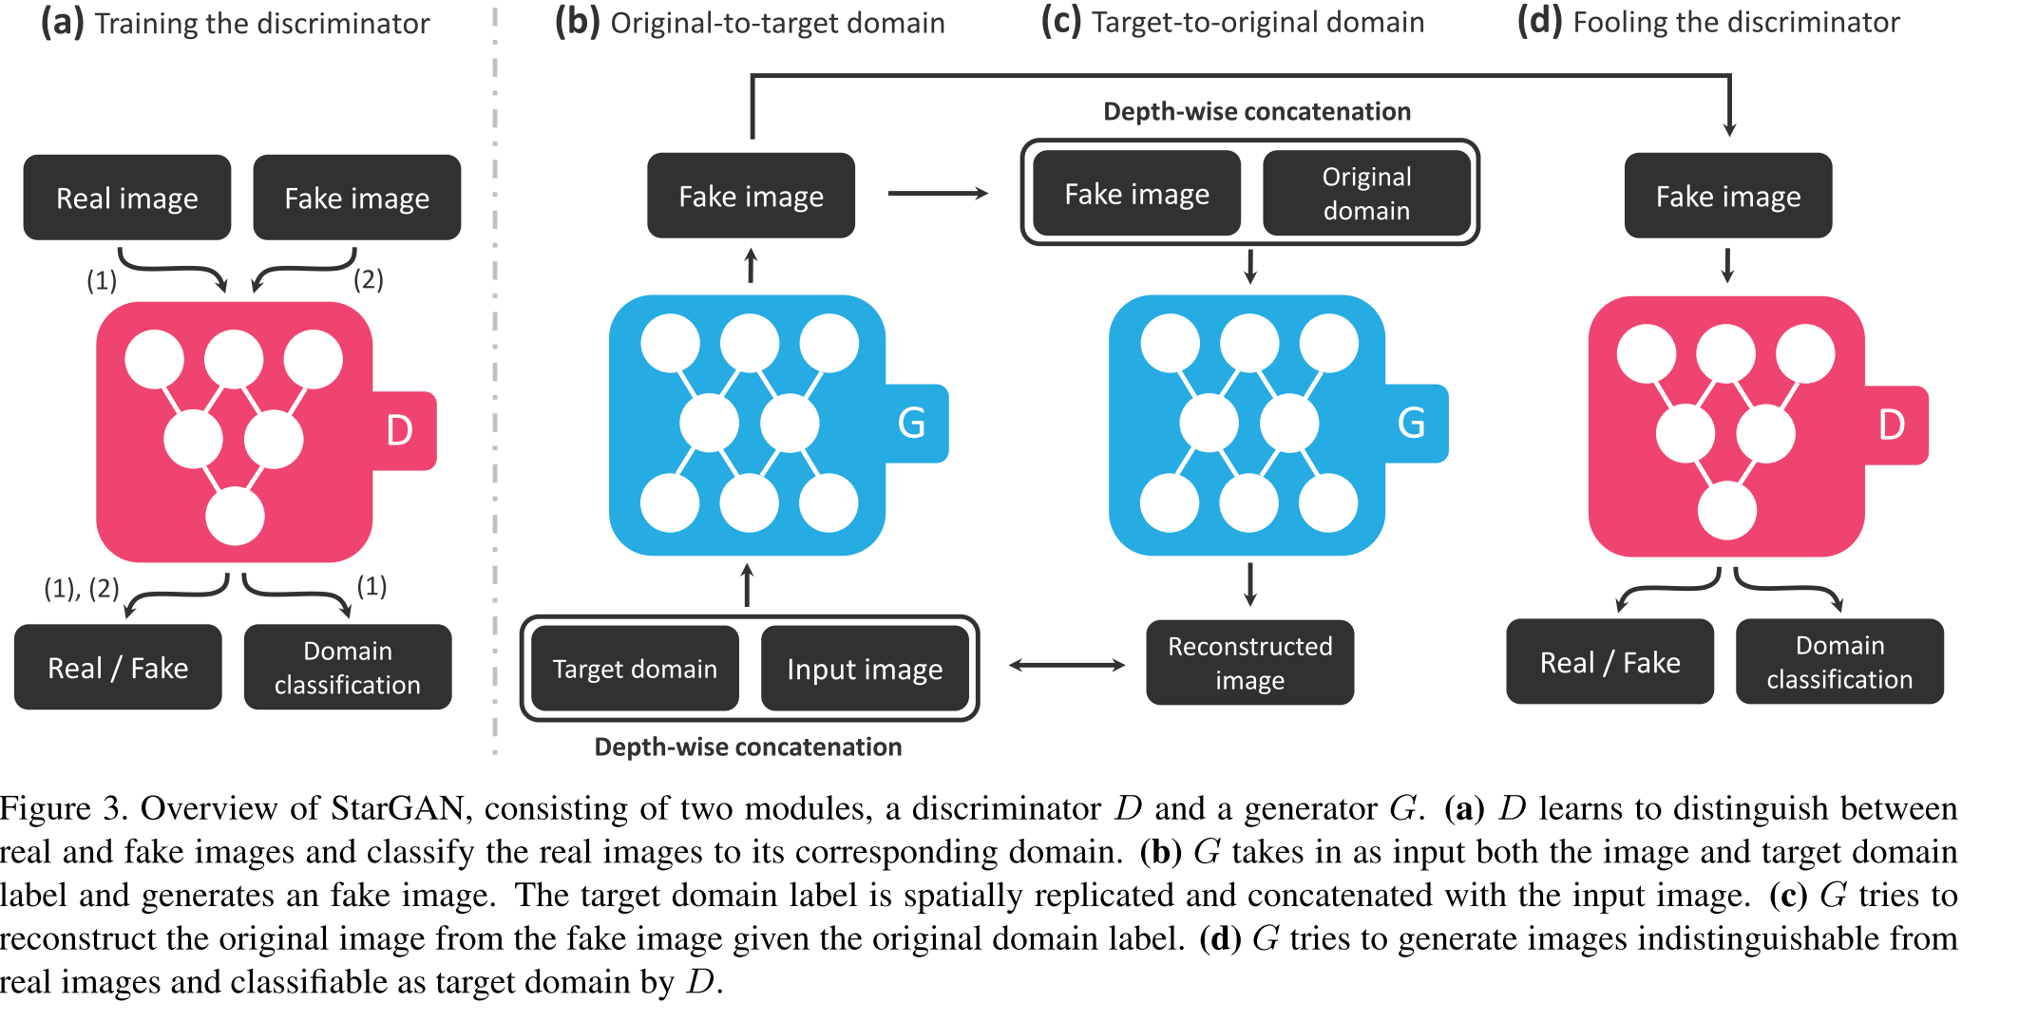
Notes:
We use λ cls = 1 and λ rec = 10 in all of our experiments.
L_adv

Slide 9
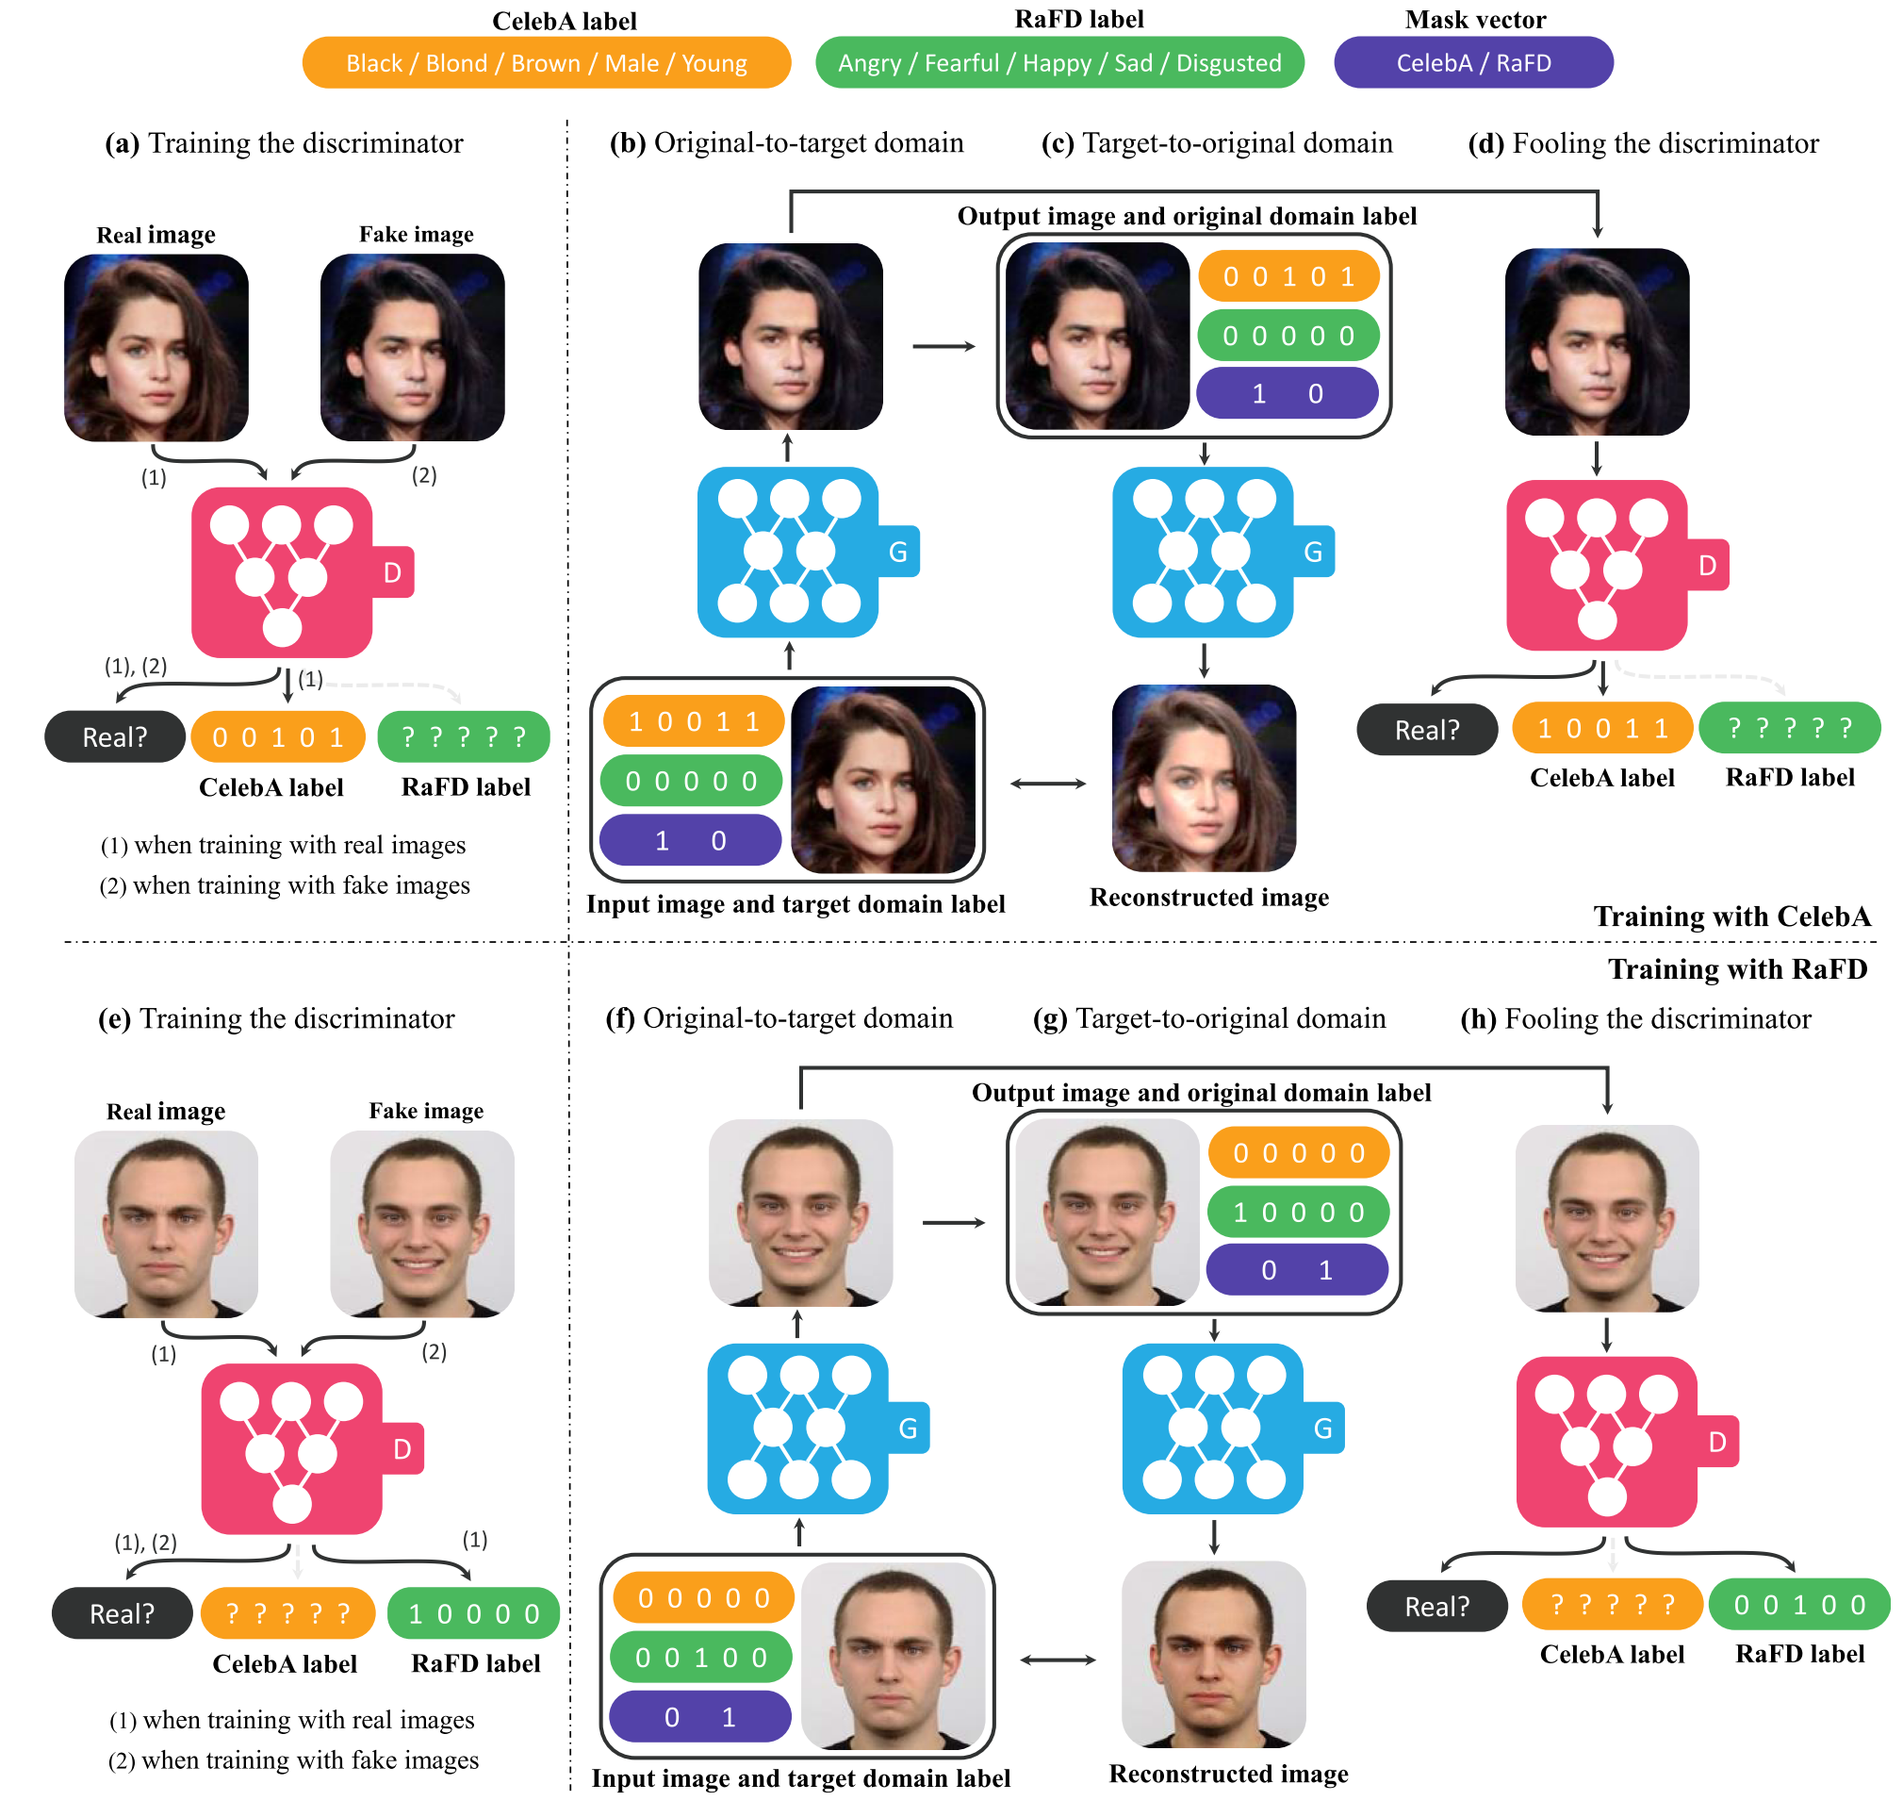
Notes:
We use λ cls = 1 and λ rec = 10 in all of our experiments.
??只考慮有label 的部份去算loss

Slide 10
Notes:
We use λ cls = 1 and λ rec = 10 in all of our experiments.

Slide 11
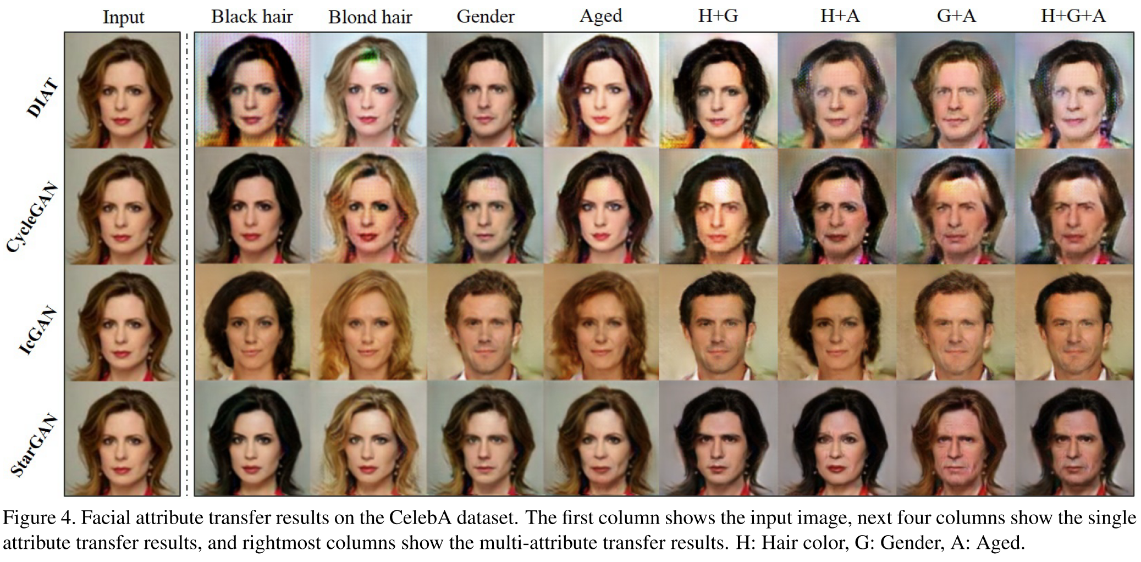

Slide 12
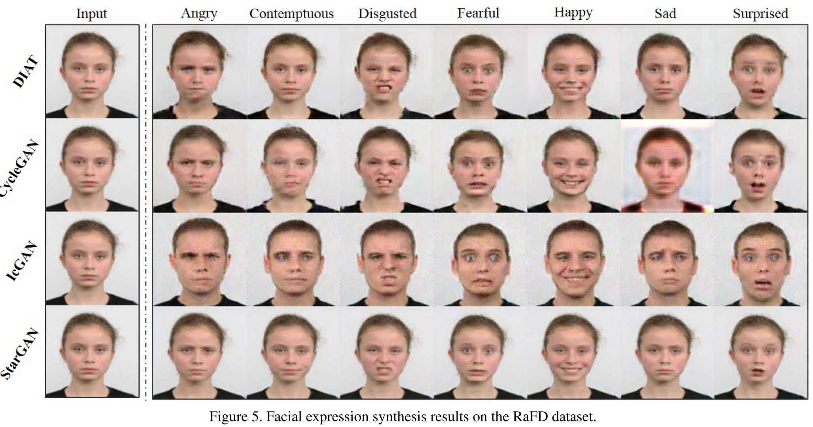
Notes:
We use λ cls = 1 and λ rec = 10 in all of our experiments.

Slide 13
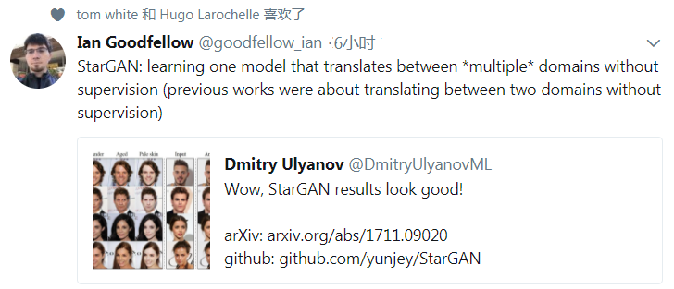
Conclusion

Slide 14
StarGAN v2: Diverse Image Synthesis for Multiple Domains Translation
Yunjey Choi^{1,2}, Youngjung Uh, Jaejun Yoo , and Jung-Woo Ha
Clova AI Research, NAVER Corp.
In arXiv
Ming-Chi Yen （顏明祺）
2019/12/27

Slide 15
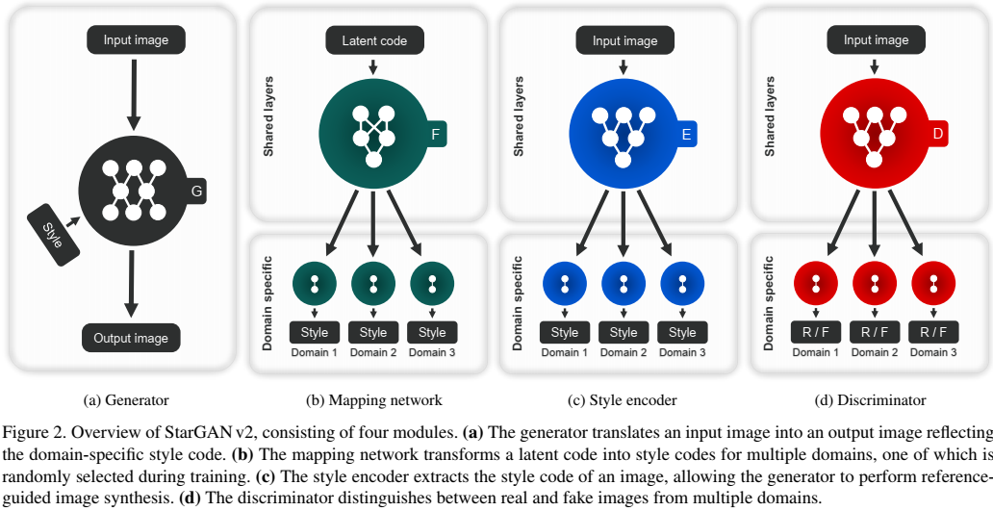

Slide 16
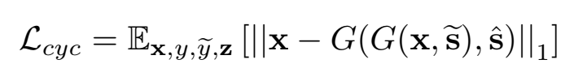


Model Architecture
G
D
Source
image
Target
image
image
T/F
Label y
Style code
Gaussian noise
F
Latent code z
Style code
Fake Target → Source
Target style code from F
$$\tilde{s}$$
E
Source → (Fake )Target
Image
Style code
Source style code from E
$$\hat{s}$$

Slide 17
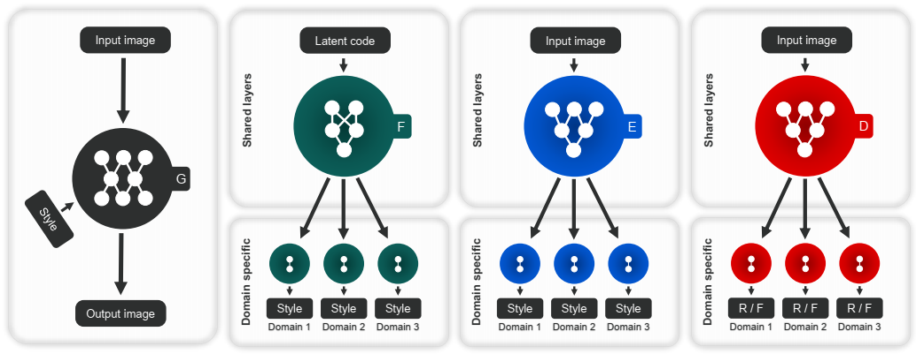
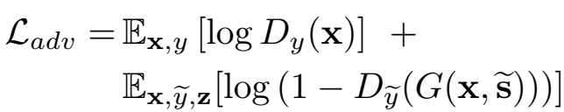



Training Objectives
Sample latent code $z$ and target domain $\tilde{y}$
Get (target) domain style code $\tilde{s}=F_{\tilde{y}}\left(z\right)$
Generate image $G(x,\tilde{s})$
$$\tilde{s}$$
$$\hat{s}$$

Slide 18


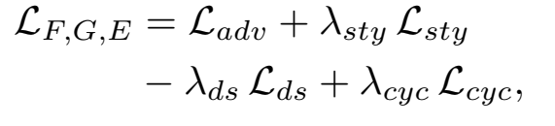


Training Objectives
Style reconstruction
Style diversification
Preserving source characteristics
$$\tilde{s}$$
$$\hat{s}$$
$$\tilde{s}$$
Target
$$\hat{s}$$
Source
Notes:
L_ds will decay to zero

Slide 19
Recap
StarGAN v1:
  Image style: determinative
  E.g.: one hot or multi-label
StarGAN v2:
  Image style: sampled
  Label y → gaussian noise →latent code z
  More same style (code) can be generated

Slide 20
Experimental Setting
Dataset
  CelebFaces Attributes (CelebA): 202,599 face images / 40 attribute
  Animal FacesHQ (AFHQ): 15,000 images (proposed)
Environment
  Tesla V100 GPU
  Training time: two days
  100k iterations

Slide 21
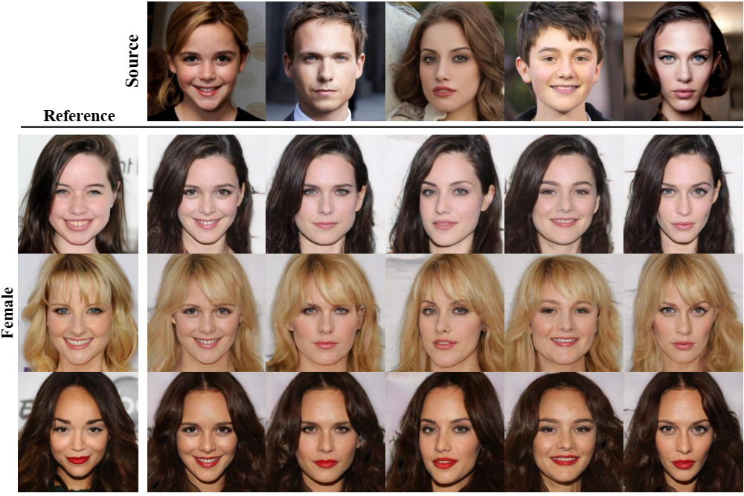

Slide 22
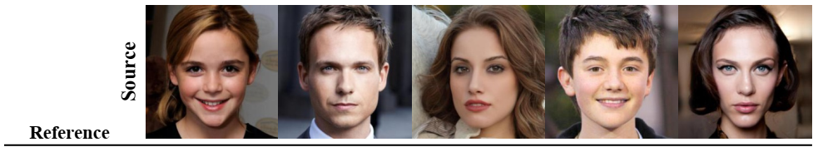
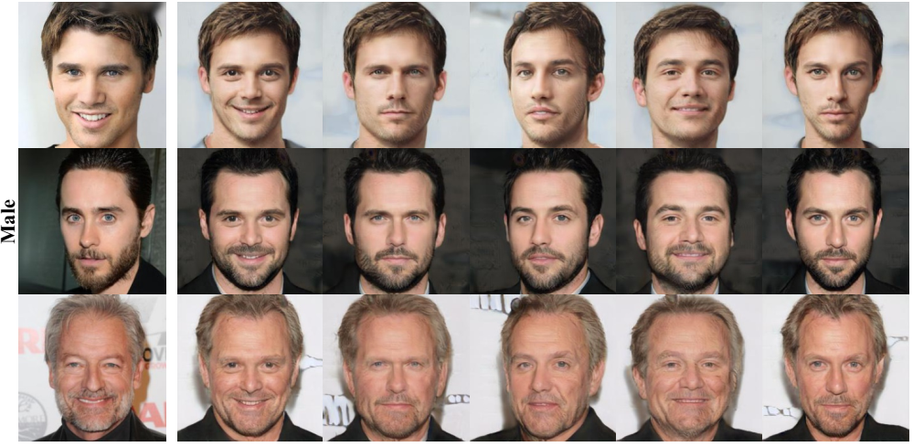

Slide 23
